Slide 1
Lipoma of the Supraspinatus

Slide 2
51 year-old male who complains of pain in the anterior and middle aspects of the left non-dominant shoulder 1 month after using his arm to push something laterally in abd ER position
Pain is stationary
SSV 30%
Flexion 100 active, 170 passive
ER ADD 60
ER ABD 60
IR LSS
Jobe test ++
BHT + at 45, unable to do it at 90
BPT+
Weak ER but no lag sign

Slide 3
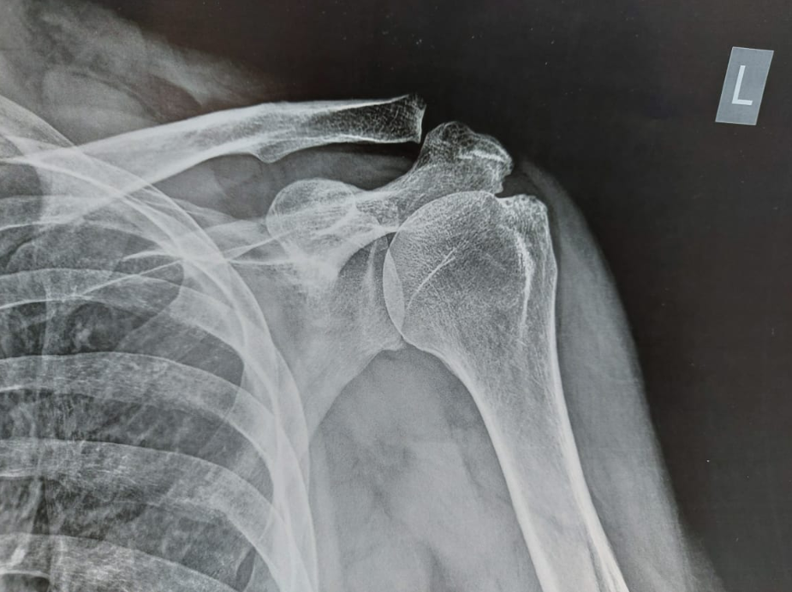

Slide 4
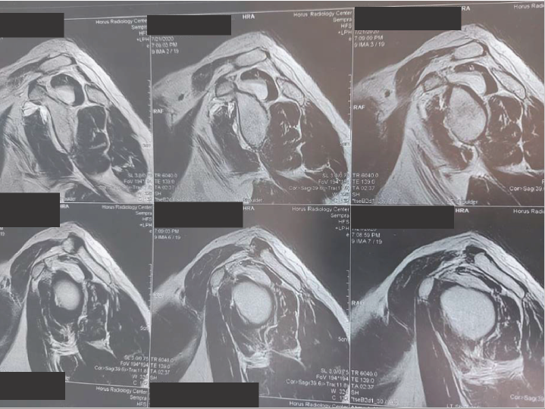

Slide 5
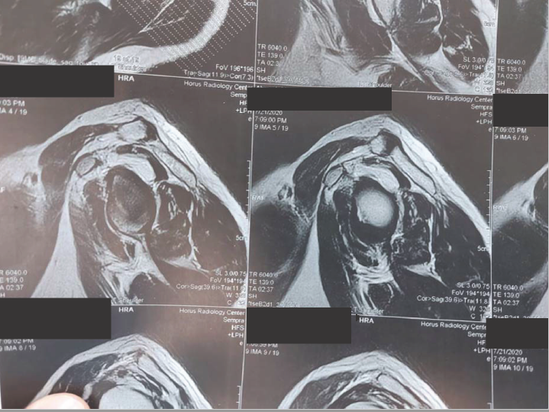

Slide 6
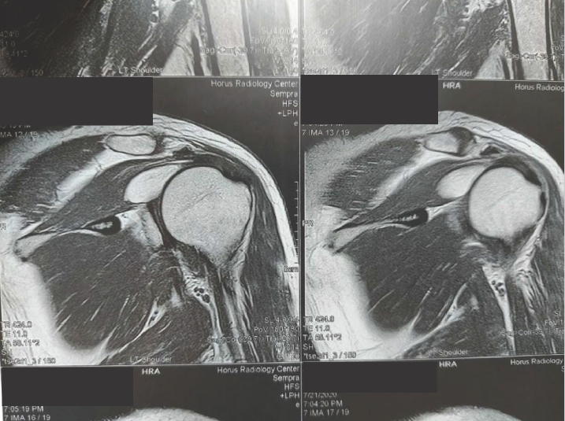

Slide 7
