Slide 1
Difficult Case
RSA in paraplegic

Slide 2
History
62-year-old RHD retired physical therapist who has been a paraplegic since her 20s. She uses her shoulders to get around in a wheelchair. She has had right shoulder pain for the past 4 years, worse over the past two years. She has 5/10 to 7/10 pain all the time. She can do 2 of 12 simple shoulder tests. She has noticed that her strength and ability to lift her chair into her car has decreased over time. She has pain at night and with activity. She has been taking ibuprofen 800 mg a day as well as Fiorinal for chronic pain. She has popping and clicking in the shoulder.

Slide 3
Medical History
PAST MEDICAL HISTORY:
1. Skin disorders, squamous cell cancer.
2. Bladder cancer.
3. Eczema.
4. Arthritis in hands, hips, and shoulder.
5. T12 paraplegic.
6. Hepatitis C.
PAST SURGICAL HISTORY: No prior shoulder surgery,
MEDICATIONS: Fiorinal plus codeine, diazepam, MVI, fosamax
ALLERGIES: No known drug allergies.
SOCIAL HISTORY: The patient denies tobacco, alcohol, and illicit drug use. She works as a physical therapist.

Slide 4
5’0” and 80 lb
Right upper extremity:
AFE 120 degrees, PFE (150) – L AFE 160
ER 45 degrees and symmetric
IR T12
Tender over the long head of the biceps.
Clunking with range of motion of the shoulder.
4/5 strength to abduction, external rotation, and internal rotation. Positive Neer, positive Hawkins, negative horn blower, positive belly press.
Skin is intact.

Slide 5
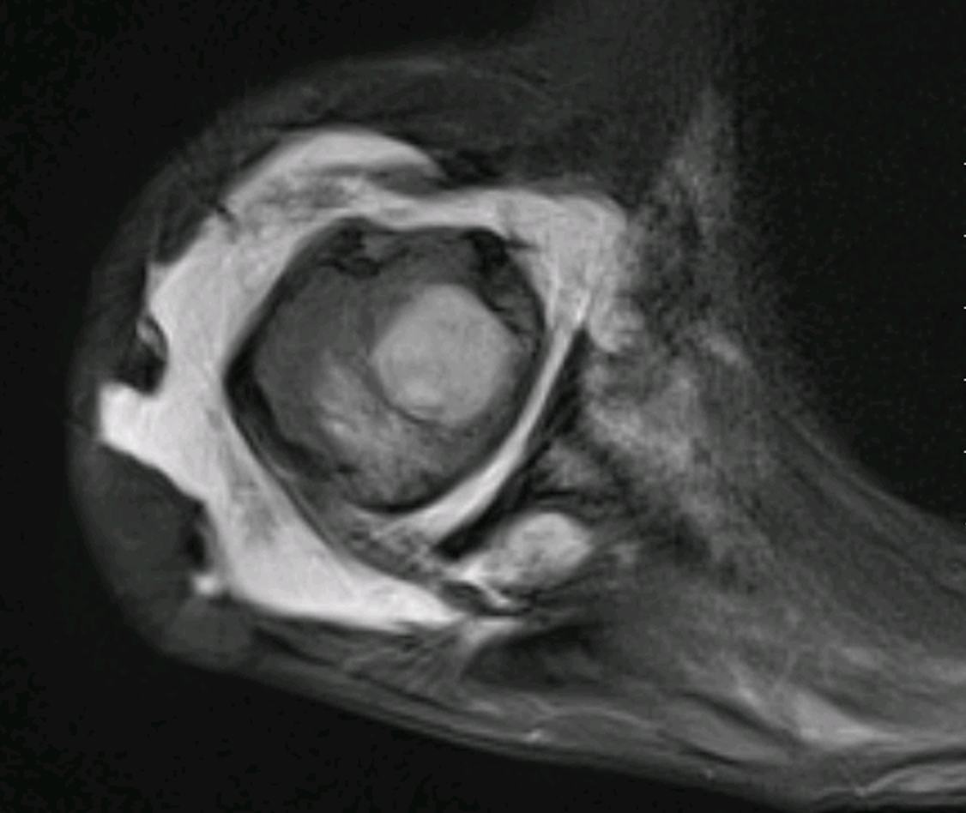
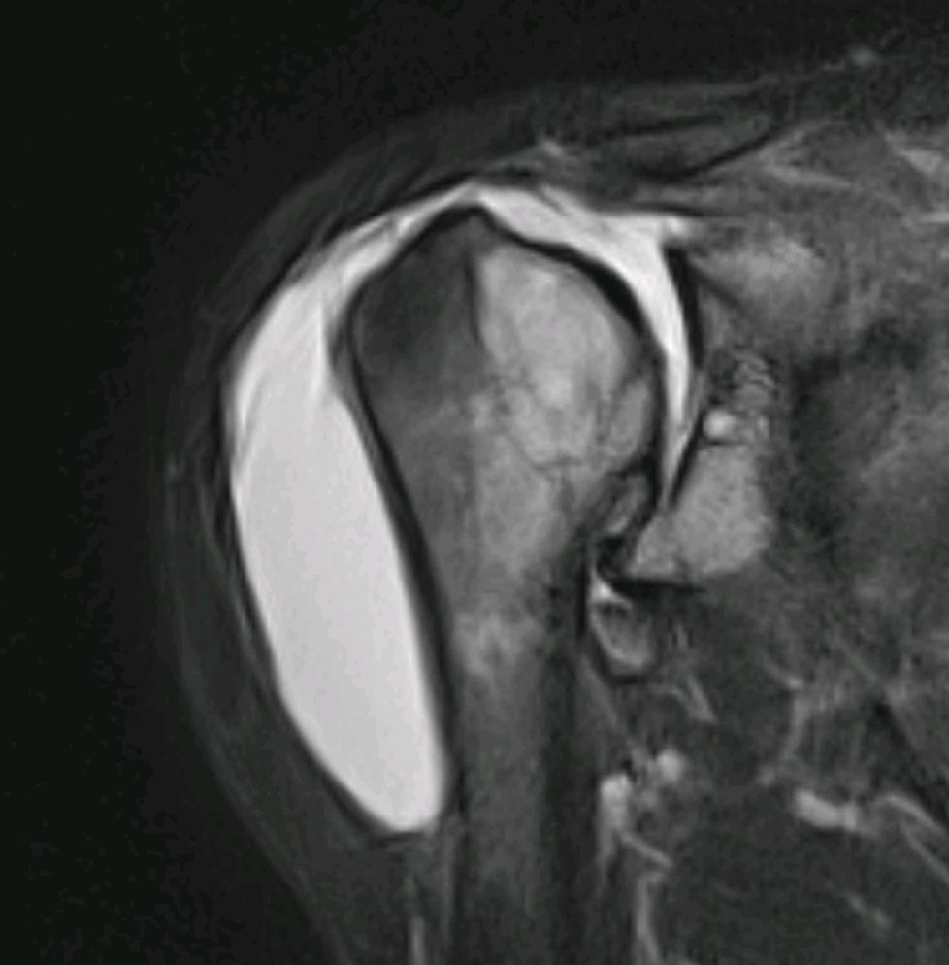
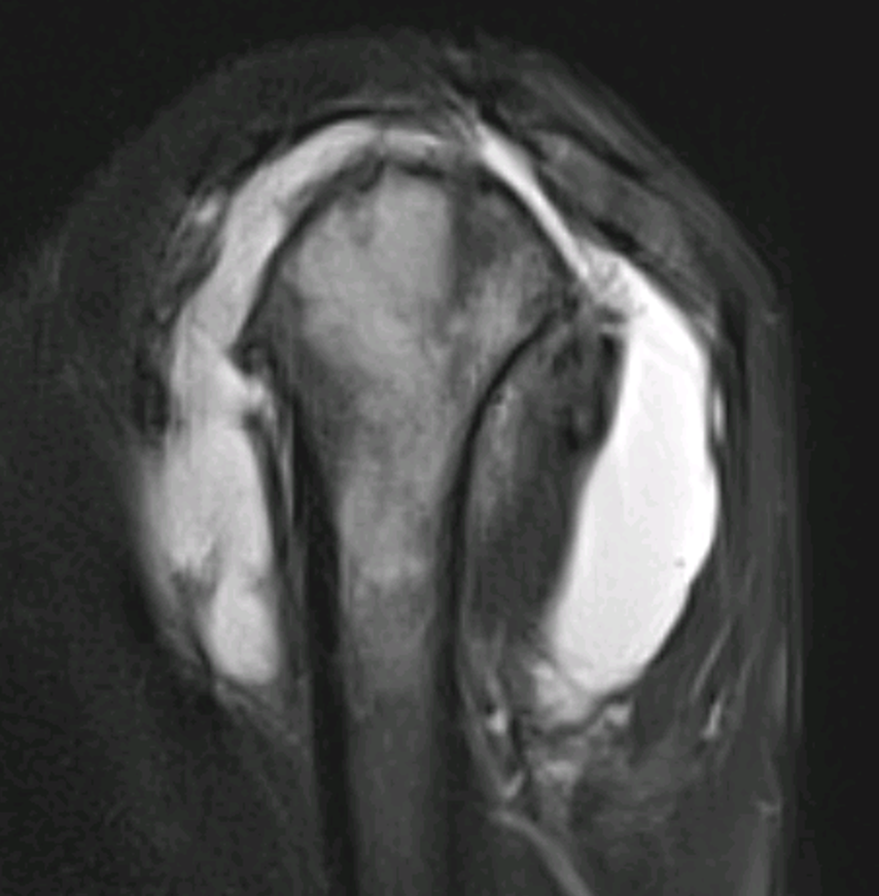

Slide 6
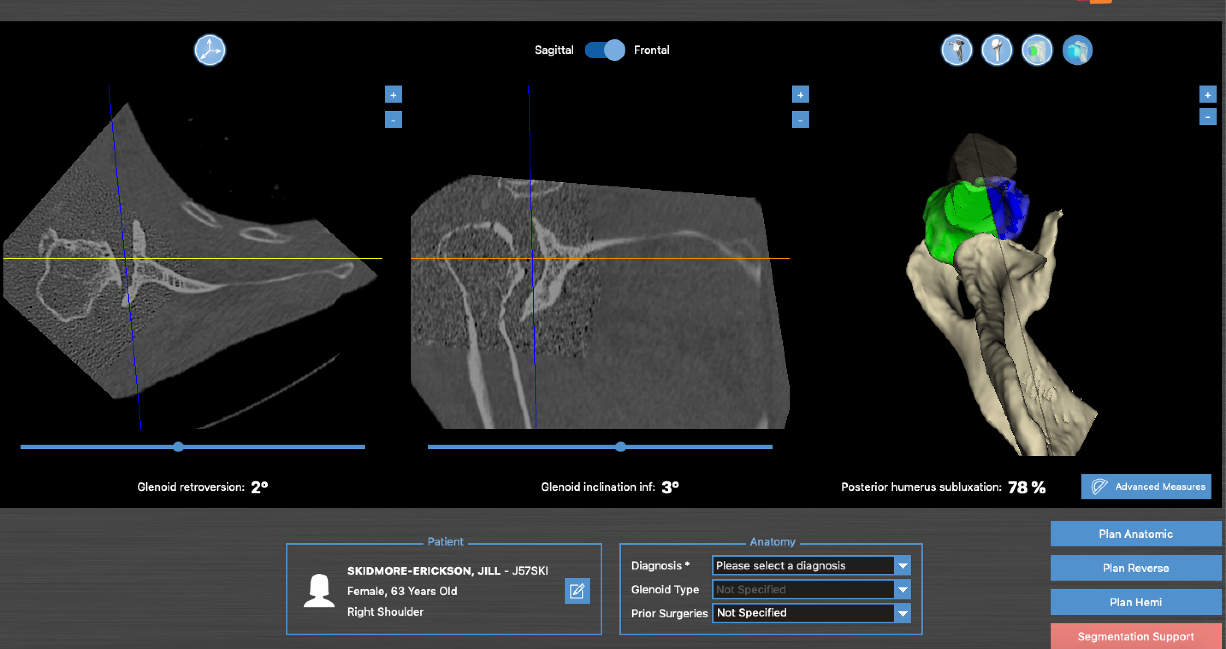

Slide 7
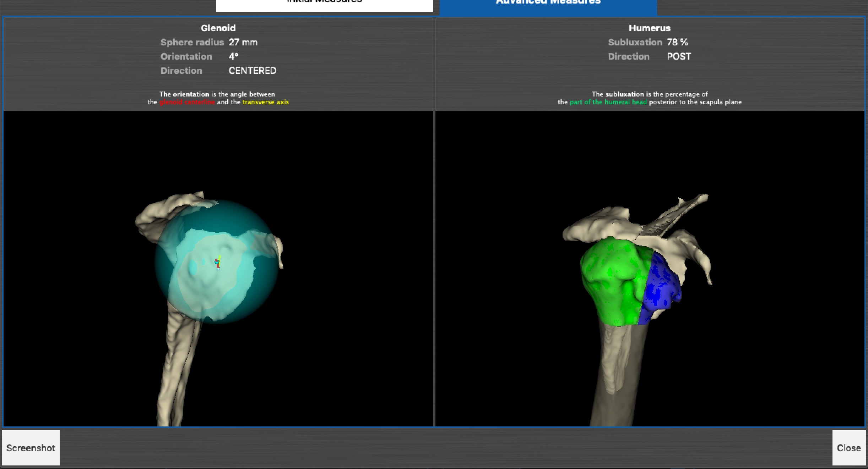

Slide 8
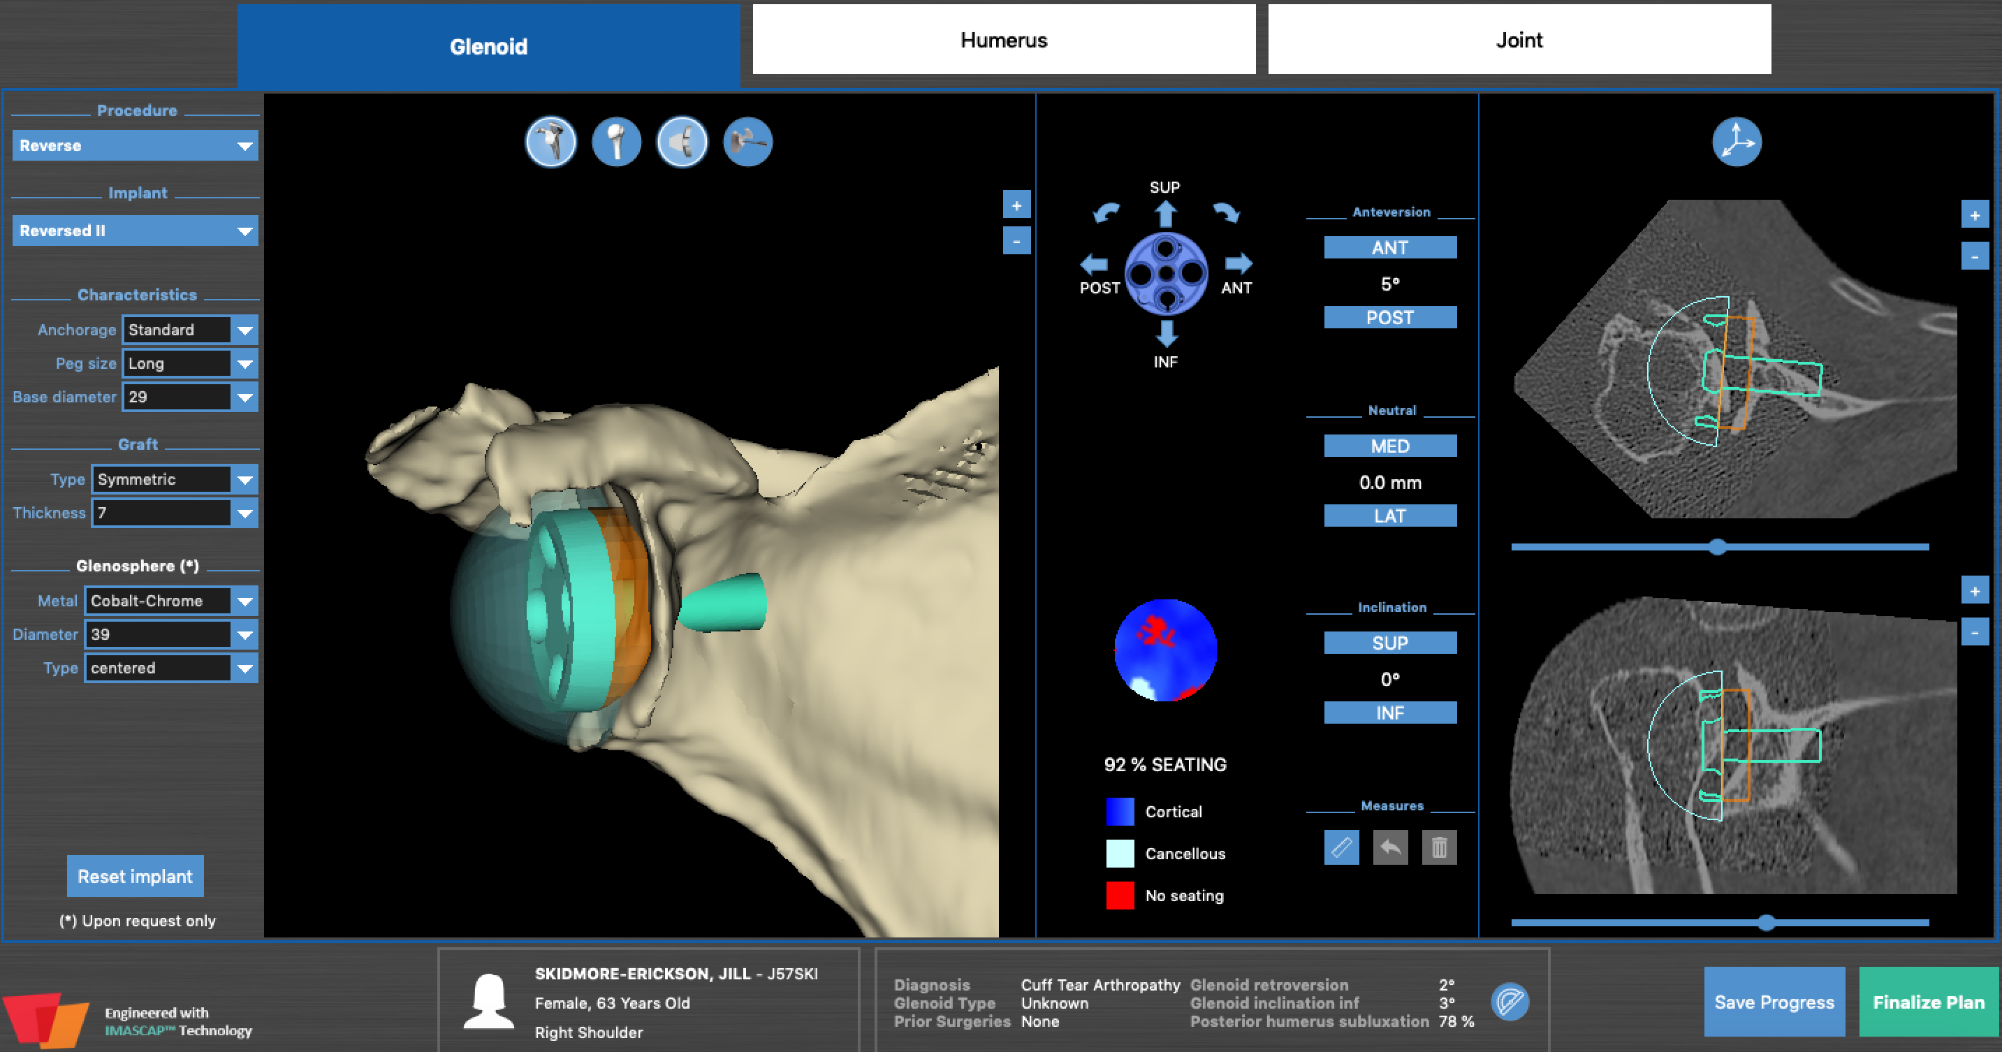

Slide 9
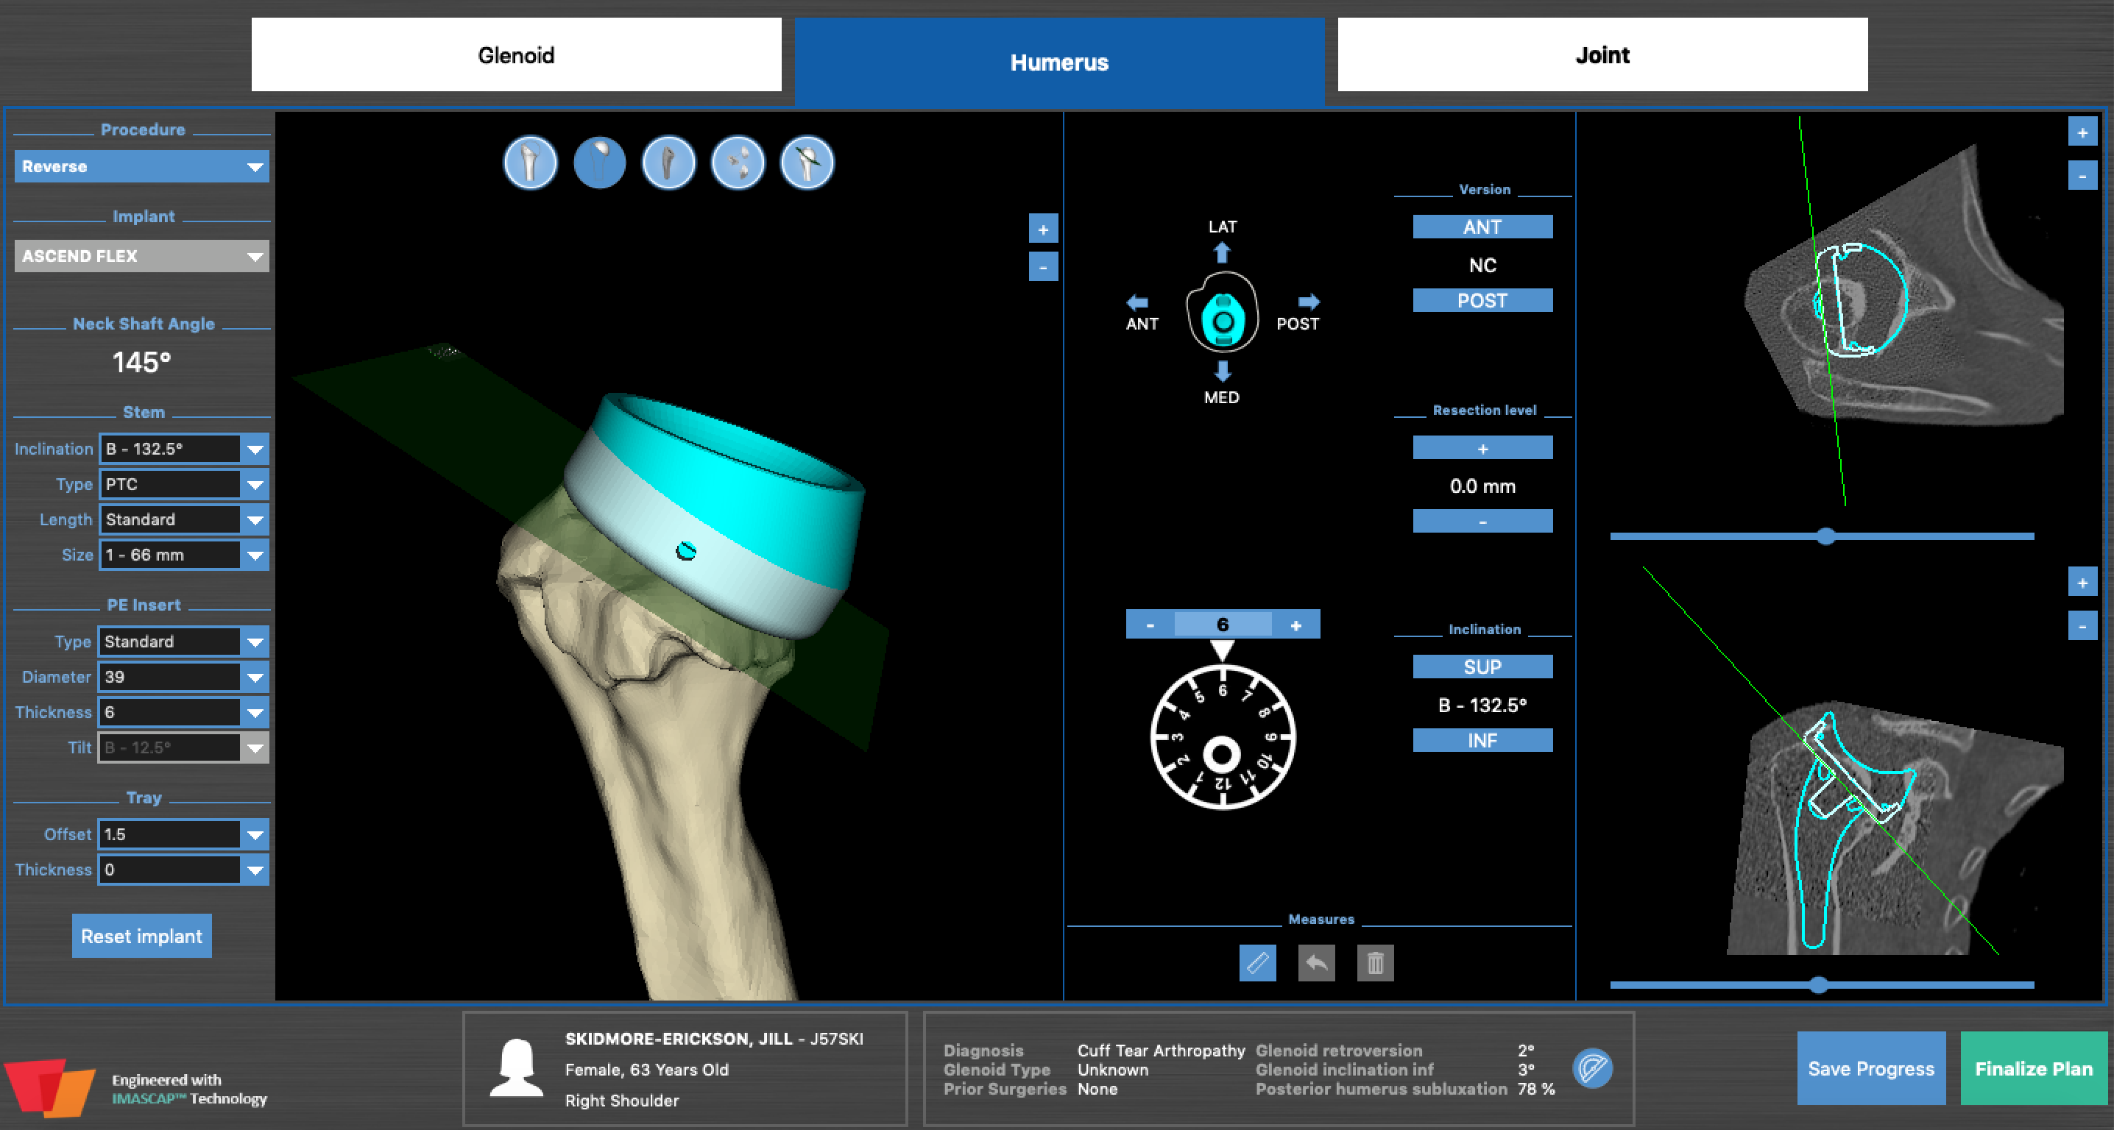

Slide 10
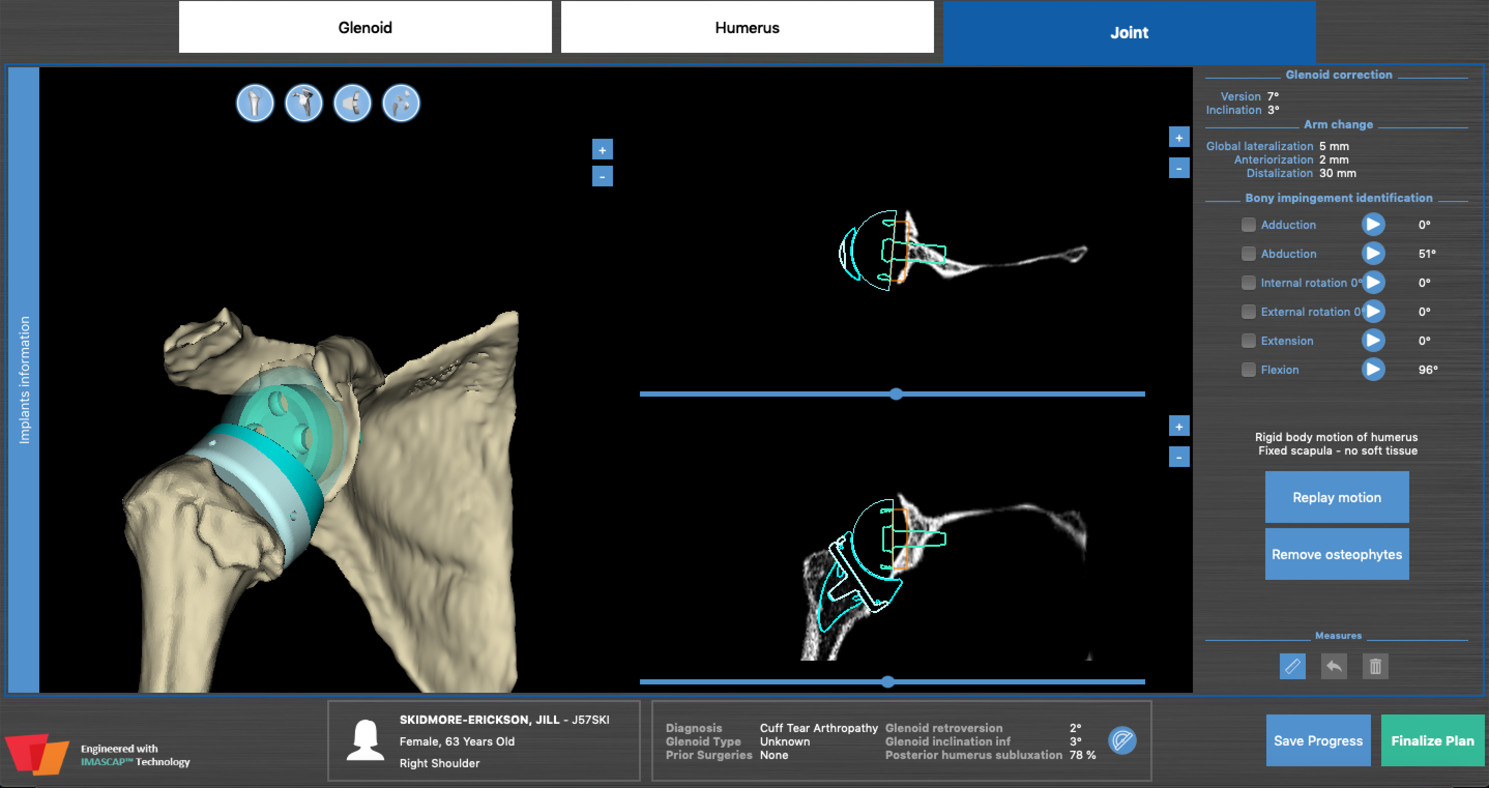

Slide 11
Questions:
What is your experience doing an RSA in a paraplegic?
How would you rehab this patient?
Would you bone graft as a separate procedure or include in one procedure?
When would you let this patient transfer to/from wheelchair?

