Slide 1
74 y.o. RHD insulin dependent diabetic patient (BMI 34.75), bilateral osteoarthritis of the shoulder left worse than right

Slide 2
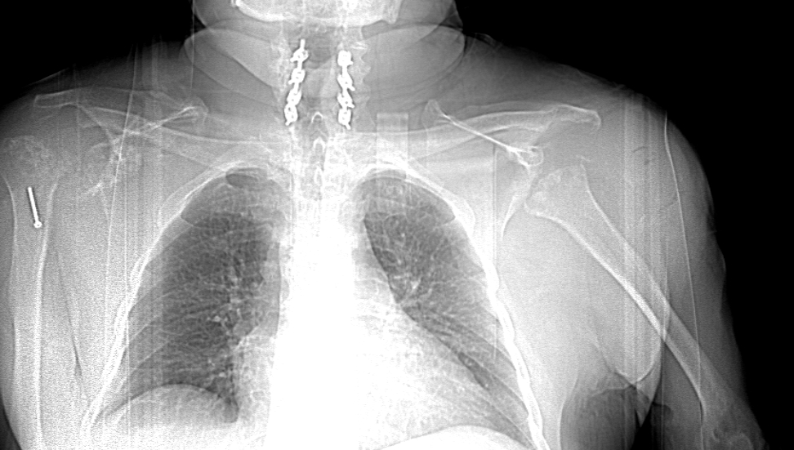
Progression of Osteoarthritis of Lt. Shoulder

Slide 3
MRI showing large intra-articular cyst, RCT subscapularis and supraspinatus, flattening of humeral head

Slide 4
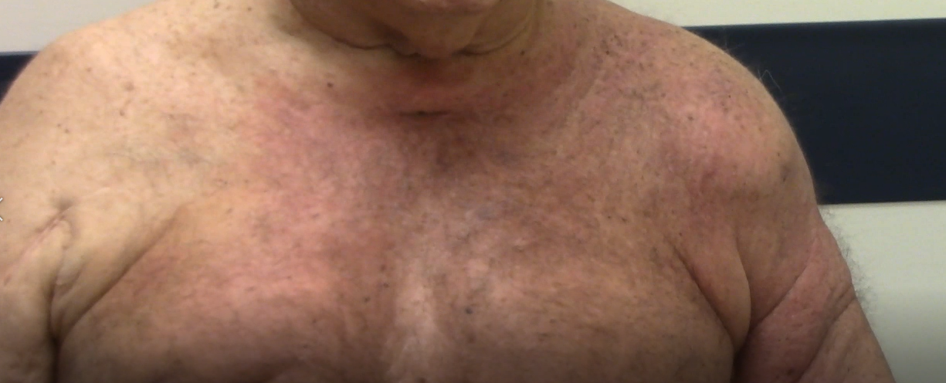
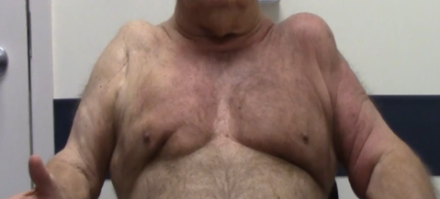
Pre-operative picture showing cyst on Rt. Shoulder

Slide 5
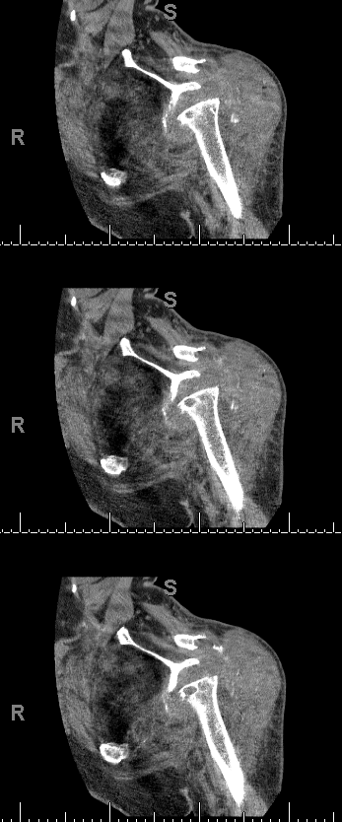
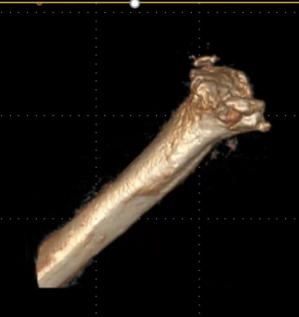
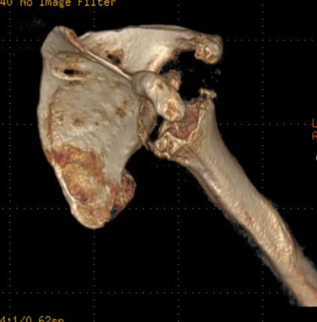
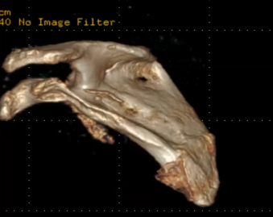
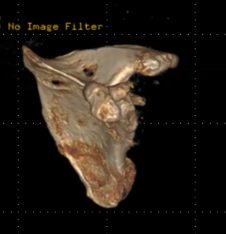
CT-Scans

Slide 6
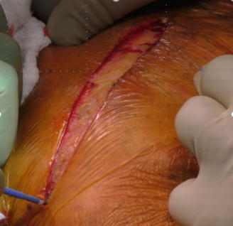
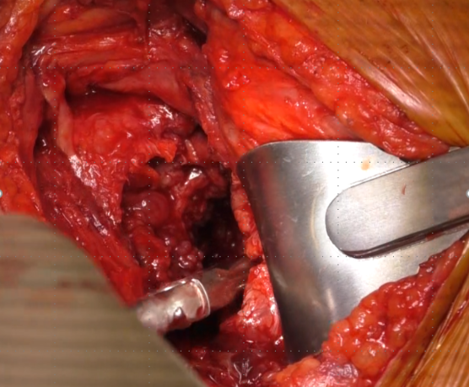
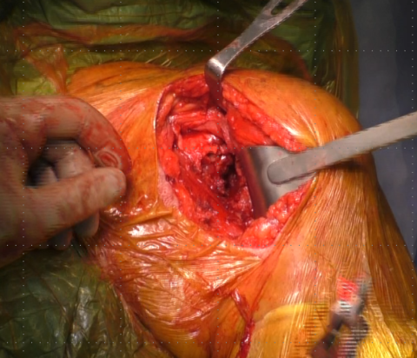
Joint exposure

Slide 7
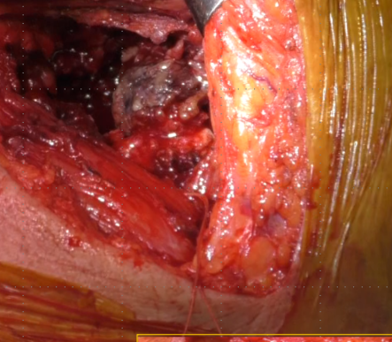
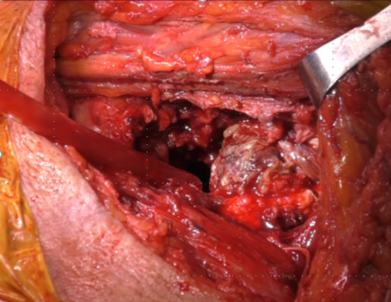
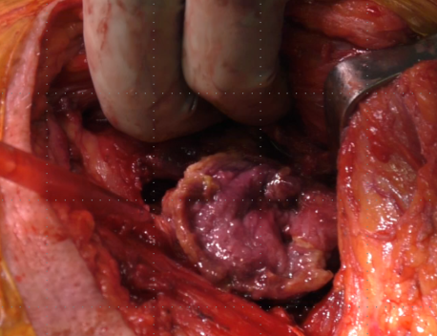
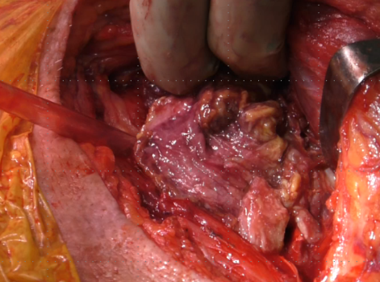
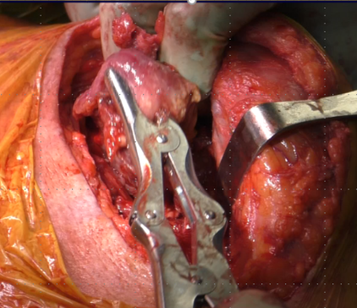
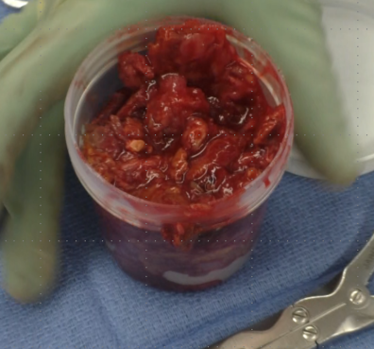
Cyst

Slide 8
Lab Results
Conjoint tendon (Lt. Shoulder):
-Rare neutrophils are present.
Pseudocapsule, left glenohumeral joint:
- Synovium with granulation tissue, hemosiderin-laden macrophages and dense fibrous connective tissue.
Pseudocapsule, left glenohumeral joint:
- Synovium with neovascularization, dense fibrous connective tissue and fragment of bone.
Deltoid cyst, left:
- Necrotic debris. Some neutrophils noted admixed with fibrin.

Slide 9
Lab Results:
No C Acnes after 21 days
No AFB
No Fungal Elements
Shoulder Tissue samples returned with moderate to large amounts of neutrophils

Slide 10
CBC (1 day post-op)
Ref Range & Units 8d ago
White Cell Count 3.8 - 10.6 10*3/uL 10.2
Red Cell Count 4.40 - 5.90 10*6/µL 3.45
Hemoglobin 13.0 - 18.0 g/dL 9.1
Hematocrit 40.0 - 52.0 % 30.0
MCV 80.0 - 100.0 fL 87.0
MCH 26.0 - 34.0 pg 26.4
MCHC 32.0 - 36.0 g/dL 30.3
RBC Distribution Width 11.6 - 14.8 % 17.9
Platelet count 150 - 440 10*3/uL 201

Slide 11
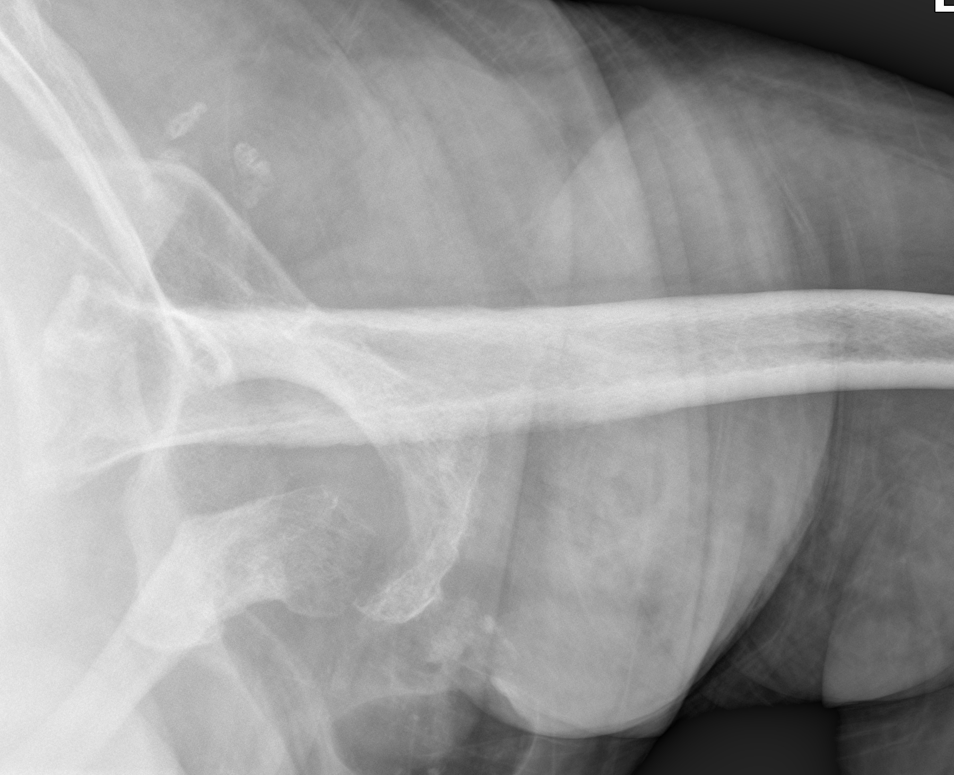
X-rays from 11/4/19

Slide 12
Patient was admitted to the hospital from the ED on 11/29/2019: Note from 11/29/19
Focal ecchymosis overlying the left antecubital fossa not associated with any event (diameter of ecchymosis is apx 8cm).
Extensive erythema starting 3cm right of the midline and extending into the left chest wall
Patient is edematous throughout
He has been using the left upper extremity
Denies fever or chills

Slide 13
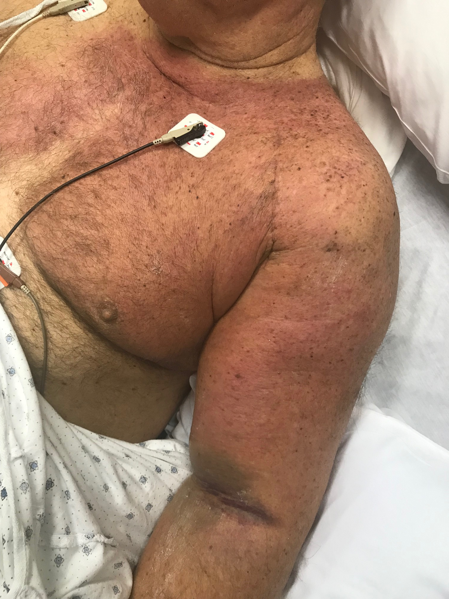
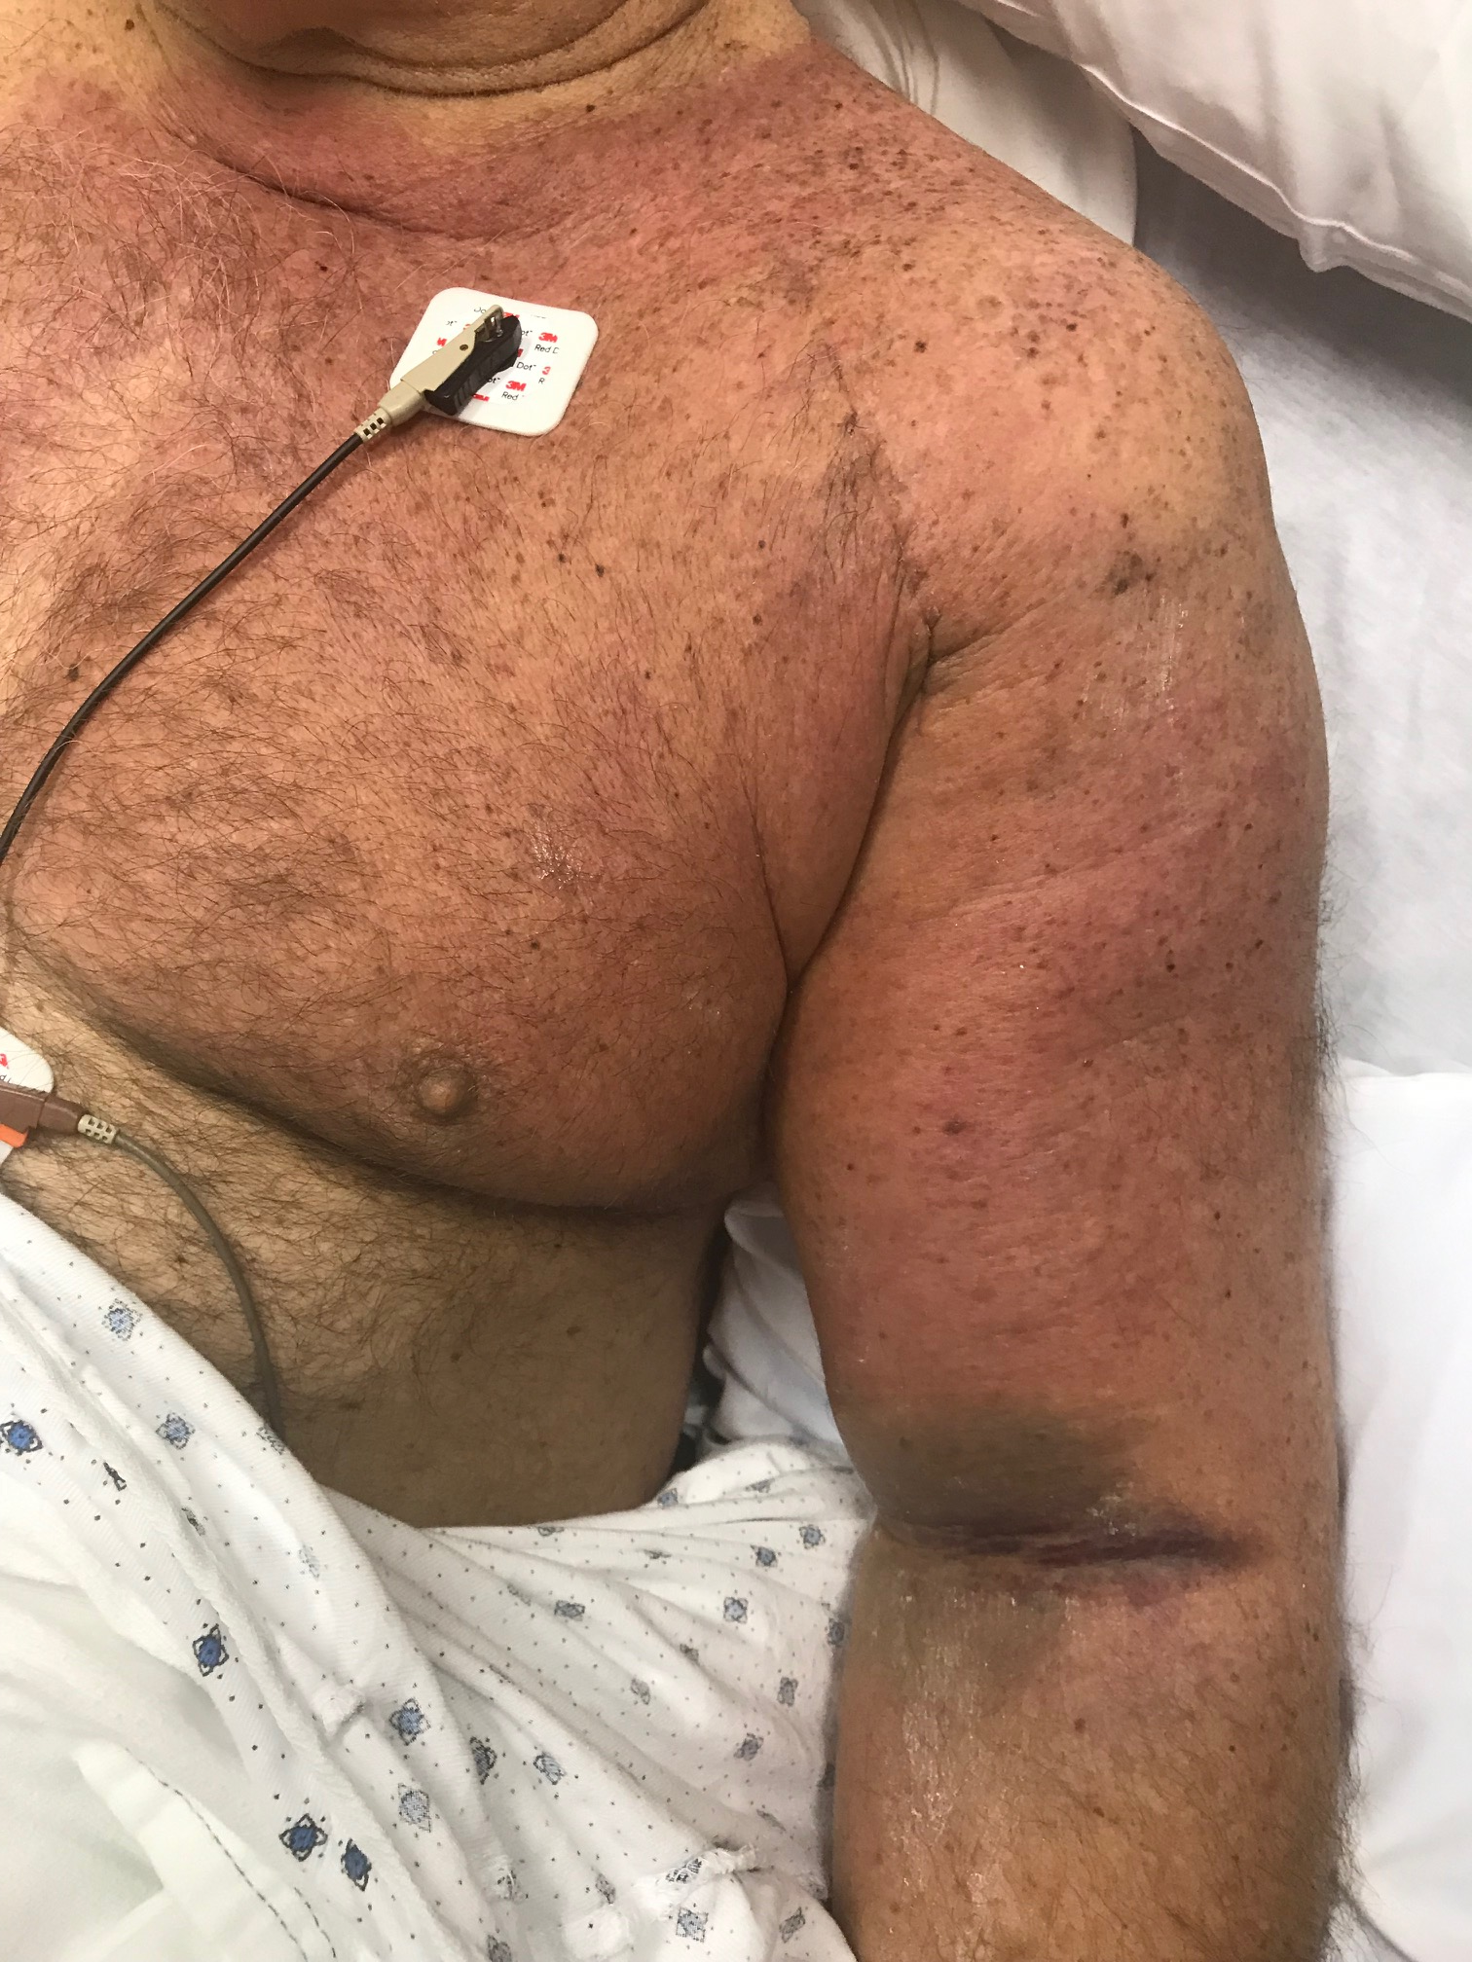
Images from 11/29/19

Slide 14
Labs
WBC 10.2 11/29/2019
HGB 9.0 (L) 11/29/2019
HCT 29.3 (L) 11/29/2019
MCV 89.1 11/29/2019
PLT 216 11/29/2019
CALCIUM 8.2 (L) 12/03/2019
NA 135 (L) 12/03/2019
K 3.7 12/03/2019
CO2 25 12/03/2019
CL 108 10/31/2019
BUN 23 10/31/2019
INR 1.6 09/24/2019
Prothrombin 16.6 (H) 12/3/19
Sedimentation rate 52 (H) 12/2/2019

Slide 15
CBC 12/02/2019
White Cell Count 3.8 - 10.6 10*3/uL 6.3
Red Cell Count 4.40 - 5.90 10*6/µL 2.78 (L)
Hemoglobin 13.0 - 18.0 g/dL 7.7 (L)
Hematocrit 40.0 - 52.0 % 24.9 (L)
MCV 80.0 - 100.0 fL 89.6
MCH 26.0 - 34.0 pg 27.7
MCHC 32.0 - 36.0 g/dL 30.9 (L)
RBC Distribution Width 11.6 - 14.8 % 18.3 (H)
Platelet count 150 - 440 10*3/uL 208

Slide 16
Next Steps and Advice for our Case?

