Slide 1
Can a shoulder arthroplasty be done in a shoulder with congenitally absent acromion?
Ron Navarro

Slide 2
History
ML is a 71 year old right hand dominant female R shoulder PAIN FOR YEARS (ALSO HAS SCOLIOSIS).
Business transportation and school with kids
Severity: severe (*)
Duration: several years (*)
Timing: constant (*)
Context: worsening (*)
Modifying factors: (*) Aggravated by: movement and activity
Relieved by: rest and Tylenol
Currently used pain medications: tylenol, oxycodone for recent total hip arthroplasty – nothing Helps
Steroid injections: no
Currently used assistive device: none
Physical Therapy: no

Slide 3
PE
Body Area - right shoulder
TTP - ant shoulder
ROM -
FF - 45
AB - 20
ER0 - to neutral
Stability – no instability
Strength - ER 4/5, cannot perform Jobes positioning
Deltoid 5/5 A,L,P
NVI

Slide 4
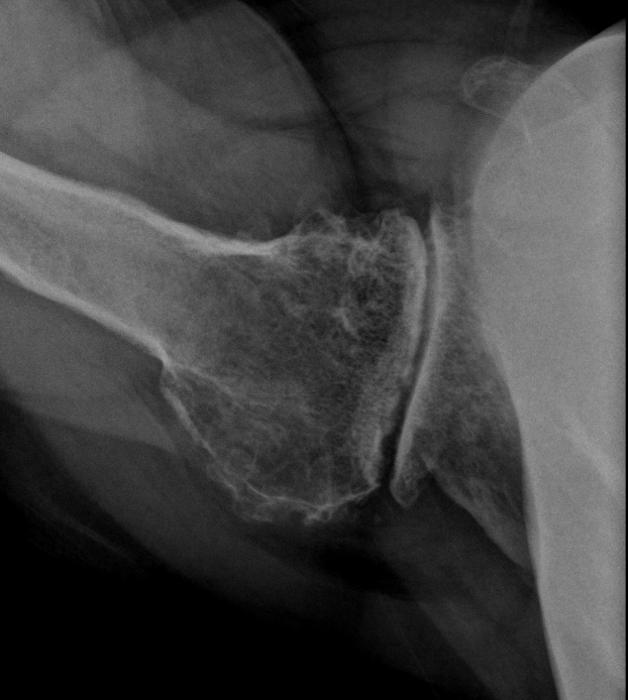
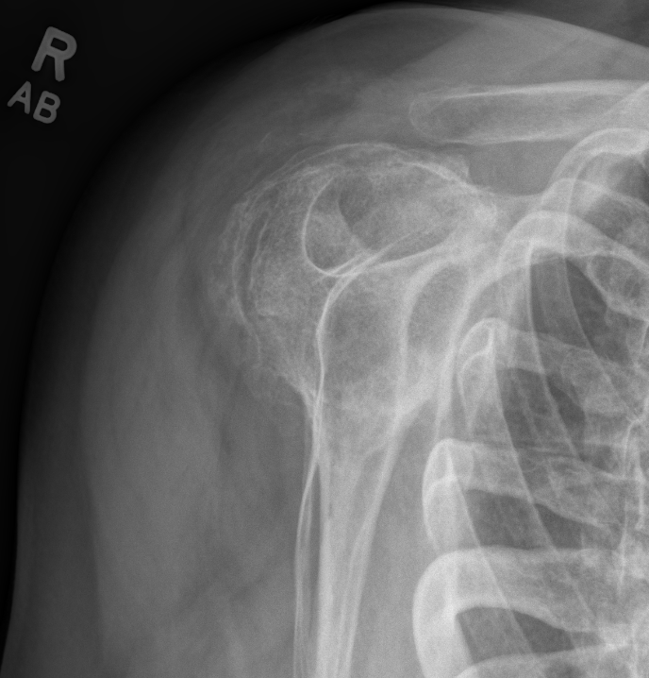
Initial Imaging

Slide 5
Pending
Ct for planning purposes
MRI

Slide 6
No acromion

Slide 7
Some q’s
Can a RTSA be placed in a patient with absent acromion?
How will planning change if any in this setting?
More images to be shared later.
thanks

