Slide 1
71 y female patient

Slide 2
HPI:
71 y.o. year old RIGHT hand dominant female with LEFT shoulder pain follow up.
In 2014, she fell at work, sustaining a traumatic injury to her left rotator cuff. She underwent a left rotator cuff repair (in 2014).
initially did well but about a year later, she started having significant swelling and pain around the joint.
Had arthroscopic debridement in 2015 – no infection found
Continued to have significant effusions that have been aspirated in the office every 4-6 weeks over the years. – no bacteria found in effusion.
Pain at rest a 7/10, up to 10/10 with movement. She has significant night pain and she puts her subjective shoulder value at less than 5%.

Slide 3
Physical examination:
LEFT Upper Extremity,
No redness, no effusion, no signs of infection
TTP over acromion – os acromiale is mobile when palpated
AROM/PROM:
Forward Flexion: 40/150, with significant crepitus
GH Abduction: 30/80
External Rotation: 30/40 no lag
Internal rotation Adduction: Sacrum
Strength: Abduction: 3/5, External rotation 4+/5, Internal rotation 4/5

Slide 4
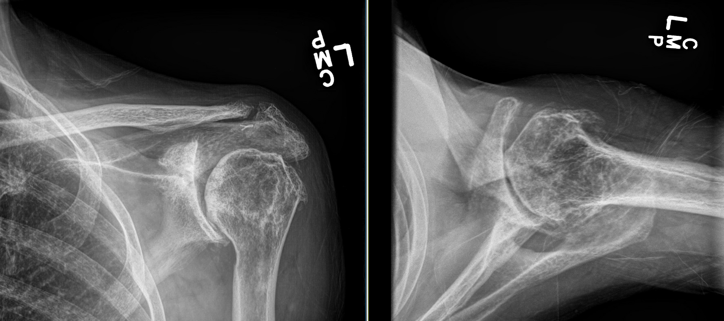
X ray

Slide 5
CT Scan
D Glenoid

Slide 6
Mobile and painful Os acromiale

Slide 7
Diagnosis
71 y female patient with cuff tear arthropathy Hamada VI with a painful type II os acromiale.
Treatment plan:
Reverse Total Shoulder Arthroplasty with iliac bone graft
Question: Treatment of the painfuls mobile Os acromiale? No treatment?

