Slide 1
HPI
13 year old RHD male that fell on his left shoulder Fall of 2018 (1.5 years prior to presentation) playing football
Had pain but continue to play. No dislocations.
Plays QB and linebacker
Played this season but continued to complain of pain.
Saw outside surgeon- xrays normal. No treatment.
Then MRI ordered that showed two exostoses so referred to my partner- MSK oncologist. Sent to me. Not concerned about exostoses.
Pain anterior. Can be an 8/10. No instability. No numbness or tingling. Pain mostly just when playing or with ER.
Per parents he is a “scholarship level athlete”

Slide 2
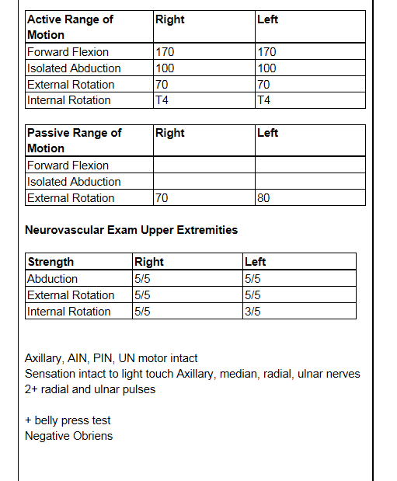
PE:
5’11” 181 lbs (13 years old)
Negative apprehension.
+ lift off
+ Belly press test.

Slide 3
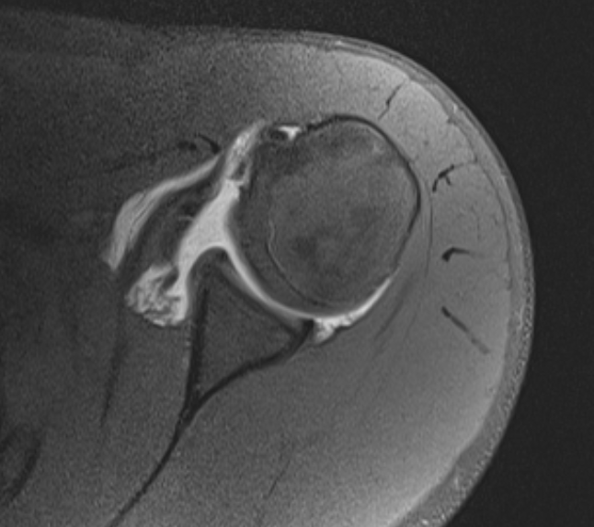
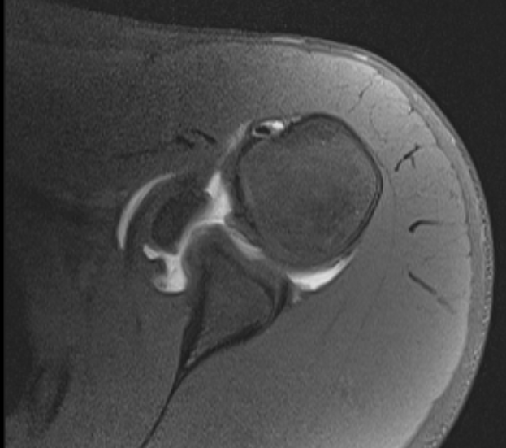
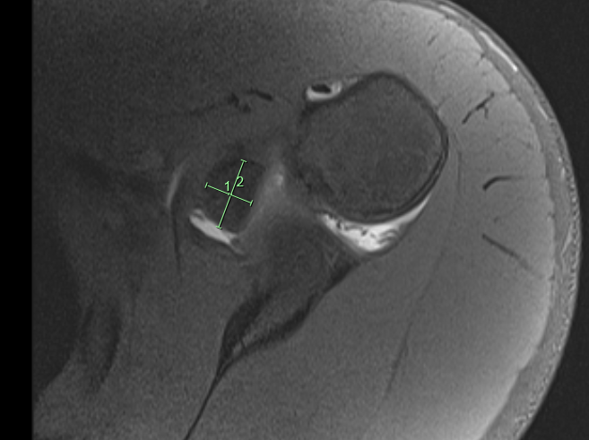

Slide 4
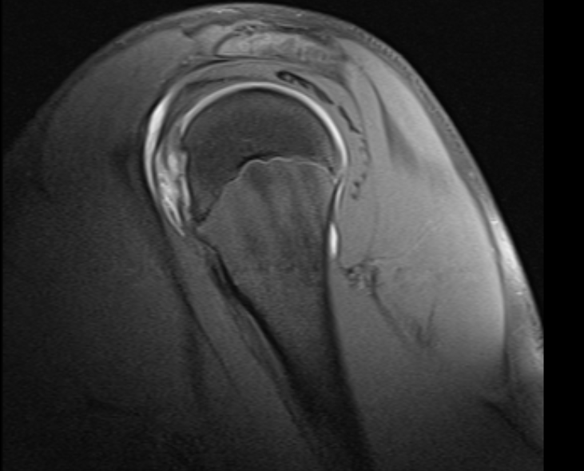
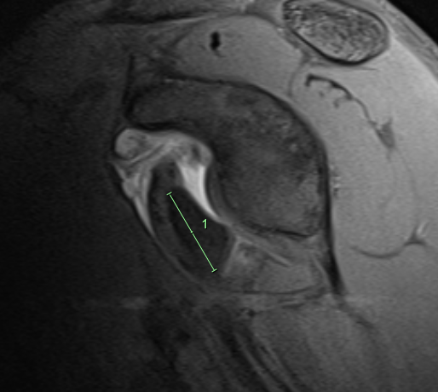
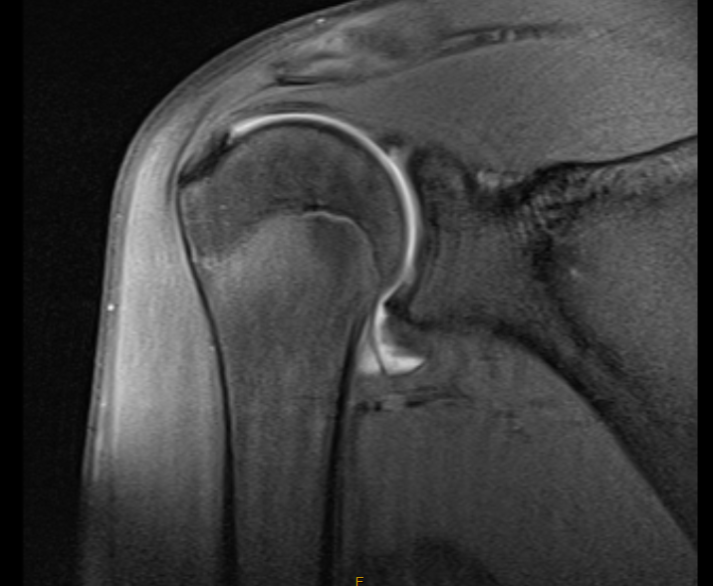

Slide 5
Plan
Appears he fractured through an exostosis/avulsed his lesser tuberosity 18 months ago
Arthroscopic versus open repair with ?debulking of the piece if truly exostoses
Anchors with double row versus screws?
Still has open physis
Any other thoughts (Tumor cleared him- no futher WU required)….

