Slide 1
Alternative Treatment for Patients with FSH and Deficient Periscapular Muscles
Right to Left Scapula Tethering with Achilles Tendon Allograft

Slide 2
Indications
Patients with symptomatic periscapular muscle paralysis and
1- Are not candidate for ST fusion because of restrictive lung disease
2- Are skeletally immature
3- Refuse ST fusion and want alternative

Slide 3
57 yo OBGYN with post Irradiation Significant Shoulder Dysfunction (Restricted Lung Capacity). Complete Paralysis of the serratus and Trapezius Bilaterally

Slide 4
One Potential Option is to Tie the Right and Left Scapula Together To Retract the Scapulae and Reduce them to Better Functional Position on the Chest Wall

Slide 5
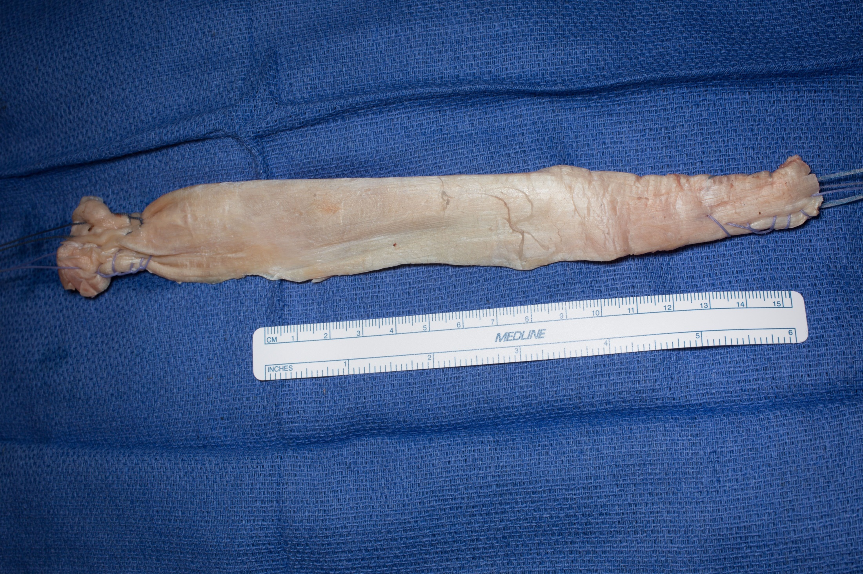

Slide 6
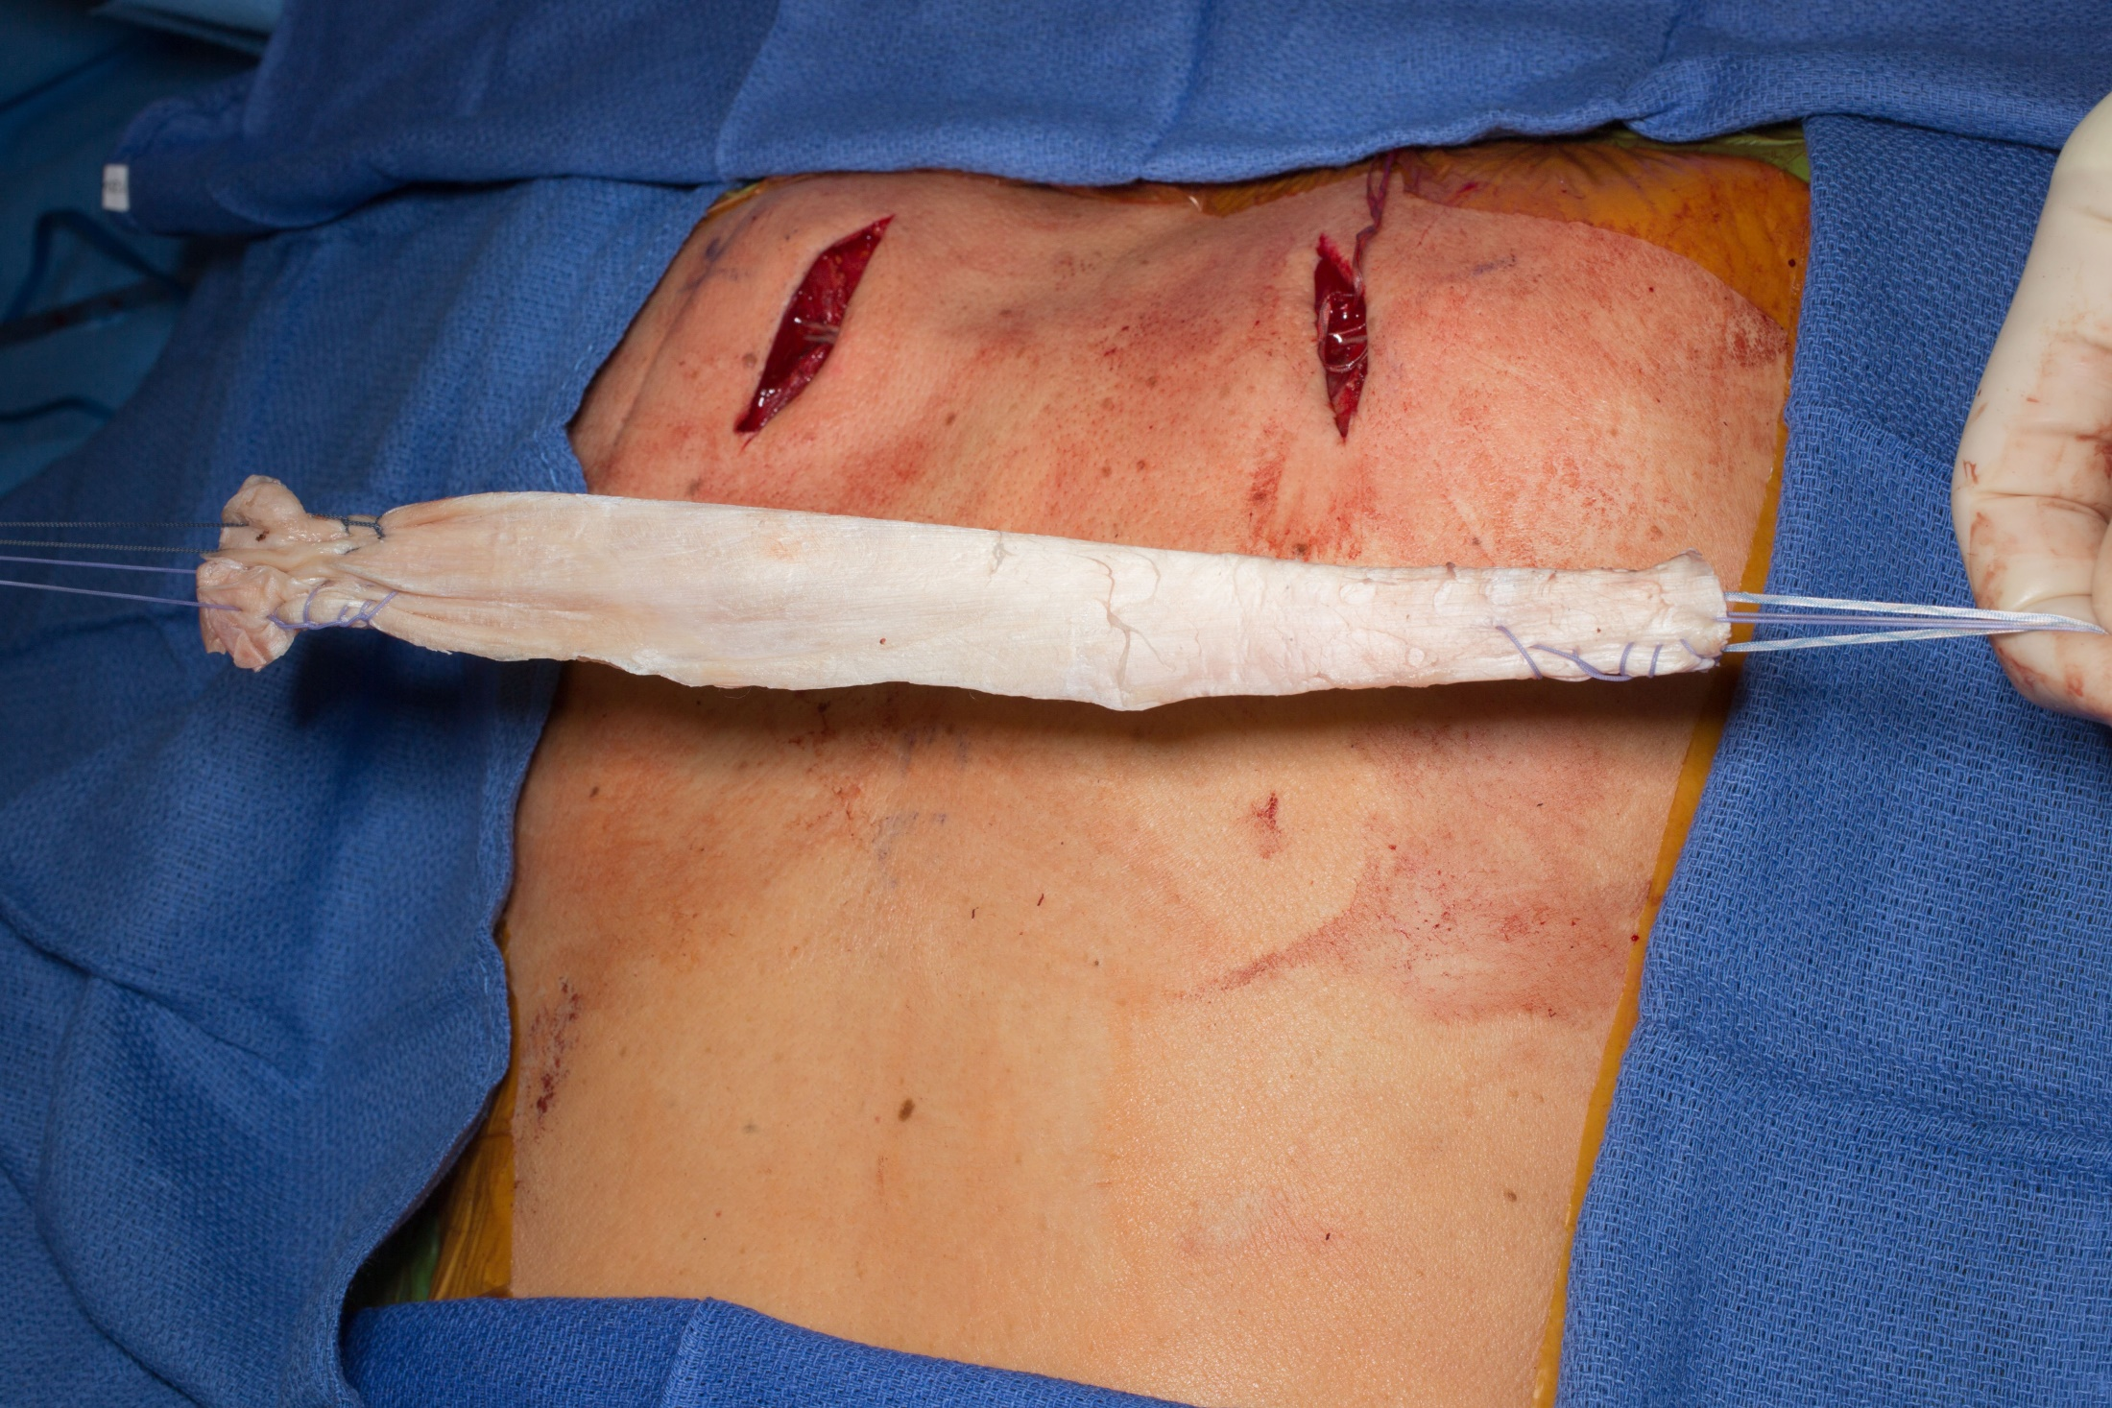

Slide 7
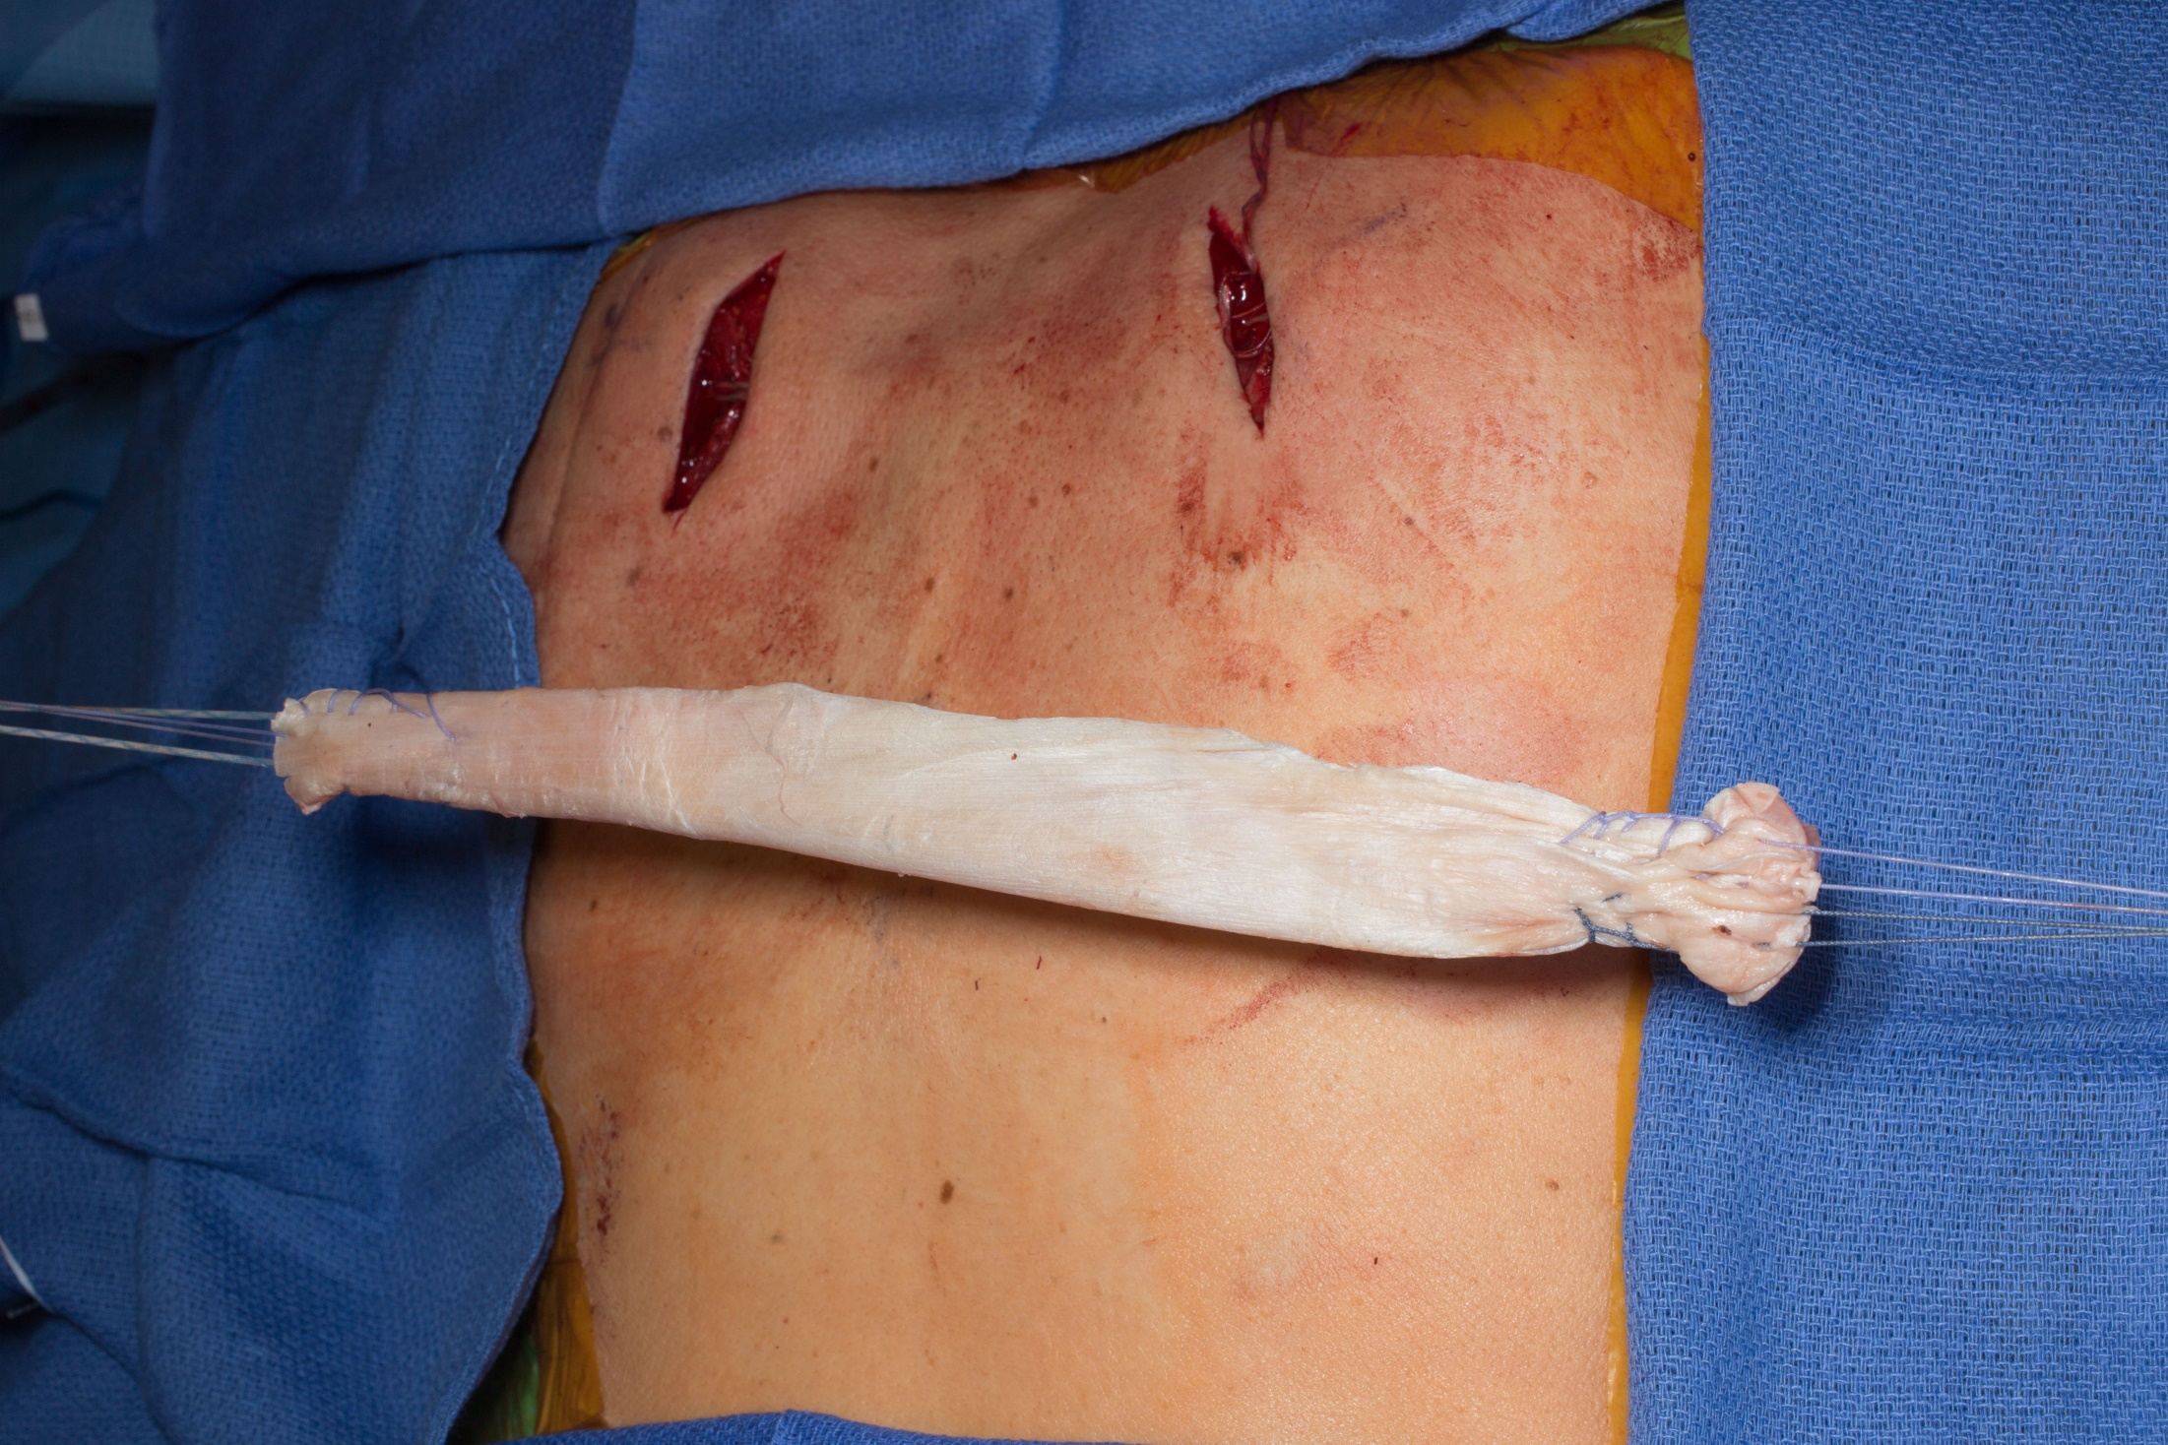

Slide 8
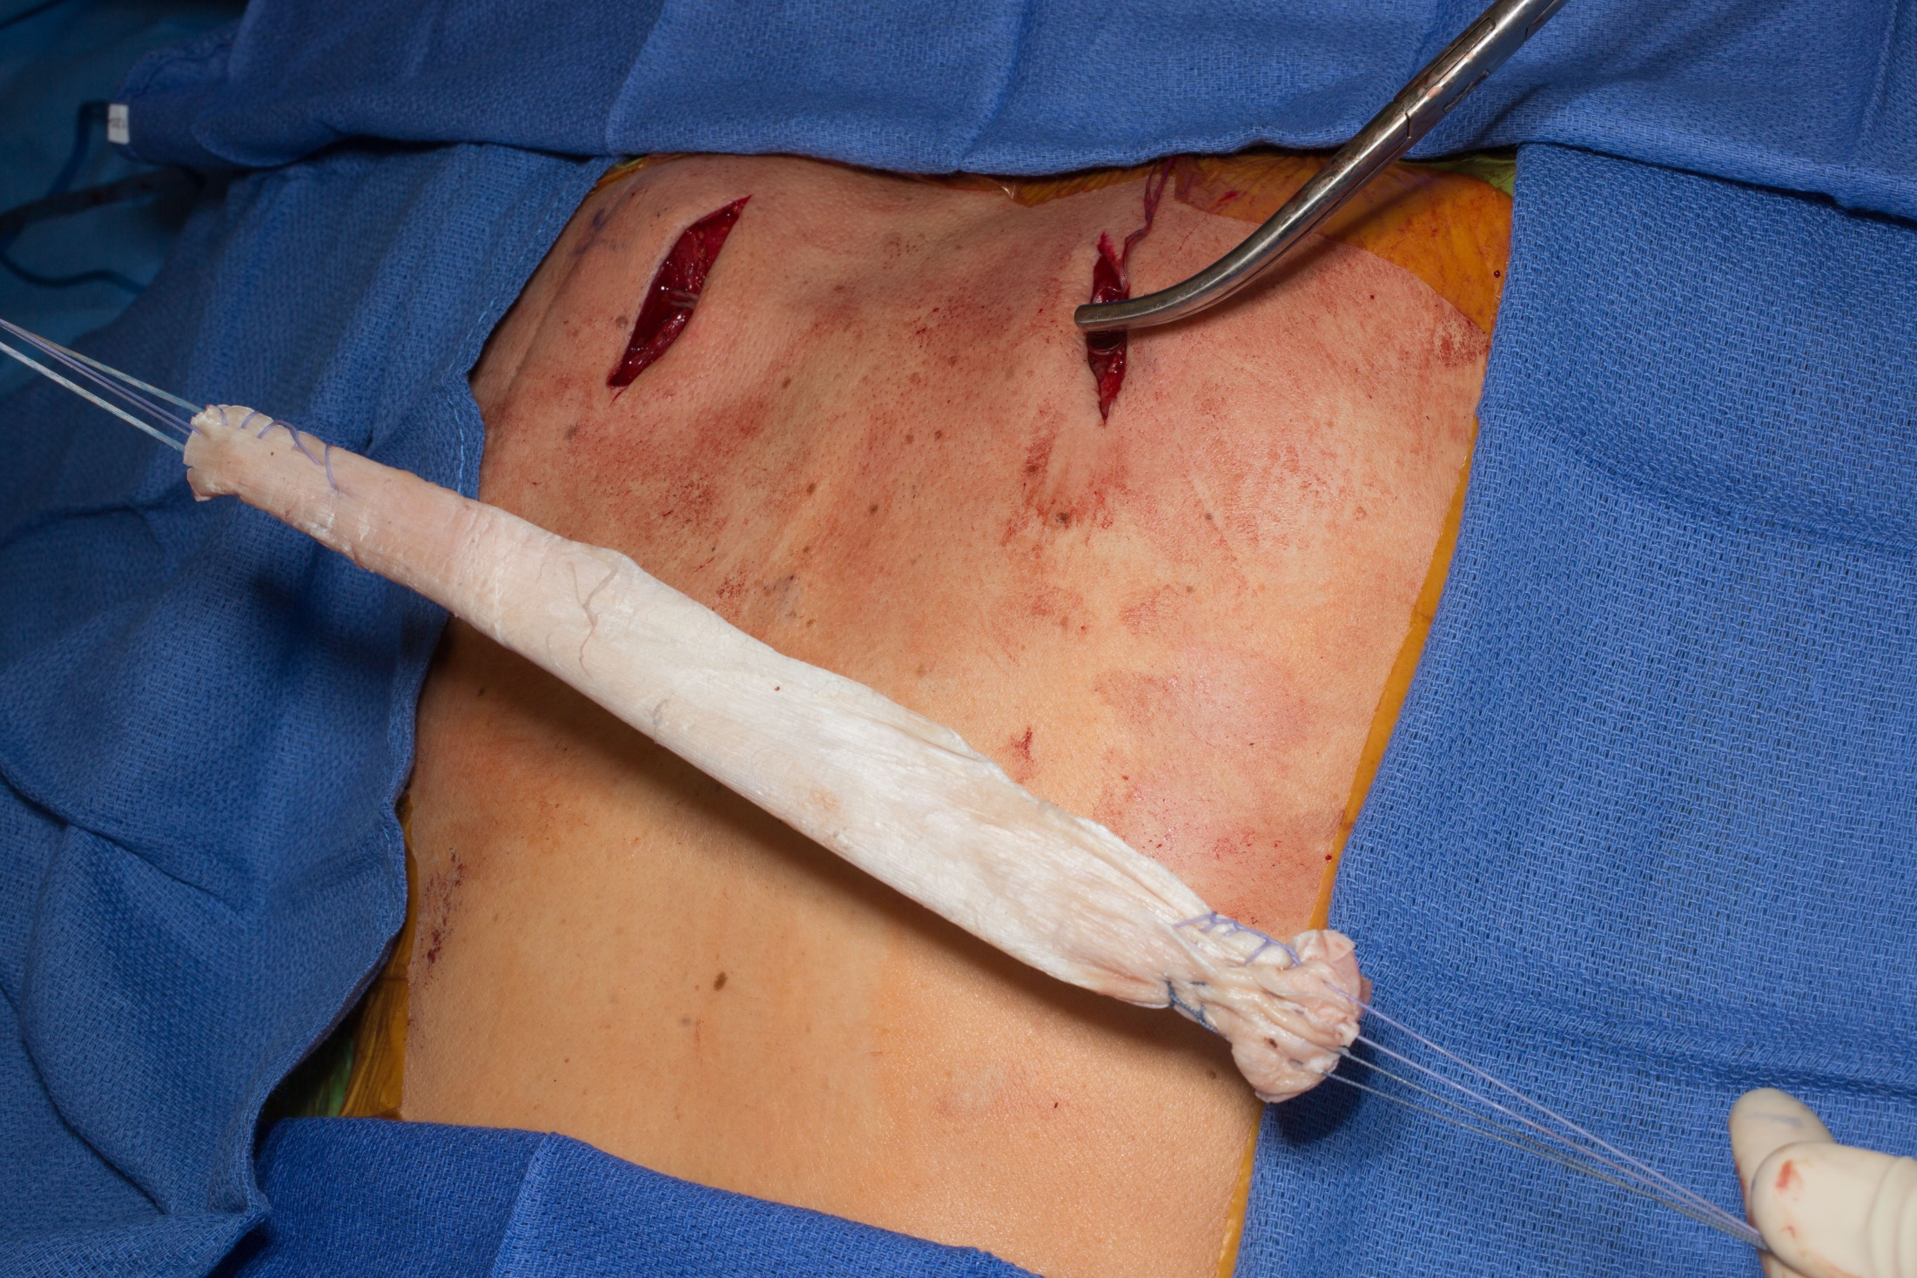

Slide 9
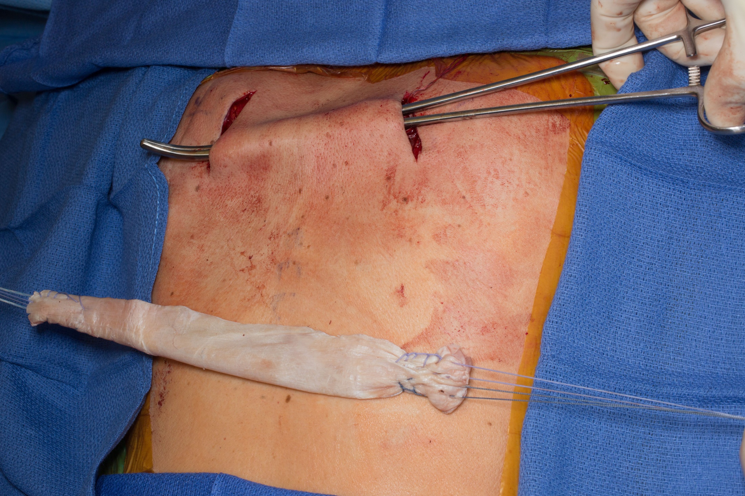

Slide 10
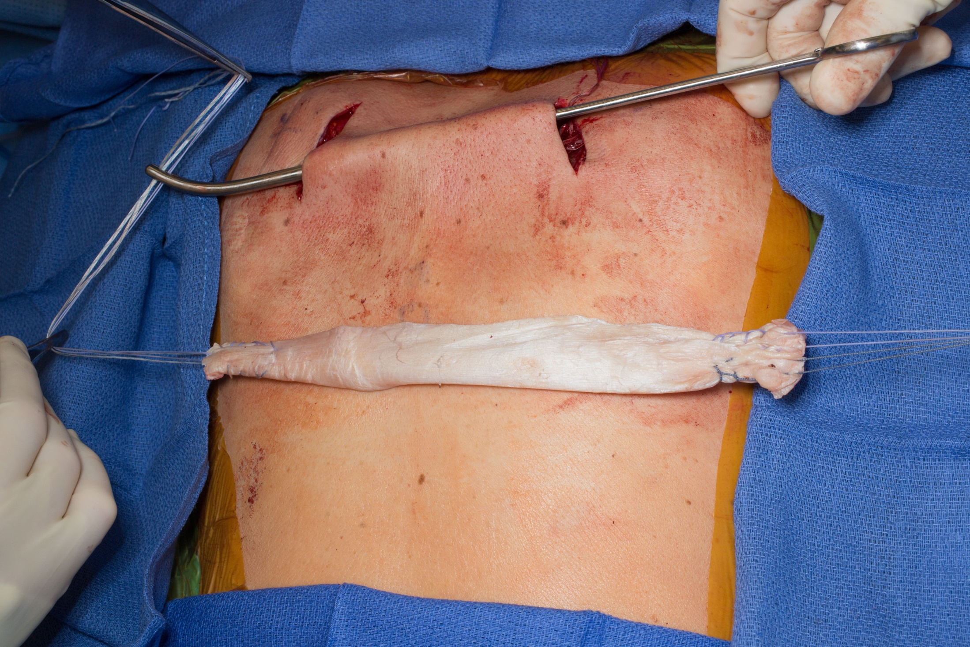

Slide 11
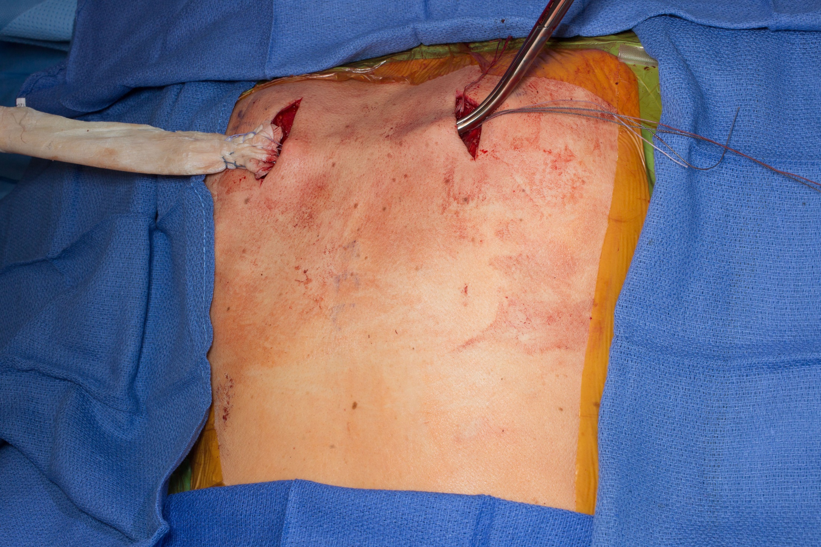

Slide 12
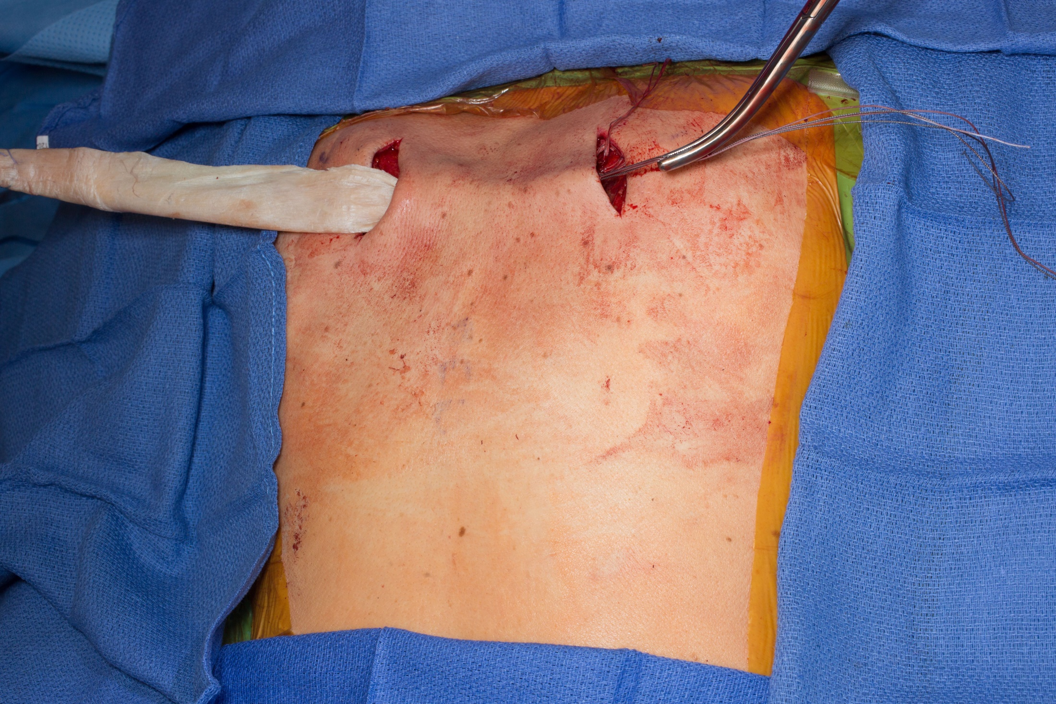

Slide 13
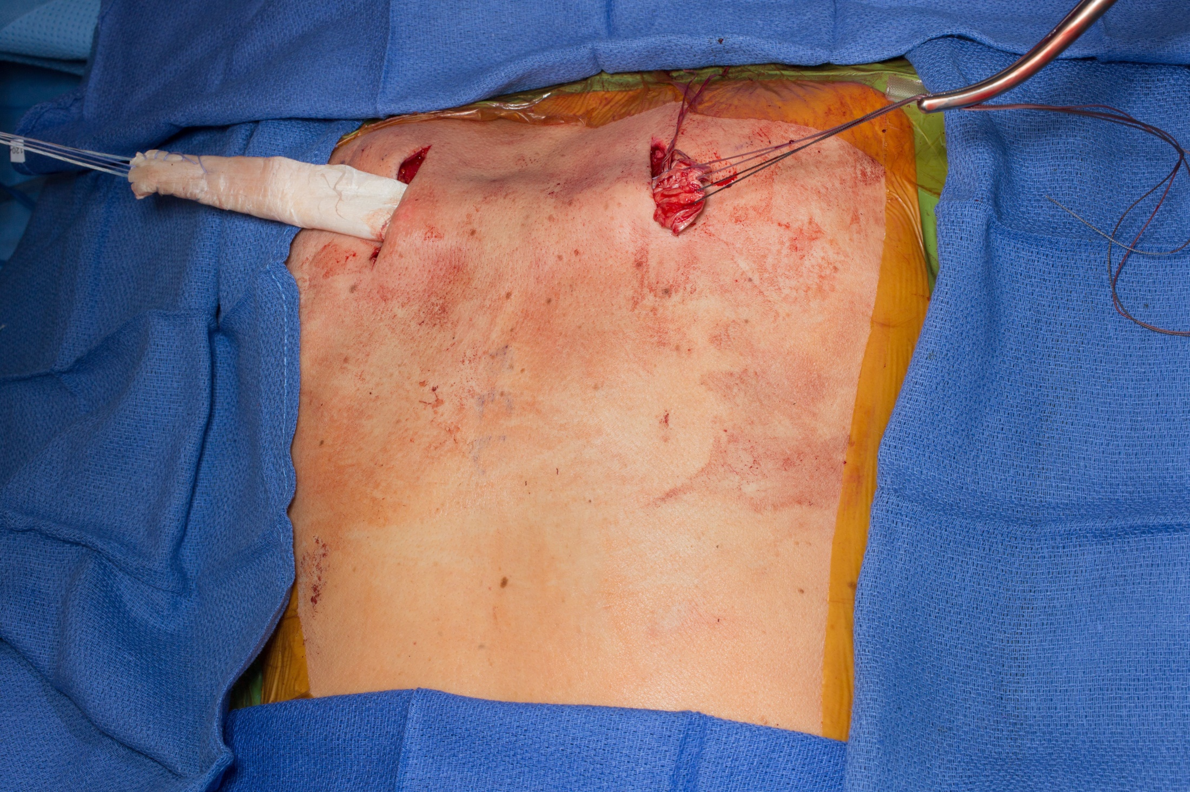

Slide 14
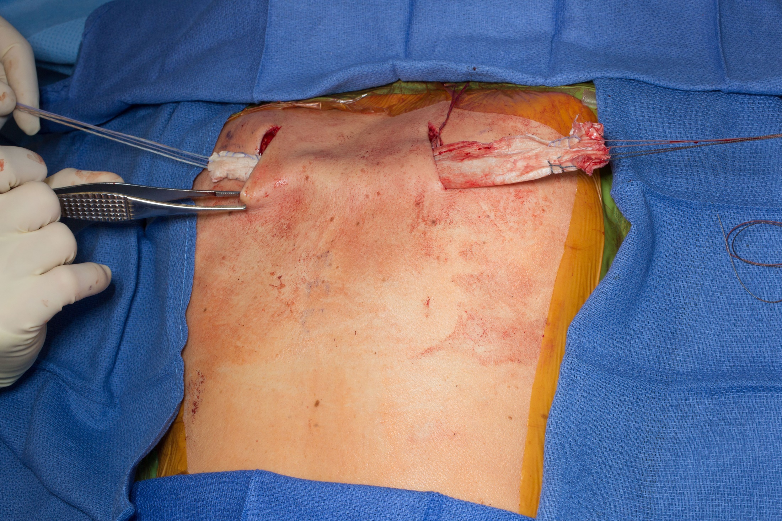

Slide 15
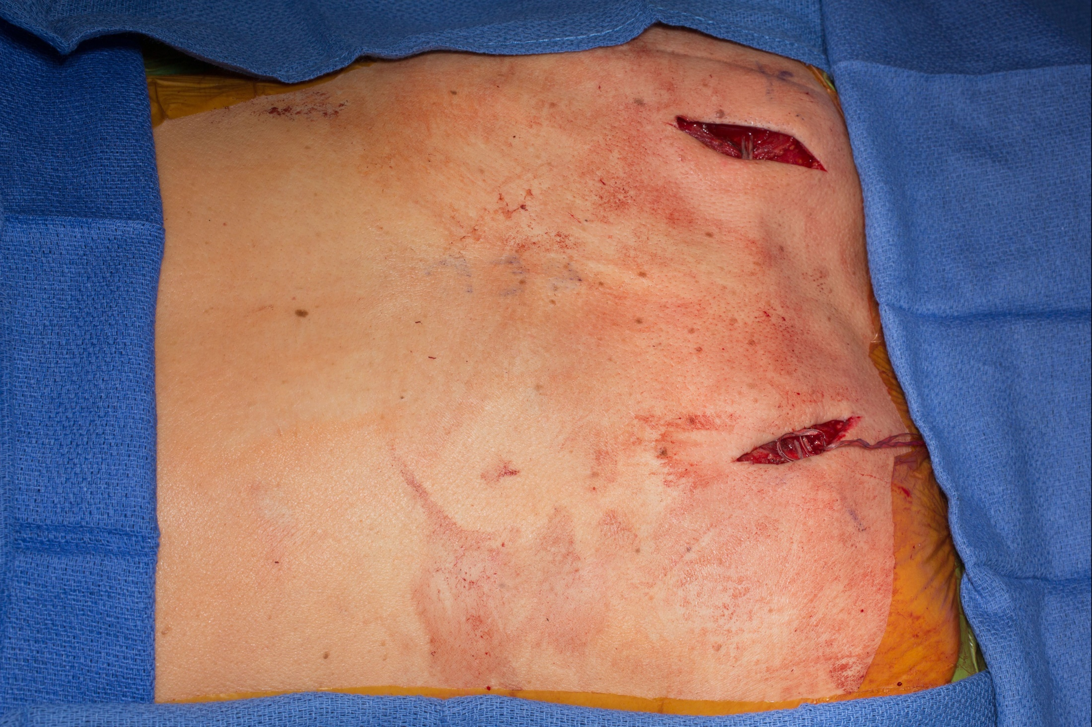

Slide 16
1 Year Post Op (Golfing)

Slide 17
26 yo Medical Student with FSHD and very Dysfunctional Shoulders
He had to stop Medical School because of that
Refused ST fusion because he read about it and saw pictures
Underwent right to left scapula Tethering
Significant improvement in shoulder function
Went back to medical school
5 Months Post Op

Slide 18
-9 yo with symptomatic FSHD and periscapular muscle wasting
4 Months post right to left scapula Tethering
Now 14 months Post surgery doing very well and back to more sports activities that he could not do before.

