Slide 1
KC
Severe superior scapular tilt unstable reverse

Slide 2
Proximal humeral fracture
Plated x 2
Revised to reverse
Acromial fracture acromionectomy clavicle stabilized to coracoid
Base of coracoid fracture non union

Slide 3
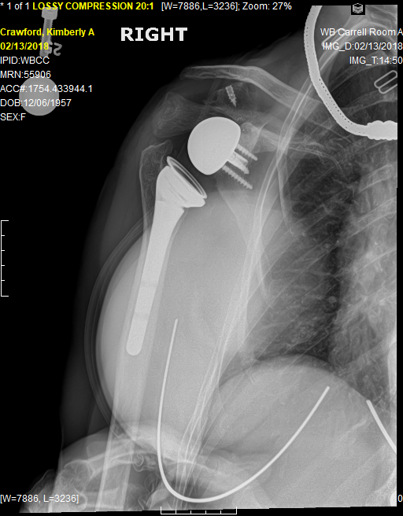
Where I came in
Type V ac dislocation with coracoid fracture with entire coracoid wedged between glenosphere and clavicle
I planned to use as wedge graft however Base plate very well fixed Implant stable anterior deltoid deficiency felt catastrophic bone loss likely so did not aalter reverse
Excised fragment and performed modified dewar barrington procedure ( suture conjoined tendon to clavicle )

Slide 4
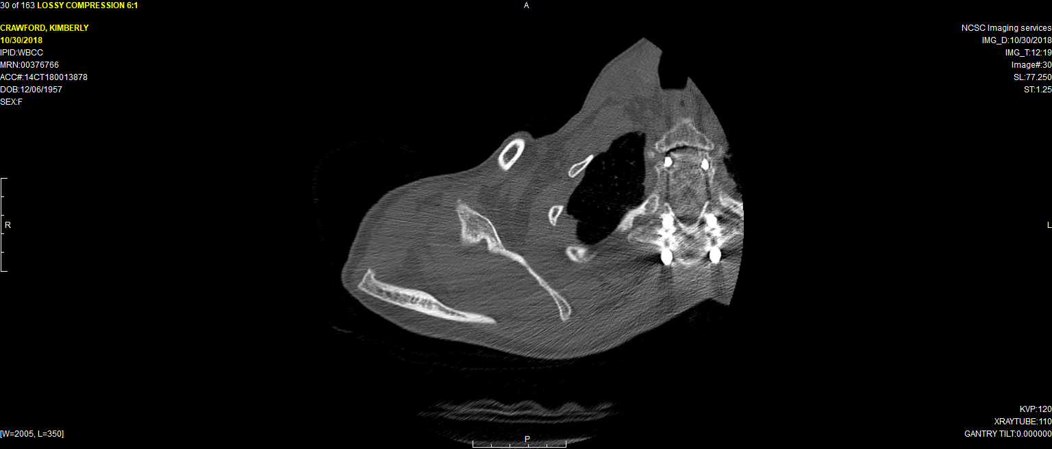

Slide 5
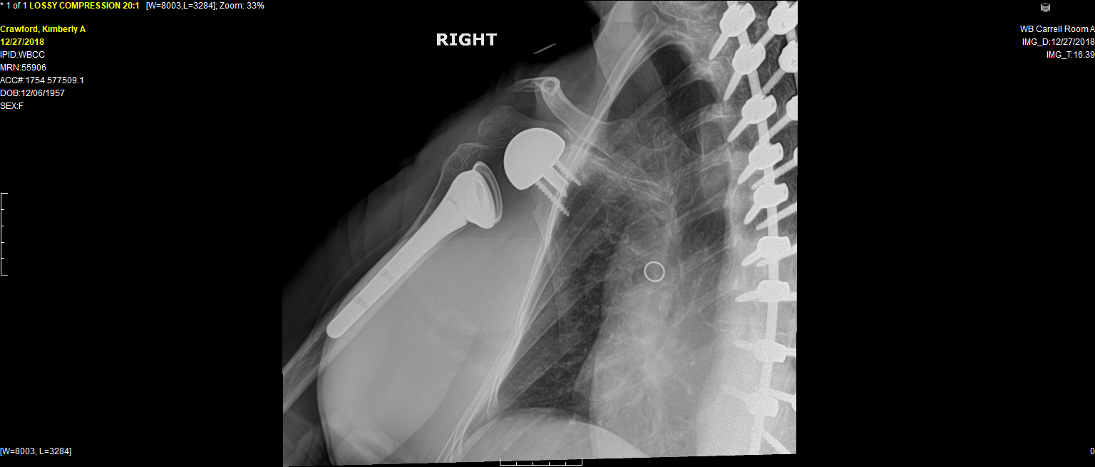

Slide 6
She was doing reasonably well with improved cosmesis not much change in active motion until under went total hip. Shoulder was dislocated during positioning has remained unstable since that time Now has symptomatic subluxations dislocations which she is able to reduce. Has had hip revised twice for instability. Wants something done as she does have some function when its in none when its out.

Slide 7
Alternatives I’ve considered
Nothing not acceptable to her
Custom increased offset glenosphere placed eccentrically to avoid removing well fixed baseplate and constrained liner with spacer on humeral side .
Remove glenosphere use alternative centerline fixation more inferiorly representative ct scan slice enclosed
Weird idea opening wedge osteotomy of scapula as some of her scapular malposition is related to scoliosis

