Slide 1
Codman Society Case presentation

Slide 2
70 y/f Acromial stress fracture after Right RTSA
CC: Severe RIGHT shoulder pain
HPI:
S/P RTSA August 2019 with postoperative acromial stress fracture (diagnosed December 2019). Patient had continous pain 5/10 since surgery - RTSA August 2019 due to irreparable rotator cuff tear.
S/p open rotator cuff repair by Dr in Maine in 2011. Never regained strength after this surgery.
Preop SSV 30%.
Pain 5-10 out of 10. Positive night pain.
Oxycodone, Gabapentin
PMHx: Attention deficit disorder, GERD, hiatal hernia, depression, lymphedema (left arm and leg) since cyst removal left breast, IBS
PSHx: LEFT RTSA 11/6/18 (PerForm Plus full wedged, 15°angled baseplate) + Biceps tenodesis (Dr. Warner, SSV 75%), Left total knee surgery, foot surgery
Meds: Amitriptyline, aspirin 325, bupropion, famotidine, Gabapentin, Oxycodone/ HYDROmorphone, methylphenidate 3x/d, nitrofurantoin, omeprazole, ondansetron, scopolamine, senna
Allergy: Midazolam
Social: Denies smoking, socially alcohol, retired nurse, lives alone in Maine

Slide 3
69y/f
PE right shoulder
Ht: 5’6”; Wt: 170lb; BMI: 27
Healed incision,
flattend right shoulder compared to left.
TTP posterior Acromion and lateral scapular spine tenderness over acromion
ROM R/L: Flexion 130/150 Abdcution 120/140 ER 40/40, IR Sacrum/T4
Preoperative (before RTSA) right shoulder Flexion 160, Abd 150, ER 40, IR SI joint
Strength: 4/5 Abduction/ER
SILT axillary, medial, radial, ulnar nerves
Intact EPL/FPL/IO
2+ radial pulse

Slide 4
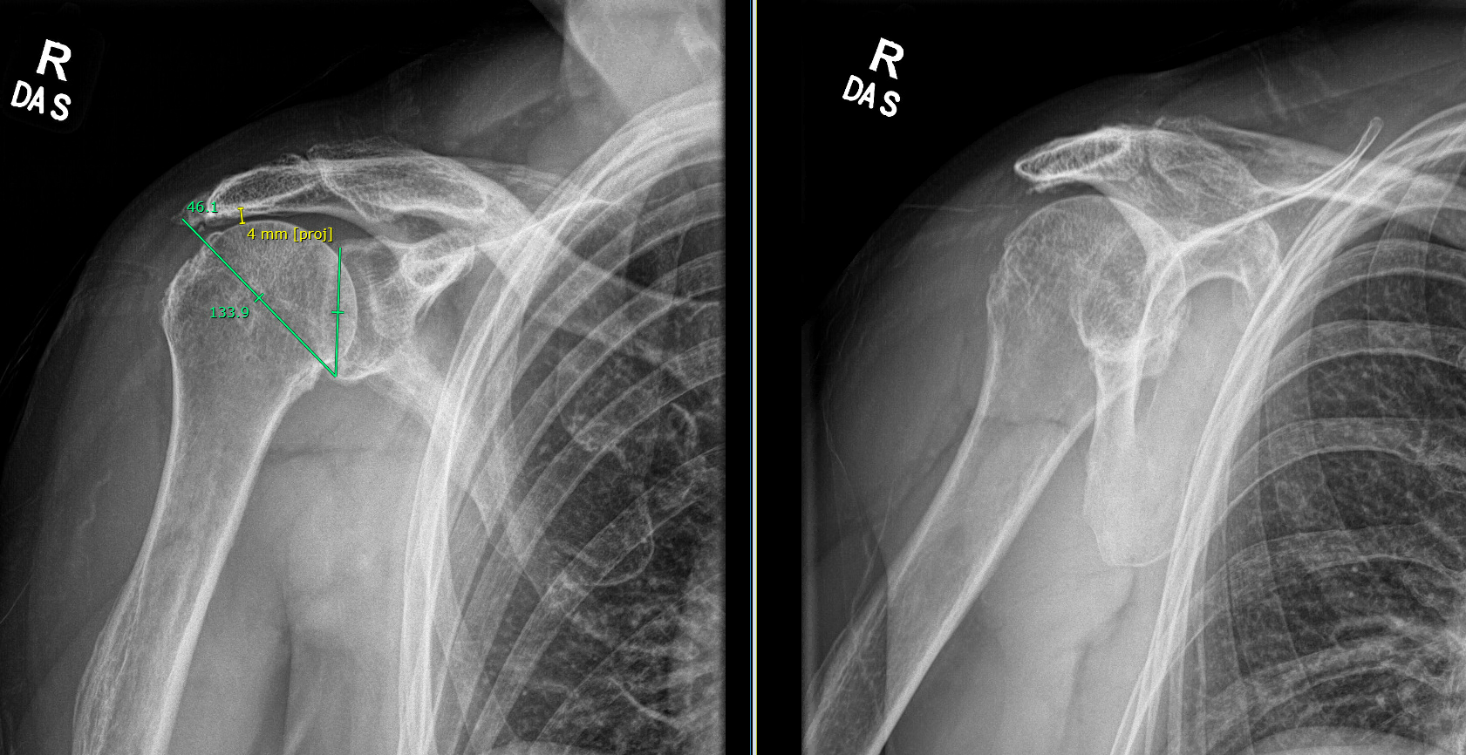
X ray RIGHT preoperative

Slide 5
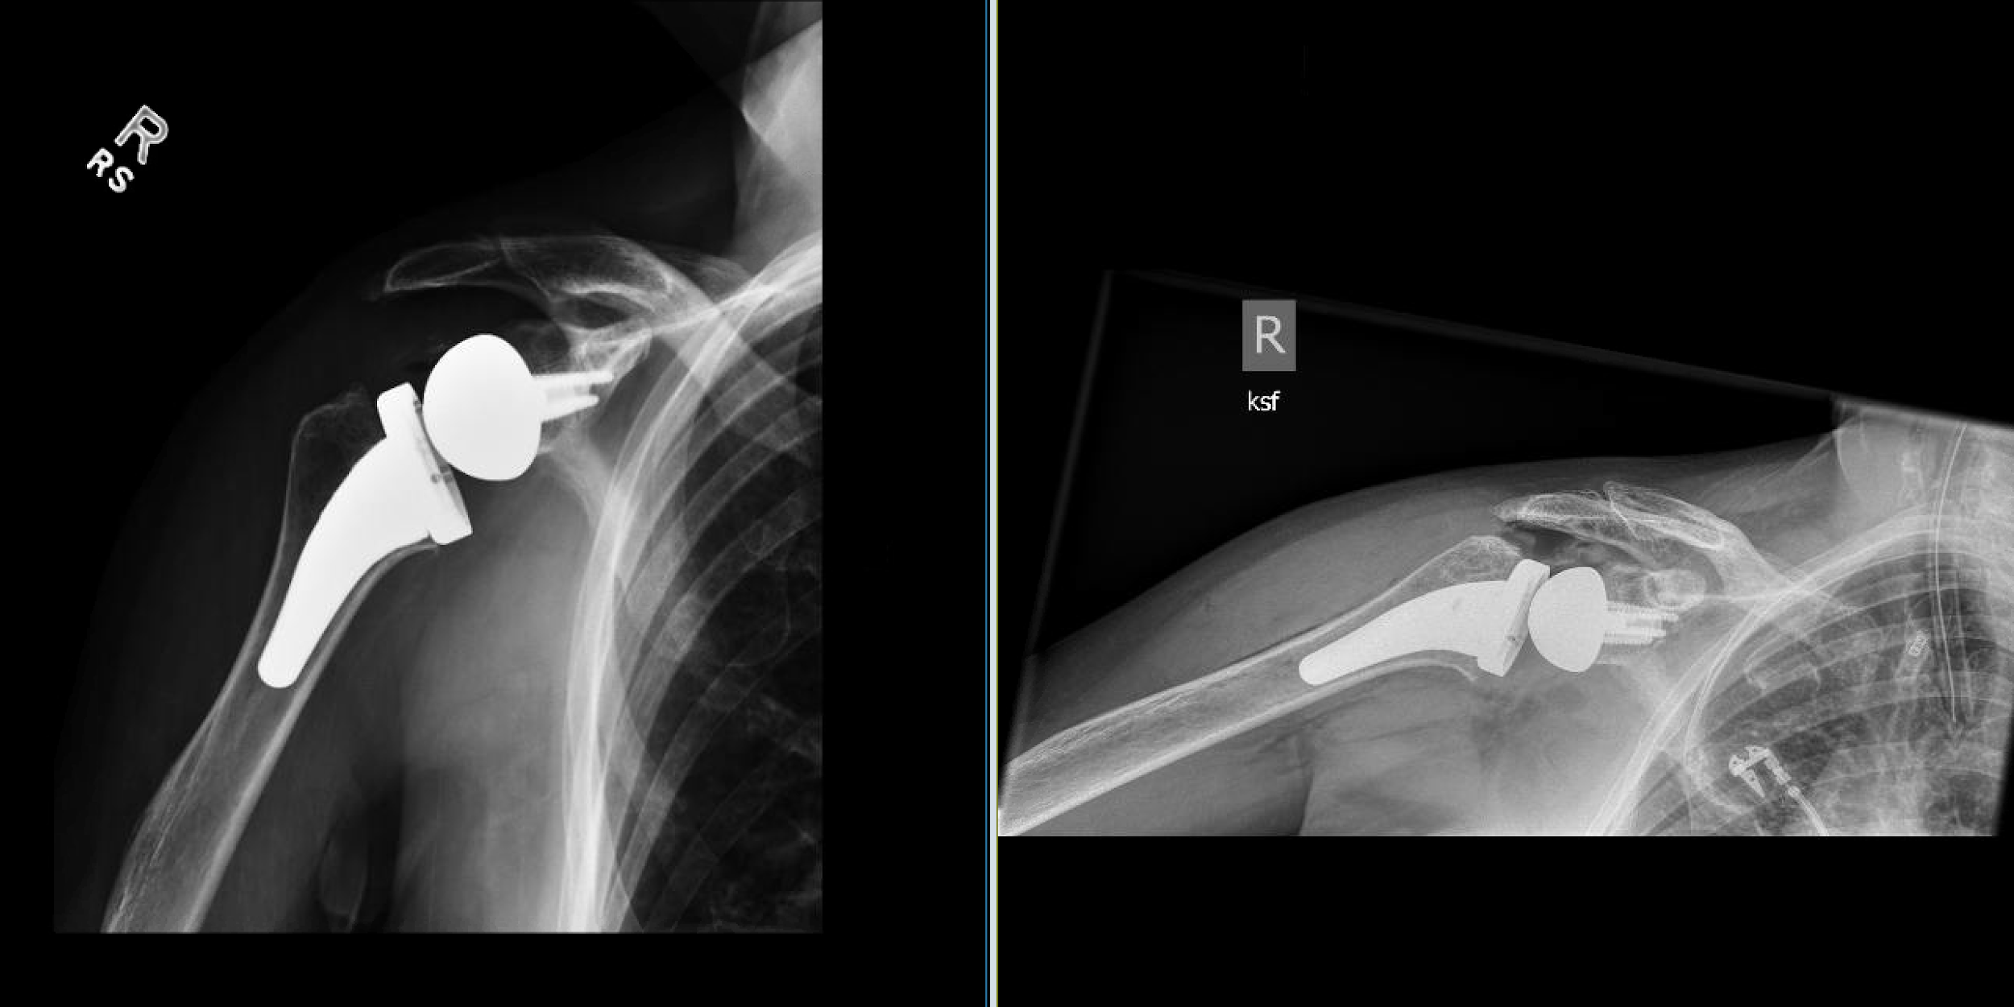
10 days postoperative

Slide 6
RTSA Implant used:
1. Preoperative virtual surgical planning with creation of patient-specific guide and 3D printed surrogate model of the glenoid.
2. Aequalis Reversed II glenoid baseplate, 25 mm long post with autogenous intercalated bone graft reconstruction (7mm superior and 7mm posterior graft) of the glenoid.
3. Aequalis Reversed centered glenoid sphere, 36 x 25 mm.
4. Ascend Flex standard press fit stem, 3B.
5. A 0 mm high eccentricity tray.
6. A 36 x 6 mm polyethylene insert.

Slide 7
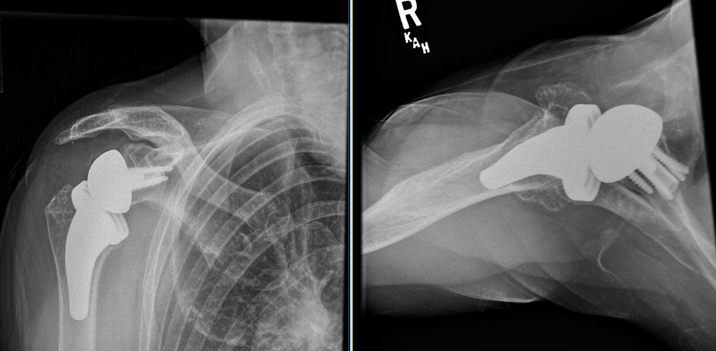
4 months postopertive

Slide 8
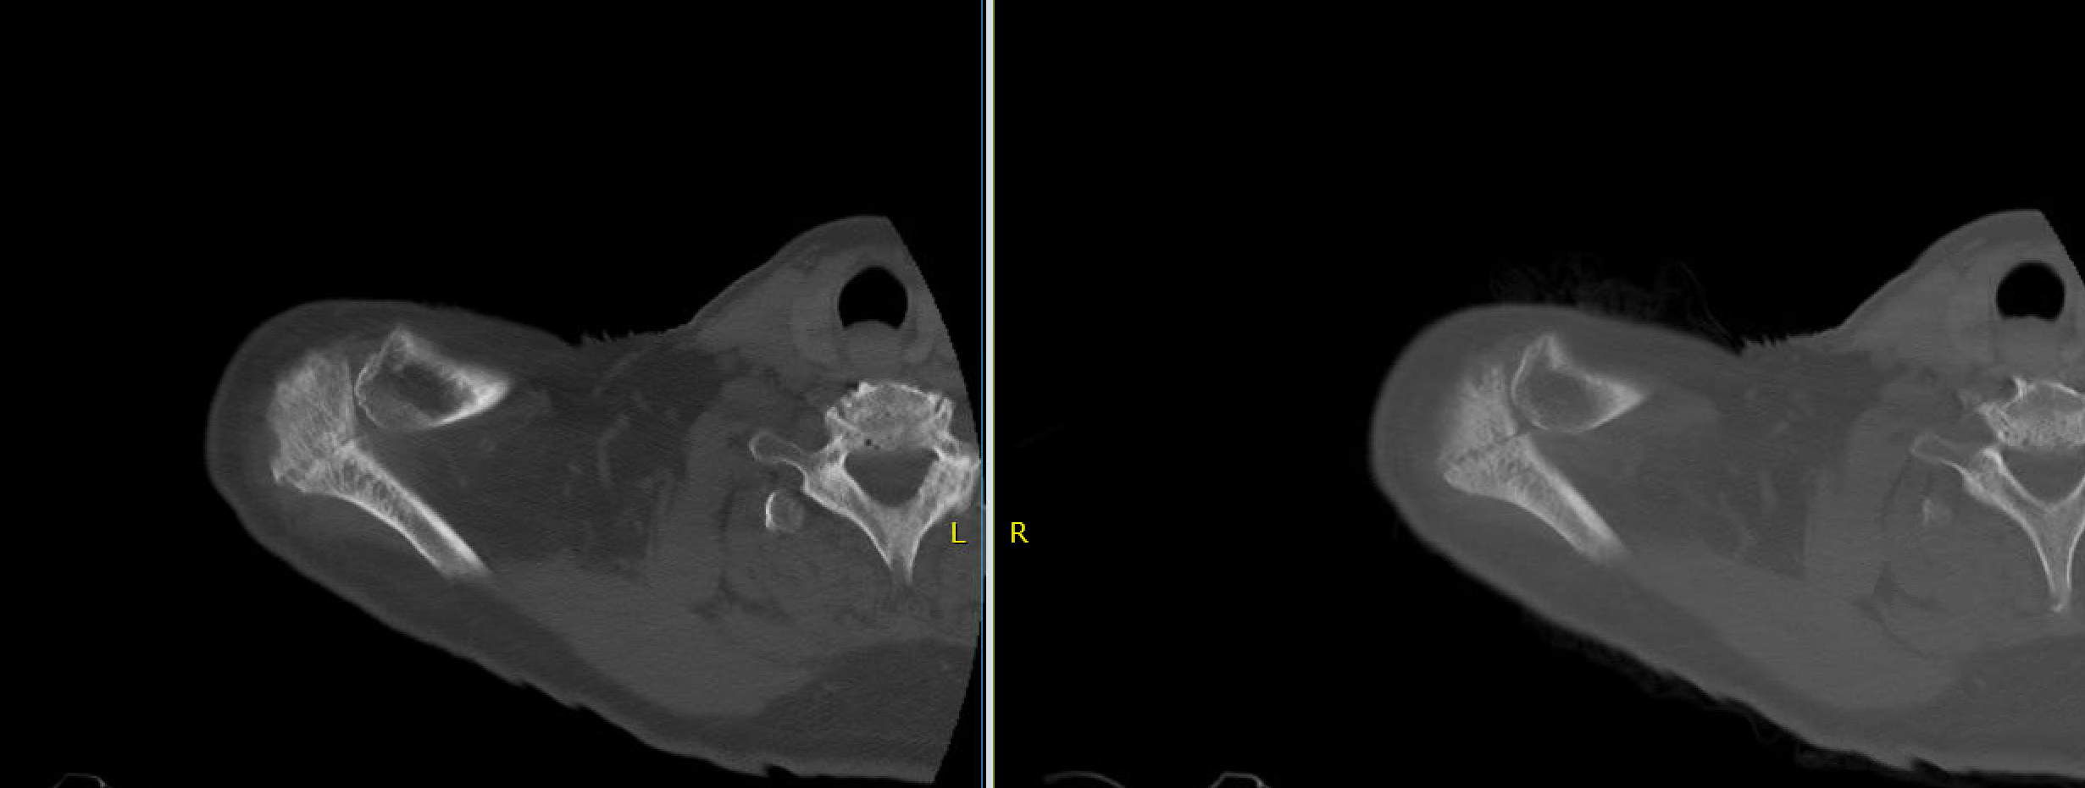
CT 4 months postoperative

Slide 9
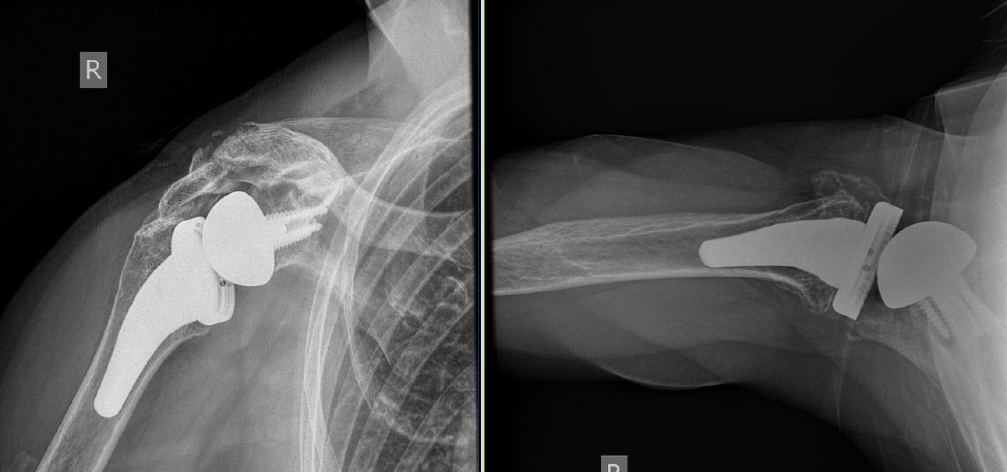
10 months postoperative - secondary displacement

Slide 10
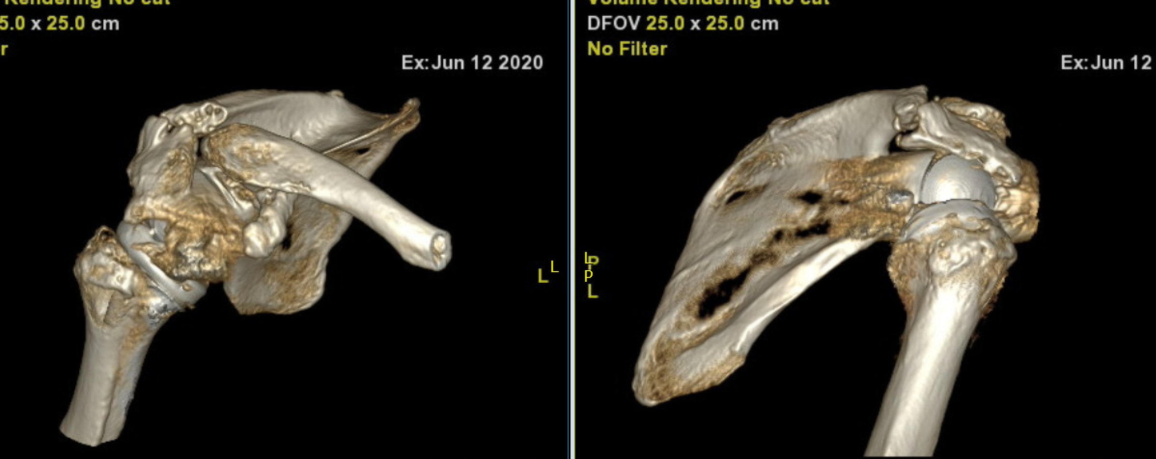
CT reconstruction anterior and lateral view 10 months postoperative - collapse of acromial stress fx

Slide 11
Treatment?

