Slide 1
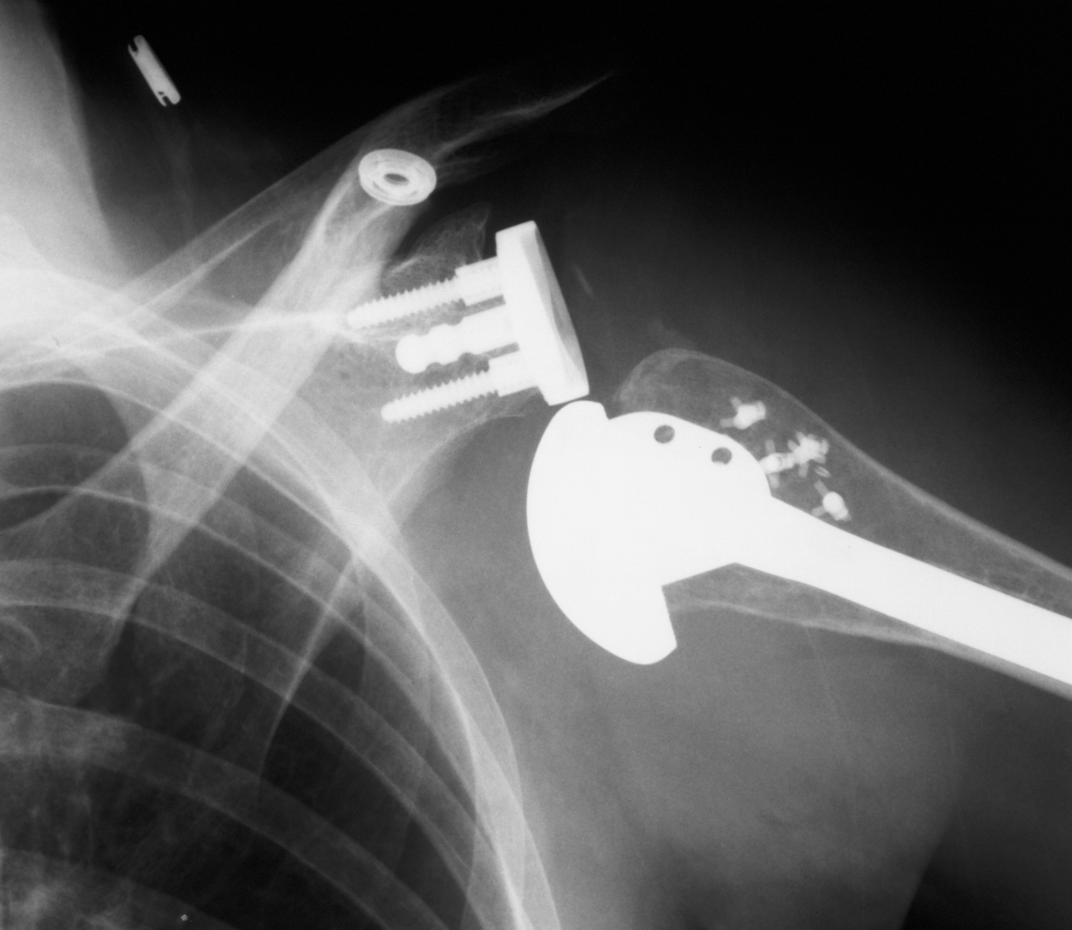
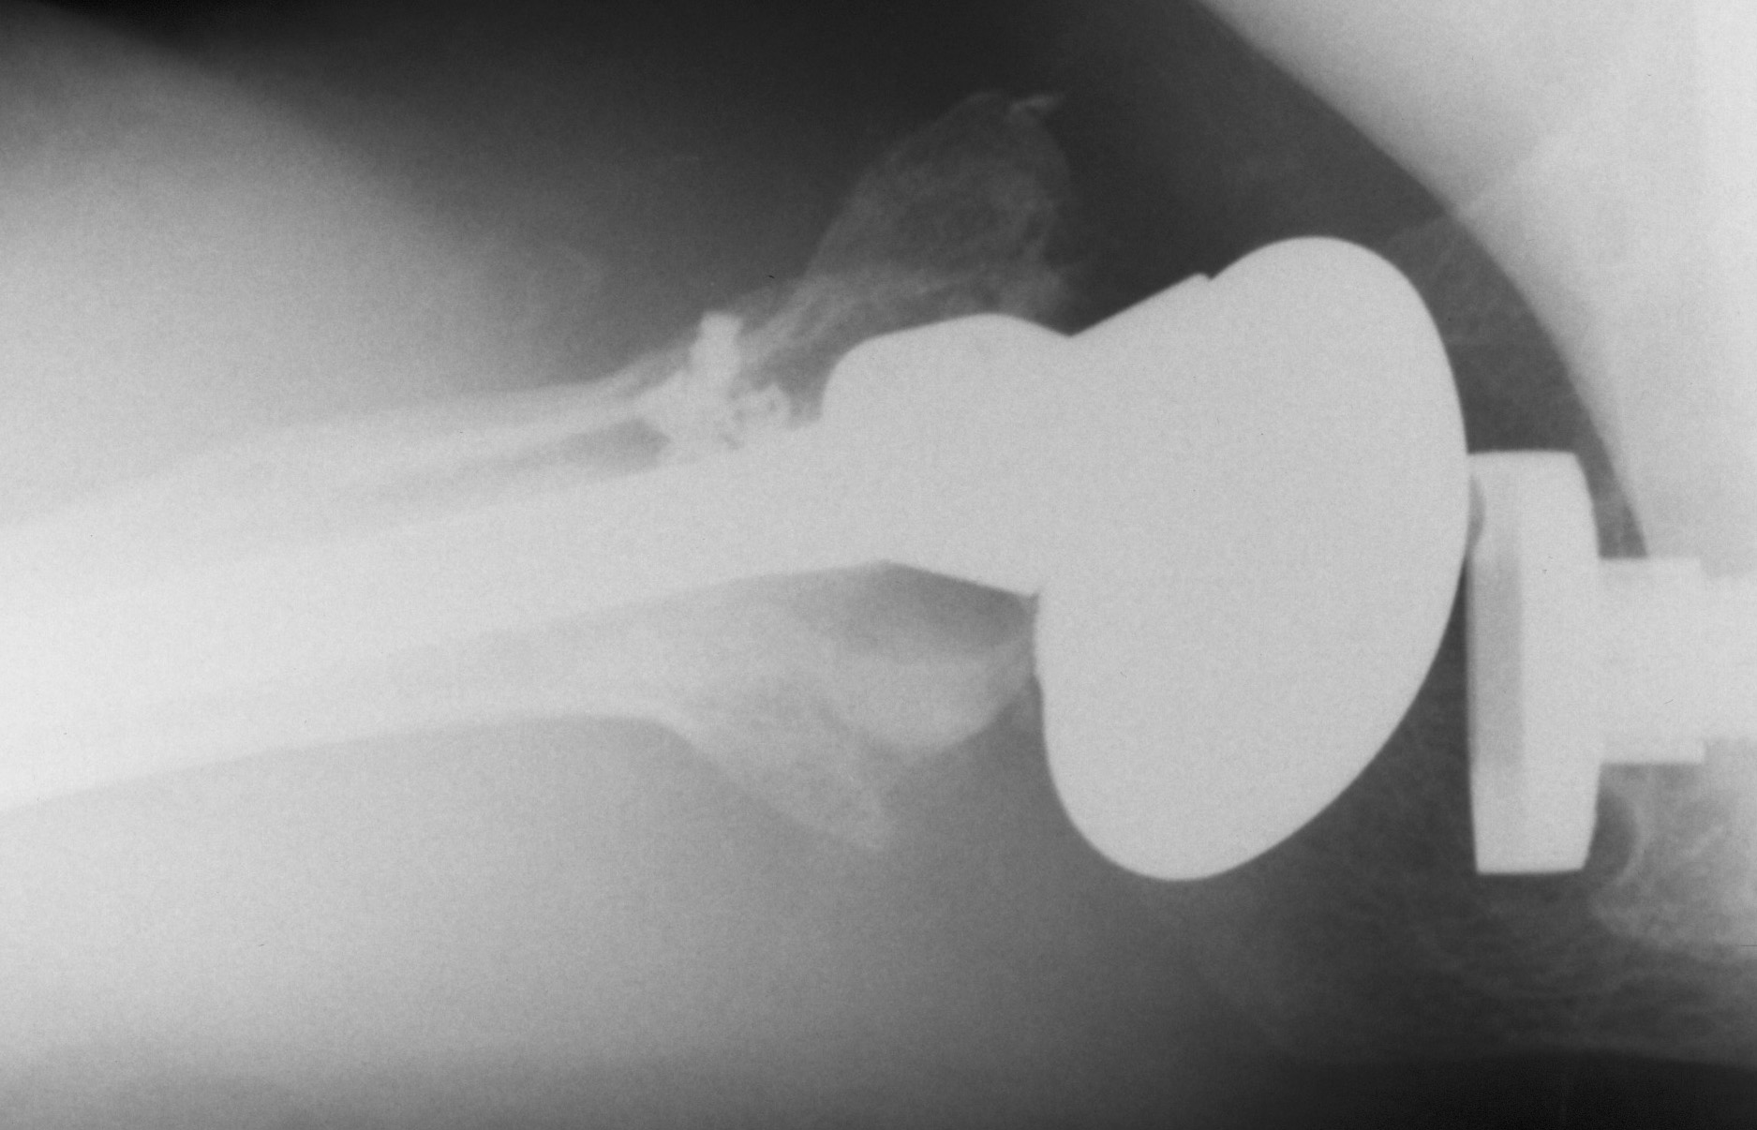
Case: Metal Back TSA in a 52 yo
1 year ago underwent TSA for AVN (1999) in NYC…then moved to Boston and presented
To the EW with this xray….
What do you see?
What would you do?
Post-reduction

Slide 2
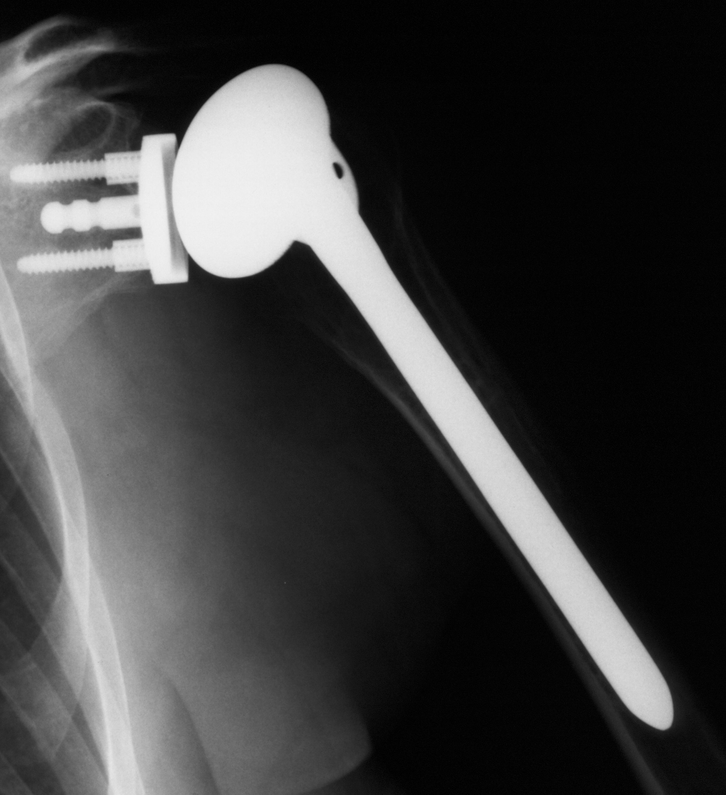
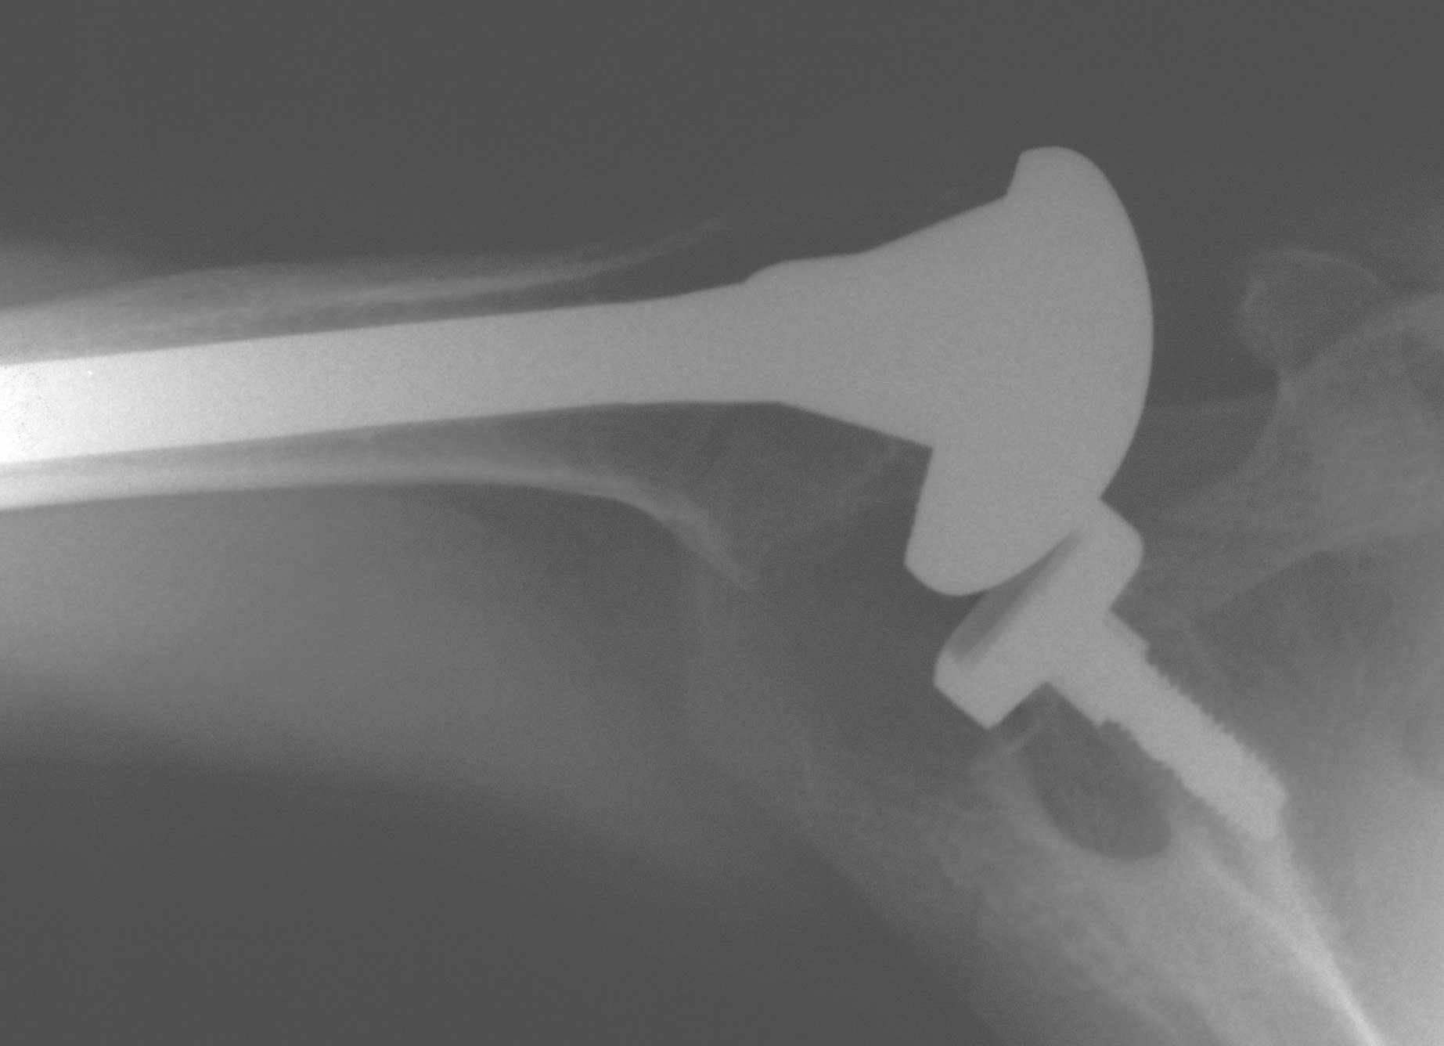
PEx
Increased ER
Weak ER
Positive Belly-press test
- It is 1999….No reverse prosthesis
- She is 39 yo

Slide 3
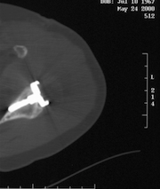
Well fixed metal glenoid
Poly fracture
Subscapularis insufficiency….

Slide 4
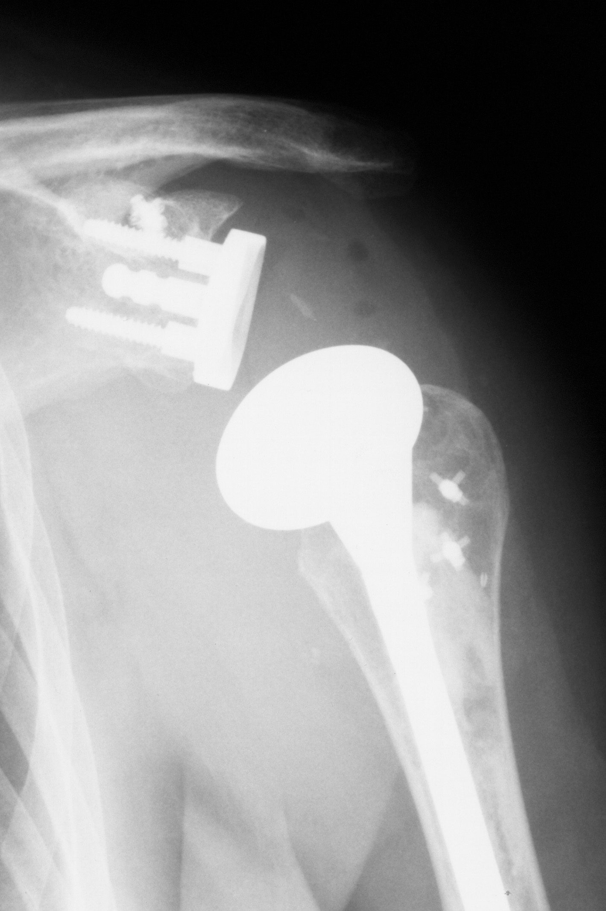
Reverse was not available in
1999 and she is 39yo
Now
What?
Poly was fractured
Well fixed stem & glenoid
Poly exchange
Pectoralis major transfer

Slide 5
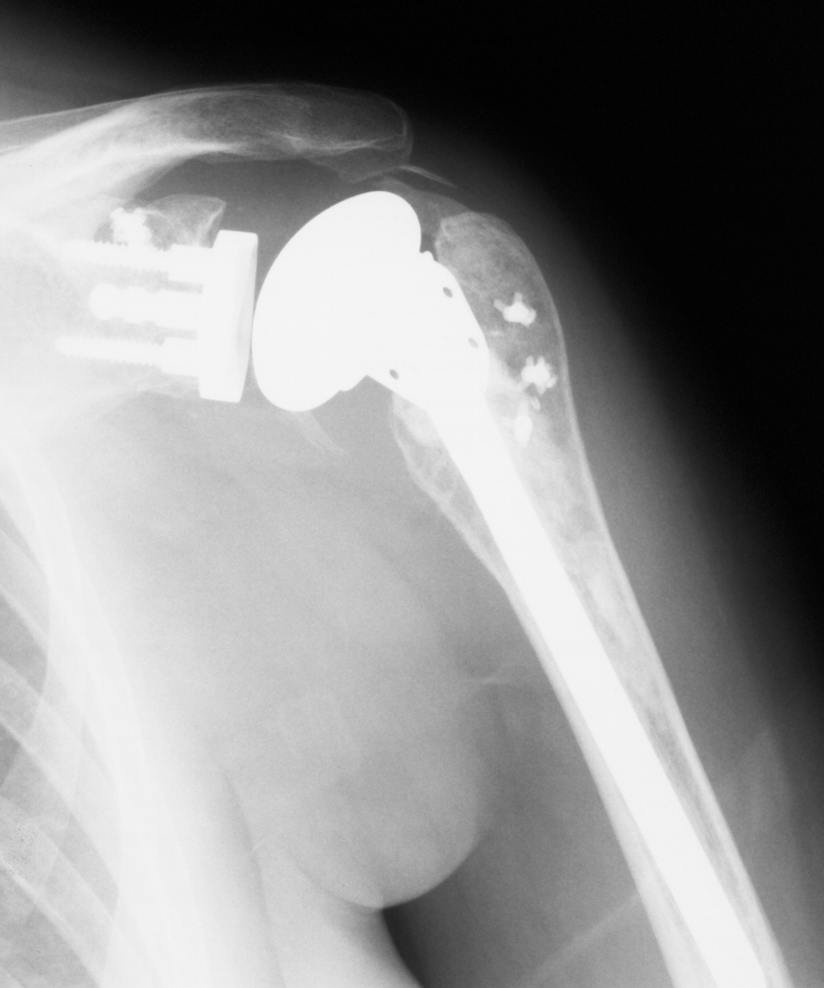
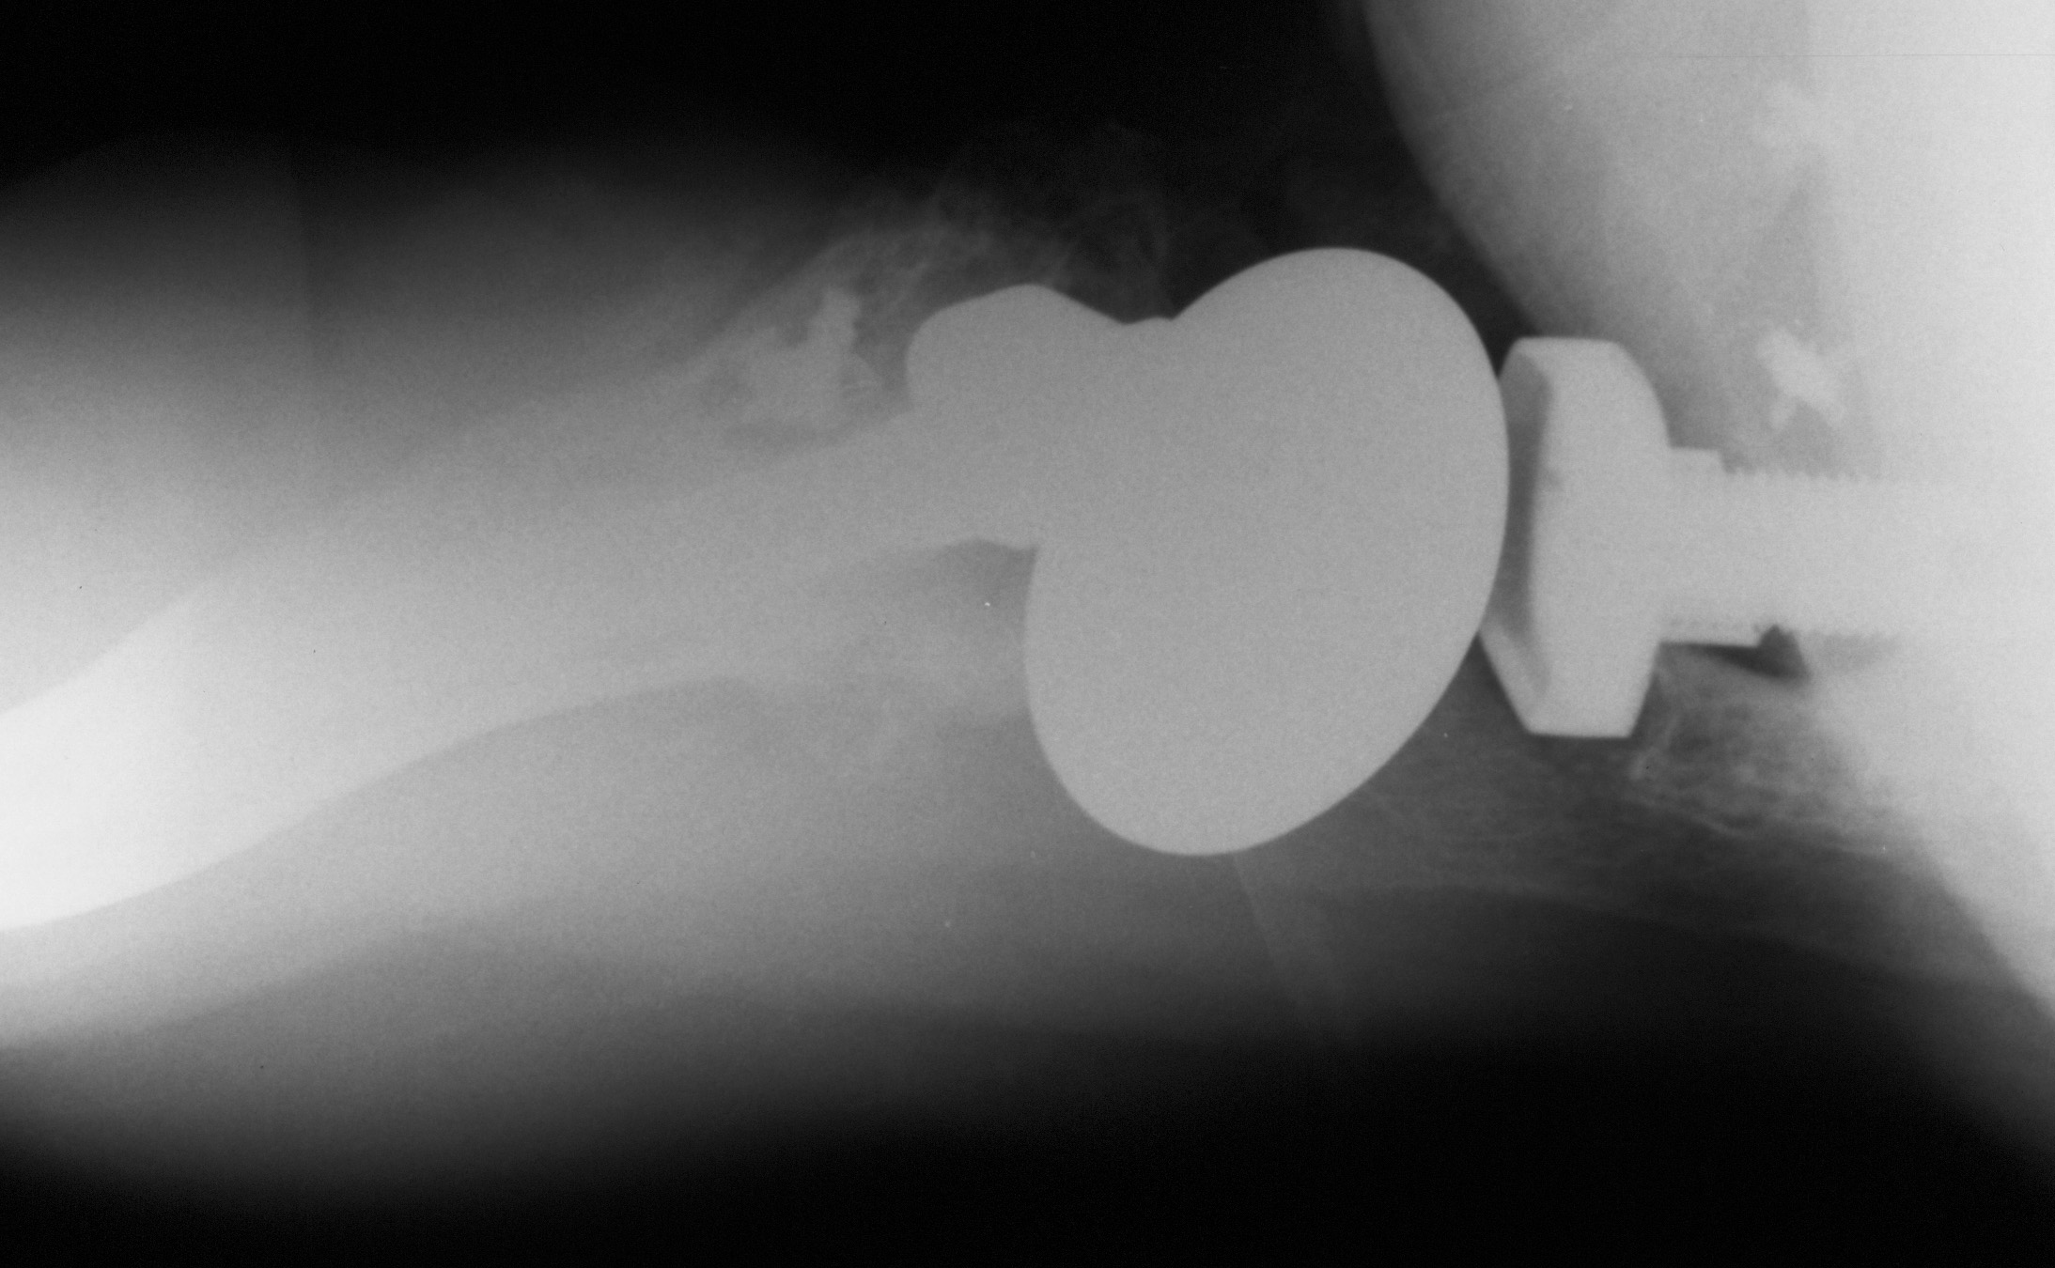
Latarjet placing Coracoid medial
To glenoid…screw broke…revised
At surgery to anchor fixation &
Sutures….
Q1: Will it work?
Q2: How long will it last?

Slide 6
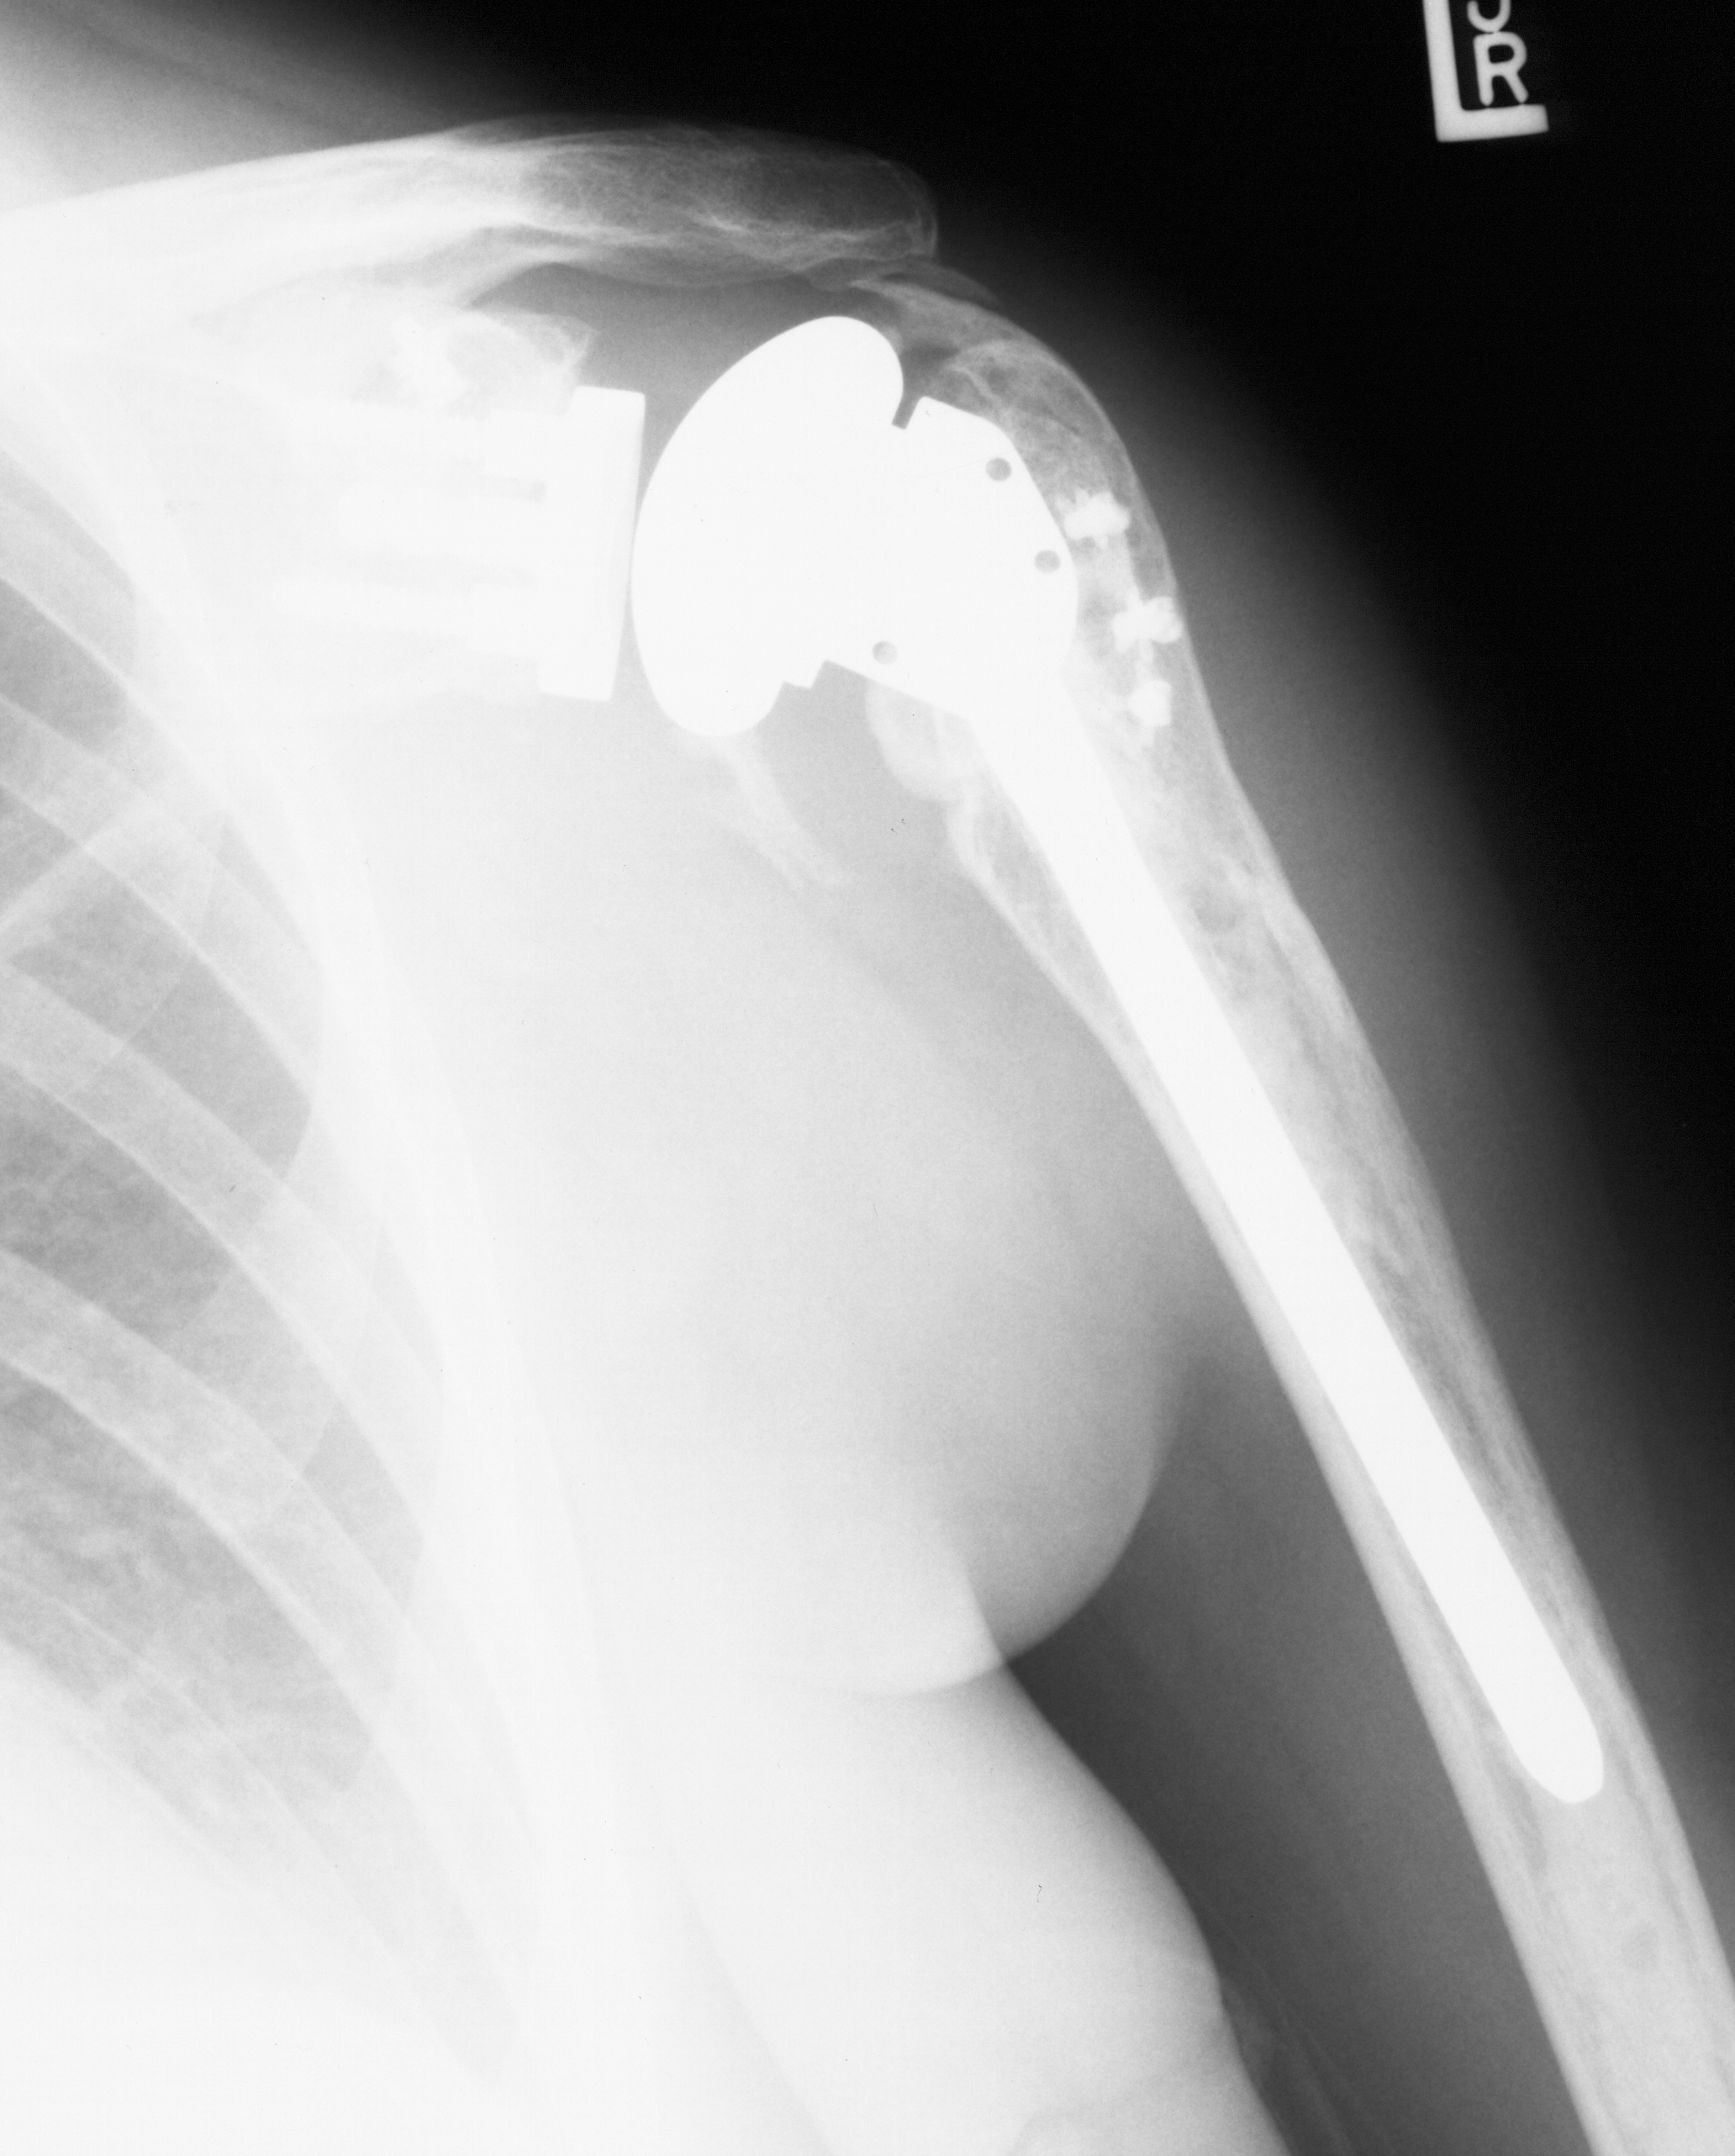
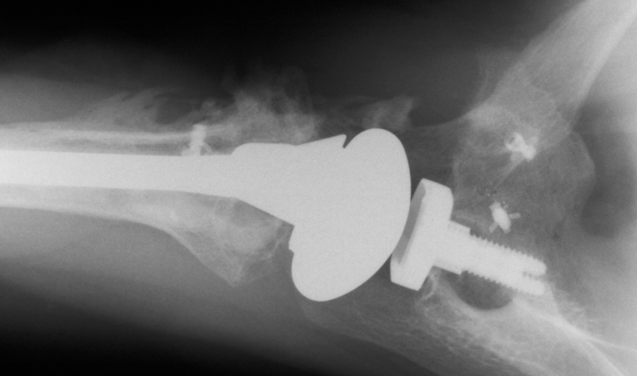
2 years postop, 2001,
Feels well, SSV = 80%
AFF = 120^{O}
AER = 30^{O}
Belly Press Positive

Slide 7
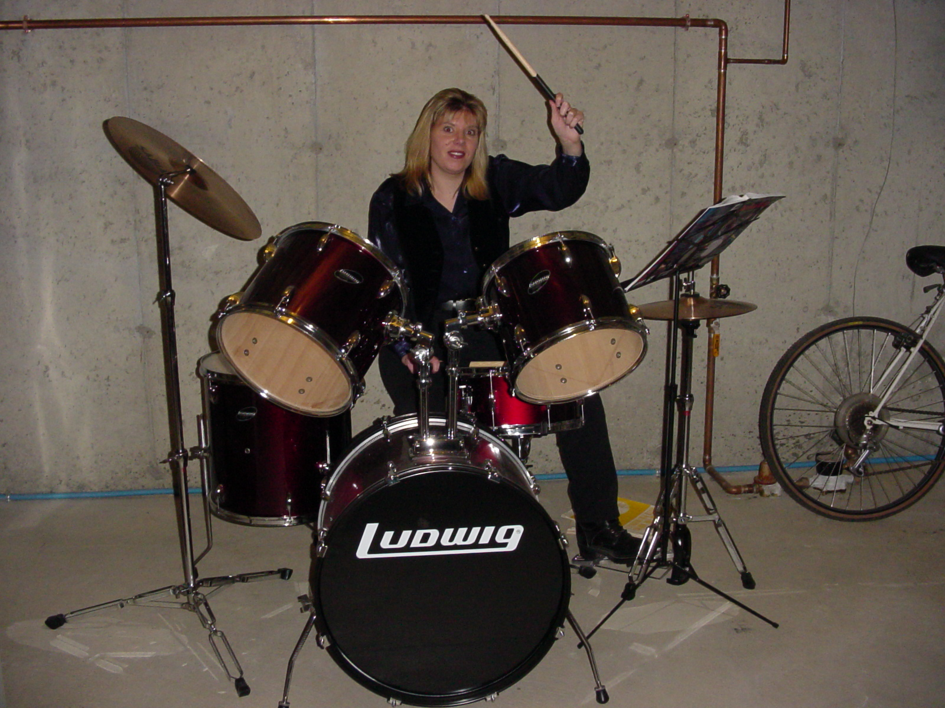
Operative side
3-Years postop

Slide 8
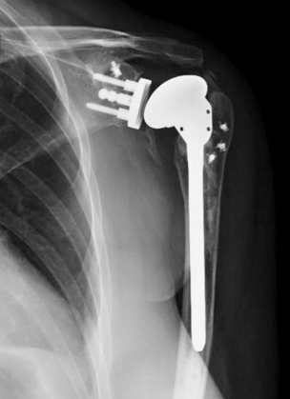
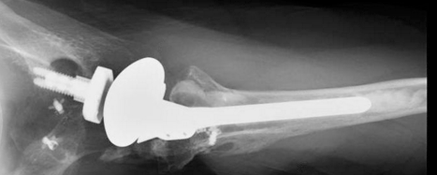
8-years postop (2007)
Pain = 0-2/10
SSV = 80%
Has a 4 yo daughter now
AFF = 120^{O}; AER = 20^{O}
ABD = 90^{O} & can put hand behind her head
AIR = T-10

Slide 9
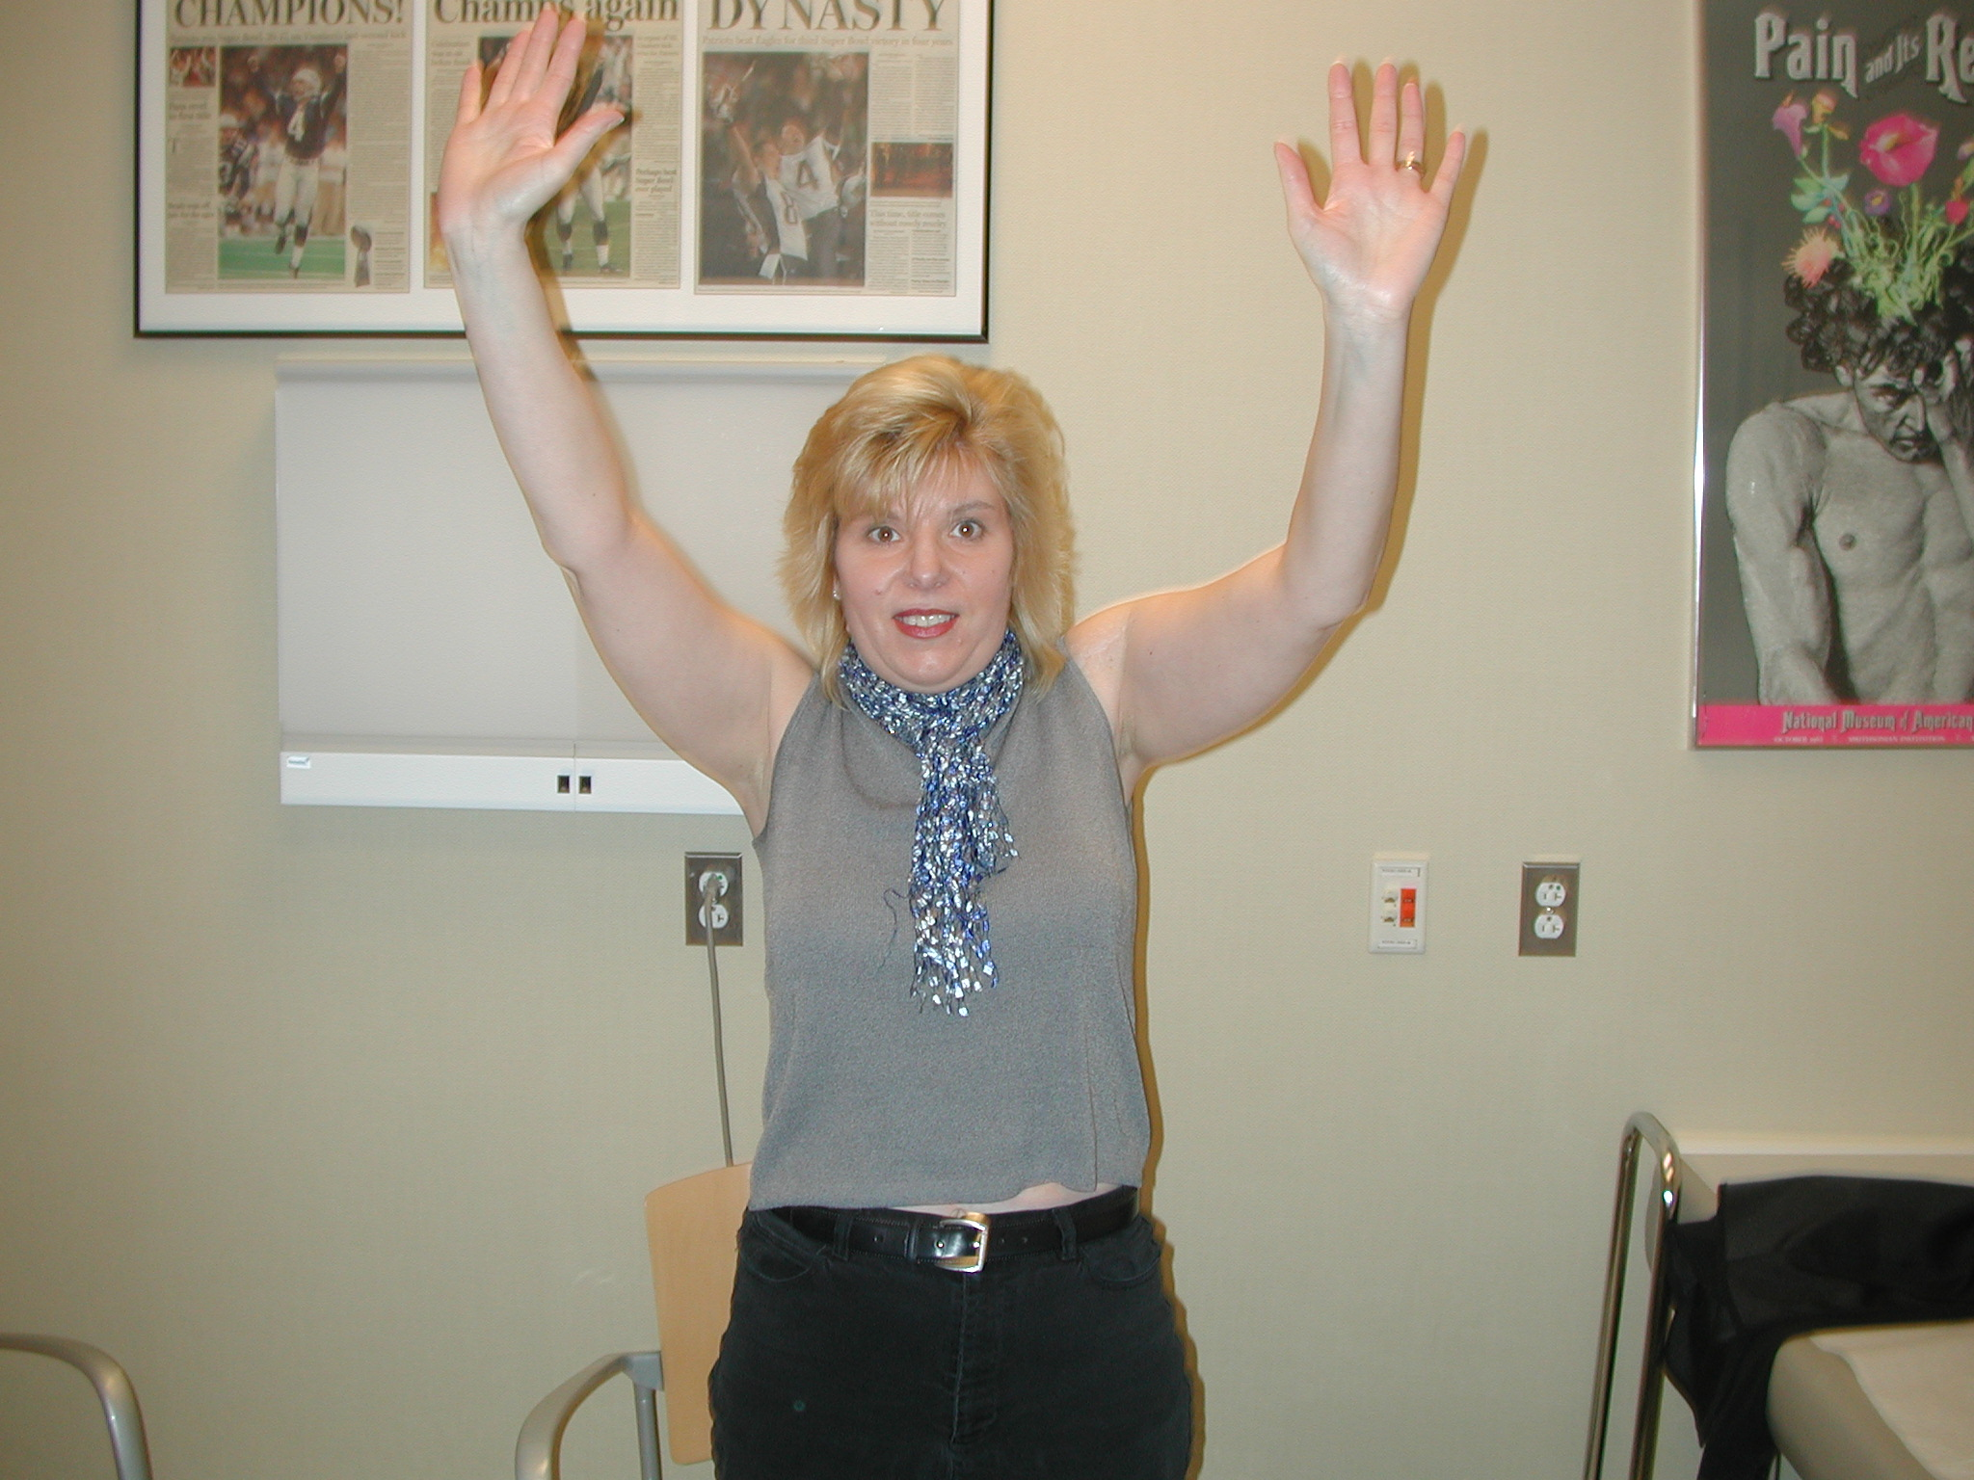
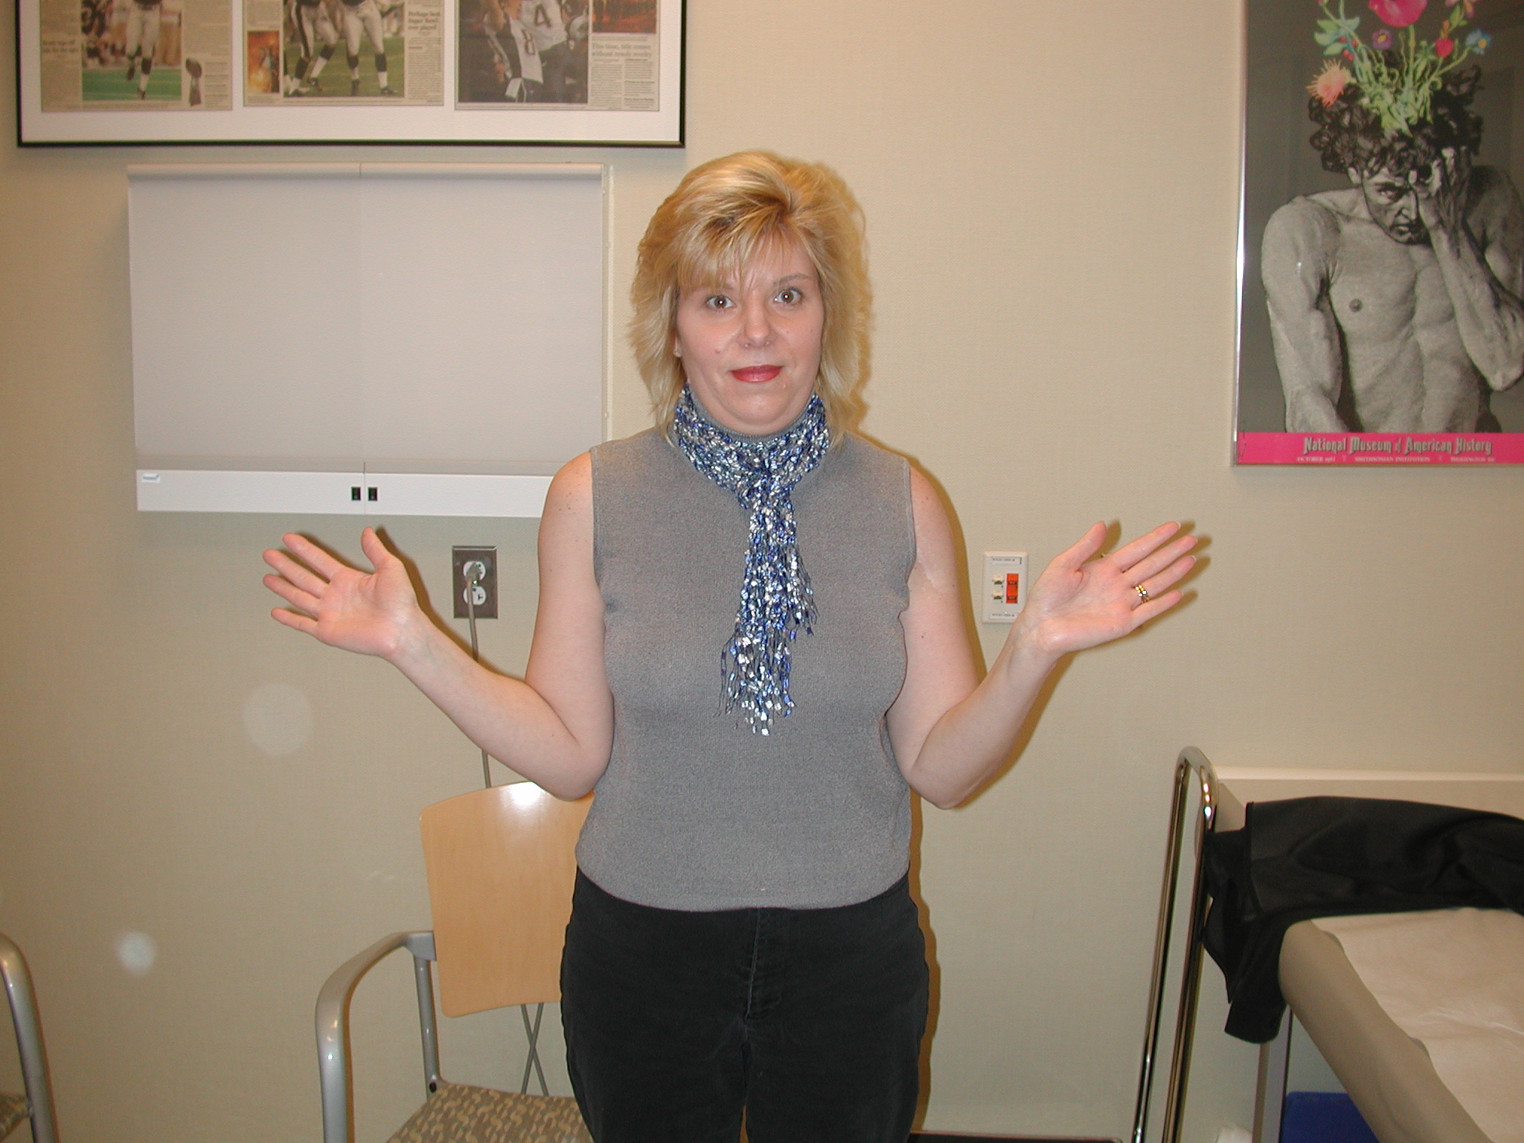
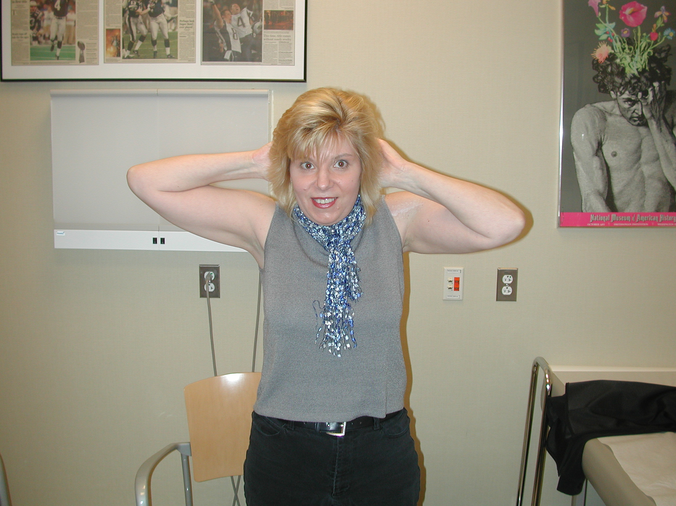
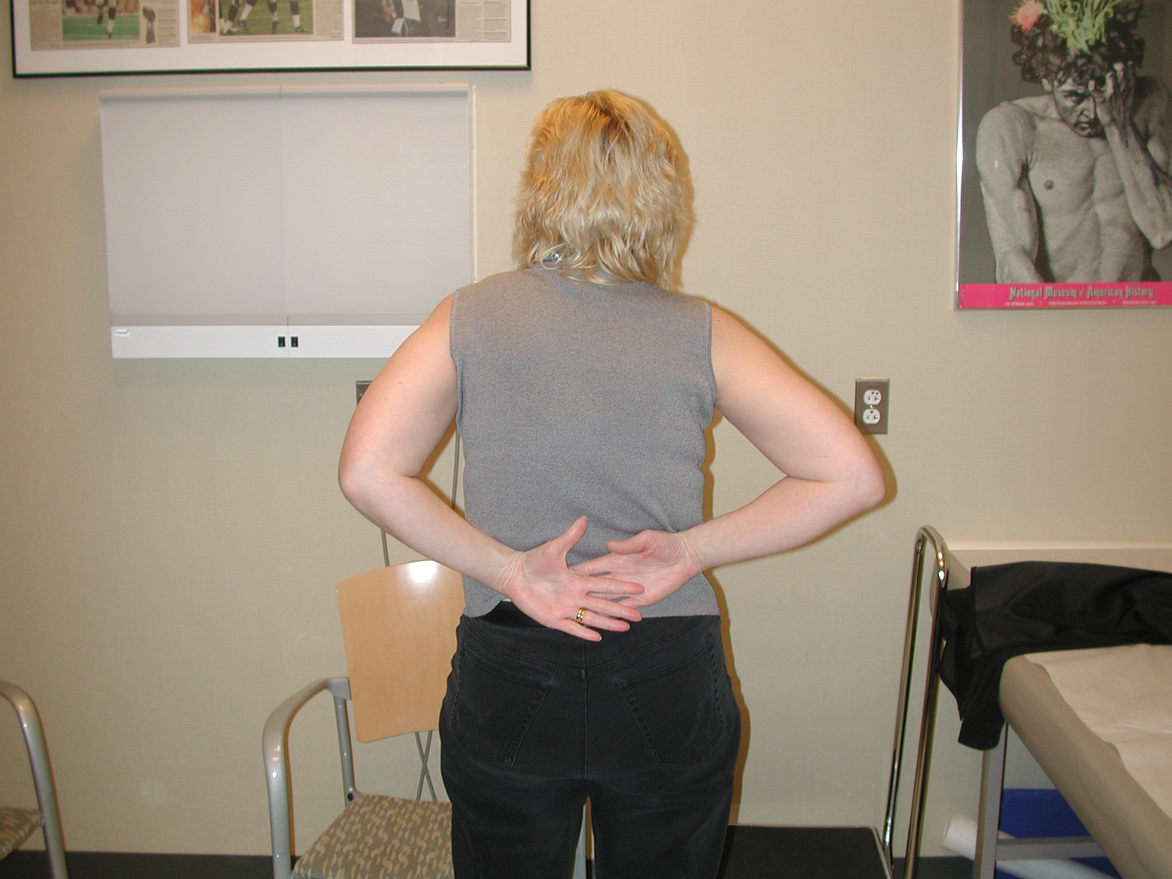

Slide 10
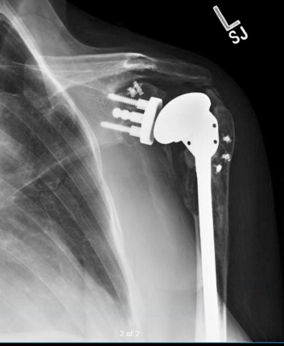
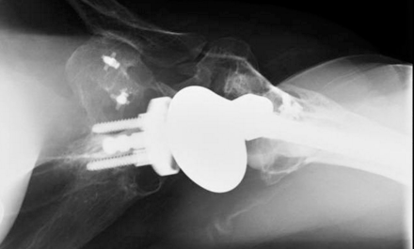
Postop 12 years (2011)
“Occasional aching” (0-3/10)
SSV = 80%
AFF = 120^{O}; AER = 30º; AIR = T-12

Slide 11
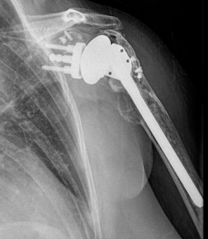
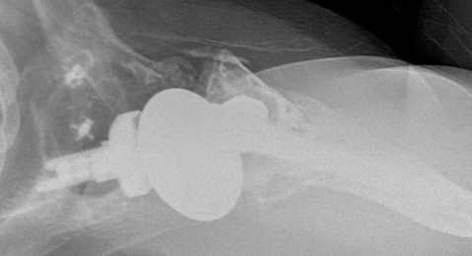
Postop 15 years (2014)
…SHE IS NOW 54yo
Pain 4-5/10
SSV = 70%
AFF = 120^{O}; AER = 30^{O}; AIR = L1
ER Lag sign = 30º; Weak ER!

Slide 12
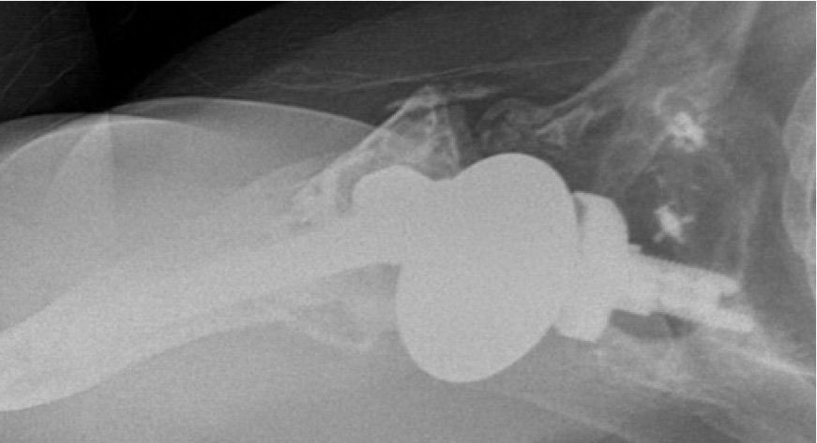
2008
Poly Wear?
2004

Slide 13
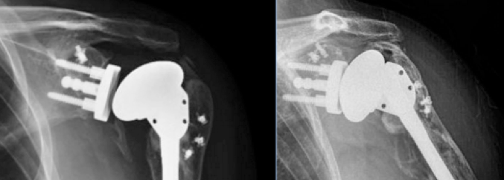
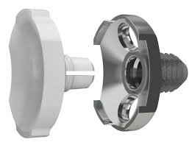
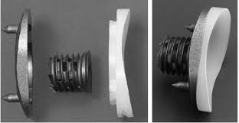
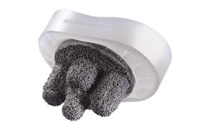
2008
2014
Poly wear????
Osteolysis

Slide 14
Patient was last seen in 2014 and she was having some pain, but tolerable and not affecting her activities of daily living.

Slide 15
2019 patient returns…
Rates her shoulder at 40-50% of normal
Pain ranges from 8-9
Forward flexion 80 degrees
External Rotation 10 degrees

Slide 16
2014 x rays
2019 x rays

Slide 17
2014 x rays
2019 xrays

Slide 18
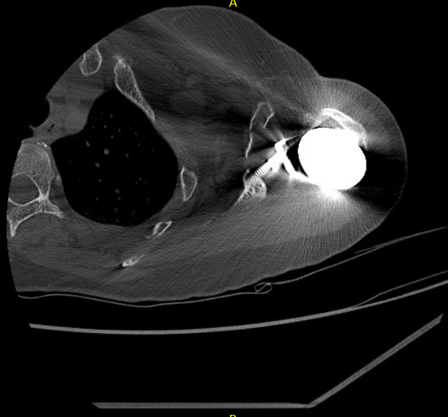
2019 CT scan

Slide 19
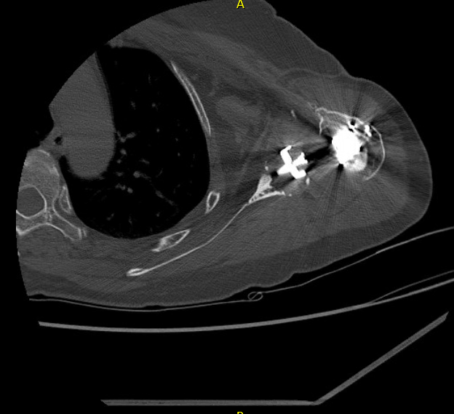

Slide 20
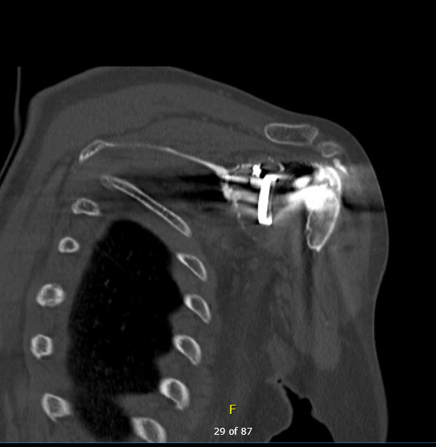

Slide 21
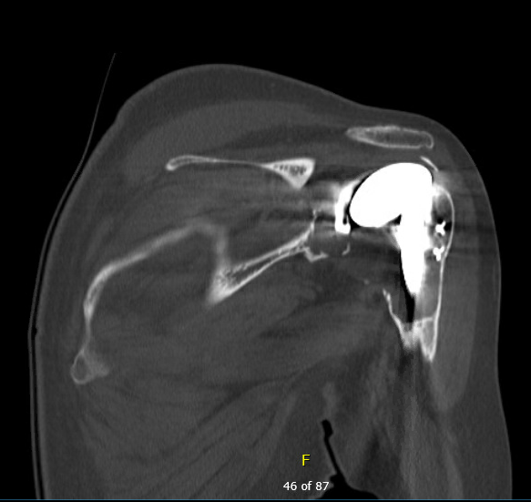

Slide 22
What is the next step…

