Slide 1
History
60 y/o M, small business owner
1 ppd smoker, daily alcohol use
PSHx/PMHx: HT, HL, CAD s/p MI and stenting
Presents with atraumatic RIGHT shoulder pain since 2012. Has continued pain
2012: Pain attributed to cervical radiculopathy → Underwent ACDF C5-C7 → Posterior fusion → No improvement
7/30/2014: Arthroscopic RCR
10/6/2014: Re-tore RC → Revision RCR → No improvement
11/25/2014: Aspiration → No infection/No improvement
4/13/2015: RSA (+ antibiotic treatment) → No improvement
6/6/2016: Explant and spacer (+ antibiotic treatment)
9/1/2016: Revision RSA → Culture grew Staph Lugdinensis → Treated with antibiotics → No improvement
5/2/2017: Subacromial corticosteroid injections (partial relief for few hrs)
6/19/2017: C3-C5 medial nerve branch block (no pain relief)
7/12/2017: Aspiration → No infection → No improvement
8/28/17: Botox injection (no pain relief)
Has tried extensive PT
No metal allergy
Pt takes Norco 10/325 3x/day

Slide 2
Exam
Lateral pain, made worse with reaching overhead and movement. Pain is made better with arm at side.
Rest: 7/10 pain; Worst: 8/10
SSV: 40%
Cervical spine shows full range of motion, no tenderness, (-) Spurling’s
Physical Exam:
Flexion: 45/135 (no lag)
External rotation @ neutral: 45/60 (no lag)
Internal rotation @neutral: sacrum
Supraspinatus strength: 3/5 | Infraspinatus strength: 4/5
(-) Impingement signs, (+) Belly press, (-) O’Brien’s sign, (-) Speed’s sign, (-) Apprehension, (-) Posterior instability

Slide 3
CT Report: Significant for no obvious component loosening, fractured osteophyte at inferior aspect of glenoid, supraspinatus atrophy

Slide 4
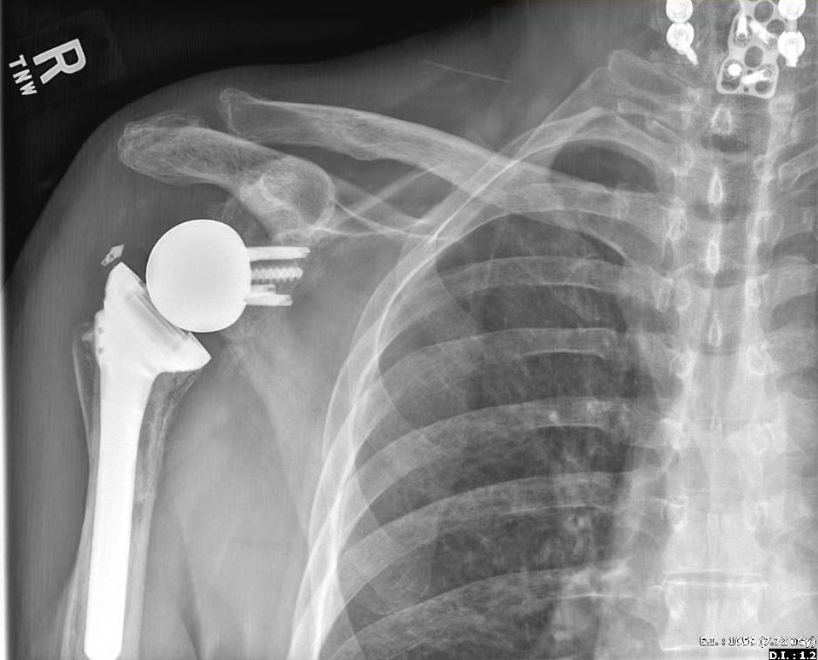
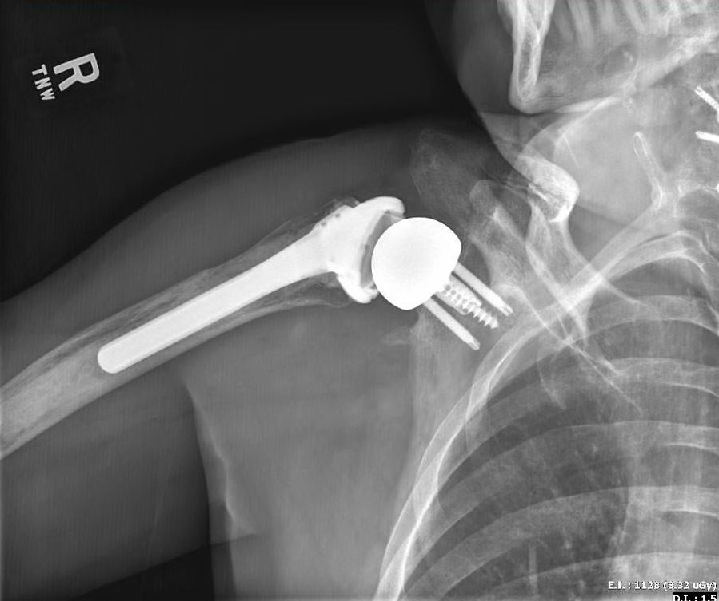

Slide 5
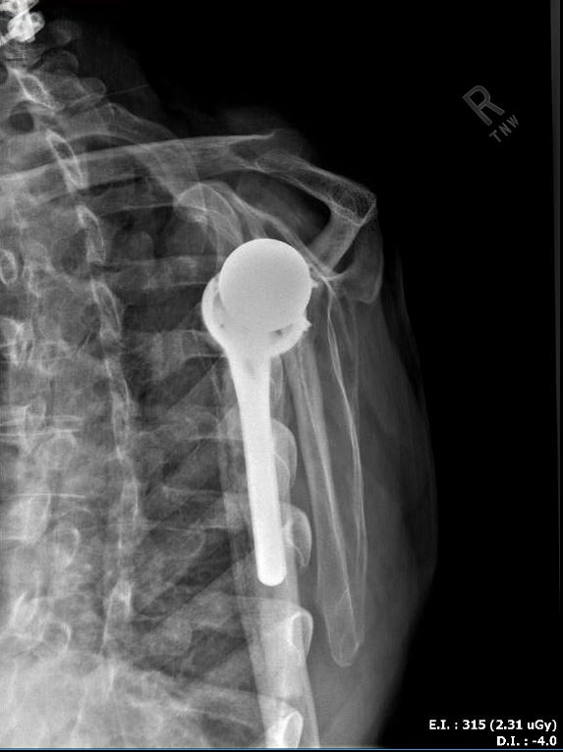
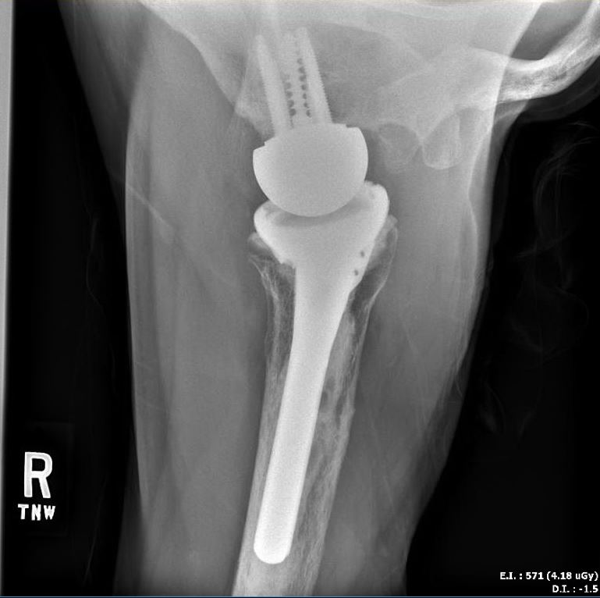

Slide 6
Assessment/Plan
Pt has continued R shoulder pain and a history of prosthetic joint infections. Pain with passive ER at neutral abduction is suggestive of mechanical etiology
Plan????
EUA with fluoroscopy to determine mechanical cause of symptoms
Arthroscopic biopsy and assessment of implant stability

