Slide 1
65 yo M RHD Engineer.
Oct 2020: RT shoulder arthroscopic rc repair (Sps, Upper Sbs, biceps tenodesis) October 2020.
1 month postoperative (Nov. 2020): +Redness anterior shoulder, ++ swelling anterior portal. Purulence.
Taken to OR by surgeon for Superficial wound irrigation debridement/drain placement in OR on Nov. 2020.
Surgeon did not enter subacromial space or joint.
Intraop. Cultures: + MSSA (Staph).
Treated 6 weeks IV Antibiotics.

Slide 2
Persistent pain in right shoulder with limited motion recovery.
6 months Postop, April 2021: Rt shoulder Mild redness anterior shoulder. Minimal Swelling. + Pain with ROM.
ESR 130, CRP 12

Slide 3
April 2021: Referred to me.
PE: Rt shoulder: Mild redness/swelling anterior portal.
Arom FF to 70 deg, Passive to 90 deg.
ER adducted to 10 deg. Active and passive
Painful arc.
Strength 4- Abduction and ER.

Slide 4
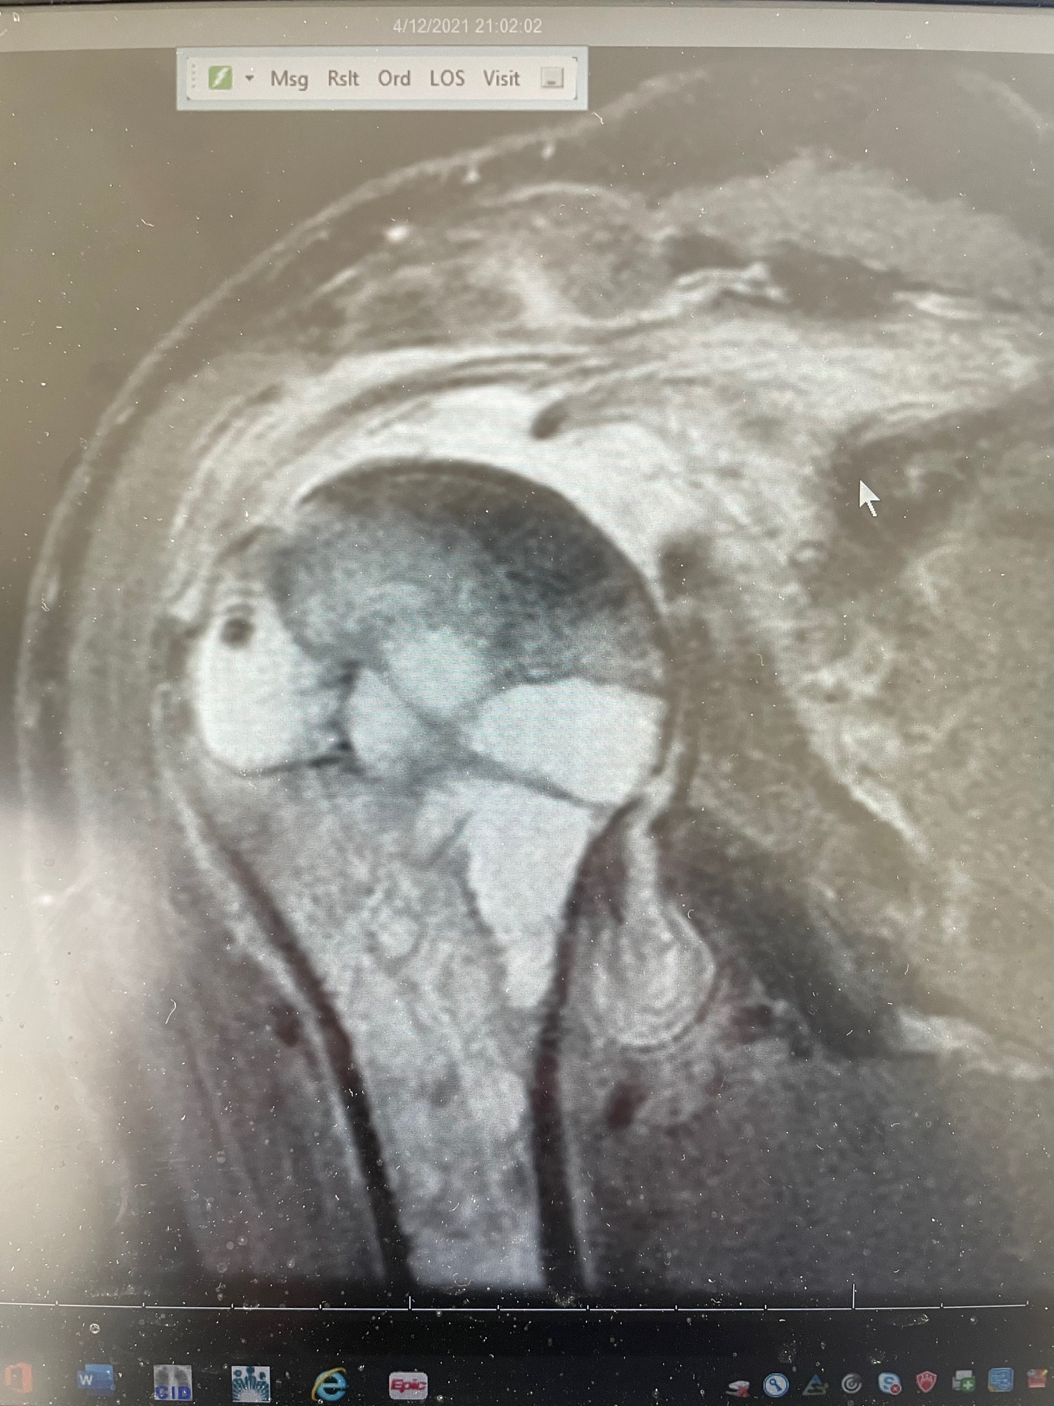
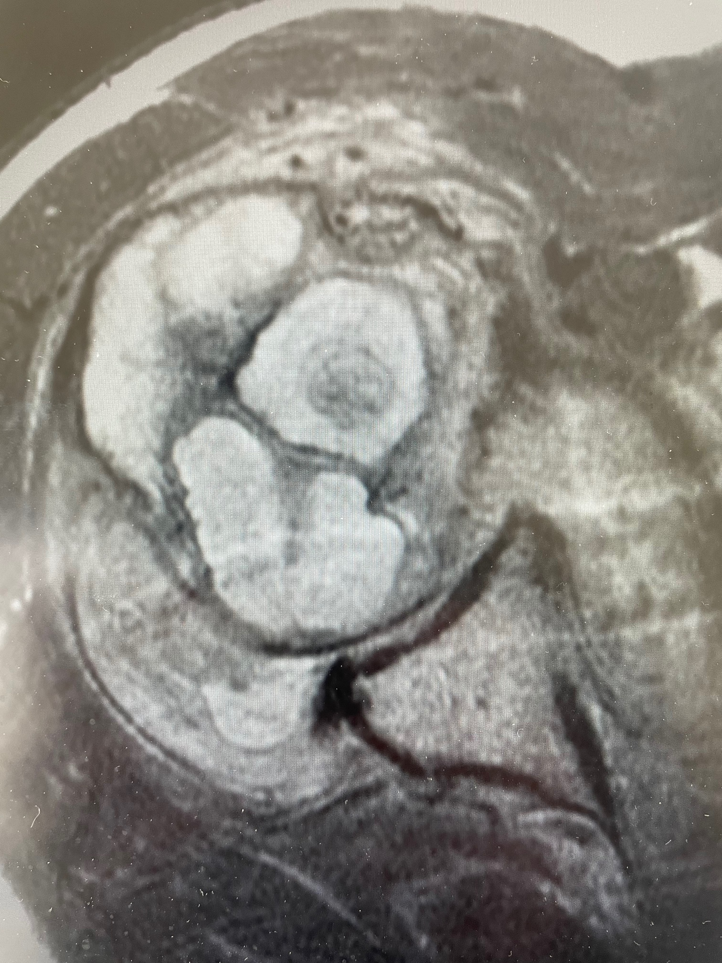
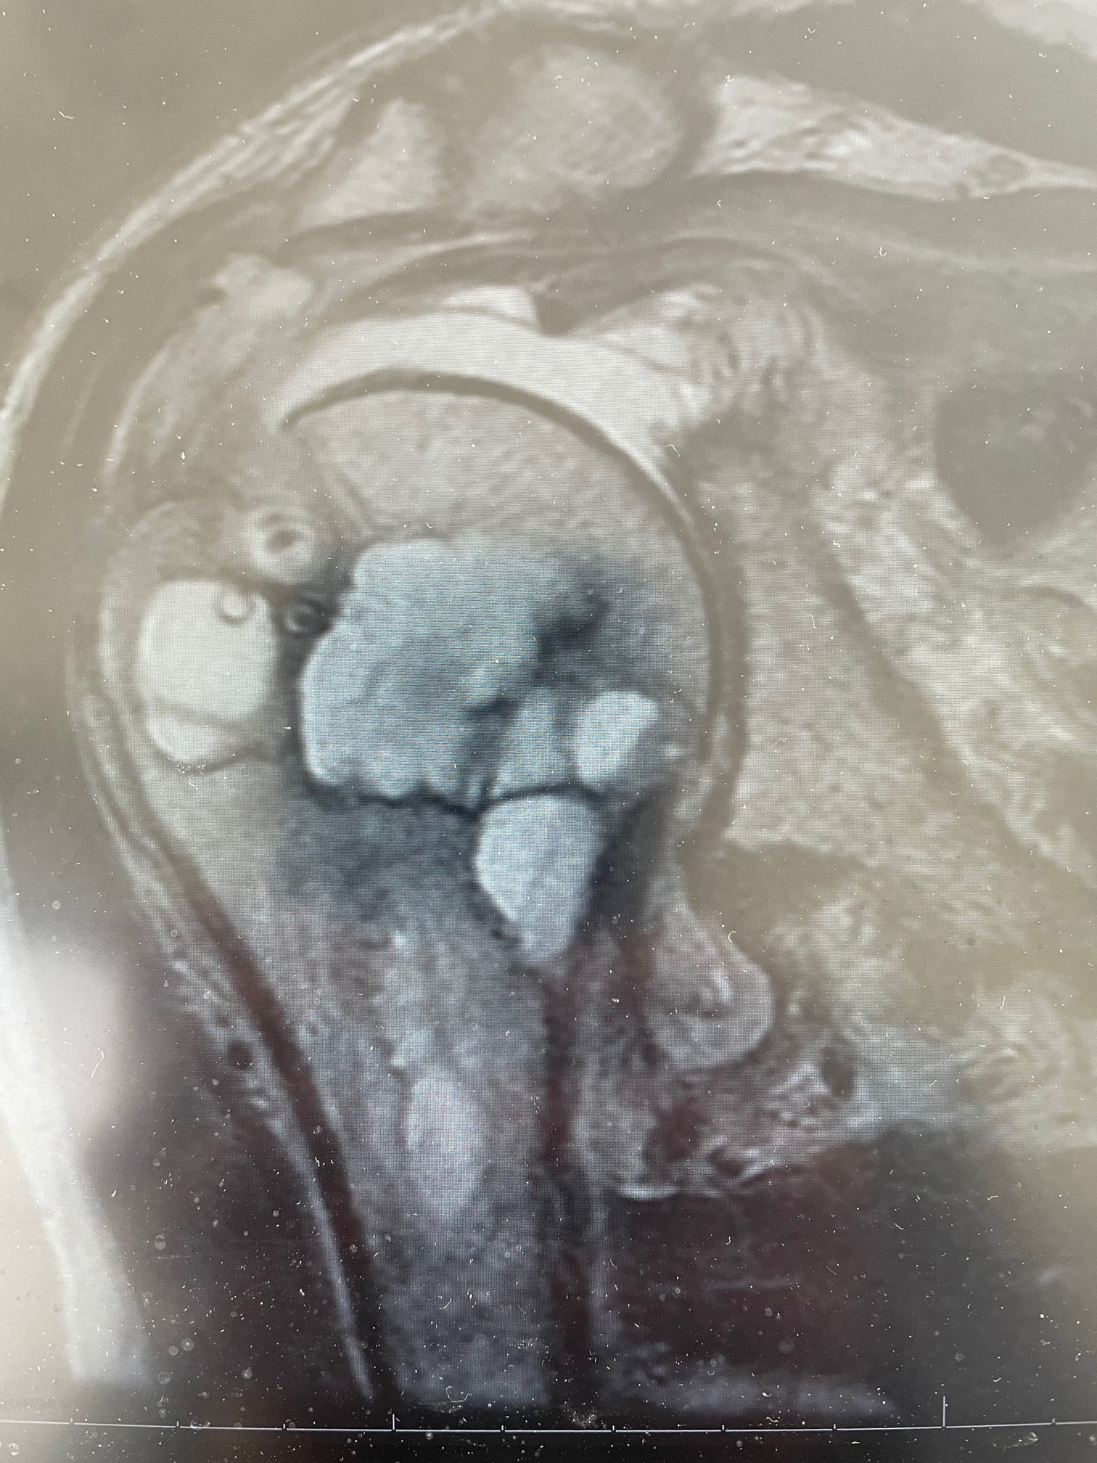
MRI April 2020 (6 Mo Postop)

Slide 5
April 2021:
Aspirate subacromial in Clinic: 10 cc. Thick SeroSanginous Fluid.
+ MSSA.
OR: Open I and D, w/ resorbable antibiotic beads (vancomycin/tobramycin) within bone defect proximal humerus, Anchors/Suture removal.
Small amt pus at anchor sites.
Cultures + MSSA.
Repeat OR: Open Irrigation debridement and Abx beads within proximal humerus.
Cortical Bone quality Good. Subscapularis Intact. Supraspin. Irreparable.
Treated: PICC line with Nafcillin x 6 weeks.

Slide 6
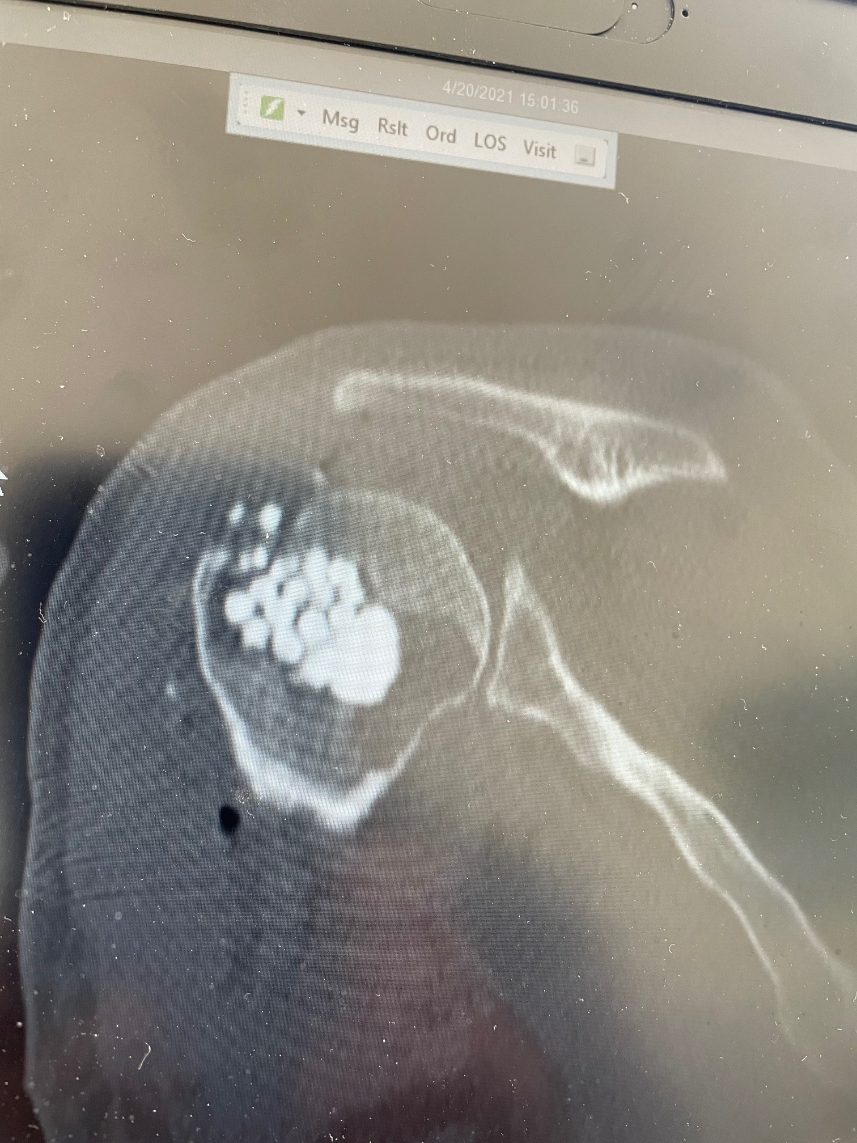
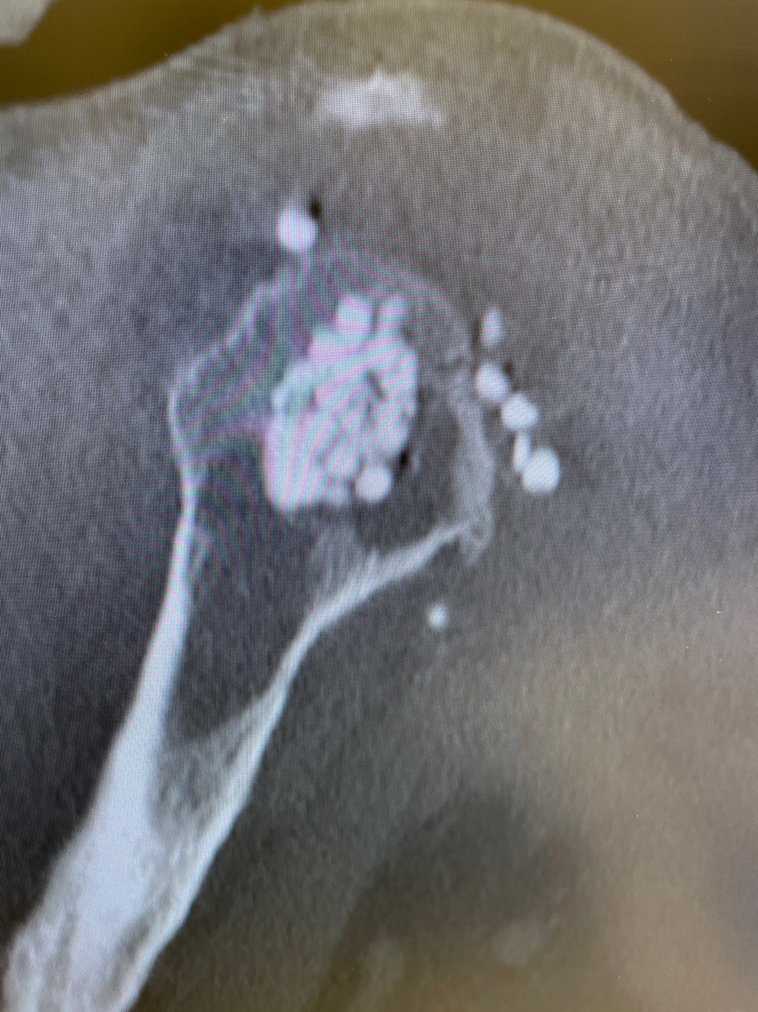
CT Postop 1

Slide 7
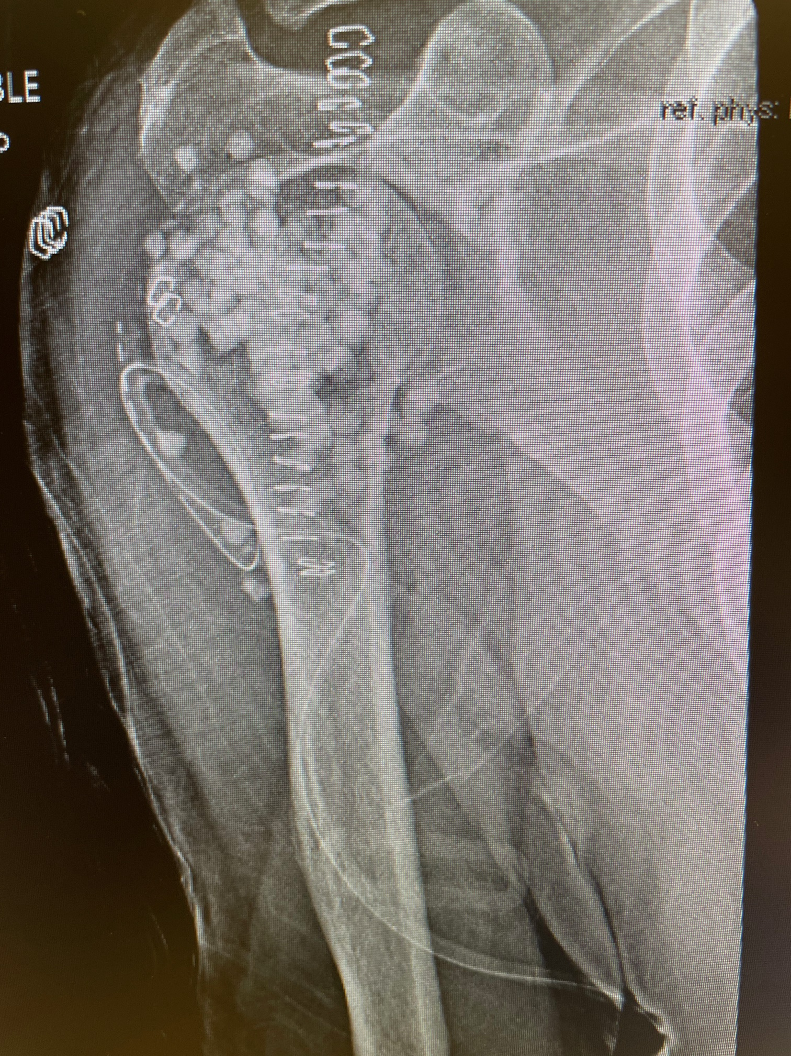
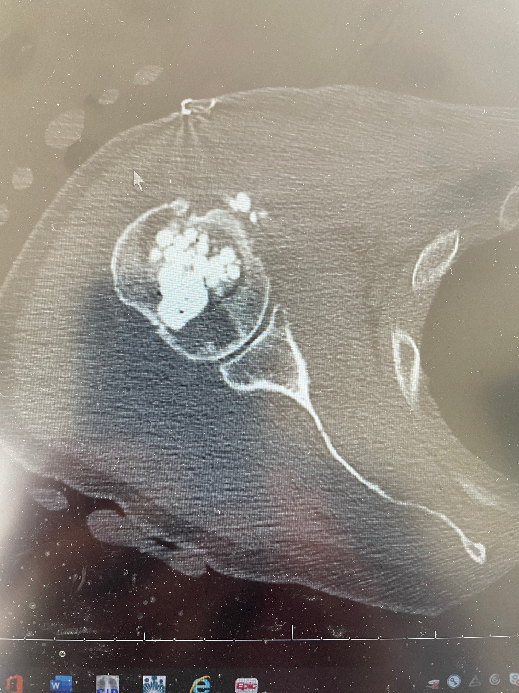
XR Postop 1 and CT with Abx Beads

Slide 8
Questions After 2 I&D’s and IV/Oral Antibiotic Treatment:
Physical Therapy with Risk of Fracture/AVN?
Bone Graft Proximal Humerus? Iliac Crest? BG Substitutes?
Antibiotic Spacer?
Reverse Shoulder Replacement?

