Slide 1
History - CC
Age 42M RHD
CC left shoulder pain
HPI: LEFT shoulder pain. Started approx 5 years ago when he slipped and tried to catch himself with his arms overhead. Denies falling. Last seen in 1/2020 in clinic. Had a steroid injection in 2020 that significantly helped alleviate his pain, but only lasted a few weeks. He says that pain, lack of function, and strength are his main complaints.
Sleep: interferes with sleep
Pain: 0/10 today, 9/10 at its worst
SSV: 10%
PMHx: hypertension
Meds: neurontin, losartan
Allergies: None
Social: self employed, does utility work (not necessarily heavy lifting)
Social Support and Living: Lives with his wife

Slide 2
PE
Motion (AROM-PROM)
Forward Flexion R: 170 L : 110
Abduction: R: 160 L : 100
External Rotation: R: 30 L : -10
Internal rotation Adduction: R: T6 L : L5
ABduction/ER: Right 60 @ 90 degrees, Left: 30 @ 90 degrees
Abduction/IR: Right 60 @ 90 degrees, Left: limited by pain
Strength: 5/5 strength with shoulder abduction, flexion extension of the elbow and wrist. Able to flex/extend at IP joint of thumb, make an okay sign and abduct/adduct all digits.
Sensory: Intact sensation

Slide 3
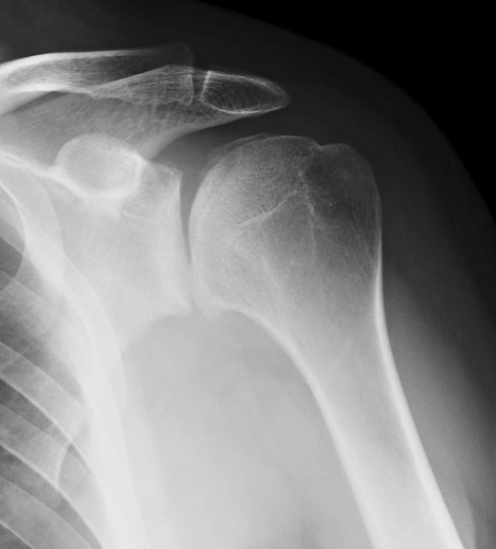
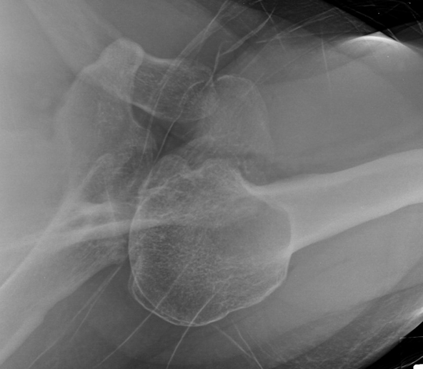
XR – 1/2020

Slide 4
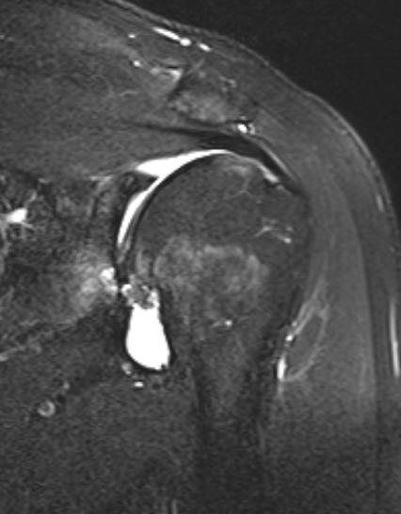
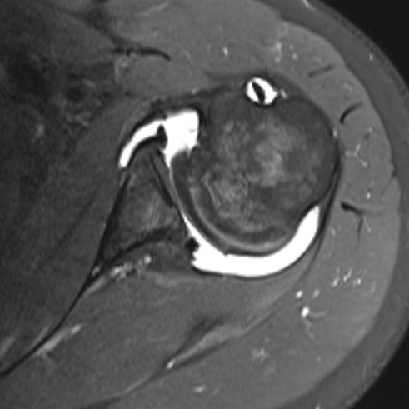
MRI

Slide 5
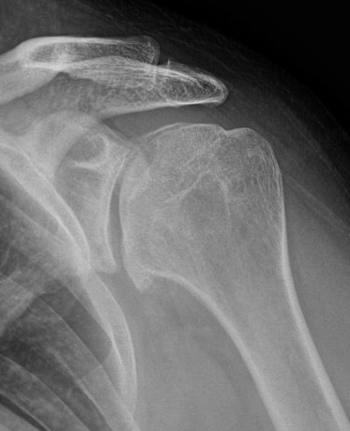
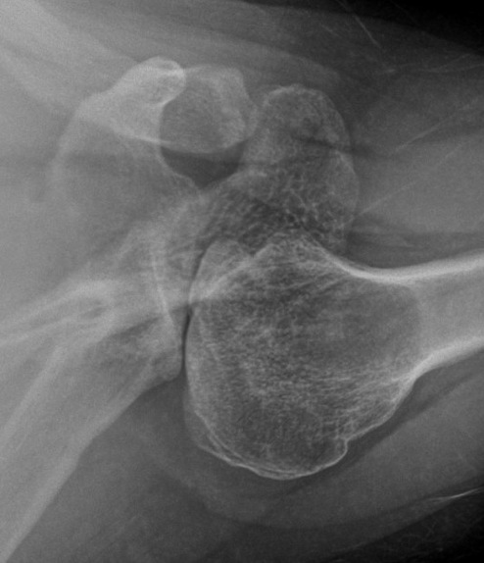
XR – 1/2022

Slide 6
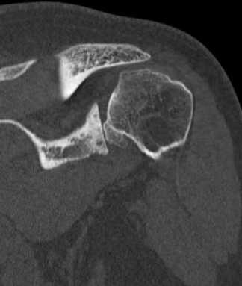
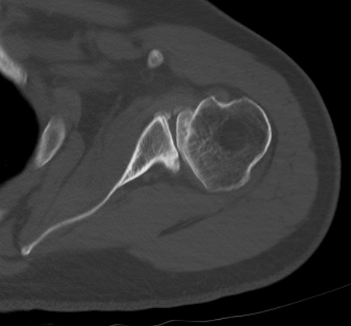
CT

Slide 7
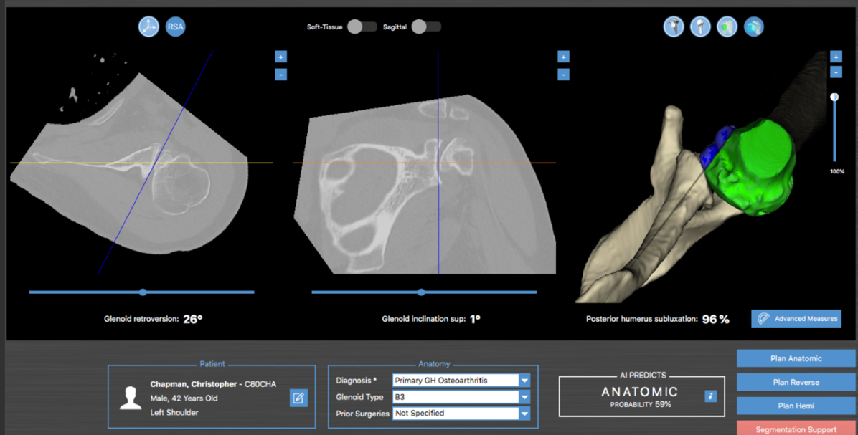

Slide 8
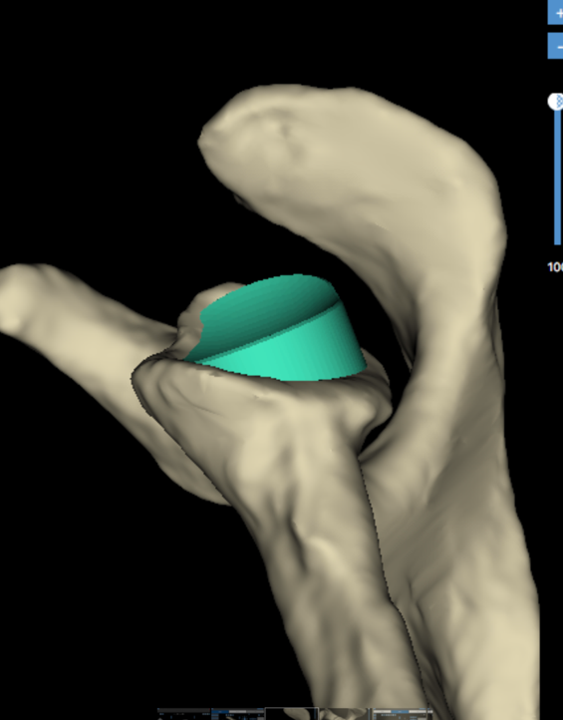
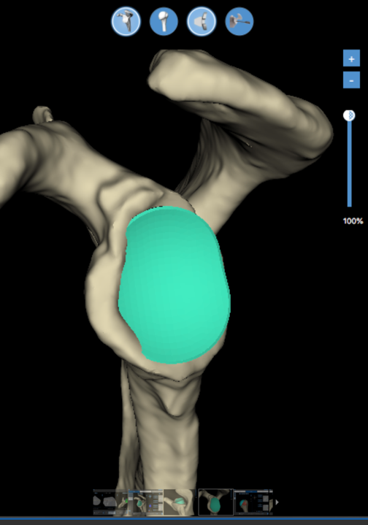

Slide 9
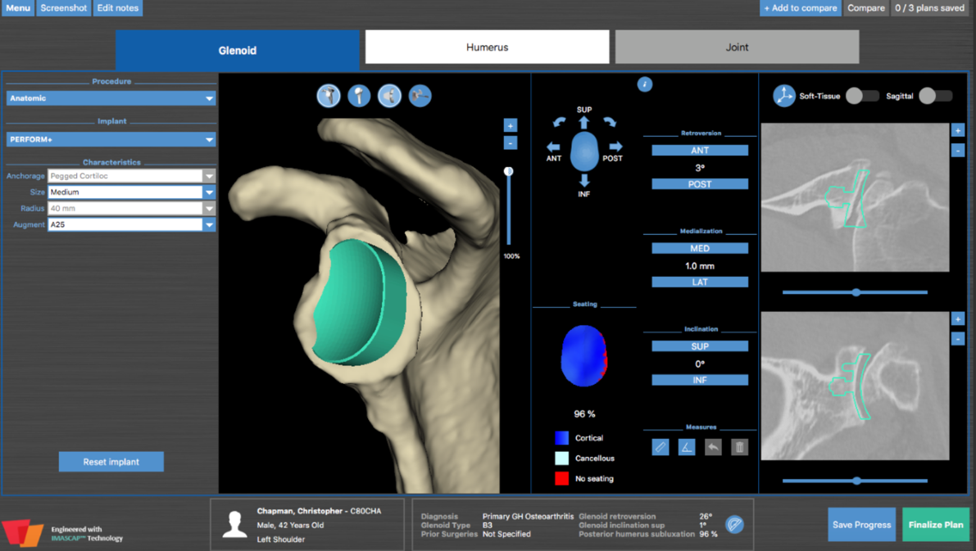

Slide 10
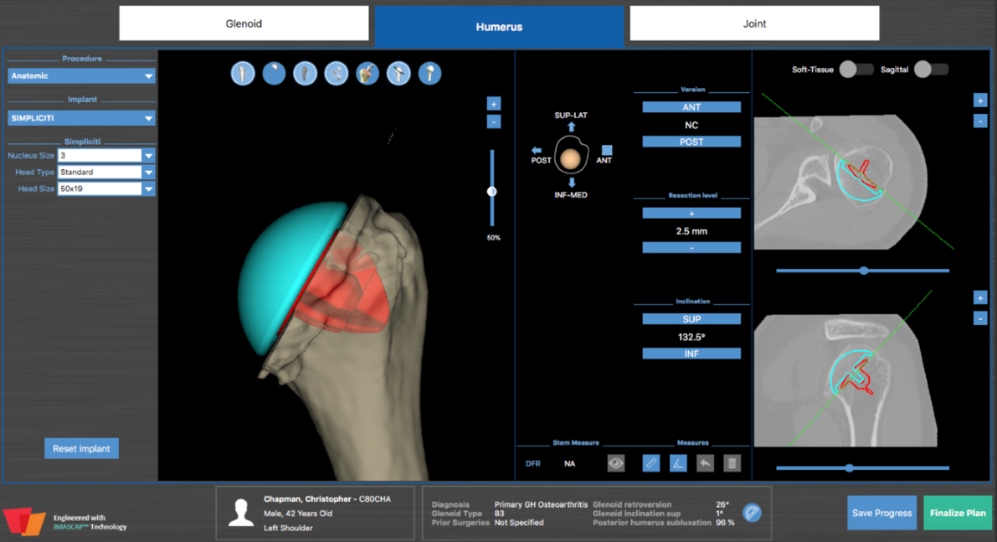

Slide 11
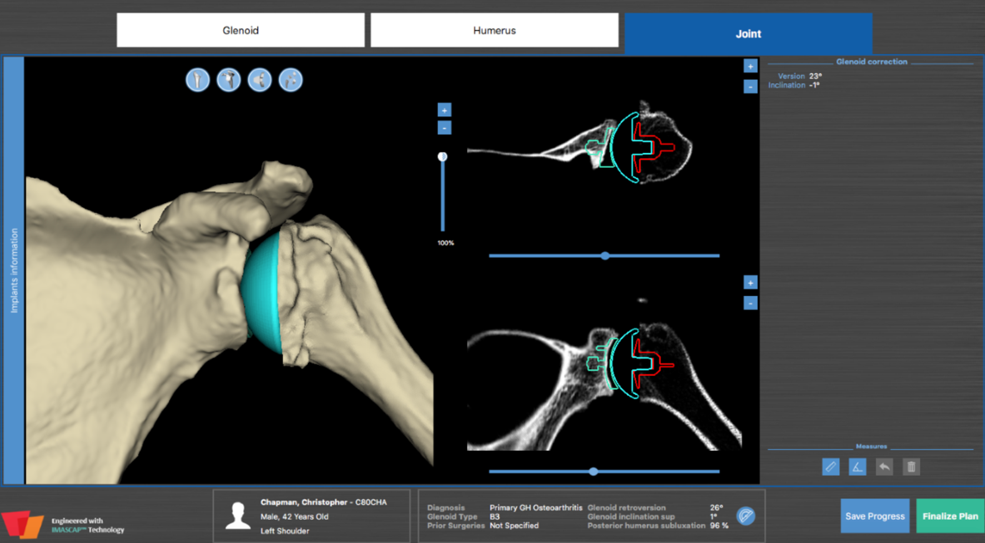

Slide 12
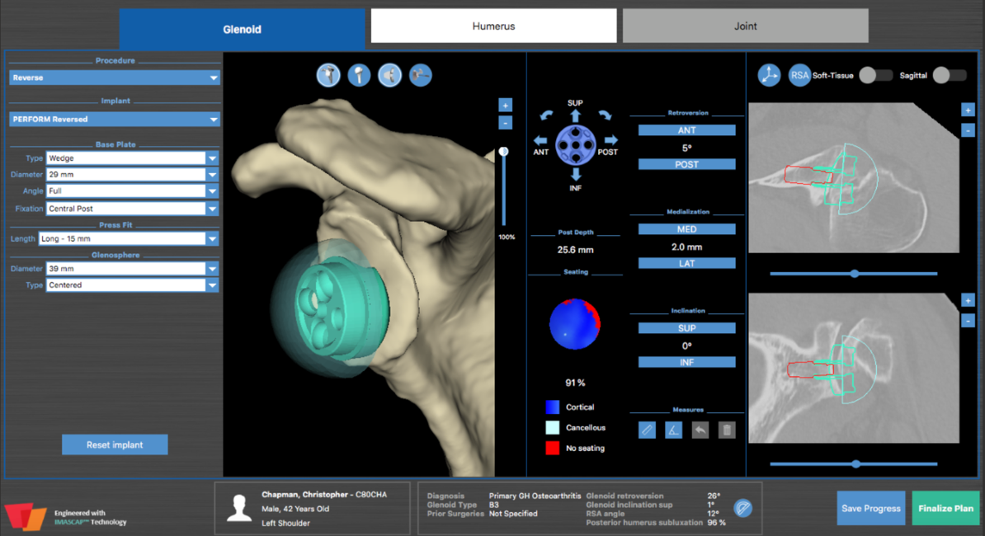

Slide 13
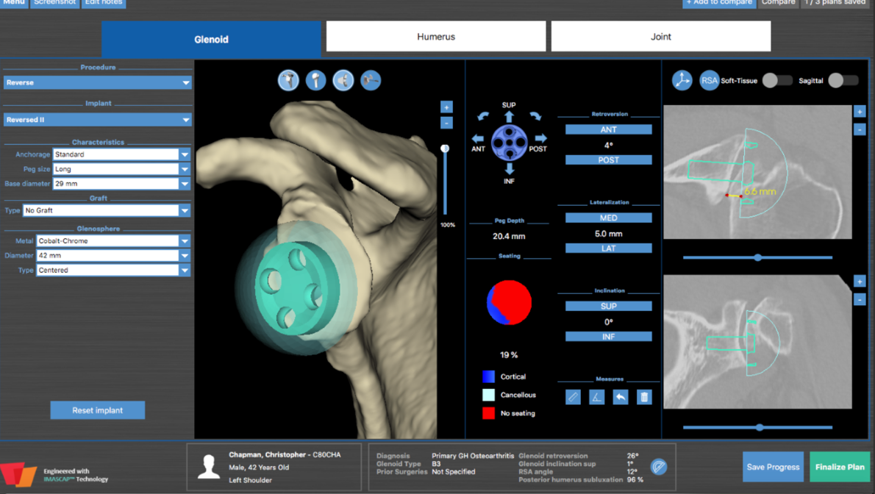

Slide 14
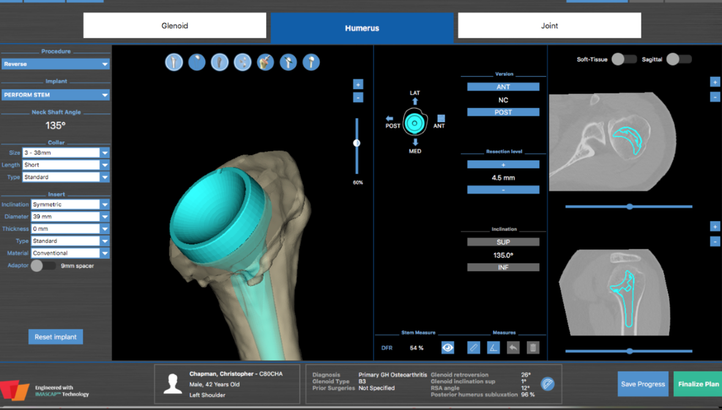

Slide 15
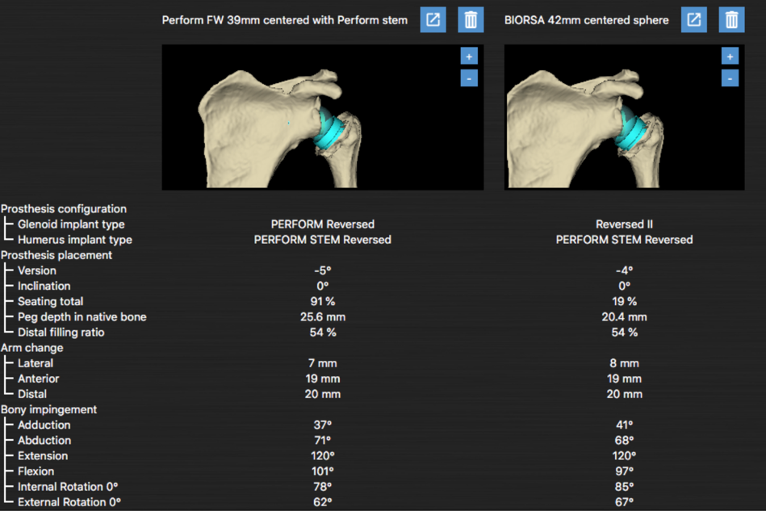

Slide 16
Options?
TSA with Anatomical Perform Plus 25 deg
Hemiarthroplasty ream and run
Reverse with Perform FW
Reverse with BIORSA

