Slide 1
65 year old female with right shoulder pain for years
Tried PT and injections with out relief
Has new grandchild and wants to be able to pick them up
+ night pain
PMH: HTN, High chol, anxiety, depression

Slide 2
PE

Slide 3
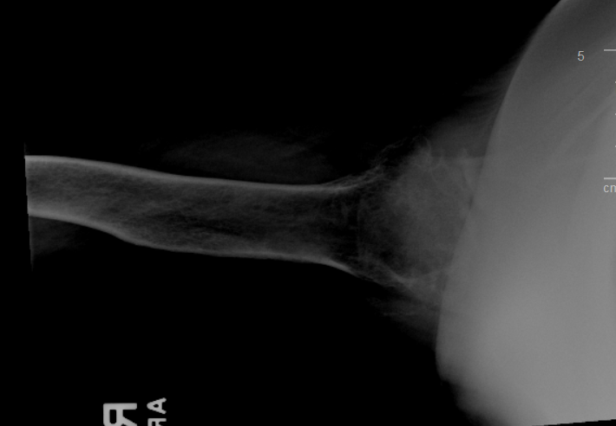
Imaging 11/23/20

Slide 4
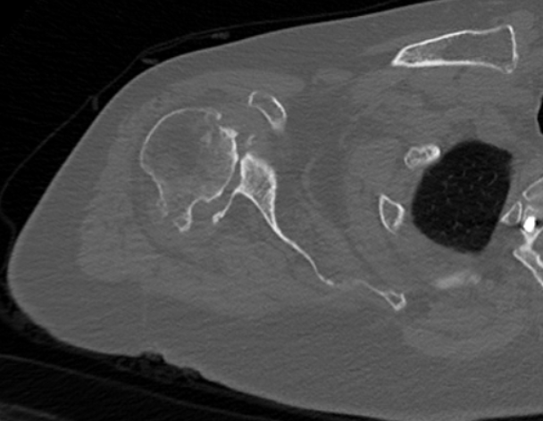
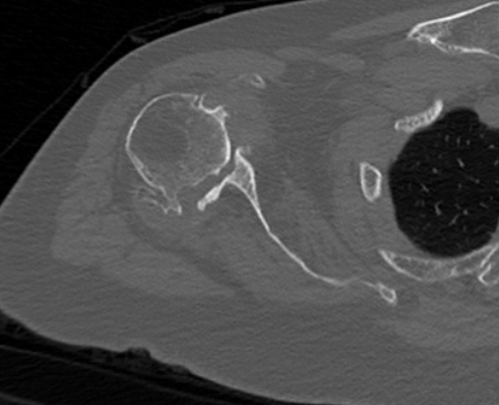
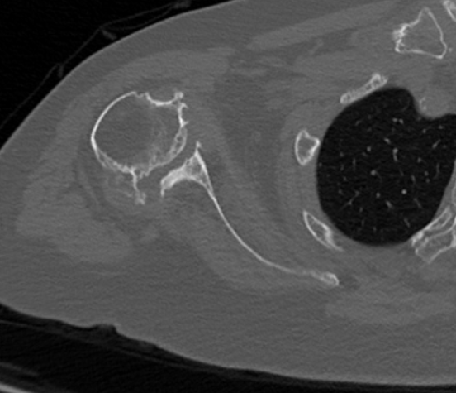
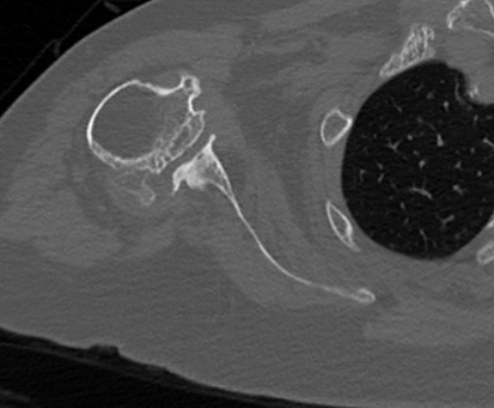
CT

Slide 5
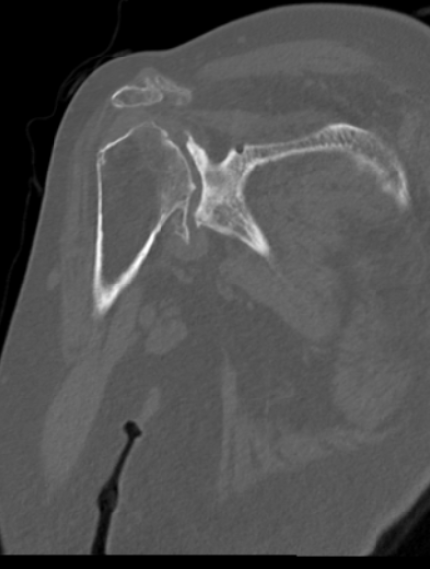

Slide 6
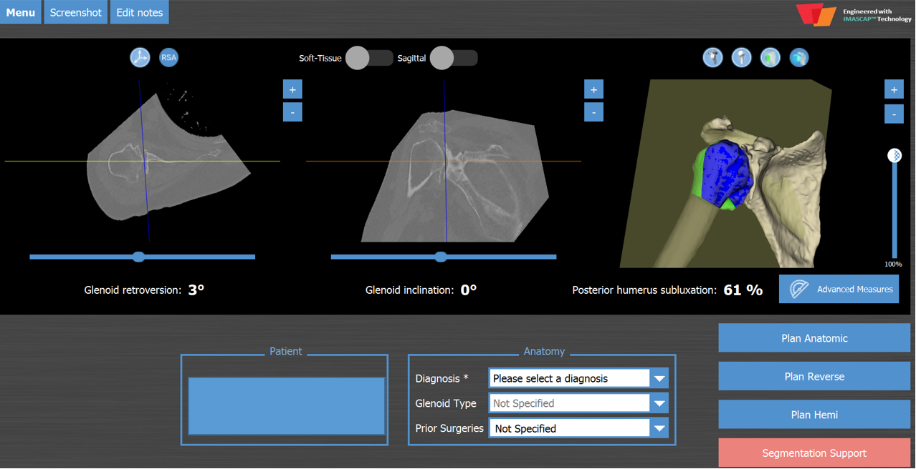
Reverse vs Hemi

Slide 7
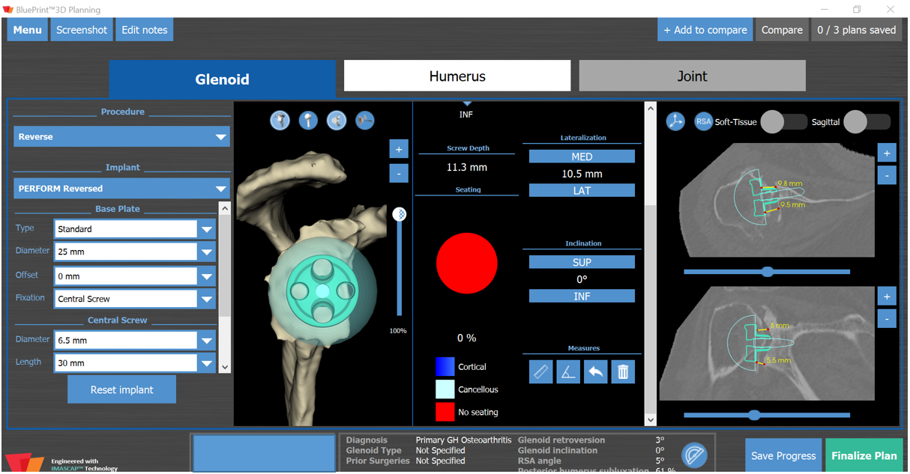
BIORSA

Slide 8
