Slide 1
Y.W. 53 y/o F
Case for Codman Shoulder Society

Slide 2
53 y/o F
HPI: 53 y/o F RIGHT shoulder injury after motor vehicle accident 2011
Multiple treatments prior to presentation to our clinic in 2015.
Open rotator cuff repair – 2011
Four additional surgeries (specifics unknown) – 2012-2013
Suprascapular nerve release – 2014
HPI: Continued debilitating pain, poor function
Rest pain 6/10; Activity pain 10/10
SSV 20% on R, 100% on the L
PMHx: HTN, gout, BPH
SH: Occupation: Director of HR for 27 yrs – Desk duties. Non smoker.

Slide 3
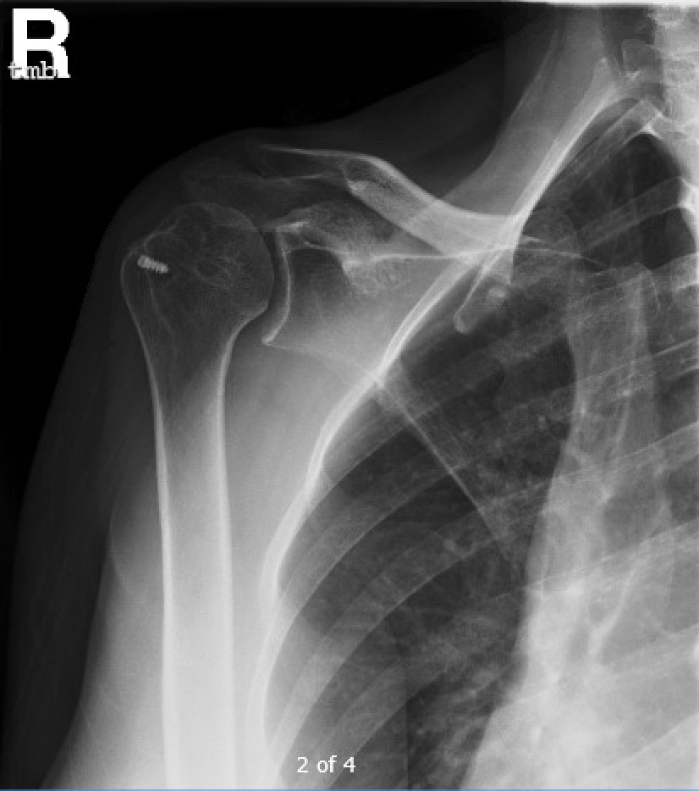
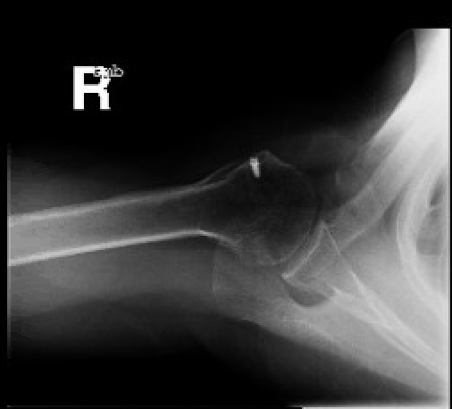
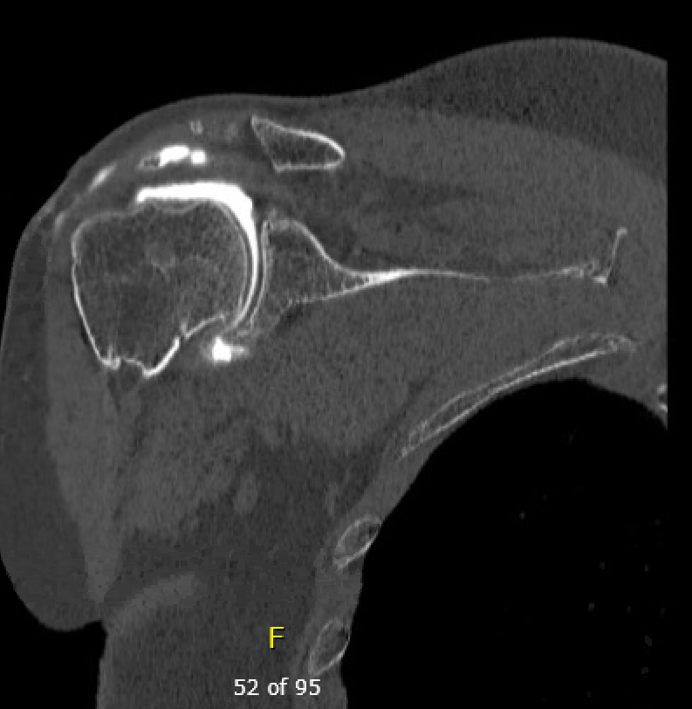
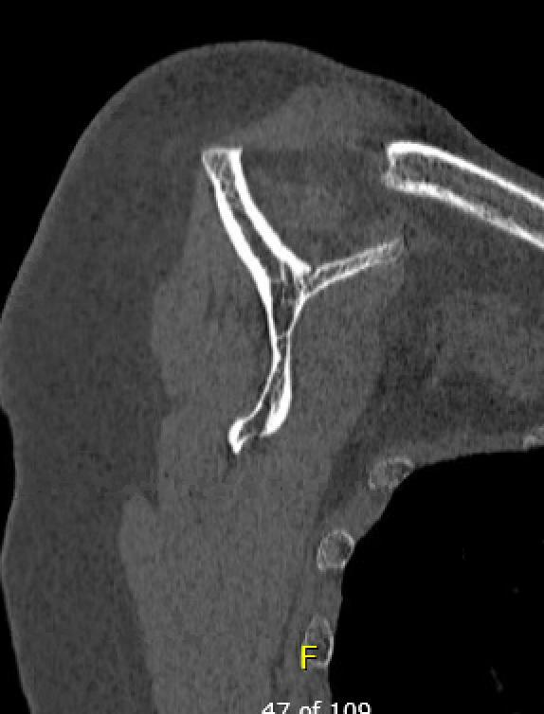
53 y/o F
Feb 2015
Plan RSA for
marked thinning of cuff in setting of multiple attemps at repair, fatty atrophy, & humeral head deformity

Slide 4
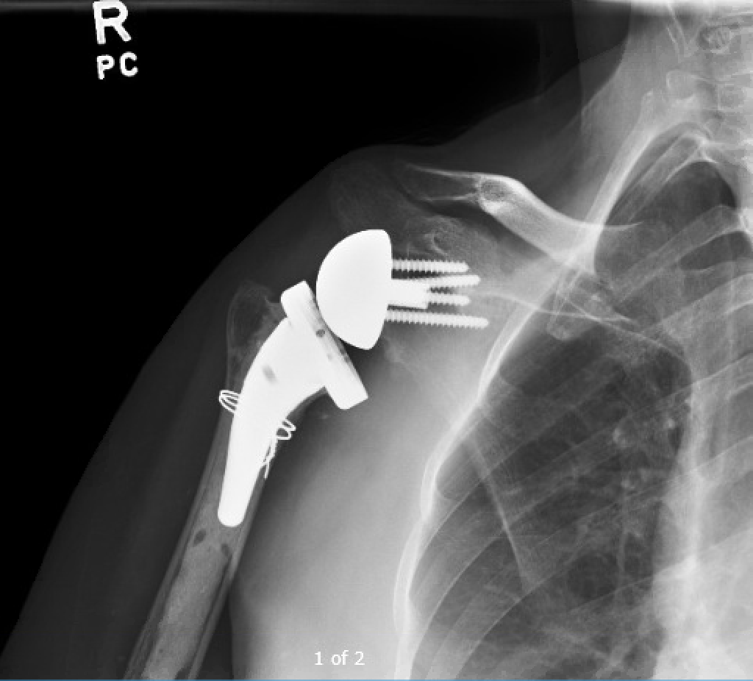
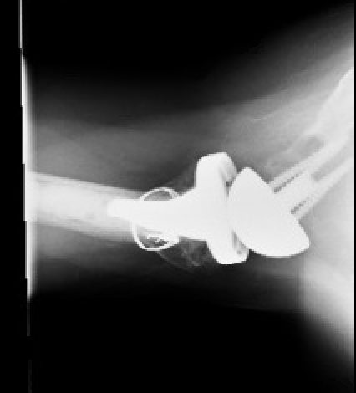
53 y/o F
April 2015
s/p bio-RSA

Slide 5
53 y/o F
After doing well initially, she developed pain in the upper arm & profound stiffness
ESR/CRP & aspiration - negative.
Arthroscopic biopsy, converted to open for profound scarring – negative
EMG – normal
XR & CT – no obvious structural problem
Case presented to Codman Shoulder Society.
Ultimately decided for resection arthroplasty to rule-out intraosseous infection before revision RSA.

Slide 6
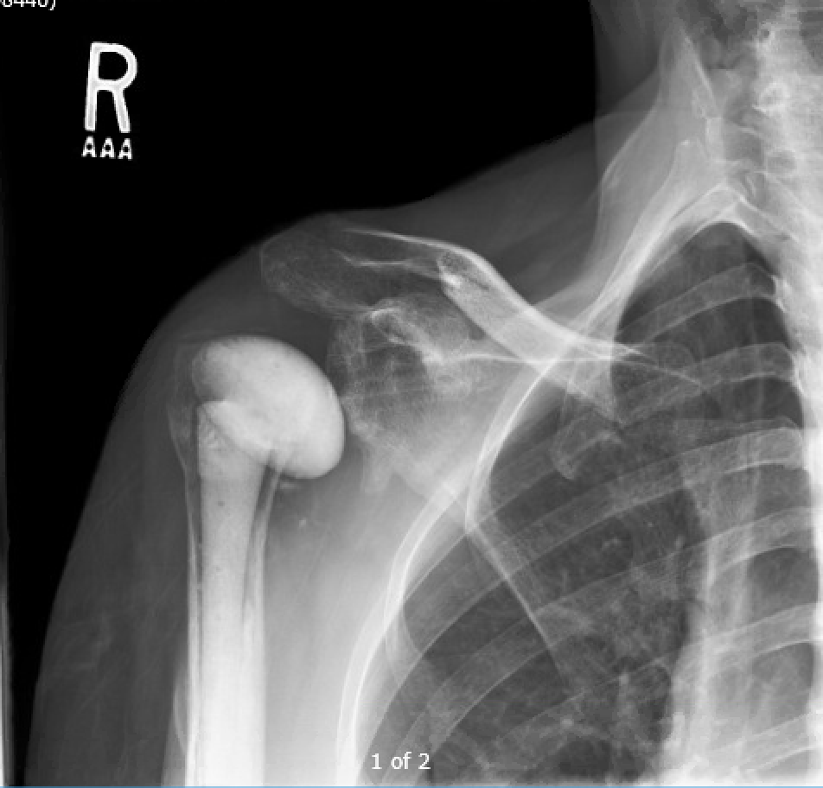
53 y/o F
June 2016
Resection arthroplasty, Prostalac spacer
PICC IV Ceftriaxone & rifampin x 6 weeks- for 1 of 5 cx positive for p.acnes
Had persistent pain after completion of IV abx – offered revision RSA vs resection arthroplasty
– pt elected for resection

Slide 7
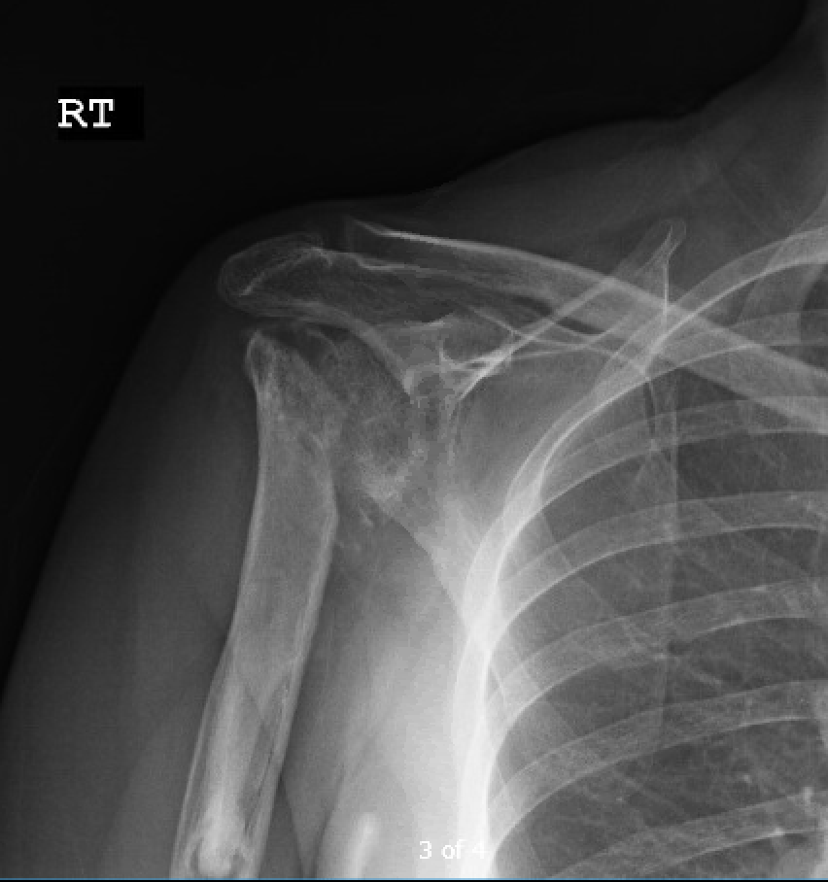
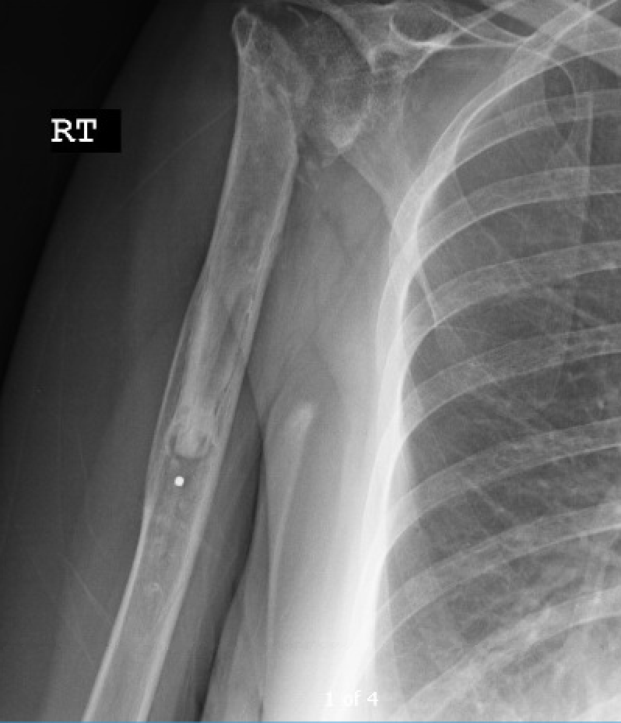
53 y/o F
Oct 2016
Resection arthroplasty
At time of resection – 2 of 6 cx positive (1 bacillus, 1 p. acnes) – treated as contaminant

Slide 8
53 y/o F
Did well initially, then had increasing pain and swelling.
Testing:
ESR/CRP - normal
Metal Allergy testing: mild to moderate sensitivity to Gold Sodium Thiosulfate, trace to chromium, moderate to Potassium Dichromate
Sent to Codman Shoulder Society
Recommendations: observation, fusion, treatment low-grade deep infection
Elected to repeat I&D, remove cement and cement plug, take cultures, and if negative plan for Revision RSA.
Nov 2017 - All intra-op cultures negative.

Slide 9
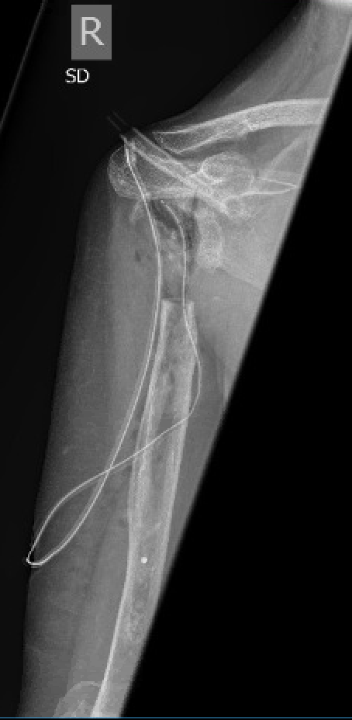
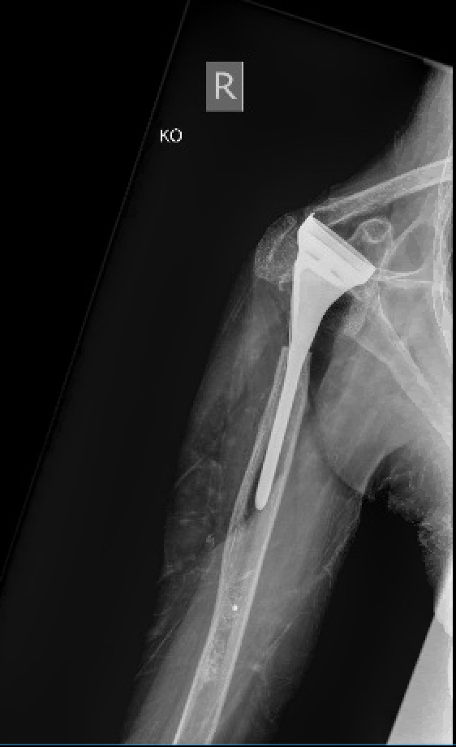
Planned for revision RSA with all titanium implants.
March 2018
Intra-op
Unable to place RSA 2/2 scarring/soft tissue tensioning, concern for neurologic traction injury.

Slide 10
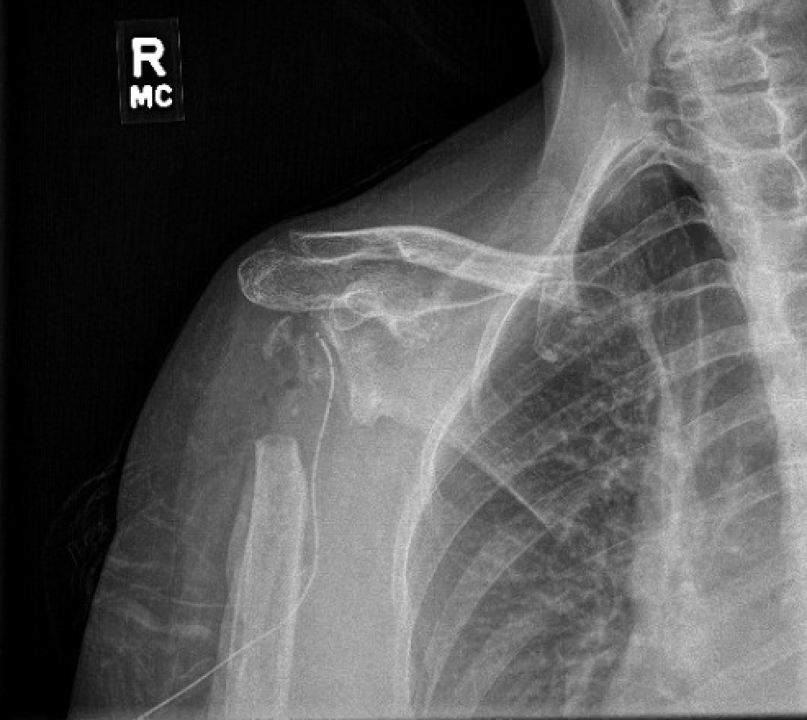
53 y/o F
Current XR
C/o of cramping/aching/burning with even minimal activity

Slide 11
53 y/o F
Options for management of painful resection arthroplasty?

