Slide 1
Case: SW
20 year old female RHD with 1 year severe left shoulder pain.
Diagnosed with RA 3 years prior, has tried several biologic agents without much success until switching to Humira 8 months ago → better control now.
BMI 32 (5’6”, 200 lbs)
ROM: 30° FE, 0° ER, IR to body
Prior normal C-spine MRI

Slide 2
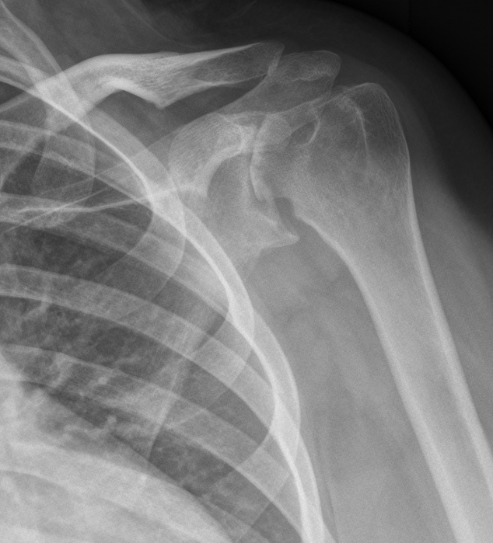
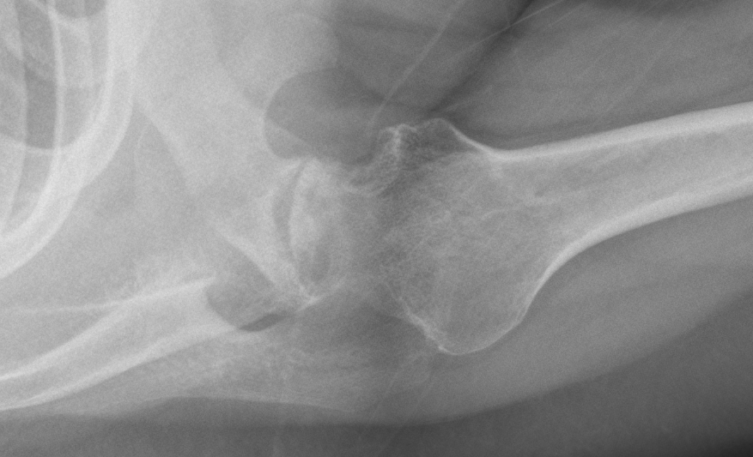

Slide 3
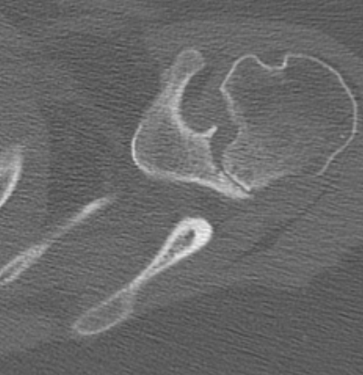
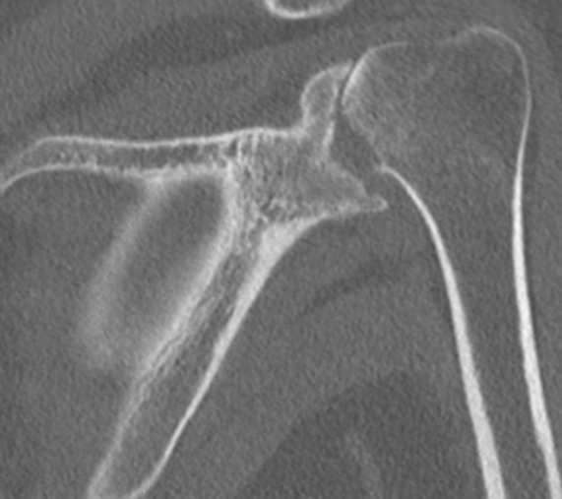
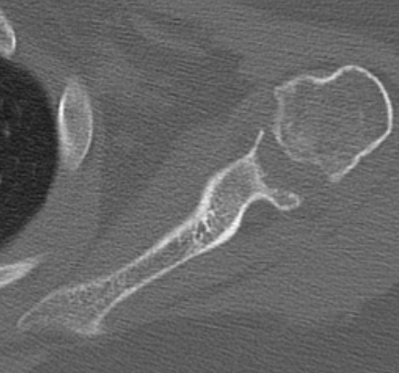

Slide 4
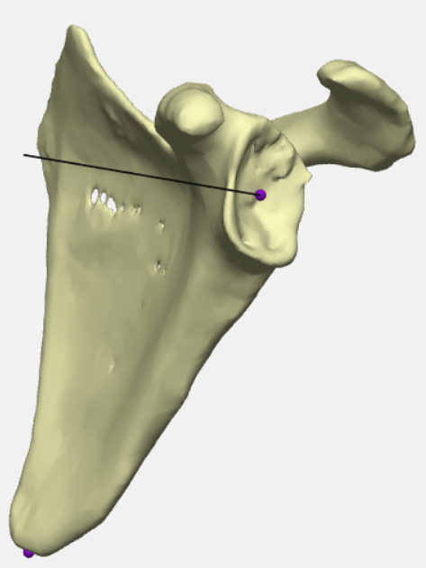
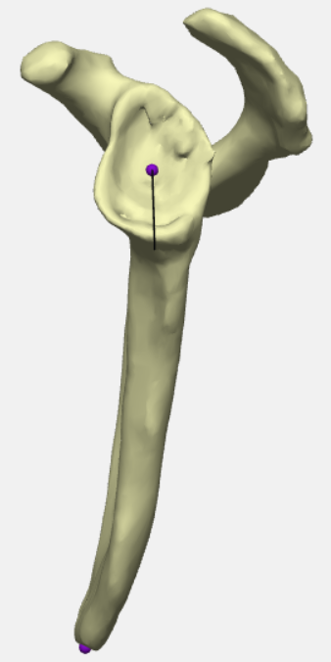
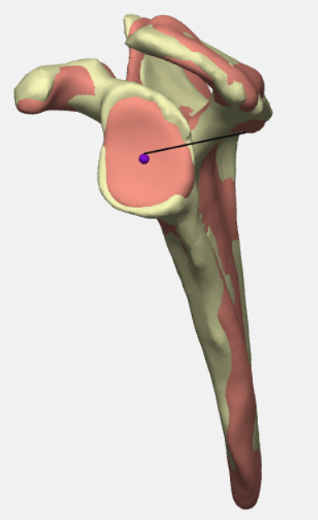

Slide 5
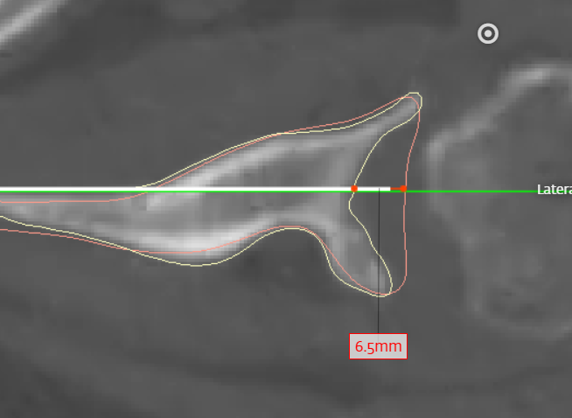
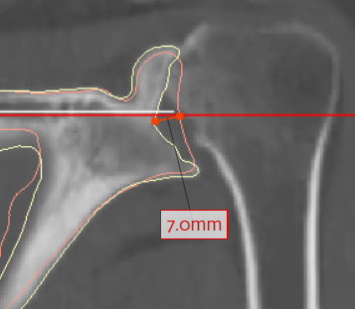
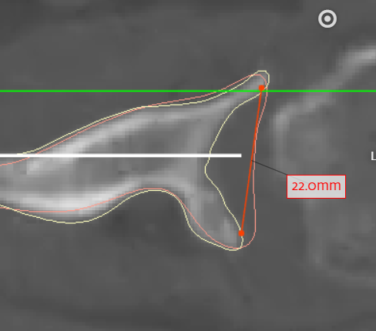
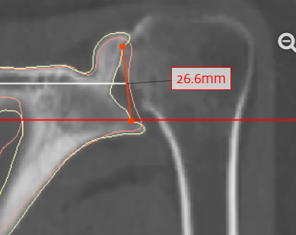

Slide 6
Options?
Hemi
Anatomic
Inlay? Which one to fit defect?
Metal backed with bone graft?
Humeral stem?
Biologic resurfacing?
Reverse
Arthrodesis

