Slide 1
76F – presents to us after multiple prior procedures with right upper extremity pain and dysfunction
History prior to presentation
Right humeral shaft fracture with attempted non op treatment
Went onto nonunion
ORIF humeral shaft
Failed fixation
Resected proximal humerus and inserted a tumor prosthesis
Attempted achilles allograft reconstruction for dislocation
Patient presents to us for with dislocated tumor prosthesis and no shoulder function

Slide 2
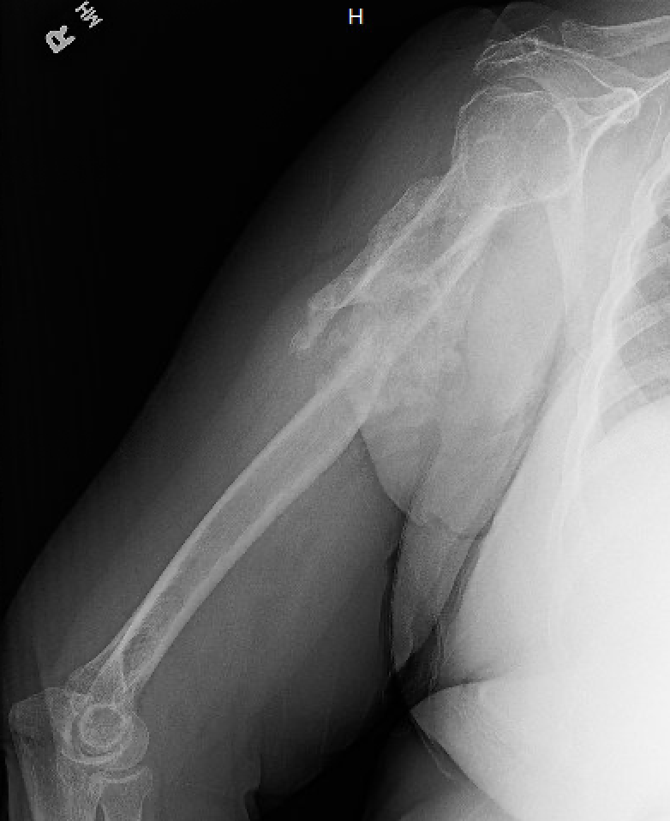

Slide 3
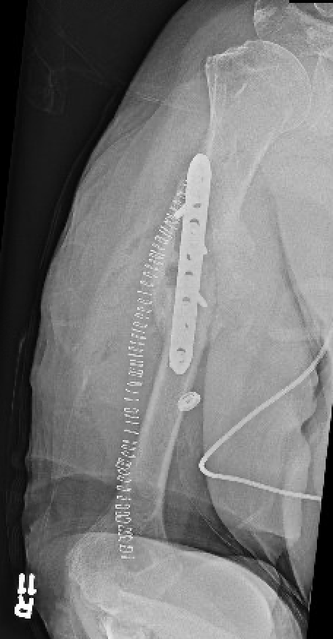

Slide 4
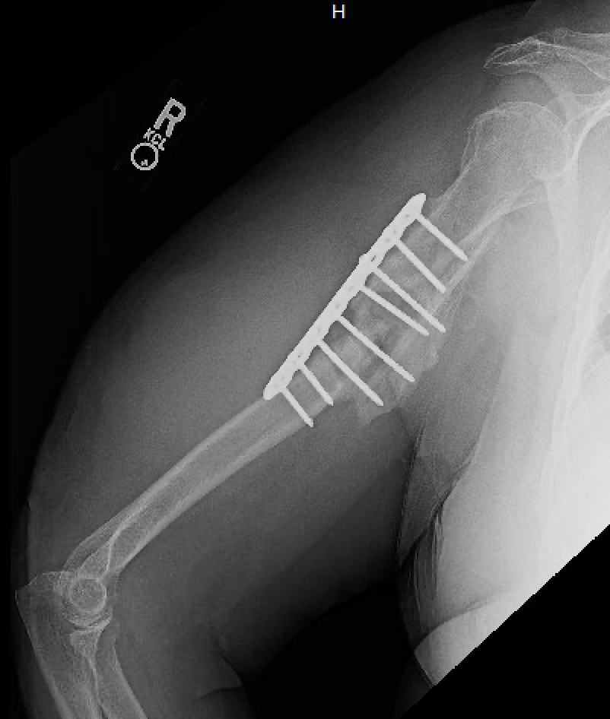

Slide 5
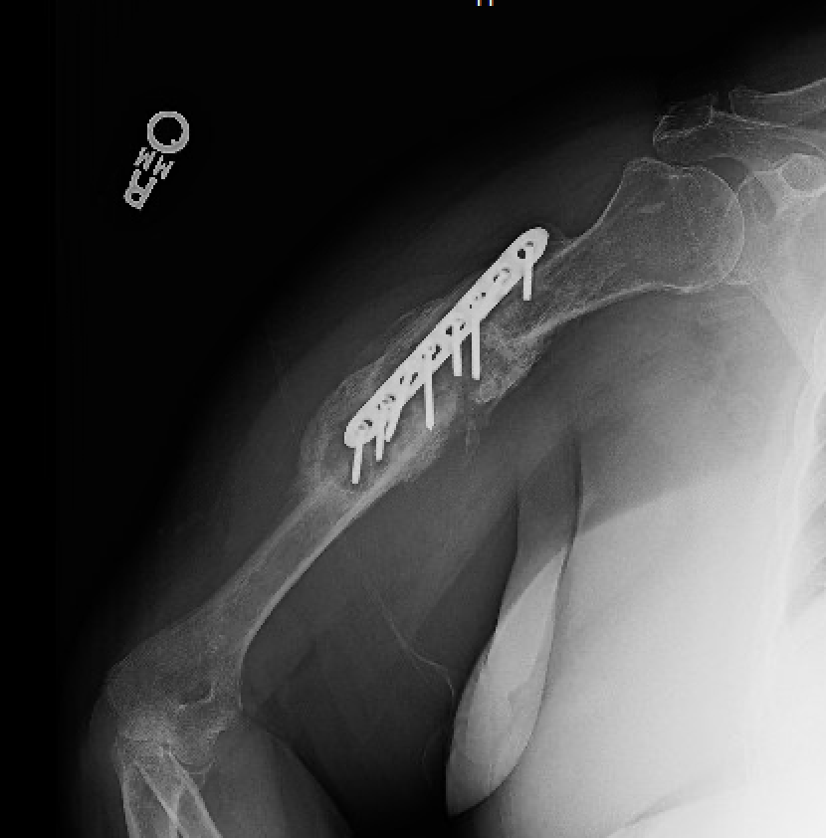

Slide 6
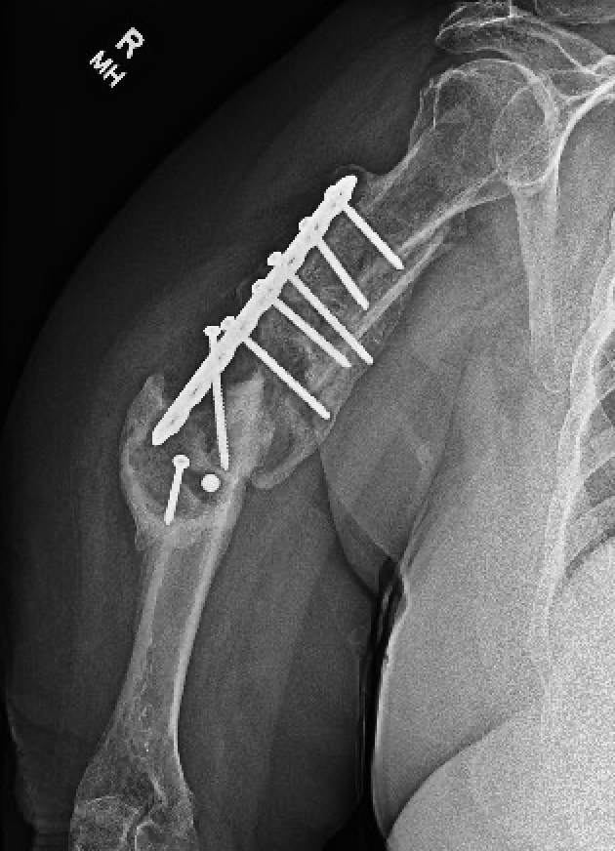

Slide 7
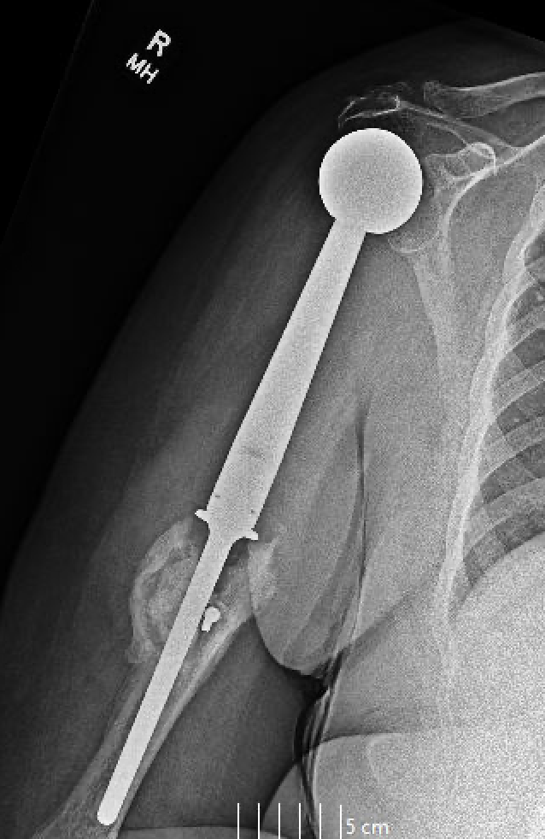

Slide 8
Imaging on presentation to our clinic

Slide 9
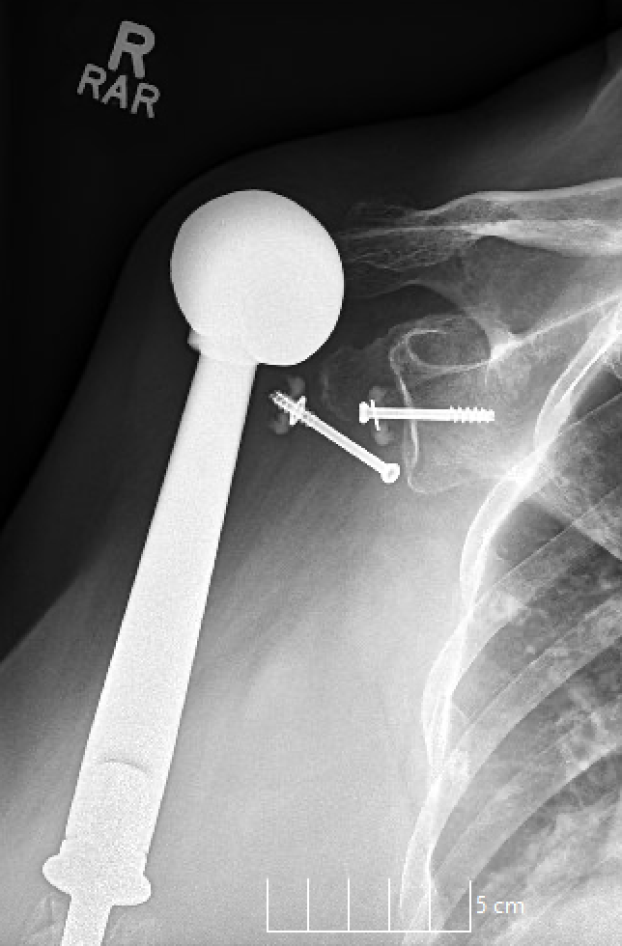

Slide 10
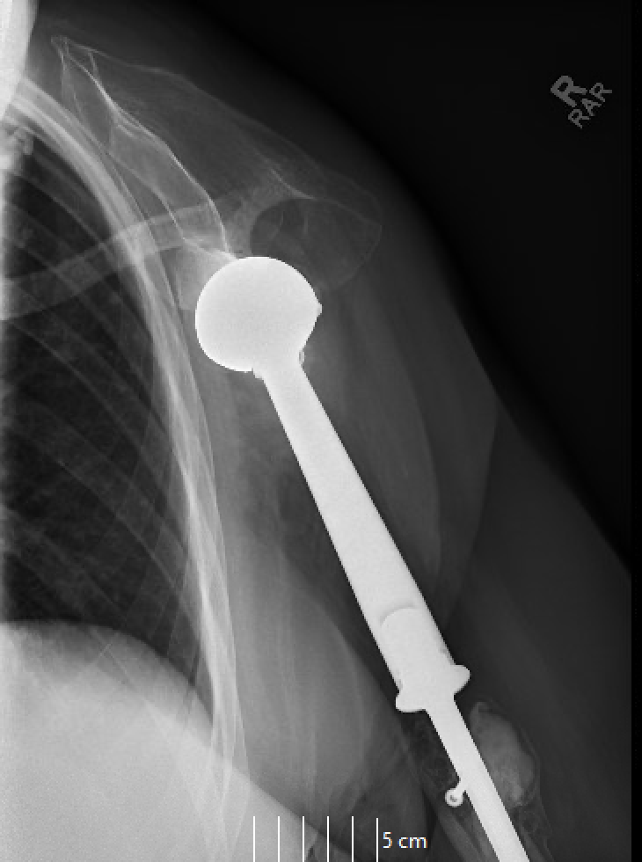

Slide 12
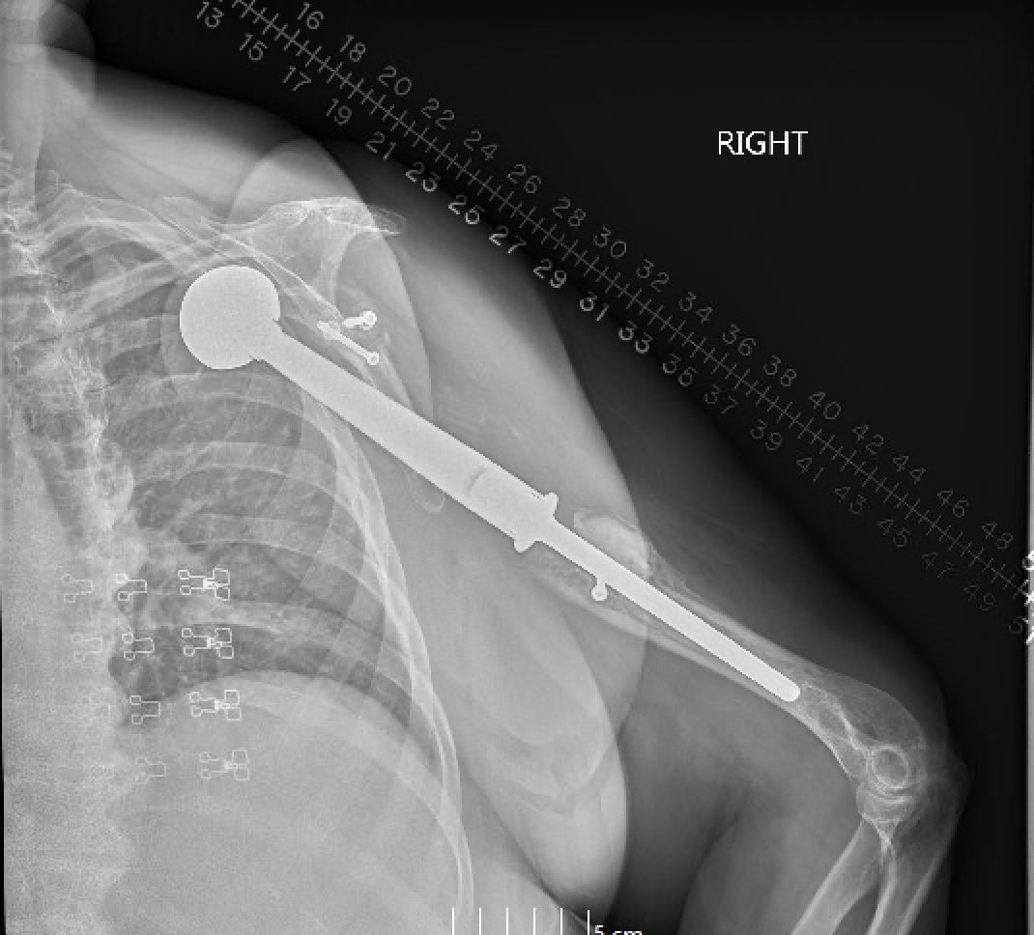

Slide 13
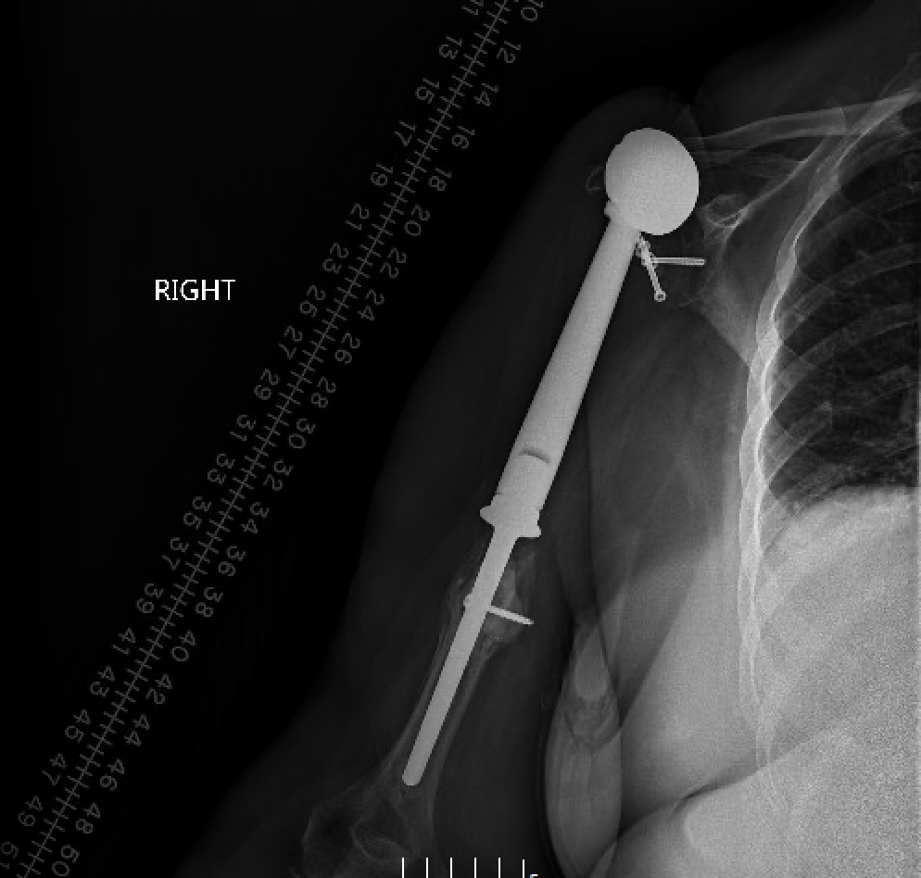
Bilateral humeri

Slide 14
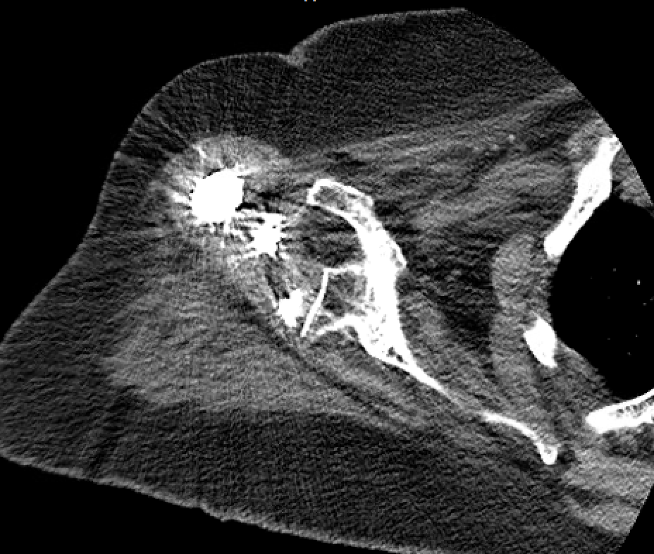
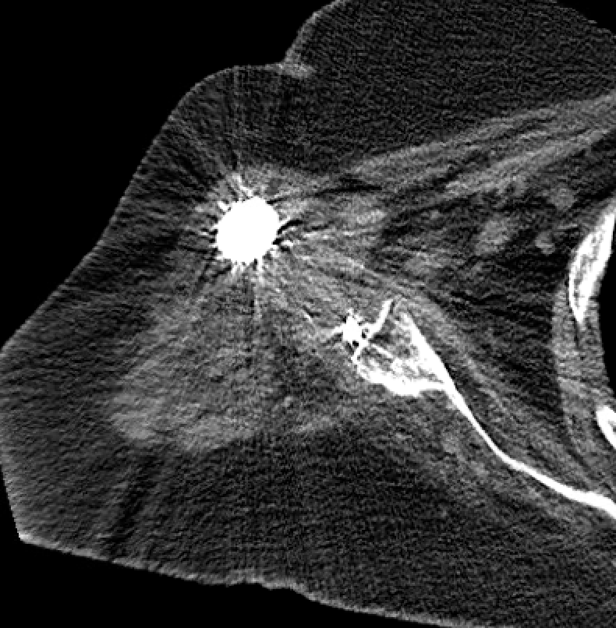

Slide 16
Plan: Revision to RSA with proximal humeral allograft reconstruction
Exam
Anterosuperior escape
Difficult to examine deltoid function but significant atrophy
Concerns
Soft tissue loss
Lack of rotator cuff function
Detachment and likely loss of deltoid muscle

