Slide 1
Case
44 yr old very nice F with history of seizures
Last seizure in 2019
First dislocation 2016, has had multiple dislocations with seizure but last in 2019
Now just constant pain in the shoulder and lack of function.
Active and otherwise healthy
Works a desk job

Slide 2
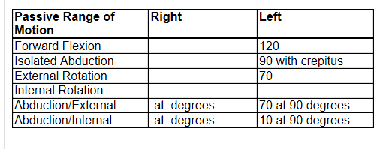

Slide 3
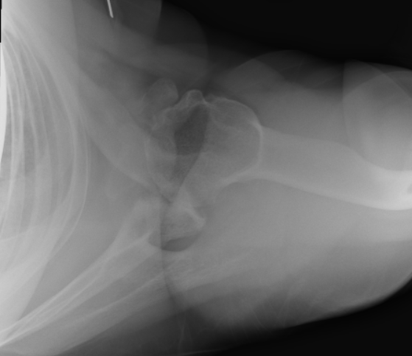

Slide 4
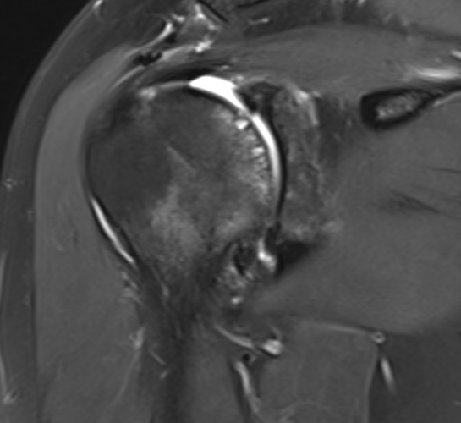

Slide 5
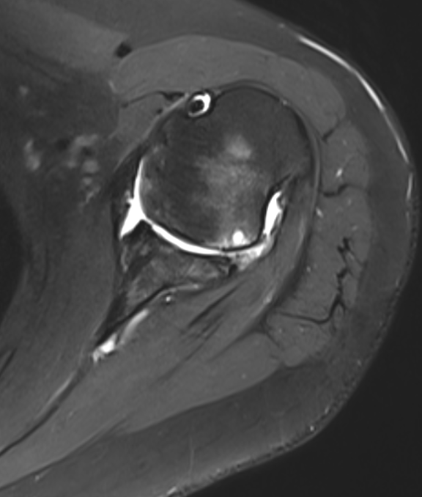

Slide 6
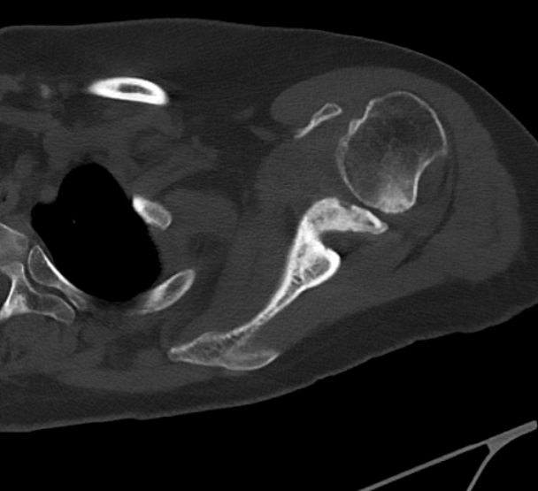
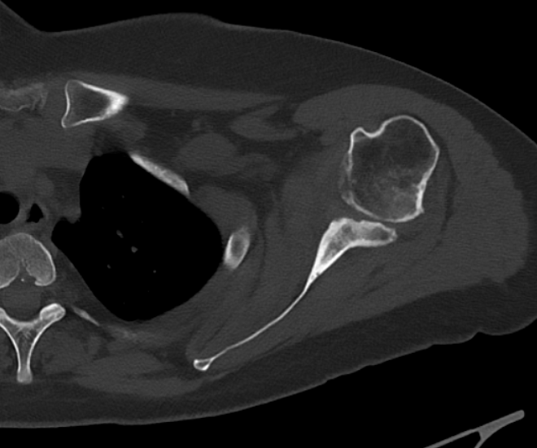
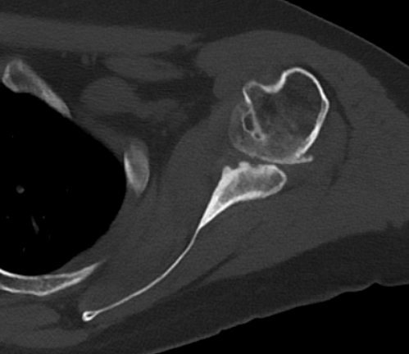
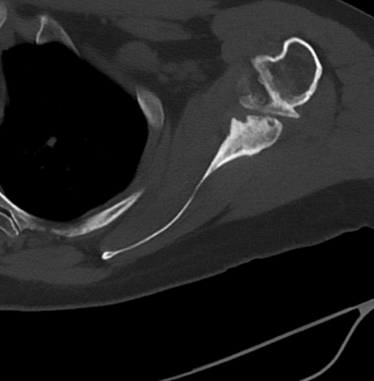

Slide 8
What to do?
Can you use DTA for this?
Reverse?
Fusion?

