Slide 1
61 yo active male who works as a roofer who underwent left TSA with augmented glenoid component 3 months ago.
At first post-op visit at 2 weeks, he was doing extremely well, pain prior to surgery gone. Patient self d/c’d sling – not very compliant. Very pleased with early result.
Then returned at 5 weeks post-op after an injury. Was walking dog and dog ran after a deer. Patient was caught off guard and pulled fully off his feet landing on outstretched arms. Had immediate pain in shoulder.

Slide 2
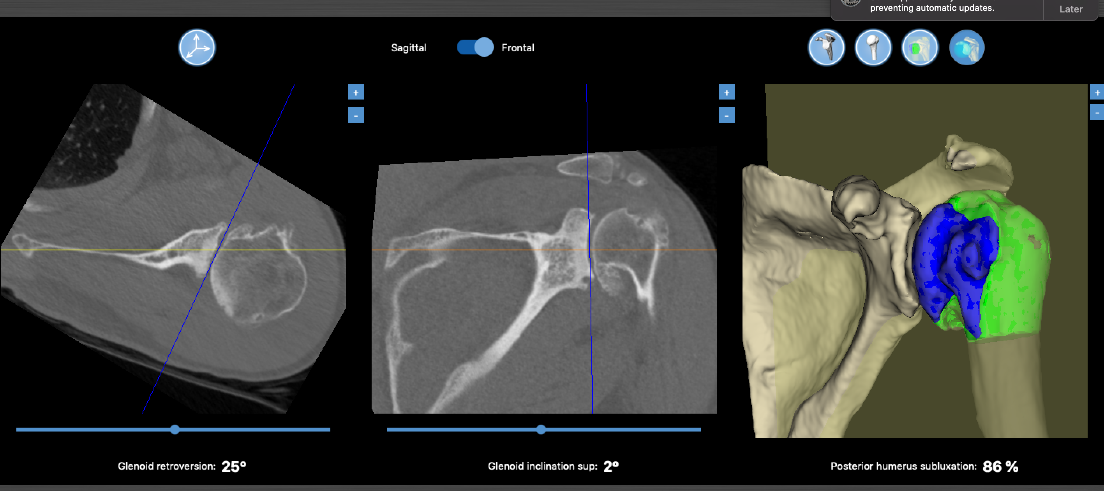
Pre-op

Slide 3
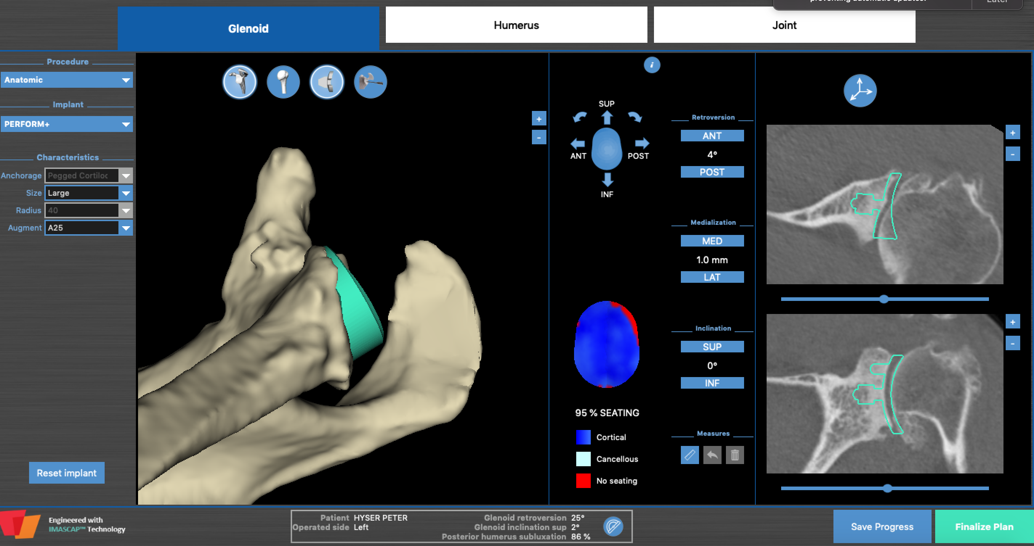
Plan

Slide 4
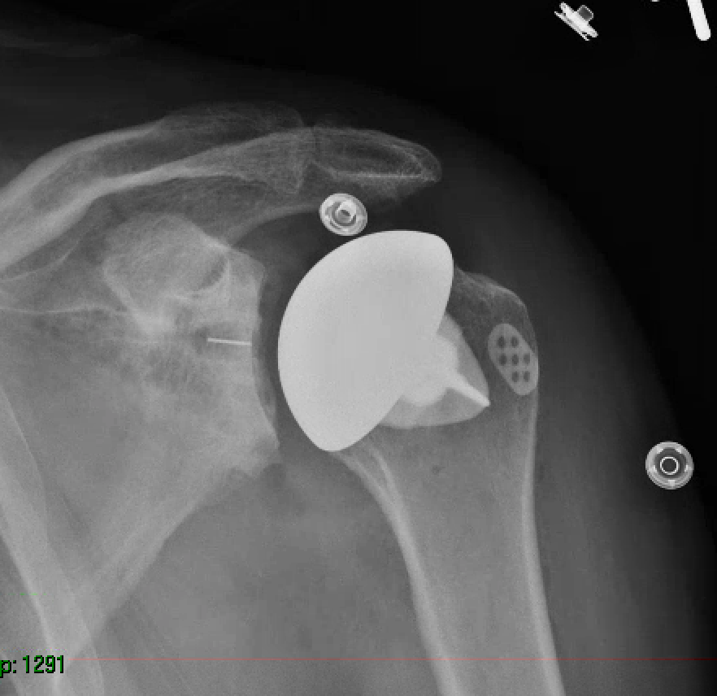
Immediate Post-op

Slide 5
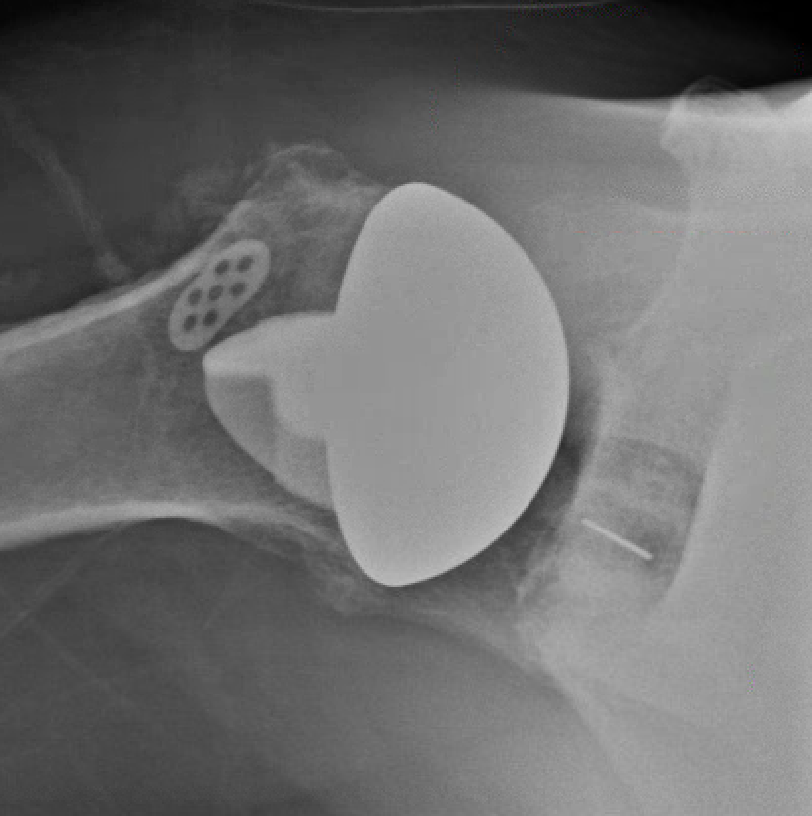
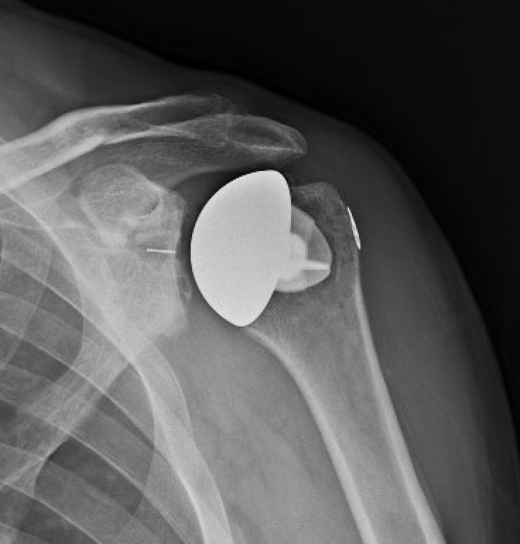
X-ray after injury at 5 wks
LTO appears intact so recommended to wait a few weeks and re-eval
Continued pain and difficulty with AROM so sent for CT arthrogram

Slide 6
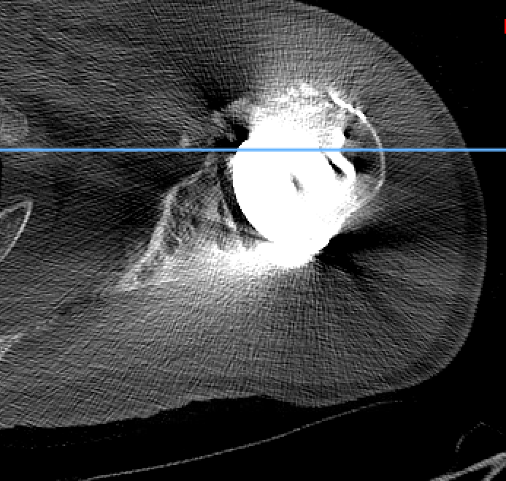
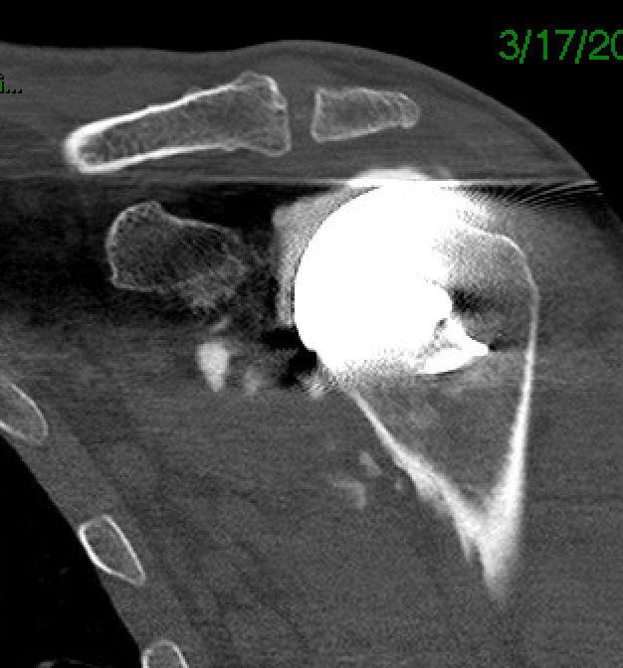
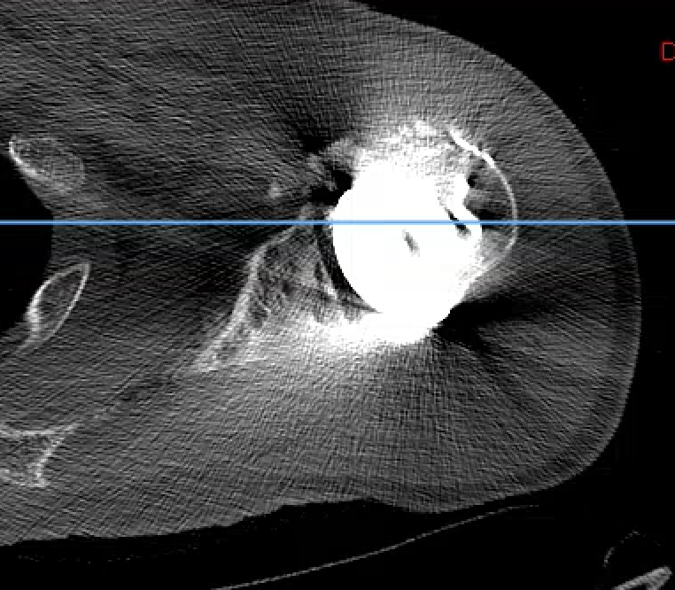
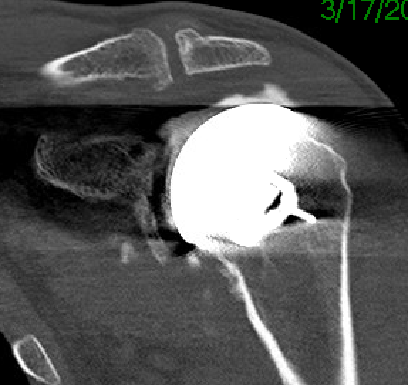
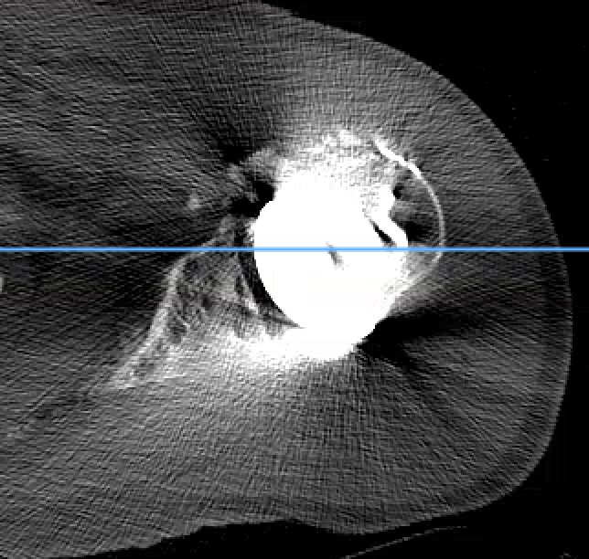
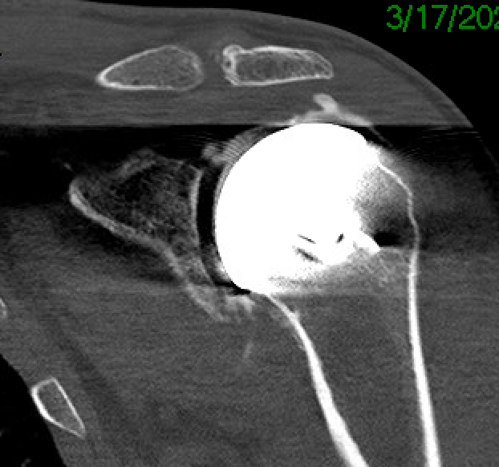
CT arthrogram
Shows high-grade partial thickness and likely full thickness rotator cuff tear

Slide 7
Patient now 3 months post-op from TSA and 6 weeks post injury. Options?
Attempt to treat conservatively and continue to try to rehab TSA
Attempt cuff repair
Scope
Open
Revise to reverse

