Slide 1
Case Presentation
Codman Shoulder Society

Slide 2
History
CC Right Shoulder Pain
HPI:
44F RHD presents with RIGHT shoulder pain she felt on ice in 2013. At that time, she sustained a type I ACJ separation and labrum tear. She underwent an arthroscopic labral repair and debridement around her ACJ by an outside provider. She had continued pain at her ACJ and then underwent a distal clavicle excision in 2014. However, she sustained a 2-3 type AC separation and underwent a ligament reconstruction with some type of allograft in 2016. The graft was rejected, so she underwent an attempt for reconstruction using her own ligaments in 2017. Also, her clavicle fractured. She had two 2 IME’s performed in her worker’s compensation case. She has failed conservative management and presented for further treatment options.
PAIN: 4-8, Constant, Difficulty with overhead activities
SSV: R = 25%
SLEEP: Night pain.
PMHx: None
PSHx: R Shoulder Surgeries x 4
Allergies: NKDA
Social: No tobacco use. Drinks alcohol socially.
Occupation: Unable to work
Social Support and Living: Lives with husband

Slide 3
PE
Height: 5'7"
Weight: 155lbs
Pertinent Positive Findings in shoulder exam:
Shortening of her right shoulder. Deformity and instability at the distal clavicle with loss of soft tissue. Skin is intact.
Motion (AROM)
Forward Flexion R: 150 L : 160
Abduction: R: 140 L : 150
External Rotation: R: 50 L : 50
Internal rotation Adduction: R: Th12 L : Th12
ABduction/ER: Right 90 @ 90 degrees, Left: 90 @ 90 degrees
Abduction/IR: Right 70 @ 90 degrees, Left: 70 @ 90 degrees
RIGHT Shoulder Special Tests:
AC joint TTP: Positive
Cross body Adduction: Positive
Impingement signs:
Hawkins: Positive
Neers: Positive
Biceps tendon tenderness: Positive
Speed's Sign: Positive
Strength: 5/5 for all rotator cuff muscles and deltoid.

Slide 4
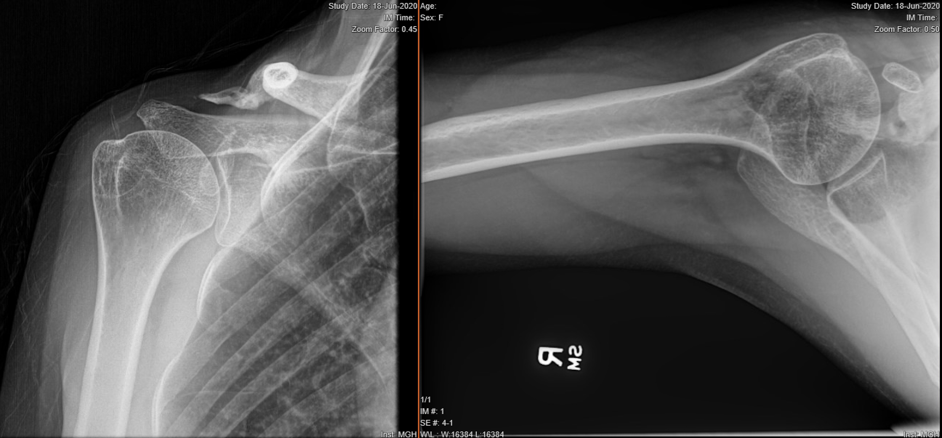
XR – Right Shoulder

Slide 5
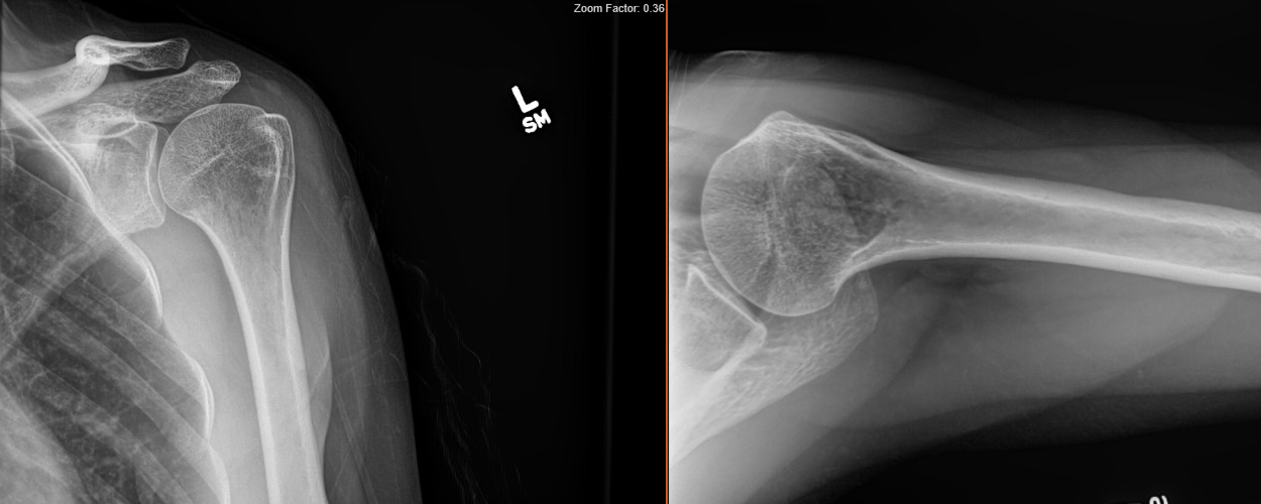
XR – Left Shoulder for Comparison

Slide 6
CT – Right Shoulder

Slide 7
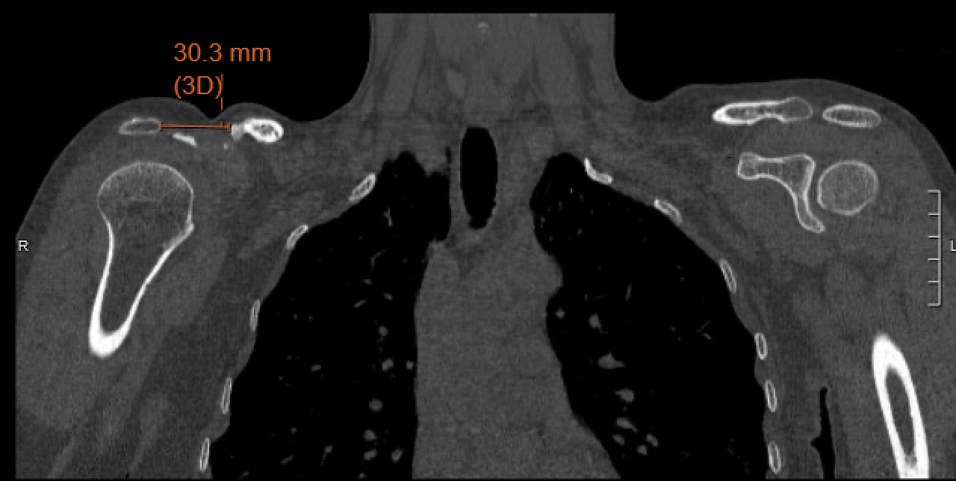
CT Bilateral Shoulders

Slide 8
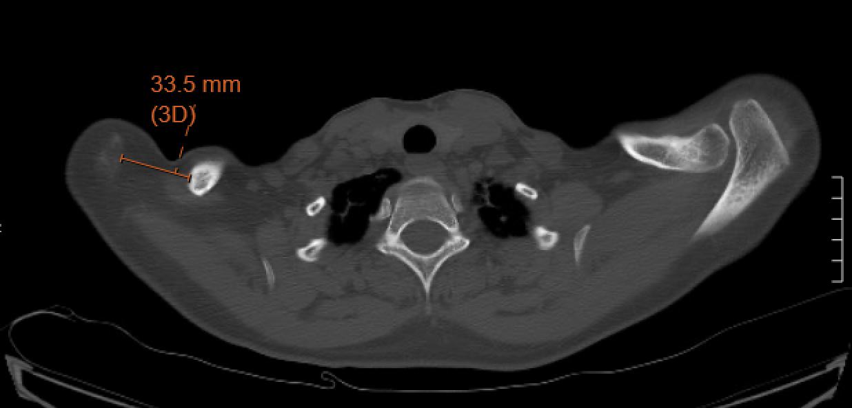
CT Bilateral Shoulders

Slide 9
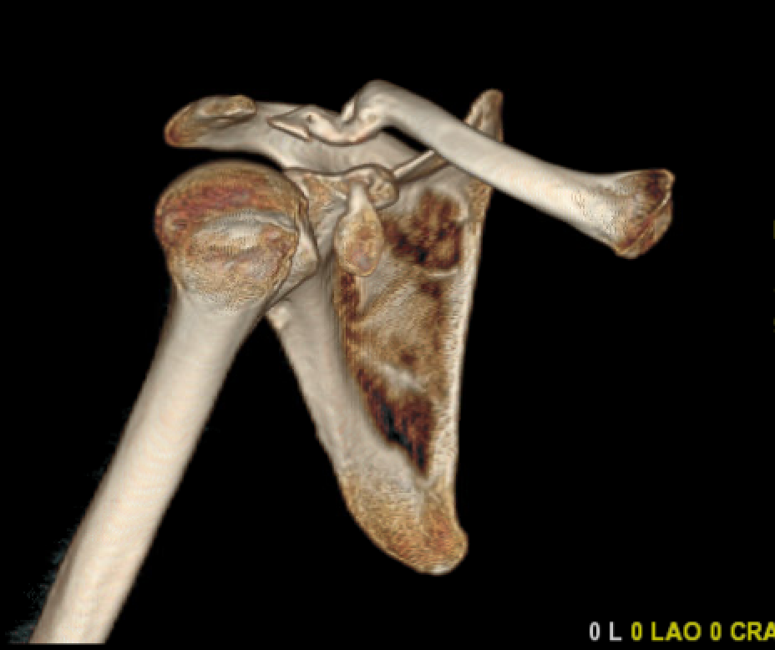
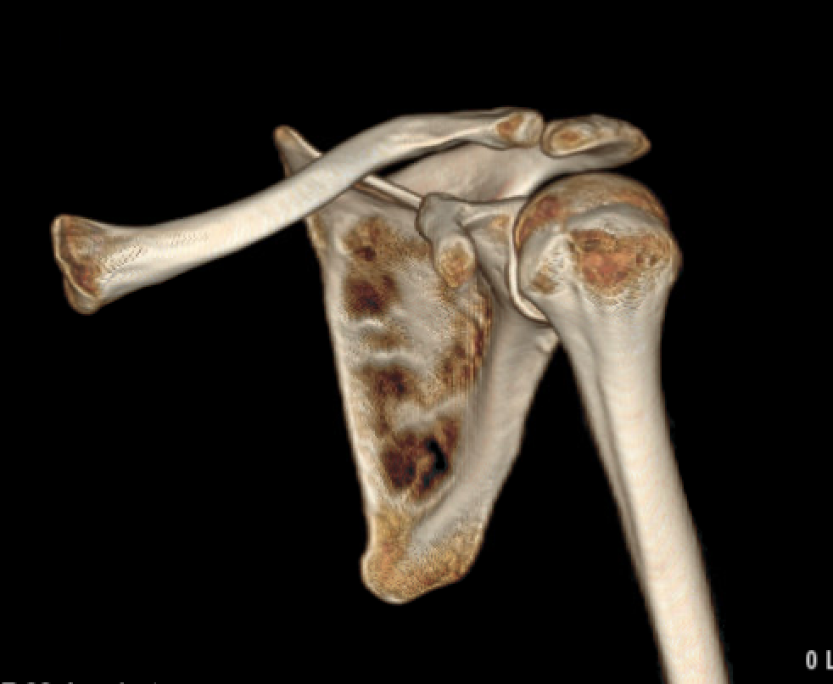
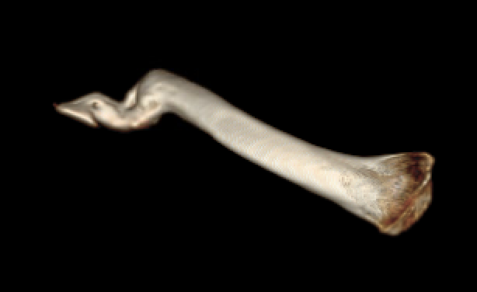
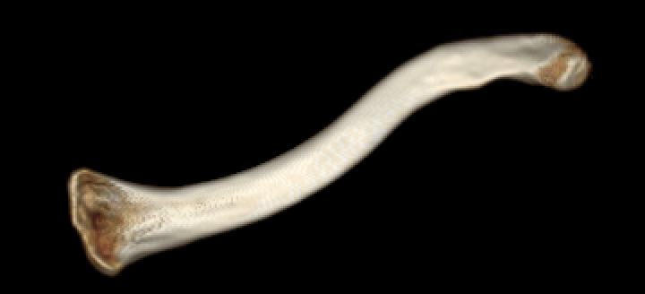
Right Shoulder
Left Shoulder

Slide 10
Case Summary
Summary
Age: 44F
Diagnosis
Right Lateral Clavicular Insufficiency
Plan
Right Scapulothoracic Fusion
Other Suggestions?

