Slide 1
Codman Case
03/04/2018

Slide 2
Patient 38 y/o M
ID: 38 y/o RHD M with RIGHT shoulder pain
HPI: RIGHT shoulder pain x 2 years.
Rest pain 3/10; Activity pain 8/10
Aggravated by overhead activities (eg. throwing)
PT for 3 months – no benefit
PMHx: Aortic insufficiency, Aortic stenosis, Bicuspid valve – asymptomatic with no exertional dyspnea
Meds: ASA, Metoprolol Allergies: None
SH: Non-smoker; Limited Alcohol use

Slide 3
Patient 38 y/o M
Physical Exam:
AROM/PROM
FF: 160/160
ABD: 80/80
ER: 50/50
IR: T8
Strength: 5/5ABD, ER, IR
Impingement signs: negative
Biceps: + Speeds + O’Briens
+ Pain with Posterior loading
NVI

Slide 4
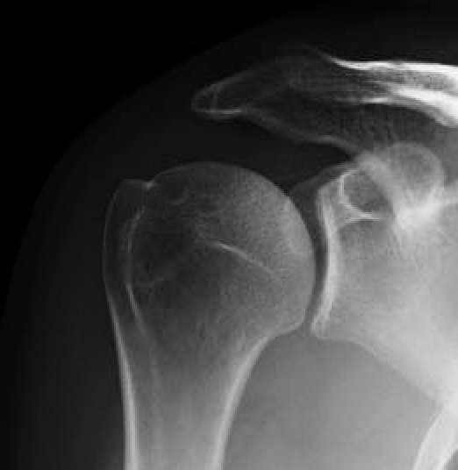
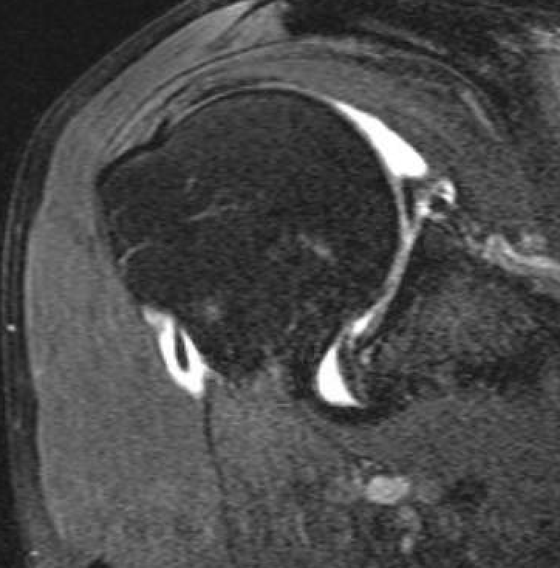
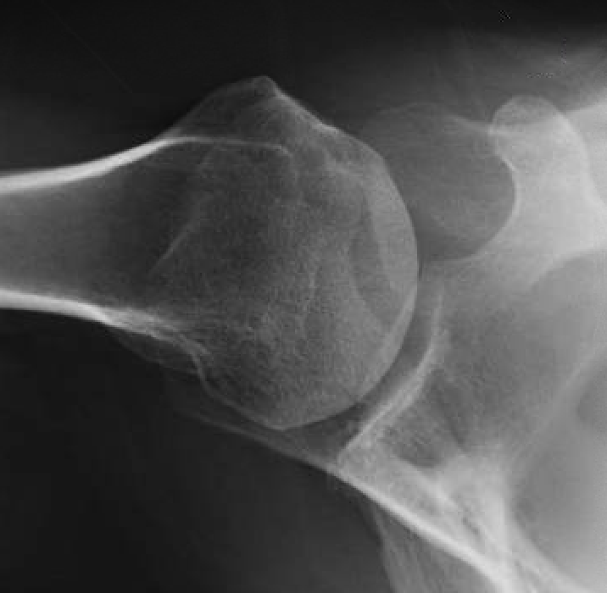
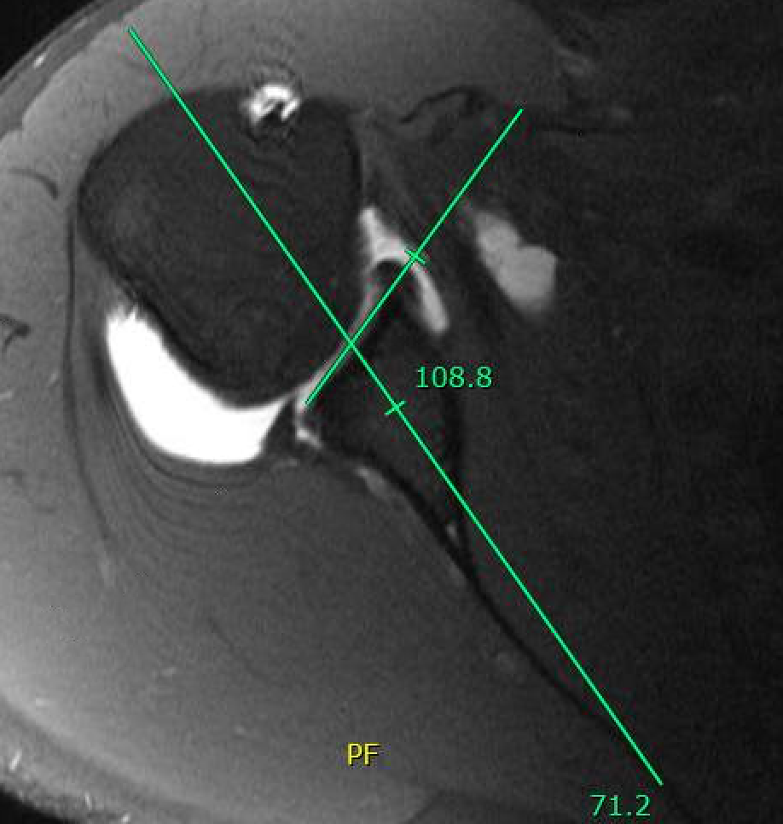
Patient 38 y/o M

Slide 5
Patient 38 y/o M
ID: 38 y/o RHD Male
Posterior/Superior Labral Tear
Failed Non-operative Management
19 degrees retroversion
Surgical Plan???
Posterior Labrum Repair + Biceps Tenodesis
Posterior Labrum Repair + SLAP Repair
Glenoid Osteotomy
Posterior Bone Grafting

Slide 6
Patient : 48 y/o M
ID: 38 y/o RHD M with RIGHT shoulder pain
HPI: RIGHT shoulder pain x 6 years.
Previous Posterior Labrum and SLAP repair 10 years ago
Pain 2/10 at rest; 6/10 with activities
SSV = 50%
PMHx: Aortic insufficiency, Aortic stenosis, Bicuspid valve – asymptomatic with no exertional dyspnea; HTN; Dyslipidemia
Meds: ASA, Metoprolol Allergies: None
SH: Non-smoker; Limited Alcohol use

Slide 7
Patient : 48 y/o M
Physical Exam:
AROM/PROM
FF: 160/160
ABD: 80/80
ER: 50/50
IR: T8
Strength: 5/5ABD, ER, IR
Impingement signs: negative
Biceps: + Speeds + O'Brien's
+ Pain with Posterior loading
NVI

Slide 8
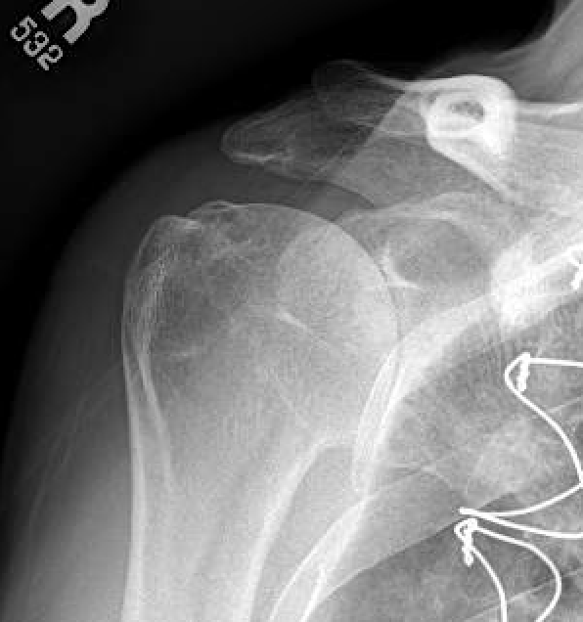
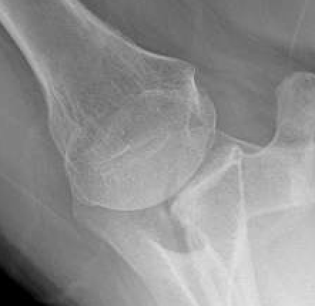
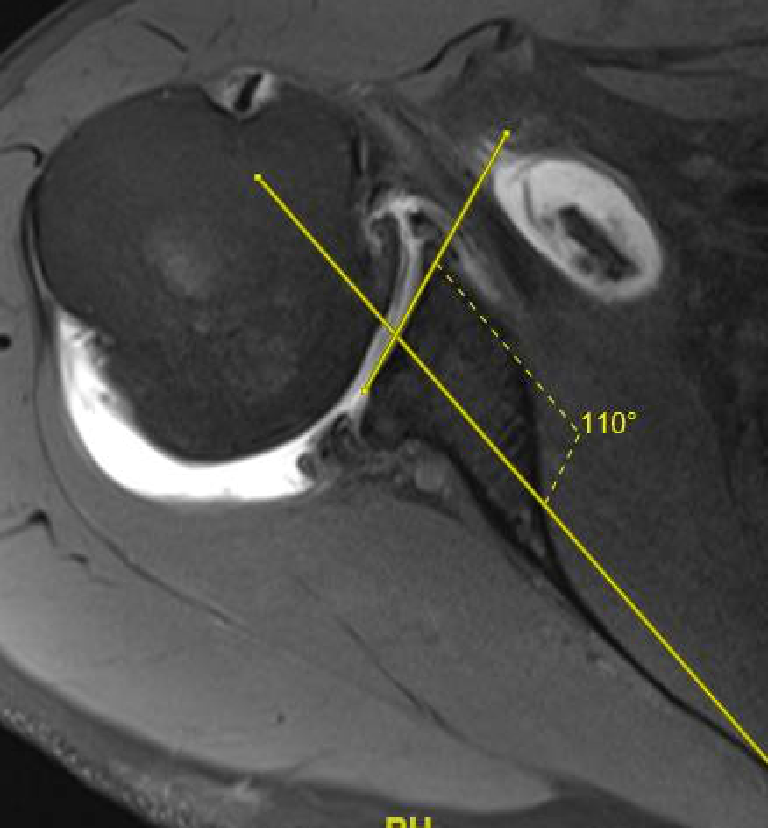
Patient 48 y/o M

Slide 9
Patient: 48 y/o M
ID: 48 y/o RHD Male
Posterior/Superior Labral Tear
Degenerative arthritis
>20 degrees retroversion
~80% posterior subluxation
Surgical Plan???
Revision Posterior Labrum Repair + Biceps Tenodesis
Glenoid Osteotomy
Hemiarthroplasty + Ream & Run Glenoid
TSA + Augmented Glenoid
TSA + Posterior Bone Grafting

