Slide 1
Difficult Case
M. Daniel Hatch
RCM Clinic, Park City

Slide 2
Patient RJ
Chief complaint: Left shoulder pain and weakness
HPI: 69 y.o. RHD M with a complicated left shoulder history
10 years ago developed iatrogenic brachial plexus palsy that affected his radial and musculocutaneous nerves
2011 – C5-C7 fusion
2016 – radial nerve transfer to the axillary and musculocutaneous nerves, anterior deltoid still atrophied
2018 – TSA (LTO)
2019 – Revision TSA due to loose humeral component (LTO healed, subscap peeled)
2019 – One week later got I&D for frank infection (subscap ruptured, repaired)
Currently on doxycycline until follow-up with ID in December.
SST 0/12. Pain while sleeping. Did physical therapy with no further improvement.
Pain 8/10

Slide 3
History (cont)
PMH: HTN, enlarged prostate, high cholesterol
Meds: Flomax, Flexeril, Losartan, simvastatin, memantine, norco, tramadol, Tylenol
ALLERGIES: NKDA
Social History: Social alcohol, no tobacco or drugs.

Slide 4
Exam
5”11 172 lb
Atrophied anterior deltoid.
ROM:
AFE 30 (PFE 145)
AER 30
AIR buttock
Strength
3/5 abduction, 4/5 IR, 5/5 ER
+belly press, +liftoff, +cross arm adduction.
Incision is well-healed
Gross sensation intact in median, ulnar, radial, and axillary nerves, although over the anterior deltoid there is decreased sensation.

Slide 5
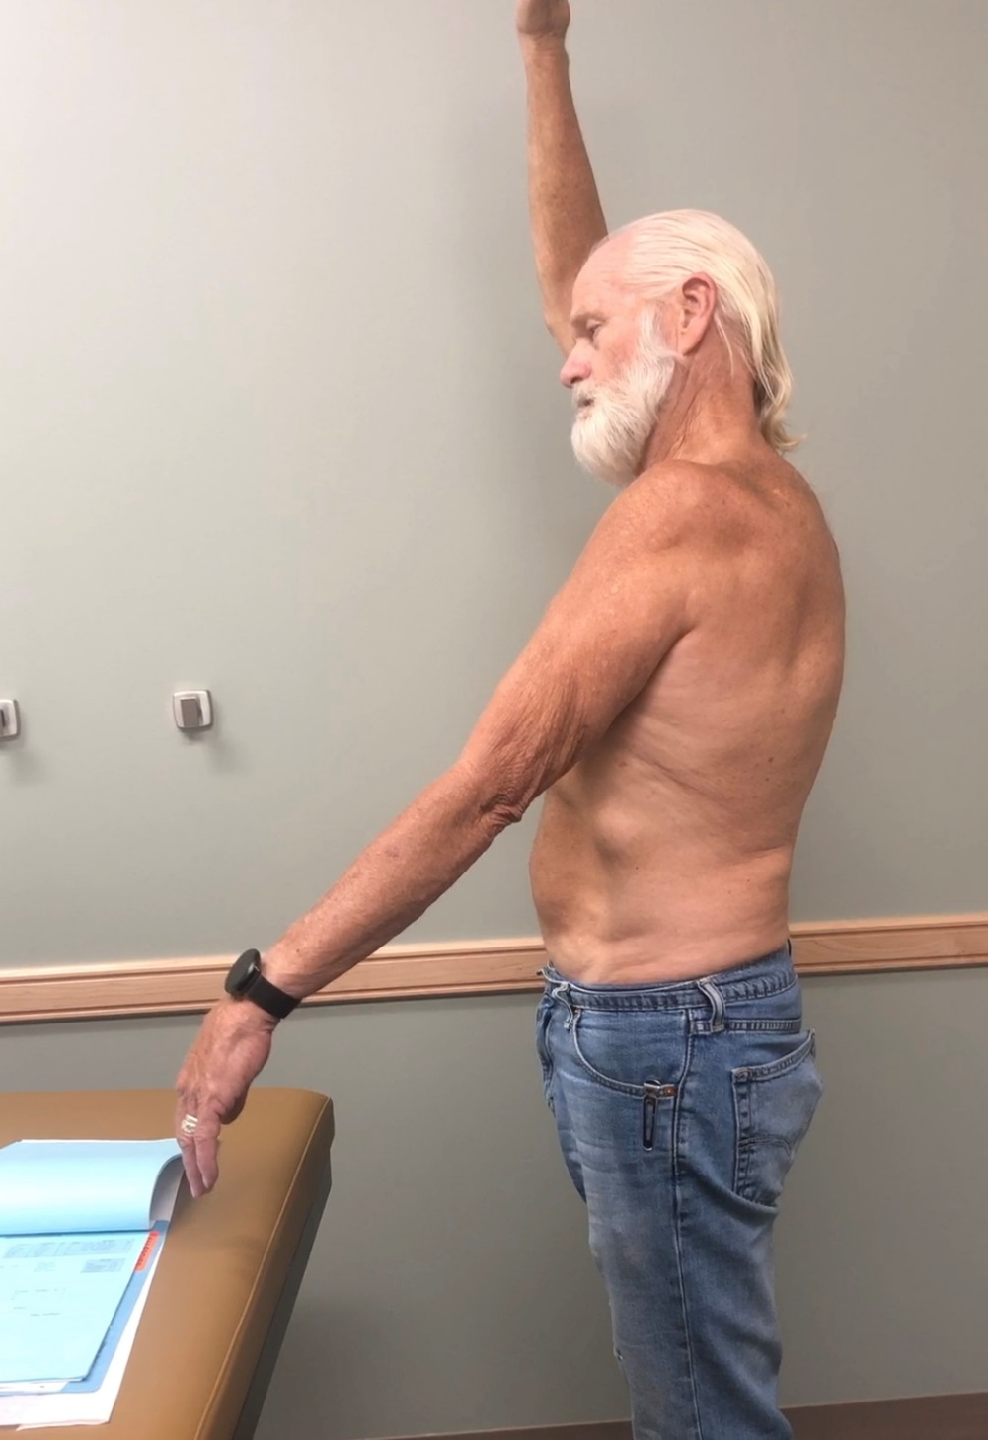
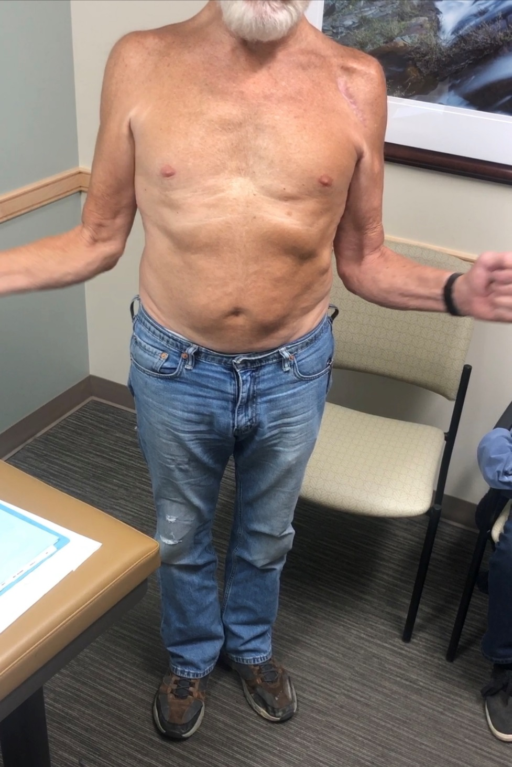
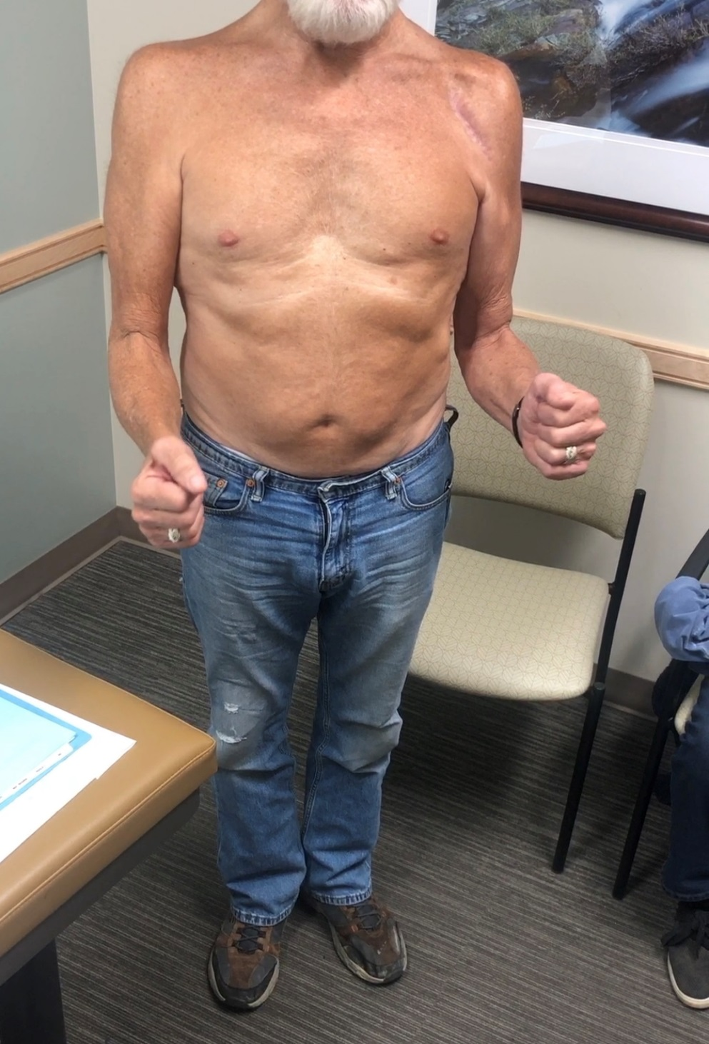

Slide 6
Studies
EMG: showed chronic denervation and chronic reinnervation of deltoid

Slide 7
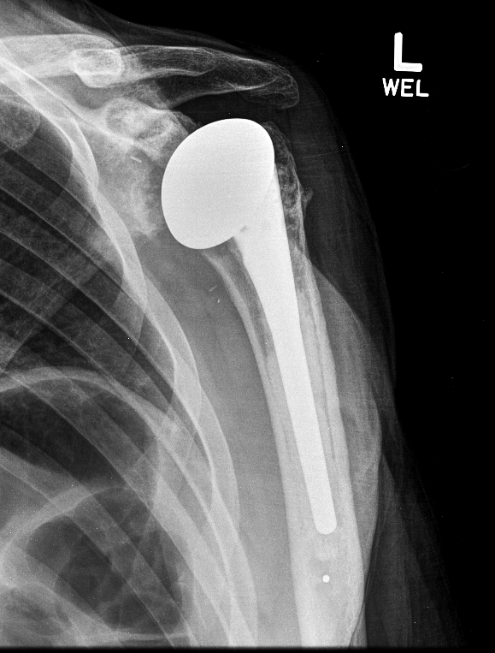
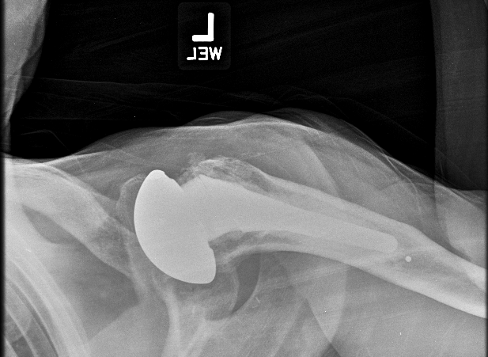

Slide 8
What to do??
Do nothing
Repair subscap again
Do a transfer to compensate for subscap failure
Revise to RSA (+/- transfer)

