Slide 1
Case Presentation
Codman Shoulder Society

Slide 2
History
CC Right Shoulder Pain
HPI:
38M RHD presents with chronic right shoulder pain which began around 2016. He denies any trauma or injury. He was previously seen by an outside provider and diagnosed with biceps tendonitis. He has trialed PT and biceps injection without improvement. He was noted to have mild glenoid dysplasia and osteoarthritis. His symptoms have worsened, and he is miserable. Major complaint is pain. He presented here for further management.
PAIN: 8/10
SSV: L = 40%
SLEEP: Night pain.
PMH: none
PSH: nasal surgery
Allergies: NKDA
SH: No tobacco use. Social EtOH
Occupation: software engineer
Social Support and Living: Lives alone in Brookline

Slide 3
PE
Height: 6'1"
Weight: 190 lbs
Motion (AROM-PROM)
Forward Flexion R: 130 - 130 L : 160 - 160
Abduction: R: 120-120 L : 140 - 140
External Rotation (in adduction): R: 60 L : 60
Internal rotation Adduction: R: T8 L : T8
Abduction/ER: Right: 90 @ 90 degrees, Left: 90 @ 90 degrees
Abduction/IR: Right: 20 @ 90 degrees, Left: 60 @ 90 degrees
Positive for O'Brien's, Speeds test
Instability tests are negative other than posterior load test is very painful. Negative Apprehension, Jobe Relocation, etc

Slide 4
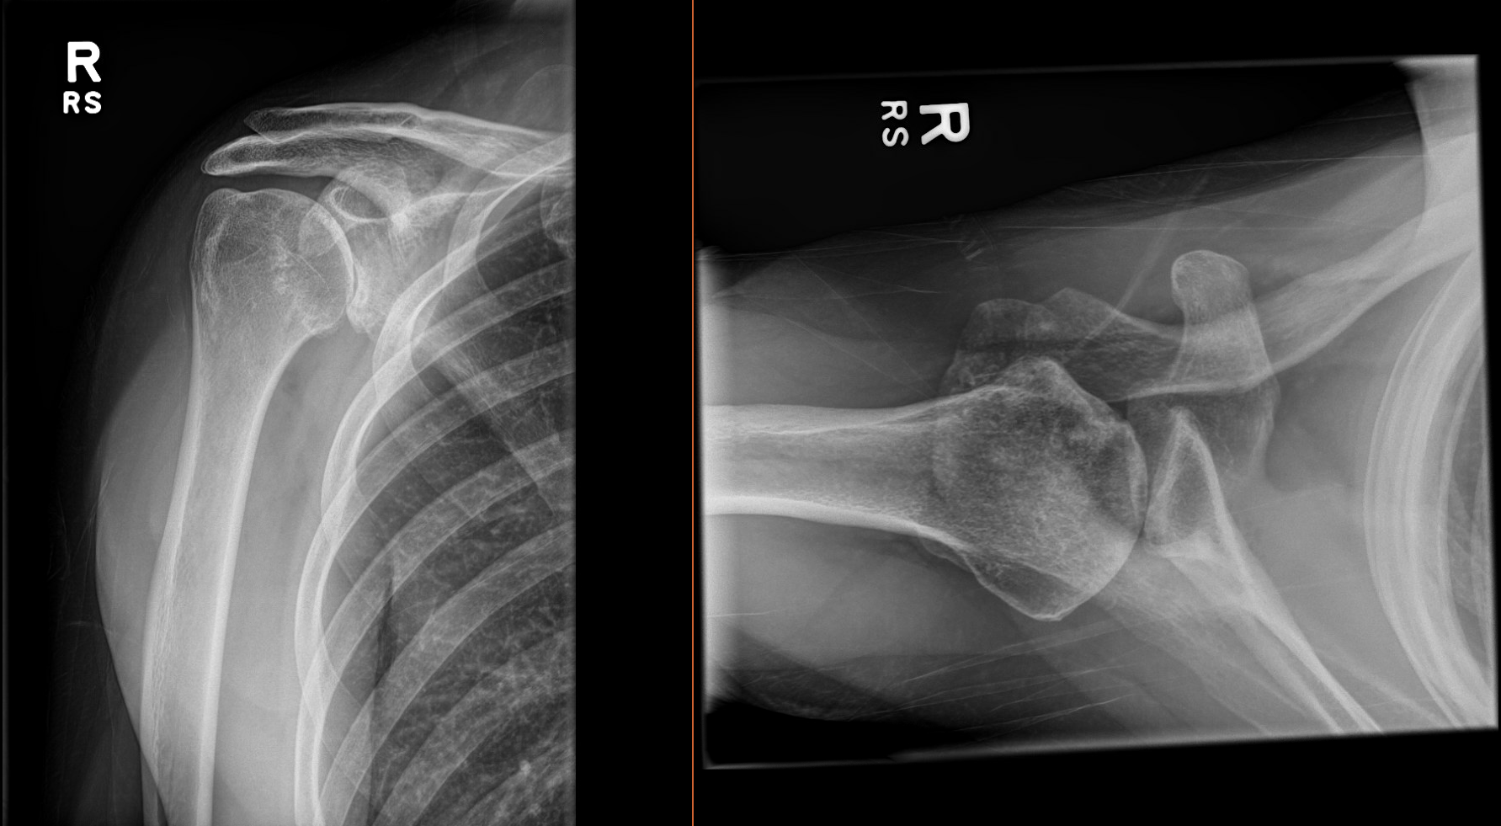
Right Shoulder XR

Slide 5
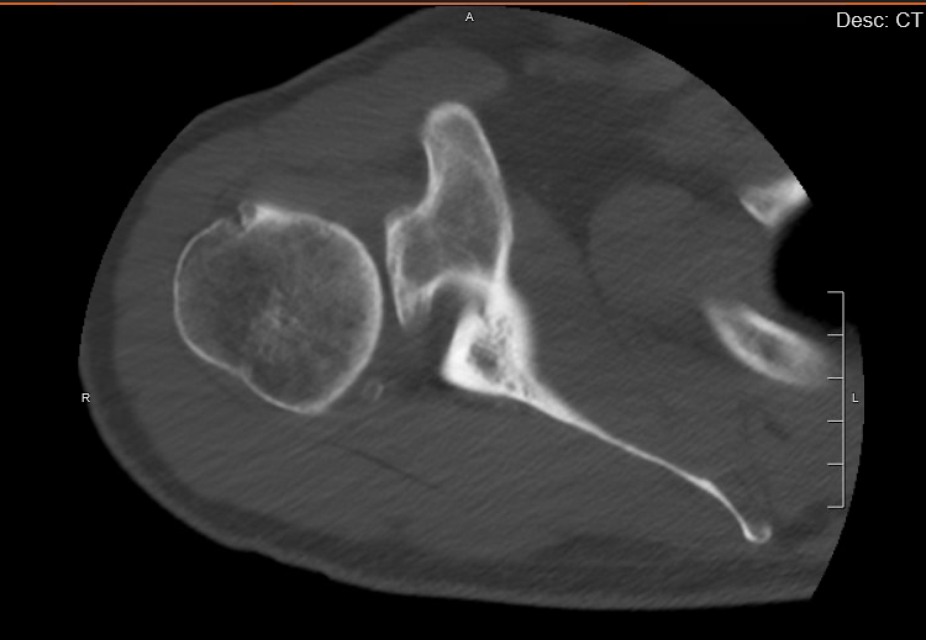
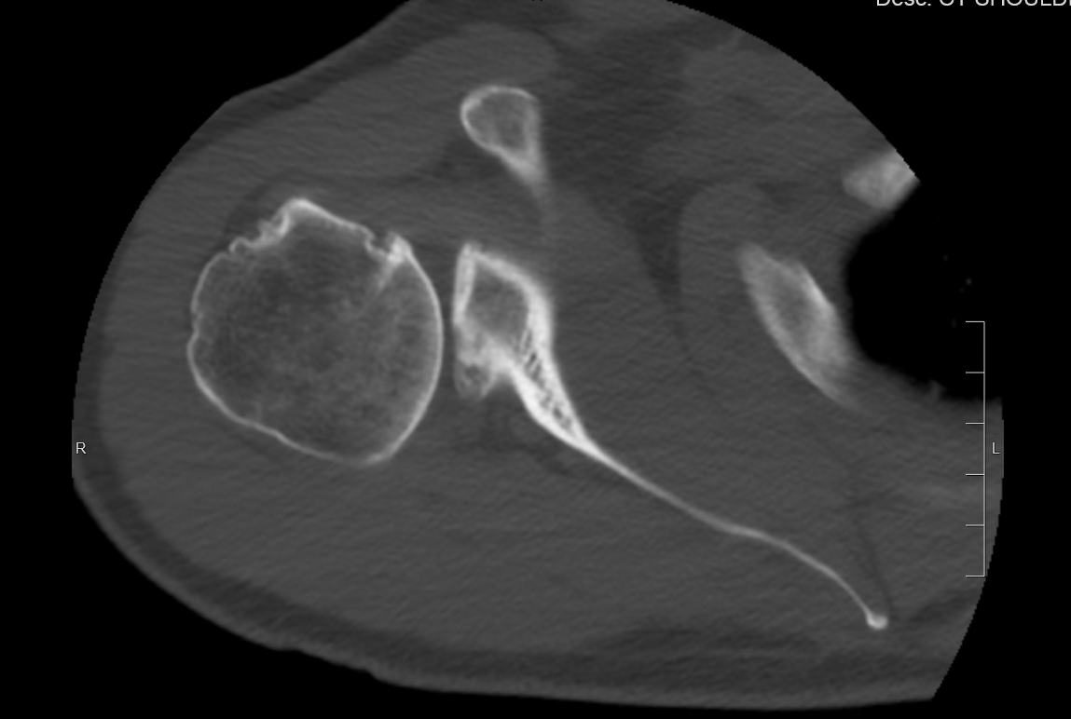
Right Shoulder CT
CT showed posterior subluxation > 90% of humeral head with sclerosis of posterior glenoid and arthrosis.
Appearance is suggestive of more of a fracture than dysplasia
Approximately 33 degrees of retroversion

Slide 6
Summary
Case
Age: 38M
Diagnosis
Chronic glenoid fracture versus dysplasia in the setting of significant glenoid retroversion and posterior humeral subluxation
Options
Right Shoulder Arthroplasty - RSA
Right Glenoid Bone Graft Reconstruction
Right Shoulder Fusion
Other Suggestions?

