Slide 1
69F with bilateral shoulder pain
Attending: Rick Matsen

Slide 2
HPI
RC
69 year old female, ambidextrous, with longstanding bilateral (R>L) shoulder pain (~15 years)
Pain severity 8 out of 10 bilaterally
Symptoms occur when trying to sleep and when using the arm.
PMH: Ectrodactyly-Ectodermal Dysplasia Clefting syndrome; reports intolerance to all opiates; prior breast cancer s/p lumpectomy and 1 week of radiation in 2018
PSH: bilateral THA, multiple fascia reconstructive procedures

Slide 3
Pertinent Physical Exam
ROM bilaterally: FE to 120, ER adduction 20, ERA 40, IRA 0
Strength: supra 5/5 bilateral, ER: right 5-/5, left 5/5, negative belly press bilateral
Neurovascularly intact

Slide 4
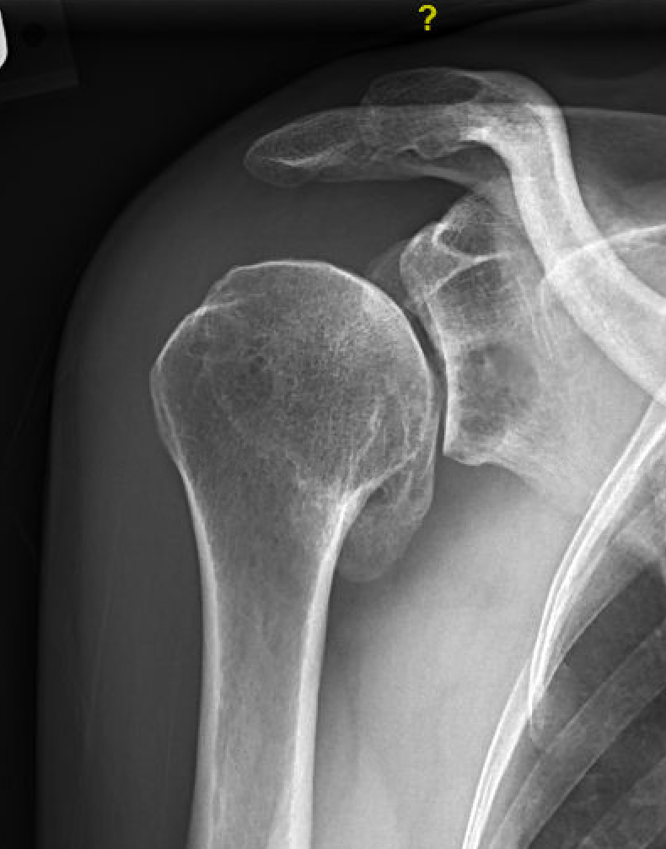
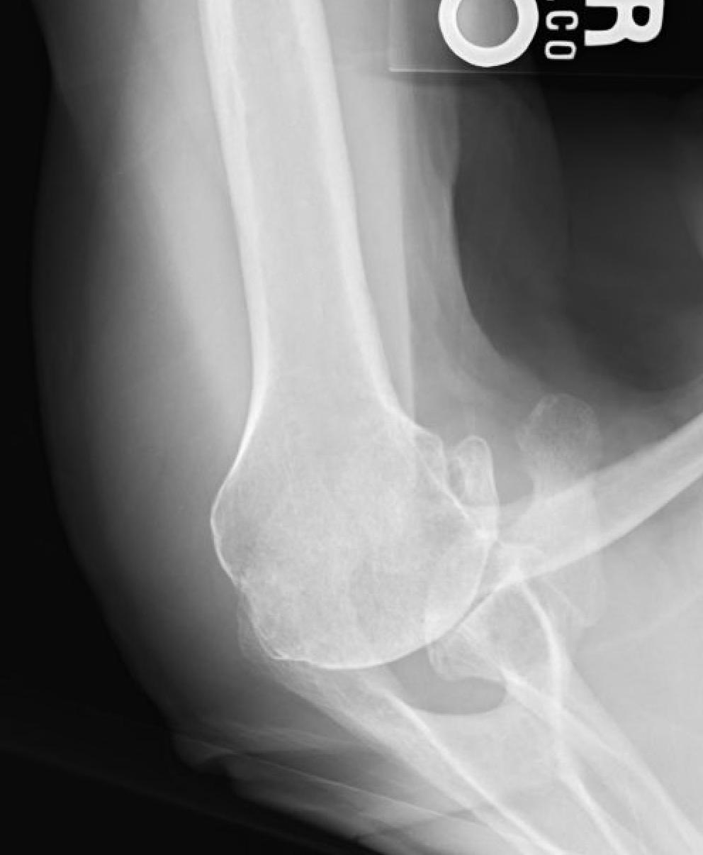
Radiographs (right)

Slide 5
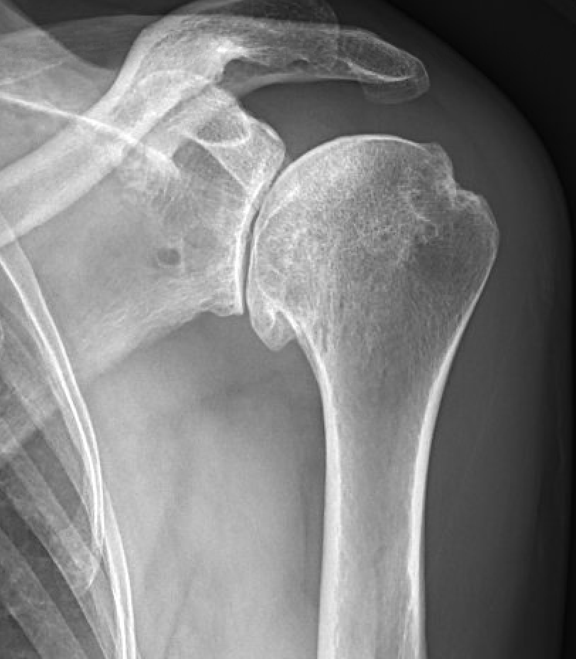
Radiographs (left)

Slide 6
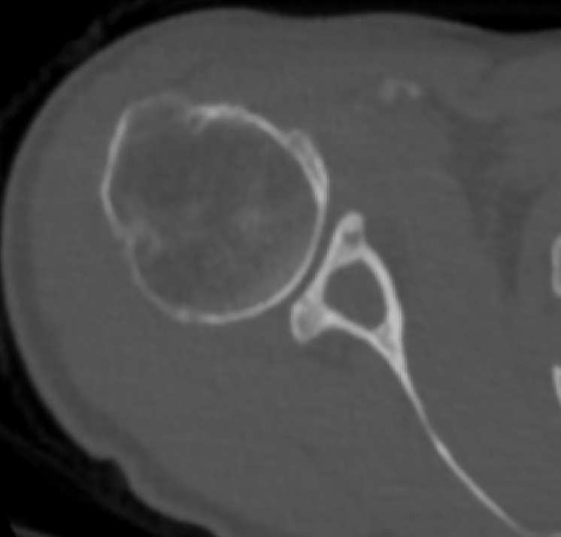
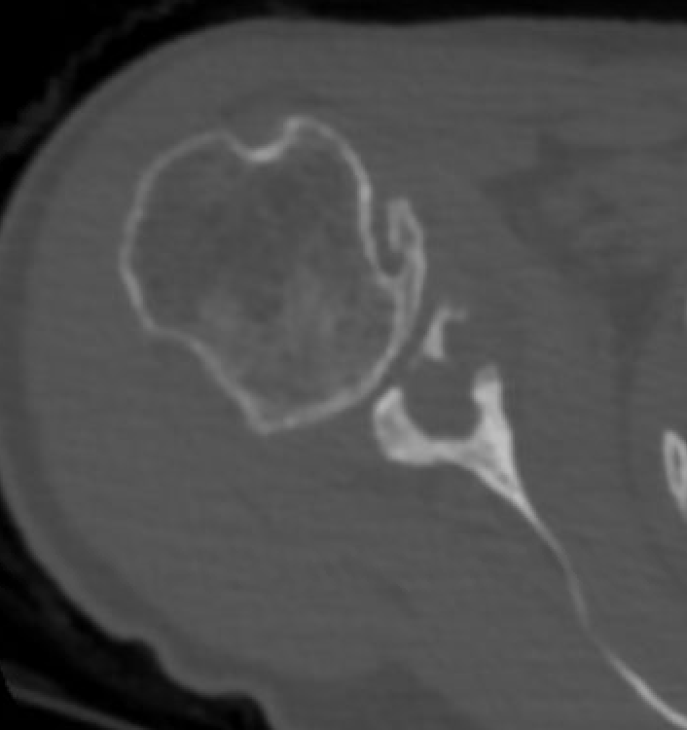
CT axial – right shoulder

Slide 7
CT coronal – right shoulder

Slide 8
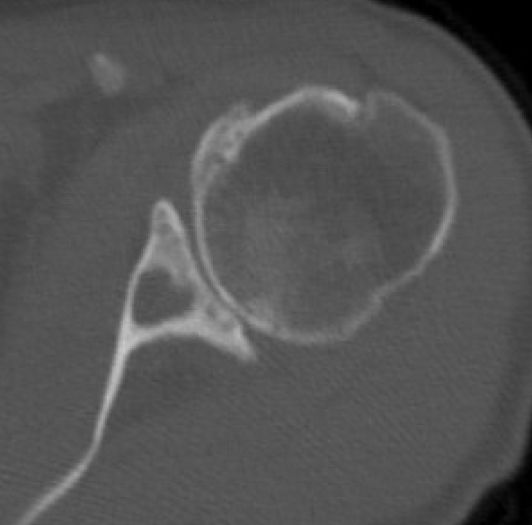
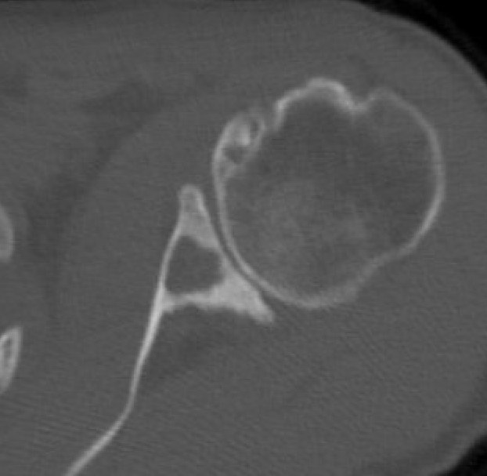
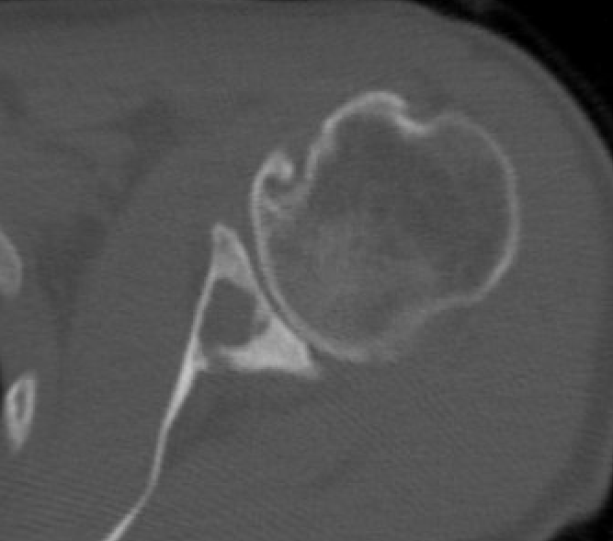
CT axial – left shoulder

Slide 9
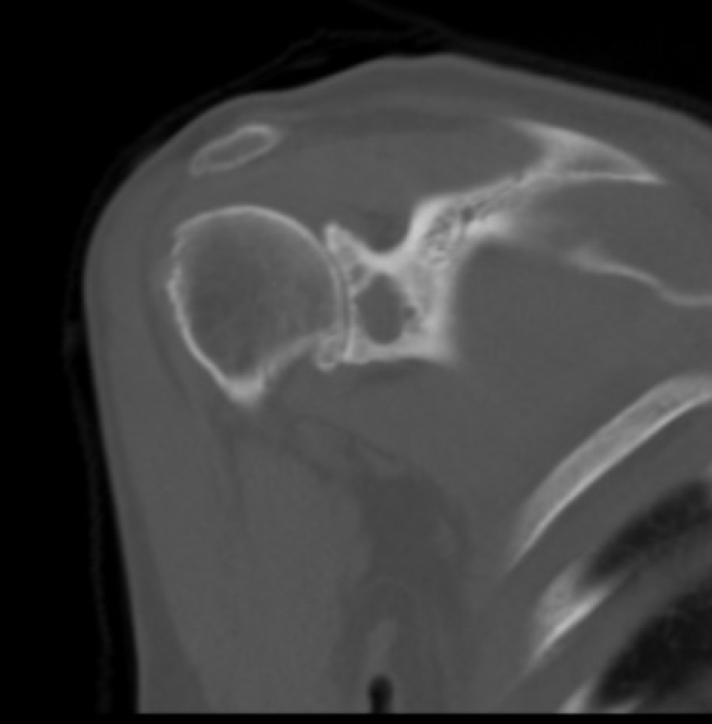
CT coronal – left shoulder

Slide 10
Assessment
MRI w/ and w/o contrast negative for malignant etiology of glenoid cysts
Assessment: Bilateral glenohumeral arthritis with glenoid cavity cysts
Treatment options
Conservative management
Single stage hemiarthroplasty or reverse with bone grafting to the glenoid
Staged arthroplasty
1st stage: glenoid bone grafting
2nd stage: hemiarthroplasty or reverse
Other thoughts?

