Slide 1
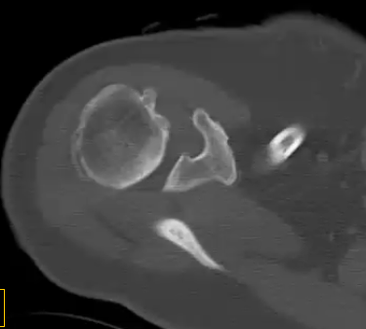
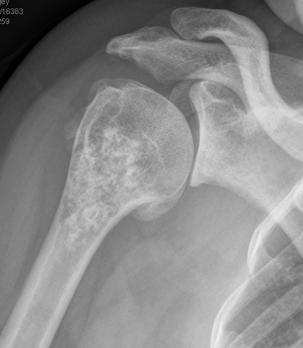
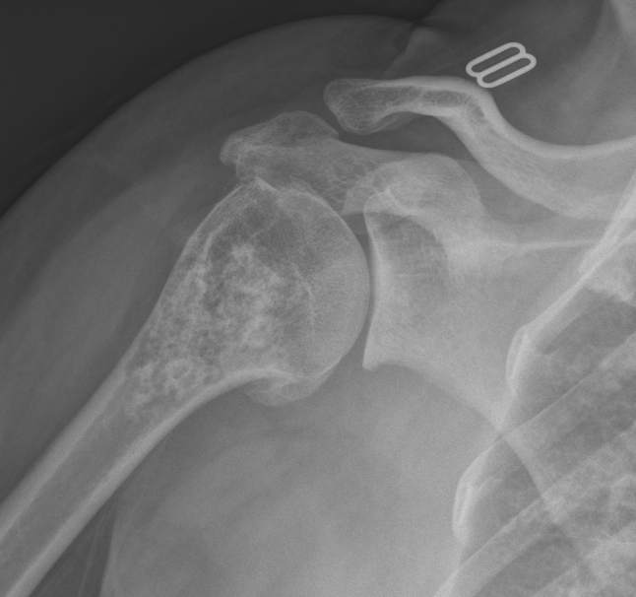
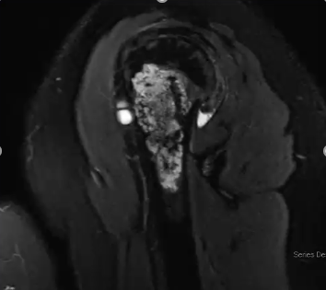
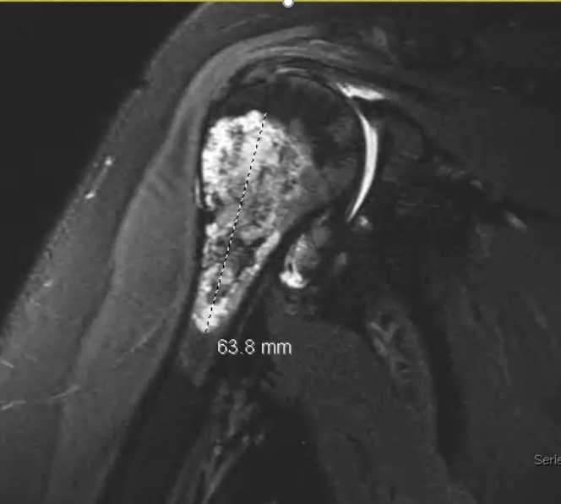
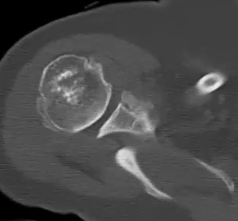
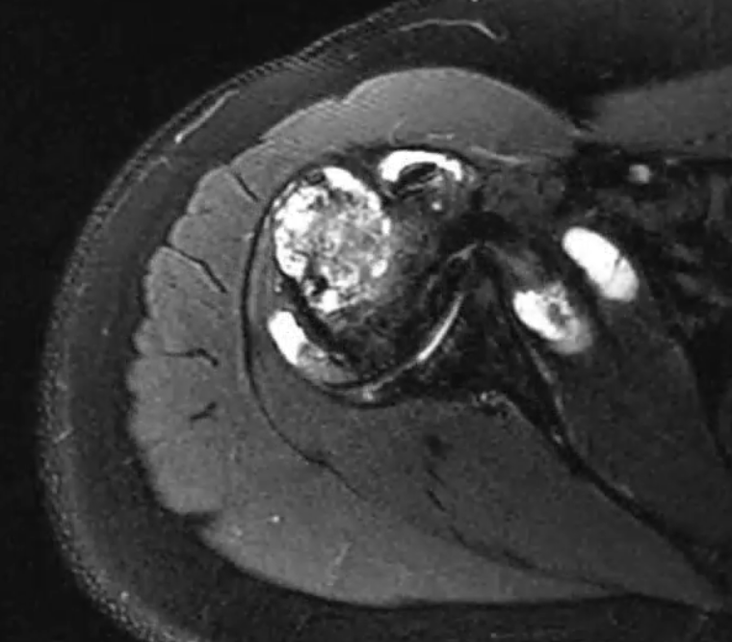
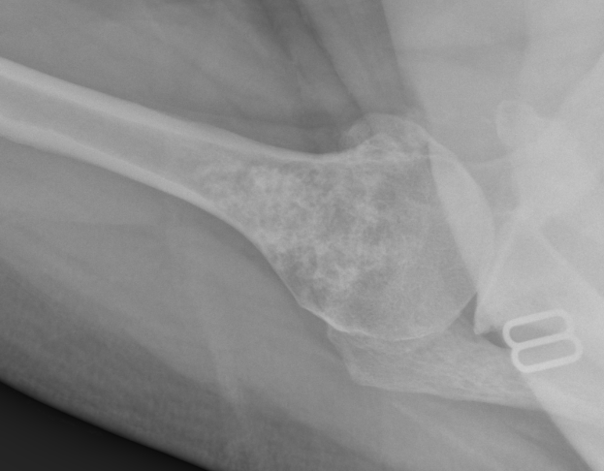
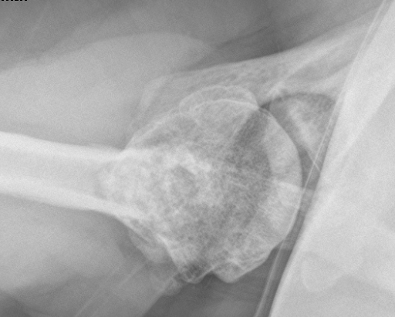
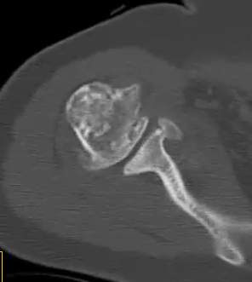
52yo LHD female with right-sided spastic hemiplegic cerebral palsy and large enchondroma
March 2019
June 2019
April 2019

Slide 2
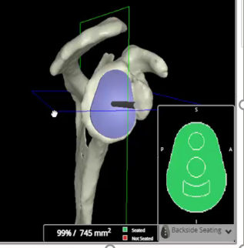
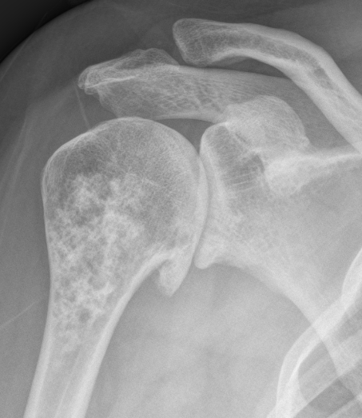
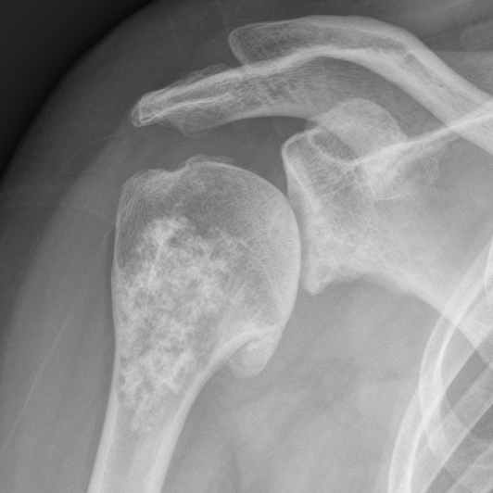
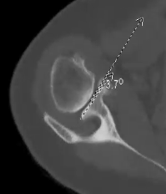
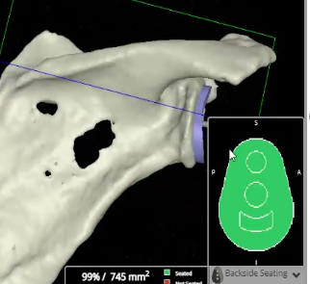
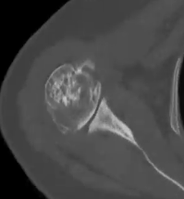
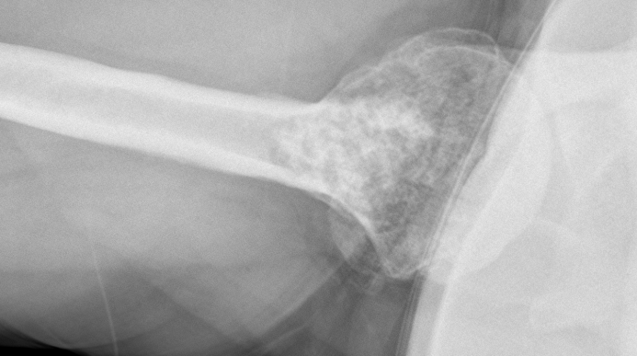
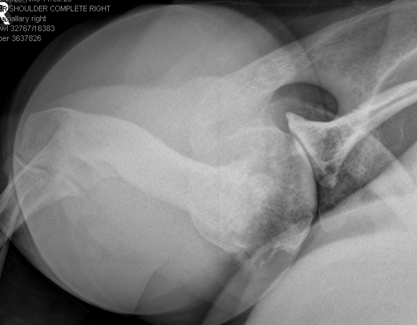
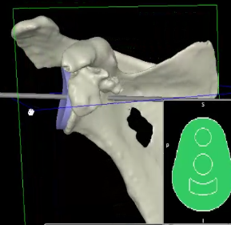
After two glenohumeral injections failed to relieve her pain, she underwent an extensive arthroscopic debridement and capsular release (10/22/19). Tissue was sent for culture. Cultures came back negative no acid-fast bacilli, no aerobic organisms, no fungal organisms, Gram stain negative and C acnes negative after being held for 21 days. VIP Plan and Pre-op CT for Eclipse TSA with humeral head Autograft
September 2019
October 2020
Notes:
10/22/20 is the most recent XR before surgery on 1/20/21

Slide 3
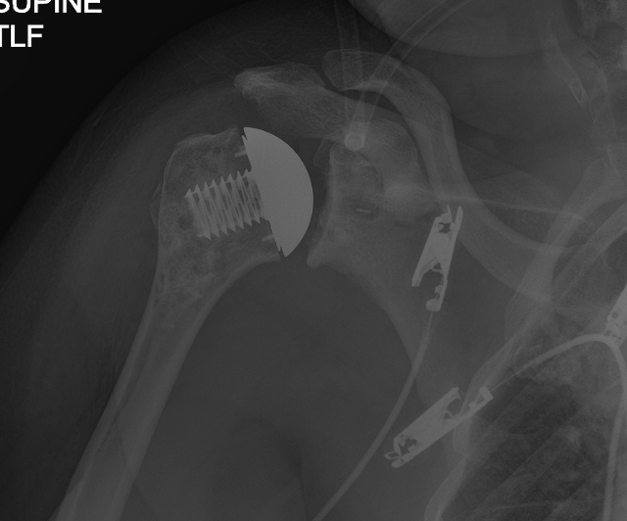
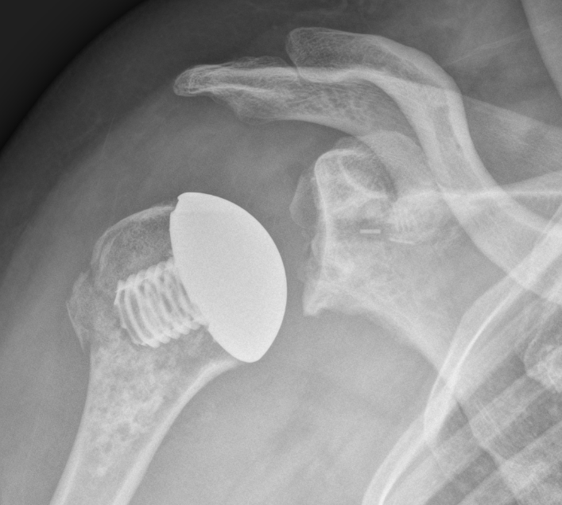
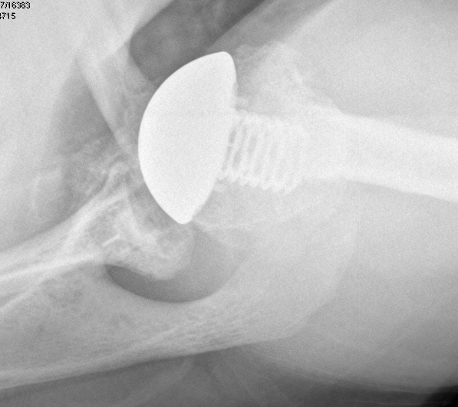
From 10/22/19 to 1/20/21 she tried PT after the debridement but could not complete it because of the pain. Meloxicam, naproxen and voltaren cream have all failed to change her state whatsoever.
On 1/20/21 we performed a curettage of the Enchondroma, and then filled it in with humeral head autograft and cancellous bone allograft (Schiebel technique). A medium cage screw and 43 x 16 eclipse head was placed on the humeral side. The glenoid was prepared with a medium vault lock glenoid cemented with antibiotics and cancellous bone allograft behind the central peg. subscapularis was repaired using 3 fiber tack DR and two 3.9 swivel locks for a double row transosseous equivalent subscapularis repair
Immediate post-op PACU XR
5 Days post-op XR

Slide 4
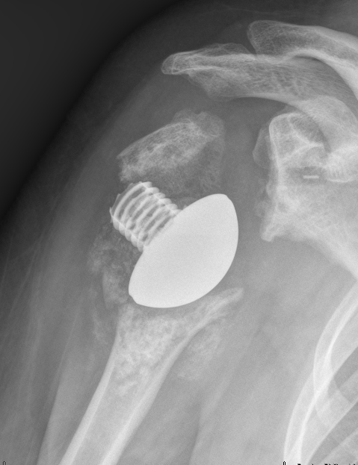
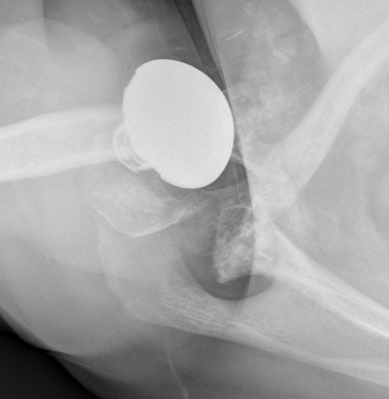
XRs from 1/25/21 show a small metaphyseal crack caused by the tumor removal. On 2/15/21 show an atraumatic catastrophic failure (patient still in sling with no report of falls)with complete disruption of the humeral component and loss of bone. There is significant metaphyseal bone loss. There is still enchondroma present in the metaphyseal region and Path has shown Chondrosarcoma variant. We proposed a removal of all the Enchondroma, Humeral and Glenoid implants followed by a long-stem reverse with the Exactech Equinox humeral reconstruction prosthesis.
5 Days post-op XR
1/25/21
3 weeks post-op
2/15/21

Slide 5
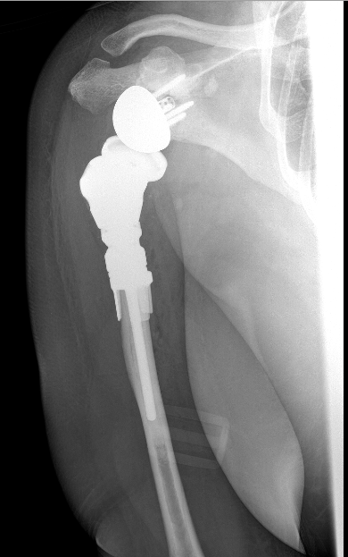
Op notes (2/17/21): UCONN orthopedic oncologist, made a flat cut 1cm distal to the end of the enchondroma, which was planned preoperatively. The Arthrex all poly glenoid was removed and the small ExacTech Equinox baseplate placed with Compression screws superior (30 mm x 4.5 mm), anteriorly (22 mm x 4.5 mm), posteriorly (26 mm x 4.5 mm) and inferiorly (18 mm x 4.5 mm) with locking caps over. The 40 standard glenoidsphere was pressfit with excellent fixation
An 18.5 Equinox humeral fixation ring, and a 6 x 80 cemented stem was impacted and cemented with 1 g of tobramycin and 1 g of vancomycin. We implanted a 25 mm middle segment, a small proximal body Equinox humeral reconstruction prosthesis with a +5 40 standard humeral adapter tray and a 40 +2.5 humeral liner. The humeral component was placed in 40 degrees of retroversion.
Immediate PACU post-op x-ray

Slide 6
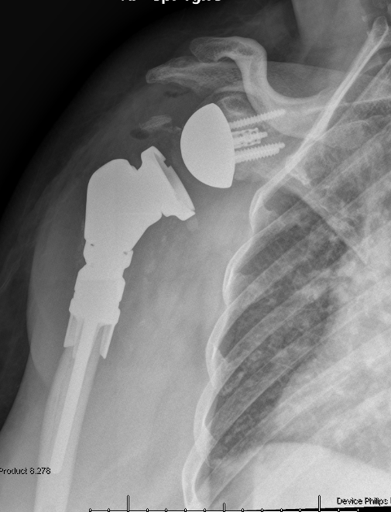
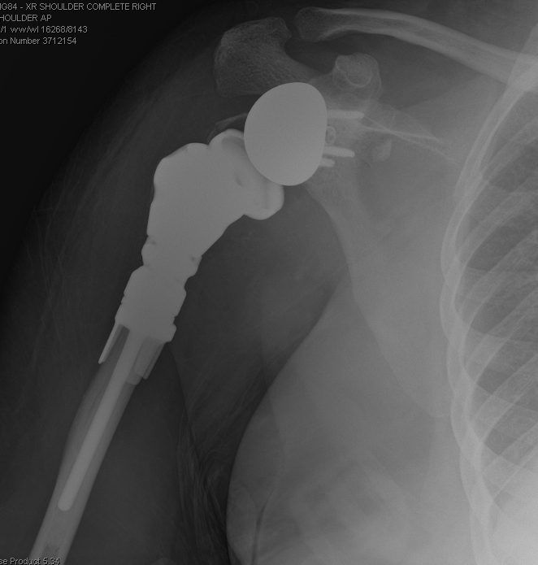
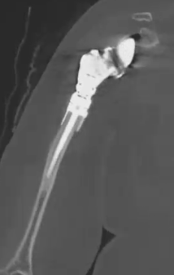
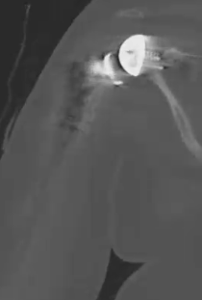
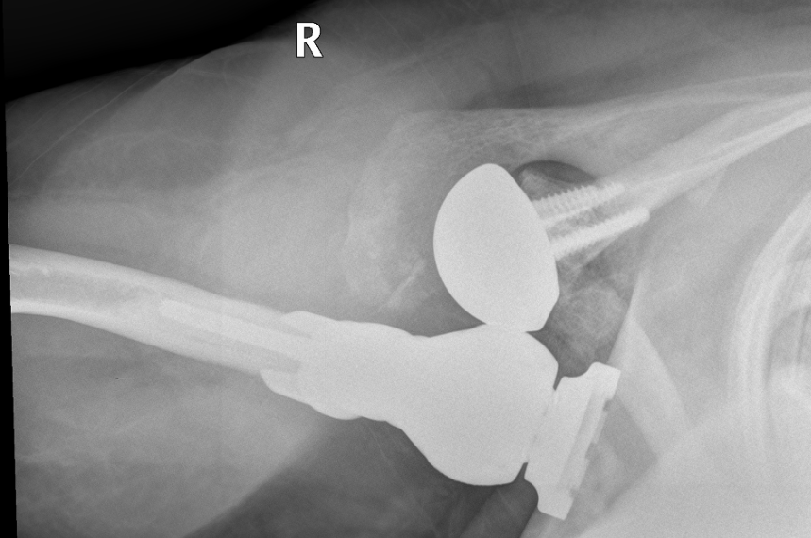
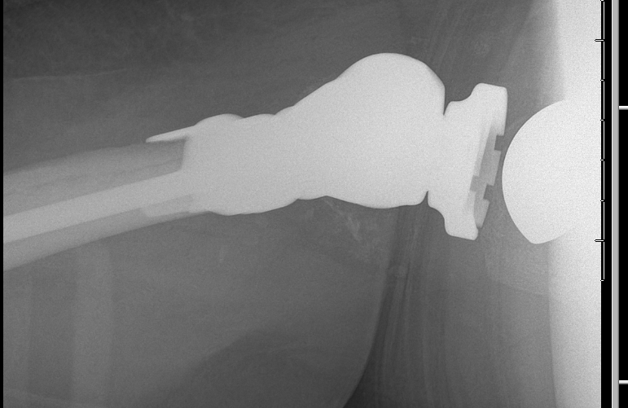
2/22/21 Patient presented at clinic 5 days post-op with pain, x-rays showed dislocation of the prosthesis. She was sent to the ED where they successfully performed a difficult closed reduction
Closed Reduction
After Closed Reduction in ED
2/22/21
5-days post-op in clinic
2/22/21

Slide 7
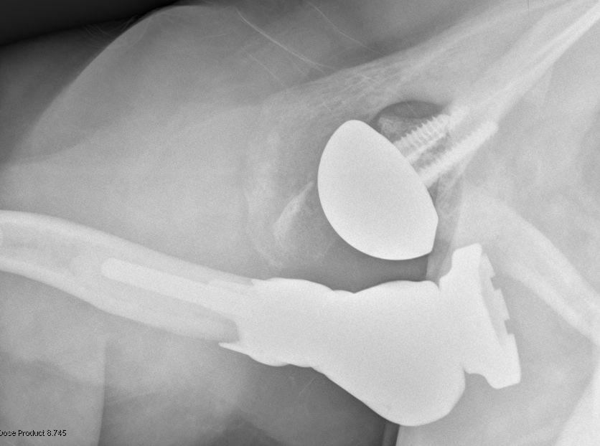
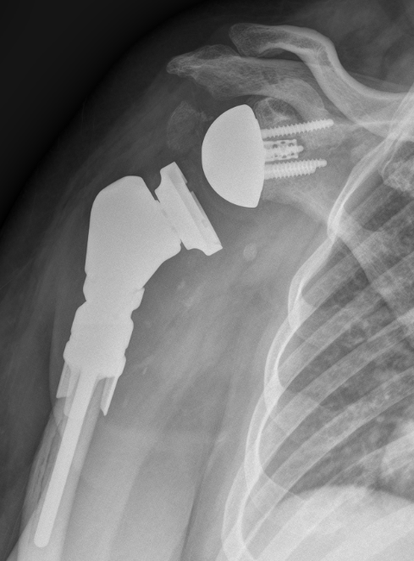
3/1/21 (10 days after closed reduction in ED) Patient re-dislocated shoulder (atraumatic, in the sling, no trauma and very little pain) and was consented for revision surgery to increase the lateralization of the glenosphere and add a constrained liner
10 days post closed reduction
3/1/21

Slide 8
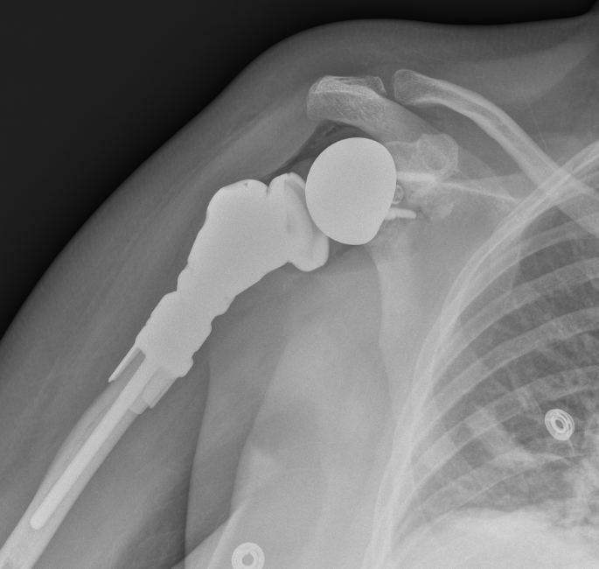
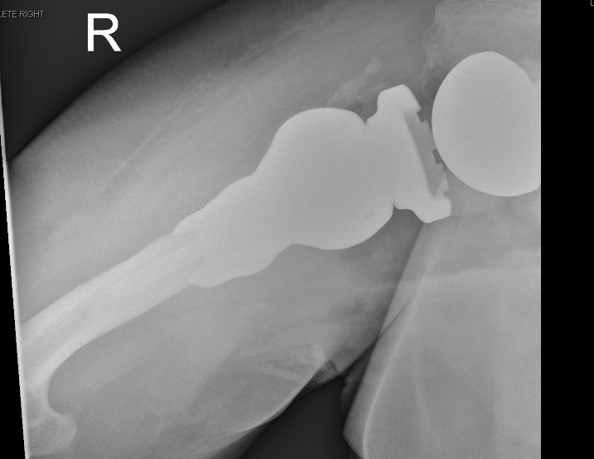
3/4/21 patient underwent revision surgery: the implant was easily reduced in abduction and internal rotation, and no frank pus or necrosis was observable during the initial dissection. The glenosphere was removed add a 40 +4 lateralized glenosphere (we could not go up in size due to the small baseplate). We also added a constrained +2.5 liner. This was very hard to reduce, and when reduced it could not re-dislocate with any type of movement
Immediate post-op PACU XR

Slide 9
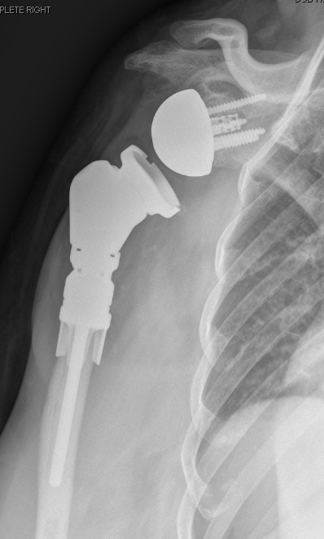
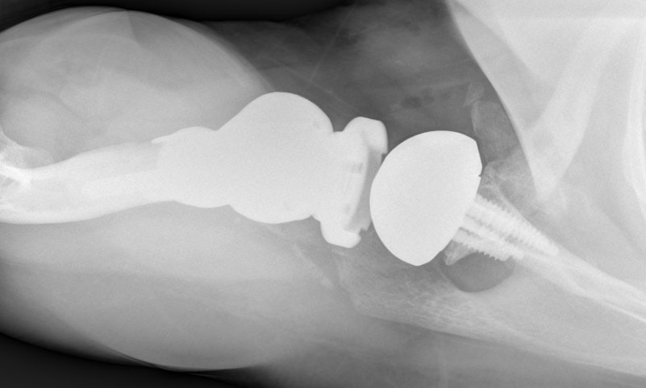
3/11/21, 1 week post-op, patients implant is located and patient feels much better
1 week Post-op
3/11/21

Slide 10
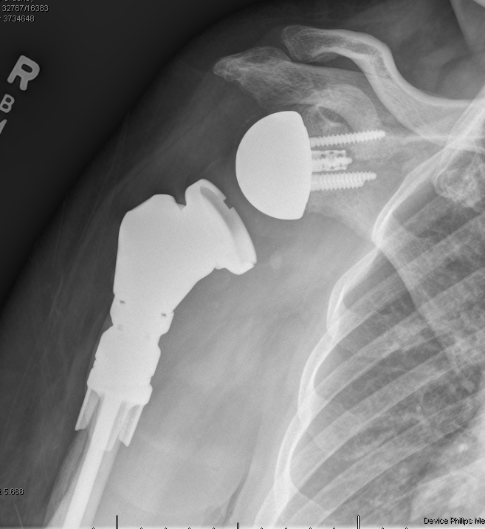
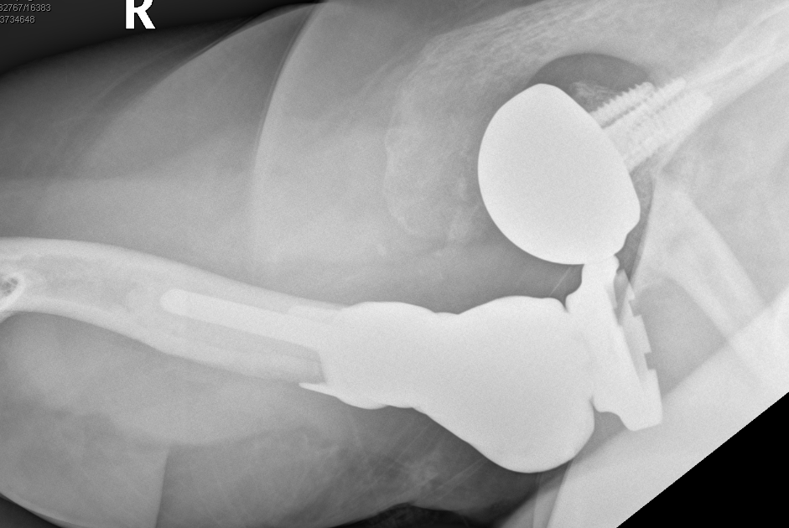
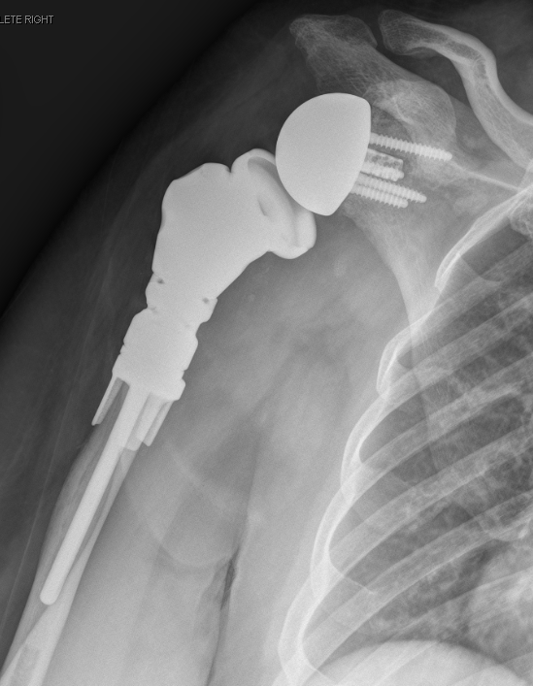
3/25/21 Radiographs show anterior dislocated humeral replacement. The patient was still in the sling with no arm movement. Pain was well controlled. Patient's lab work including C acnes (3-24-21) is negative for any bacterial growth, aerobic, anaerobic, acid-fast bacilli, or fungus. She politely declined closed reduction and is very sad and disappointed. Question 1. What am I missing 2. Movement Disorder? 3.Mechanically plan would be to increase retroversion of humeral component but everything mechanical has failed. Do not want to change baseplate as that would be third implant in less than 6 months
3 weeks Post-op
3/25/21

