Slide 1
Case Presentation
Codman Shoulder Society

Slide 2
History
CC Right Shoulder Pain
HPI:
In 11/2018, a 69M RHD underwent a Right Reverse Total Shoulder Replacement for rotator cuff arthropathy by an outside provider. Of note, he also underwent a vascular bypass on the same extremity due to a suspected blood clot on POD#1. He was doing better until he noticed progressive pain (6-7/10 and SSV 5%) and intermittent locking of the joint. He denied any trauma or injury. An XR in 11/2019 showed a dislocated glenosphere, and then he was referred to Dr. Warner.
His Pex showed marked weakness of flexion with Active Flexion = 40 deg and he had passive ER to 30 deg with lag sign of 30 deg.
Our workup concluded a right shoulder failed reverse prosthesis from prior surgery with associated prior vascular injury and dislocated glenosphere. CT also showed a superiorly inclined position baseplate. EMG showed axillary nerve dysfunction which was manifested in deltoid atrophy and weakness. Previous surgeon did a trans-deltoid approach. and the vascular surgeon did an axillary artery bypass.
PMH: OA
PSH: L Shoulder RCR, R THR
SH: Denies Tobacco
Occupation: Retired, Corporate Sales

Slide 3
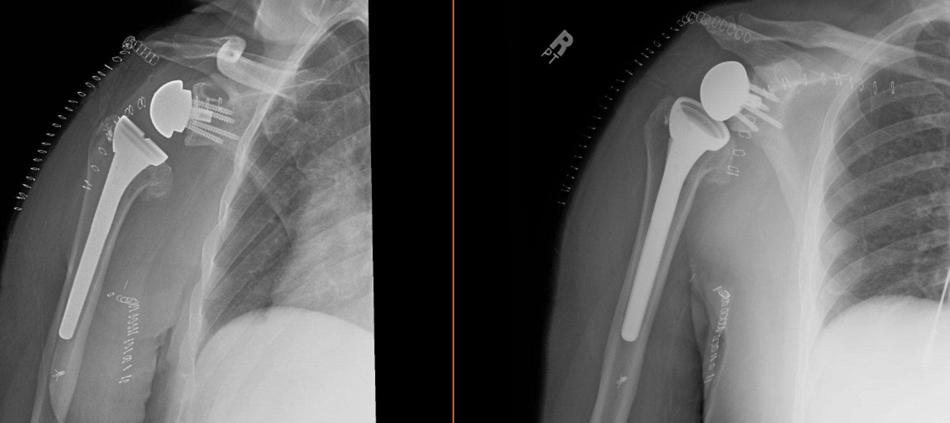
Previous Post-operative XR from Initial Surgery

Slide 4
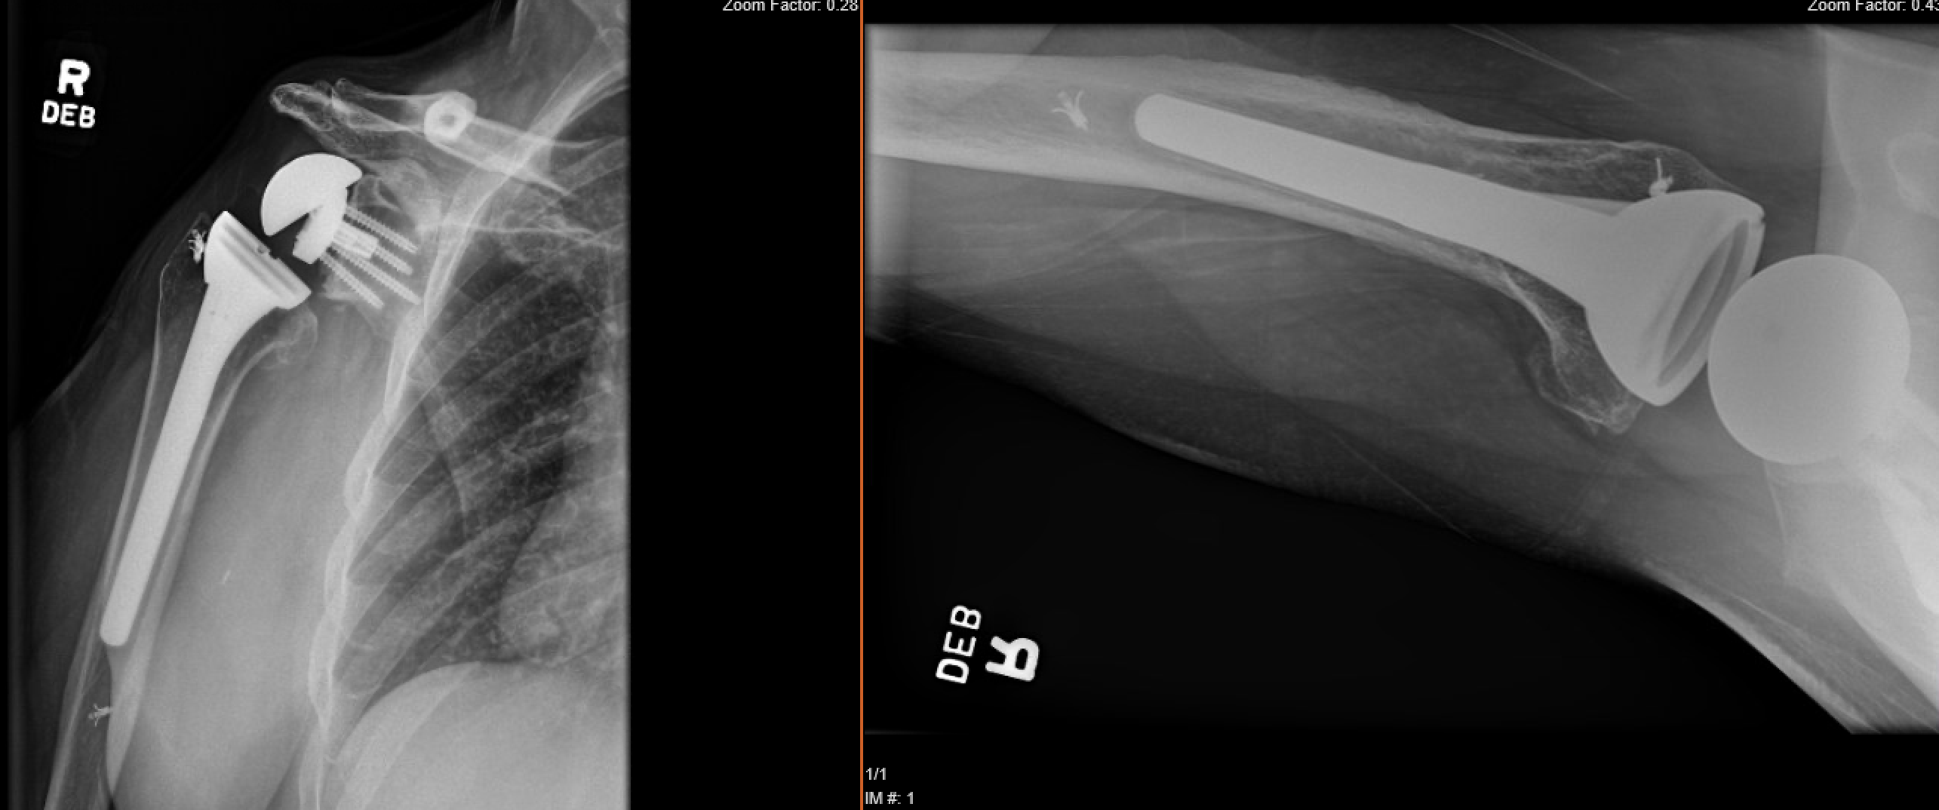
XR Upon Initial Presentation to Dr. Warner

Slide 5
CT – Right Shoulder
CT scan demonstrates that the glenosphere was displaced upward from the baseplate and the baseplate itself was not united to the bone and has been placed in a superiorly inclined position

Slide 6
Case
Diagnosis:
Right shoulder failed reverse prosthesis from prior surgery with associated prior vascular injury and dislocated glenosphere
Procedure:
In 2020, Dr. Warner performed a complex revision reconstruction which included removal of the previous components (DePuy), releases of extensive adhesions, and a revision reverse total shoulder replacement. Vascular surgeon was present due to concern for location of vascular graft after prior surgery.

Slide 7
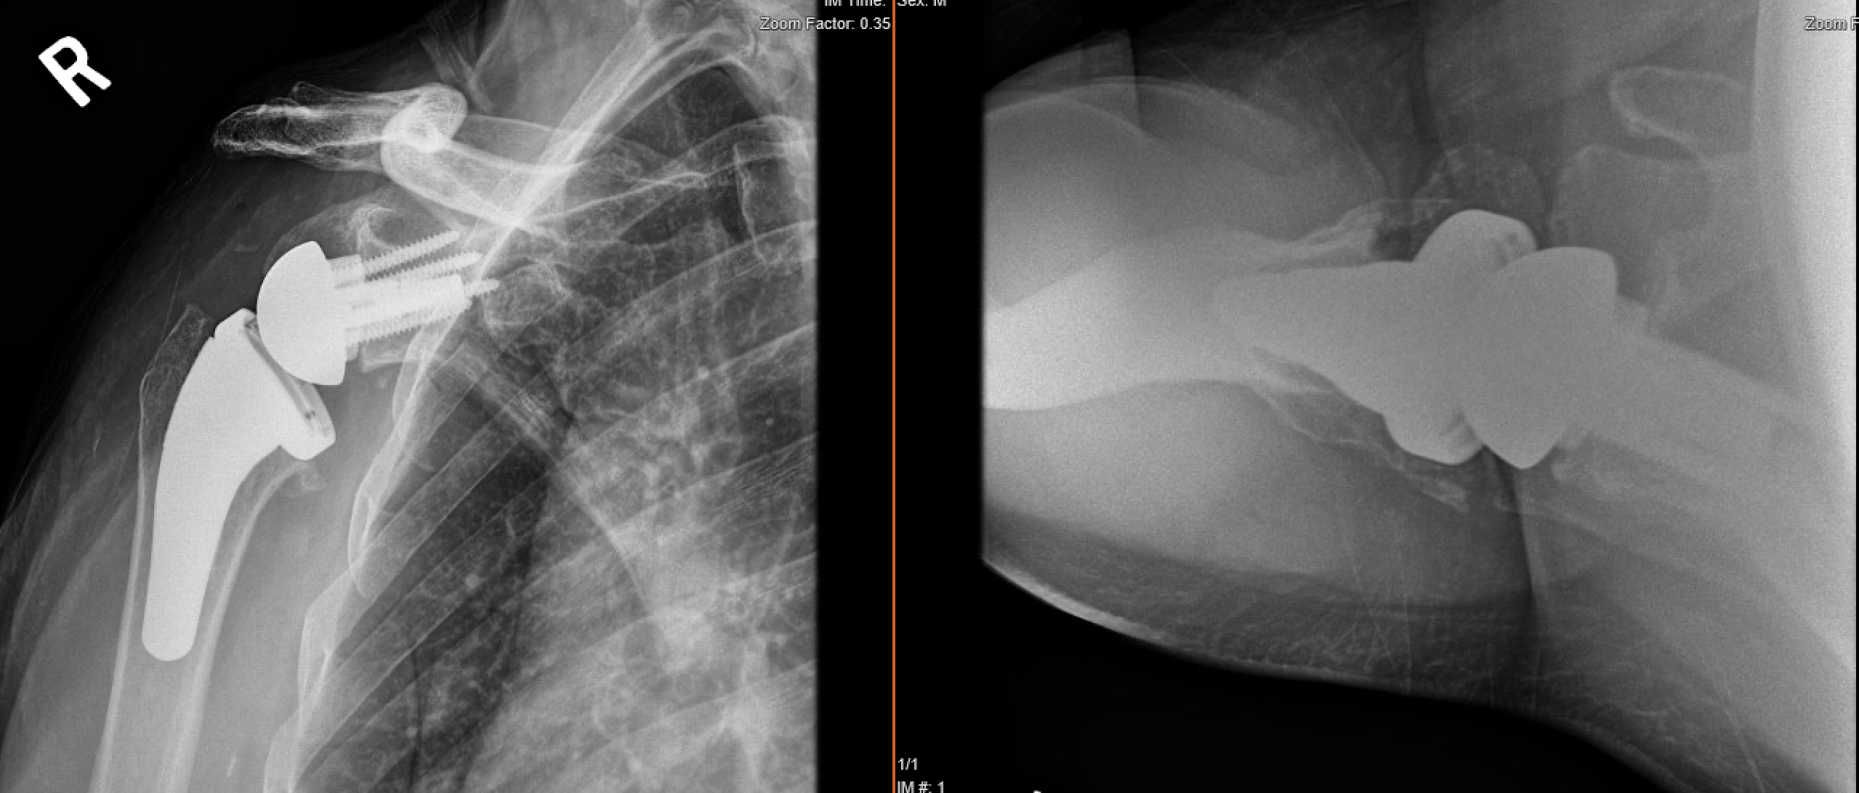
XR of the Revision Surgery

Slide 8
9/2020 Clinical Exam
Patient is happy. Pain has significantly improved (2/10). However, patient does have limited function and weakness. He is about 4 months after surgery.
Ht: 5’7”
Wt: 185lb
Video:
Significant for External Rotation Lag and deltoid atrophy

Slide 9
Case Summary
Summary
Age: 69M
Diagnosis
Right Revision Reverse Total Shoulder Arthroplasty in the setting of external rotation lag and axillary nerve dysfunction
Plan
Role for Lower Trapezius Transfer After RSA?
Thoughts or other Suggestions?
Q1. Is it reasonable to consider LTT for ER dysfunction?
Q2. Is it likely he will be happy with function if axillary nerve does not recover?

