Slide 1
26 y/o M c Posterior Shoulder Pain
ID: 26 y/o M with left posterior glenoid instability.
HPI: Presents with increasing pain with overhead activities and bench pressing, feelings of instability.
Hockey injury 3 years ago, subluxation, but no dislocation. Diagnosed with a posterior labrum tear on MRI but did not undergo surgery. Underwent multiple rounds of PT.
Continued symptoms- posterior shoulder pain with bench press, incline, and overhead activities.
Pain 5/10; SSV 60%
PMHx: Healthy
Meds: None
Allergies: NKDA
SH: Project Manager for Software Company; No Smoking; No Etoh
Very active, works out multiple times per week
Labs: None

Slide 2
26 y/o M c Posterior Shoulder Pain
Physical Exam:
6’0”, 175 lb, BMI: 23 kg/m²
Positive posterior load and shift test
Negative Biceps and AC tests
R AROM/PROM
FF: 160/160 (R 160)
ABD: 140/140 (R 140)
ER: 60/60 (R 60)
Abd ER: 80/80 (R 80)
IR: T8 (R T8)
Strength:
Forward Flexion 5/5, ER 5/5, Abduction 5/5
NVI

Slide 3
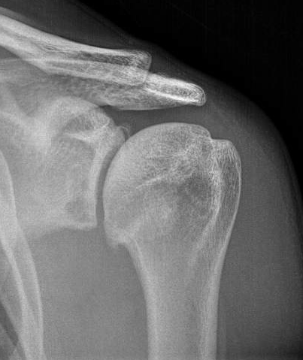
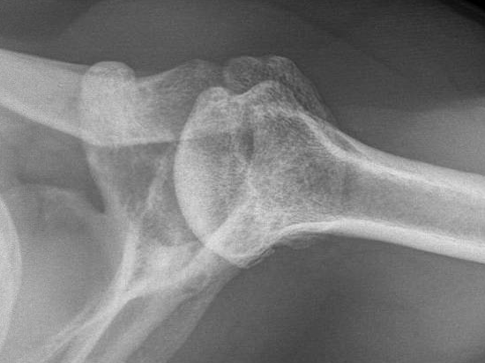
26 y/o M c Posterior Shoulder Pain

Slide 4
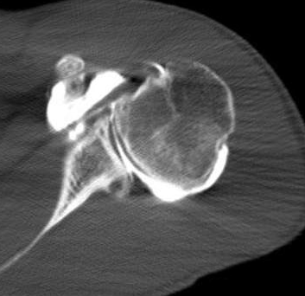
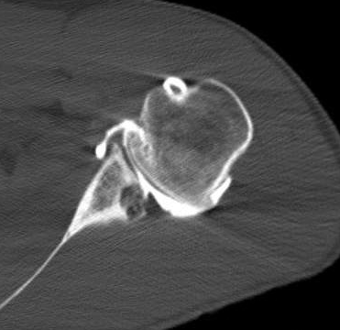
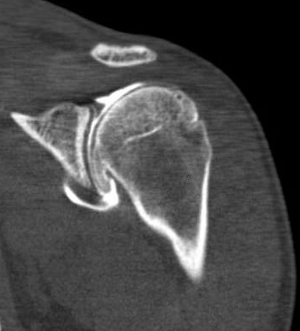
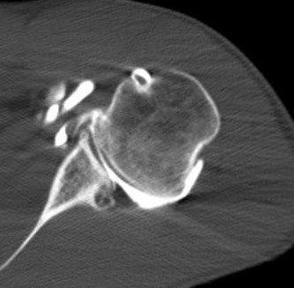
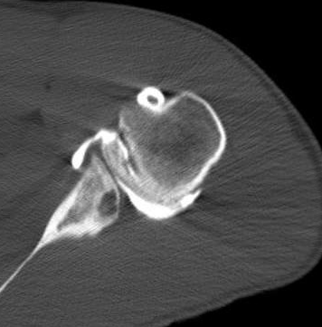
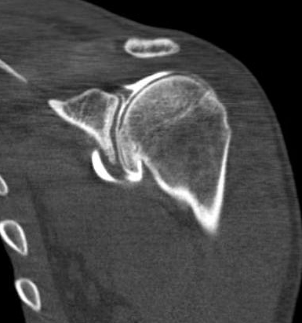
26 y/o M c Posterior Shoulder Pain

Slide 5
26 y/o M c Posterior Shoulder Pain
ID: 26 y/o M c posterior shoulder instability and glenoid bone loss
Treatment?

Slide 6
26 y/o M c Posterior Shoulder Pain
ID: 26 y/o M c posterior shoulder instability and glenoid bone loss
Underwent arthroscopic ICBG posterior glenoid reconstruction

Slide 7
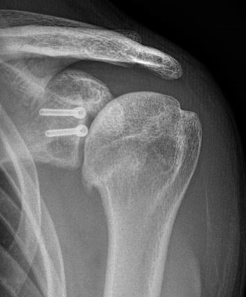
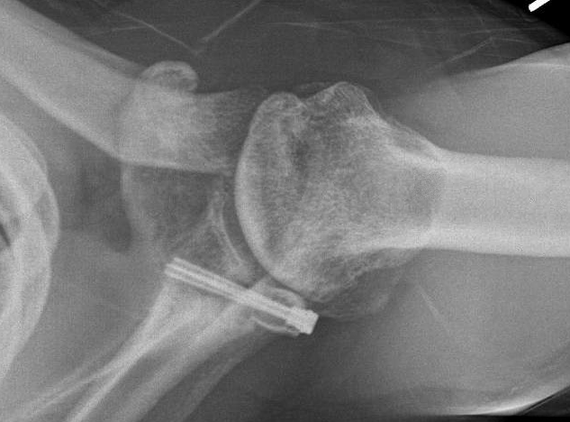
6 Weeks Postoperatively

Slide 8
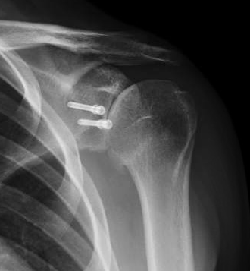
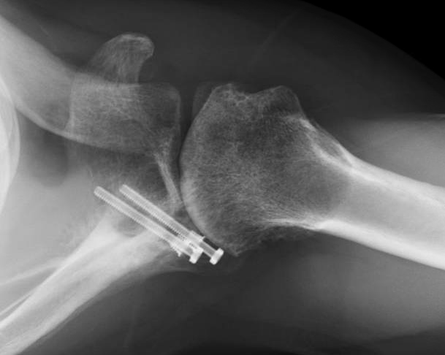
3.5 Months Postoperatively

Slide 9
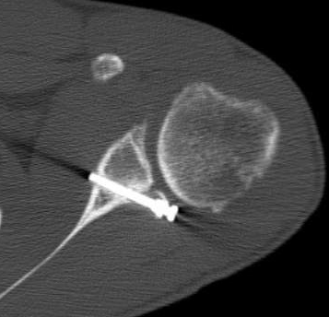
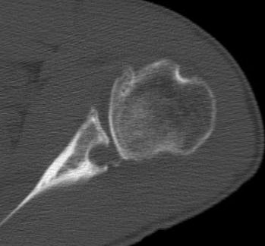
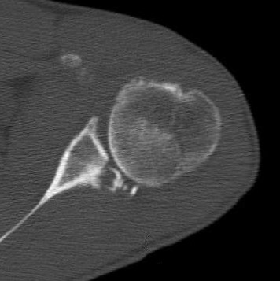
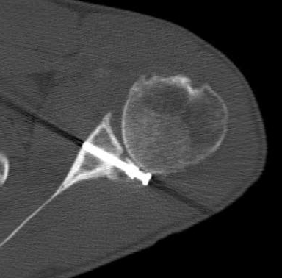
3.5 Months Postoperatively

Slide 10
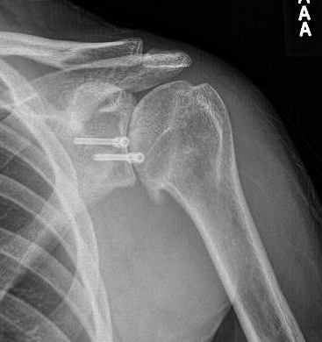
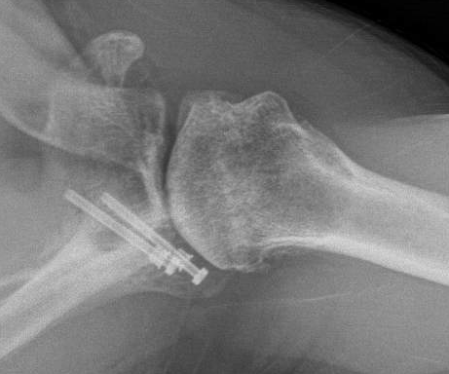
6.5 Months Postoperatively

Slide 11
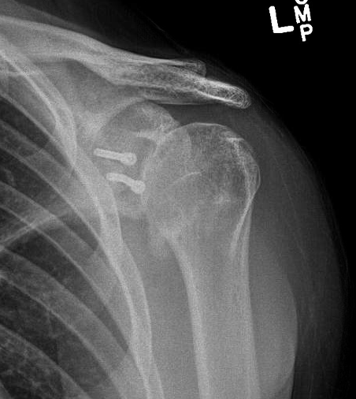
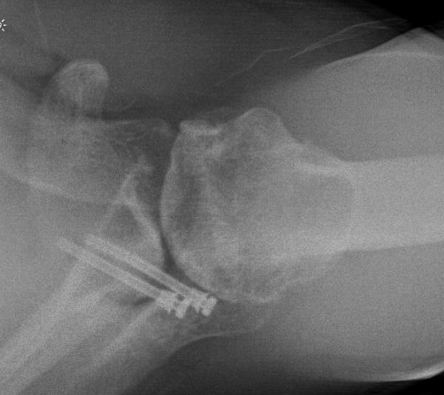
1 Year Postoperatively

Slide 12
1 Year Postoperatively
Patient presented with increasing stiffness, but no pain.
Stopped making progress with PT
Pain 0 out of 10
SSV 70%
Exam
Active: Flexion 120, Abduction 90, ER 30
No biceps or AC pain

Slide 13
1 Year Postoperatively
Resorbed posterior bone graft with progressing arthritis
Treatment?

Slide 14
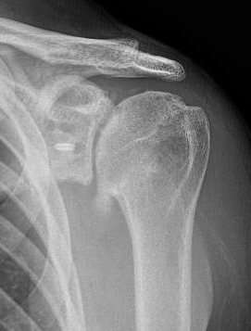
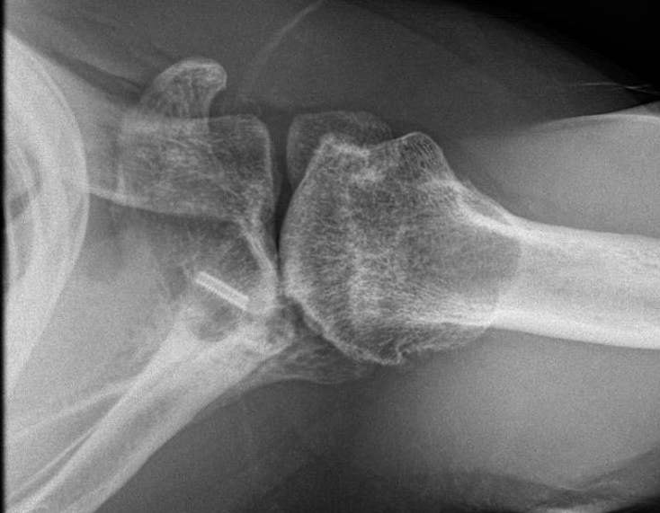
Postoperative after Hardware Removal

