Slide 1
24 y/o M c B recurrent shoulder instability
ID: 24 y/o male with bilateral recurrent shoulder instability with recently diagnosed seizure disorder
HPI: Bilateral shoulder instability over the past 9-10 years
First dislocation over 9 years ago playing basketball on left side
2009: L Arthroscopic Bankart Repair- continued to have subluxations postop
2013: L Latarjet- initially did well, but eventually pain returned
2015: L Latarjet Screw removal for “bent screw”
2015-2017: L shoulder recurrent subluxations (~50) with 6 dislocations requiring reduction
2017: began first experiencing R shoulder subluxations (no dislocation)
MRI C-spine- no syrinx or other pathology
PMHx: DM (type 1) on insulin pump, newly diagnosed seizure disorder
Meds: Insulin
Allergies: NKDA
SH: Engineer; No Smoking; No Etoh

Slide 2
24 y/o M c B recurrent shoulder instability
Physical Exam:
5’11”, 183 lb, BMI: 25 kg/m²
Tests
Positive Belly Press on the L, negative on the R
Positive apprehension on the L
Positive posterior provocative tests on R
B AROM/PROM
FF: L 110/120 (R 100/130)
ER: L 30/30 (R 40/40)
Abd ER: L 80/80 (R 80)
IR: L L5 (L L1)
Strength:
Bilateral: 5/5 Abduction, 4/5 IR: R ER 4/5, L ER 5/5
NVI, including axillary n

Slide 3
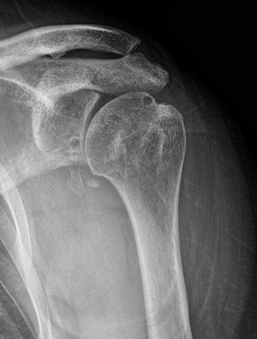
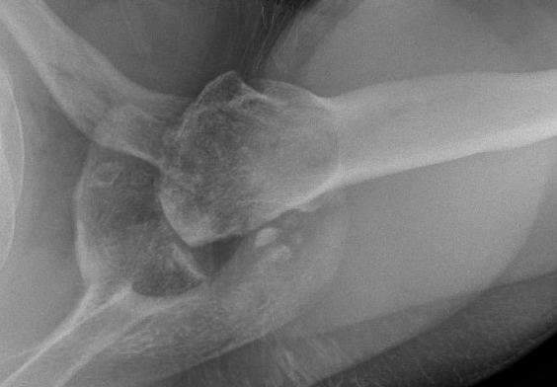
24 y/o M c B recurrent shoulder instability
Left

Slide 4
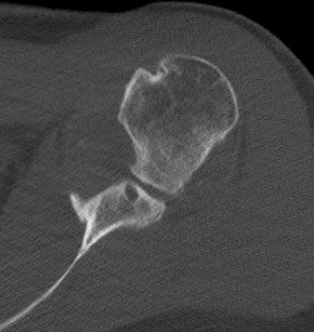
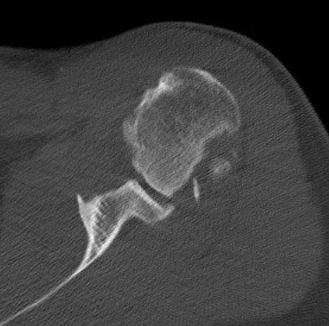
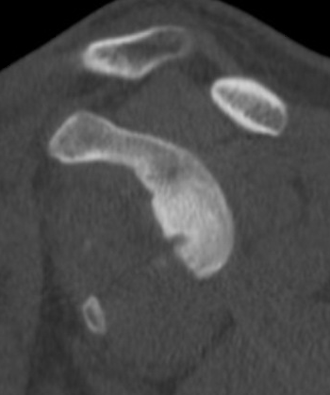
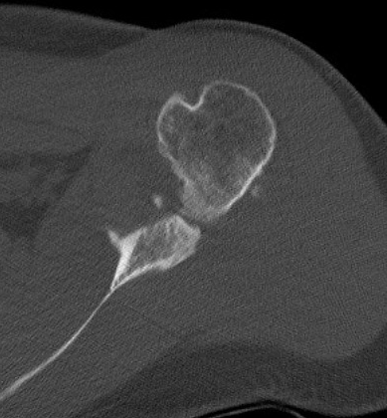
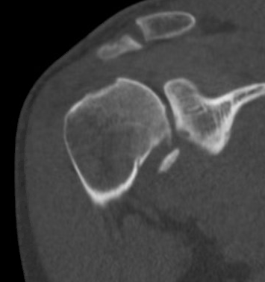
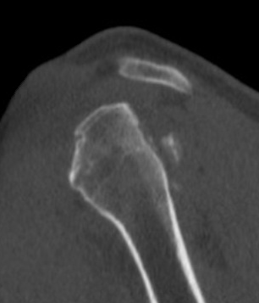
24 y/o M c B recurrent shoulder instability
Left

Slide 5
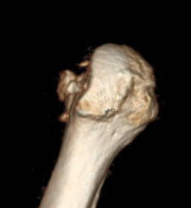
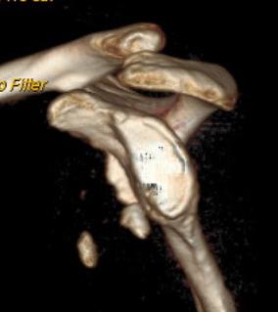
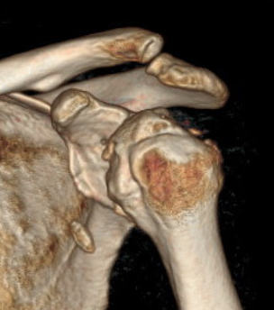
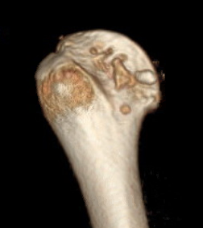
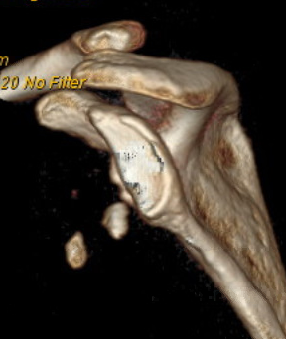
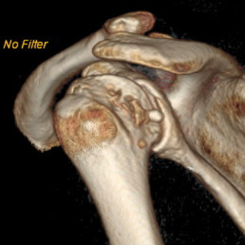
24 y/o M c B recurrent shoulder instability
Left

Slide 6
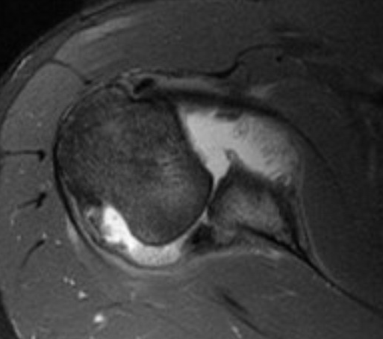
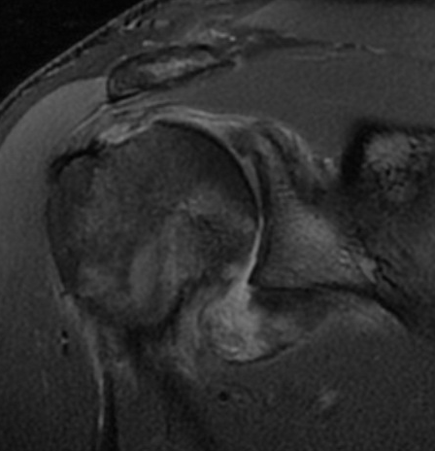
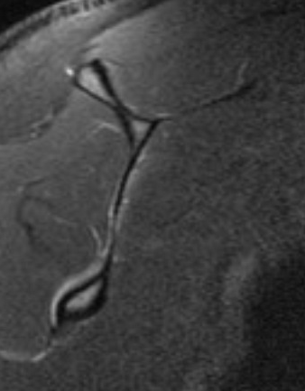
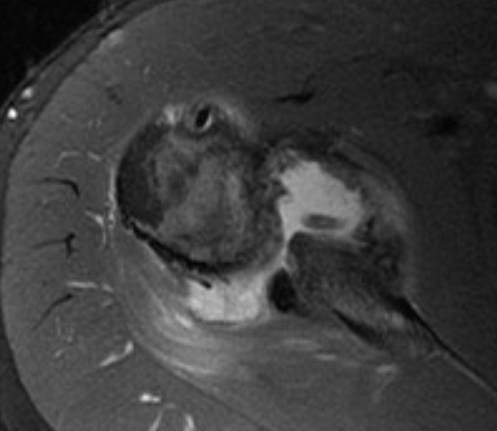
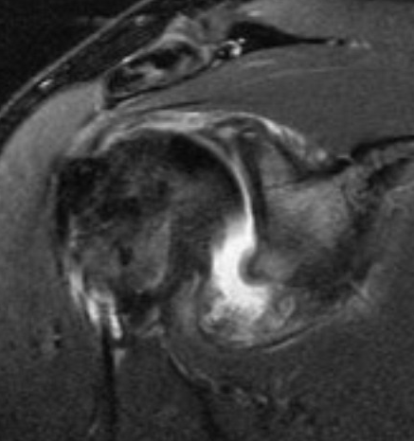
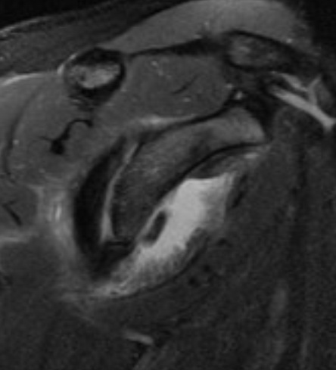
24 y/o M c B recurrent shoulder instability
Left

Slide 7
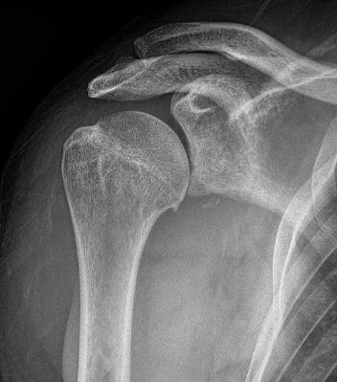
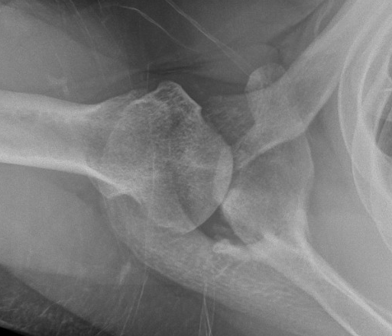
24 y/o M c B recurrent shoulder instability
Right

Slide 8
24 y/o M c B recurrent shoulder instability
ID: 24 y/o male with left recurrent anterior shoulder instability after latarjet with marked bone loss, recently diagnosed seizure disorder, and right posterior shoulder instability
Treatment Options?
Left
ICBG vs. distal tibial allograft to glenoid
Humeral head

