Slide 1
20 yo UCONN Lacrosse goalie
Insidious onset of left shoulder pain, weakness 10 months ago
No history of trauma; viral illness etc.
Atrophy, weakness of left shoulder ABD,FF
I saw her for 1st time last weak
Non-dominant arm and she has not missed a game or practice
Pain is generalized, impingement type/painful arc but not incapaciting
Occurs daily and increased if she tries to use it more overhead

Slide 2
Work-up
Plain radiographs: normal
MRI shoulder: fatty infiltration of trapezius
MRI neck: normal
CT scan of neck: normal
EMG: + spinal accessory Nerve palsy (Oct 2020)

Slide 3
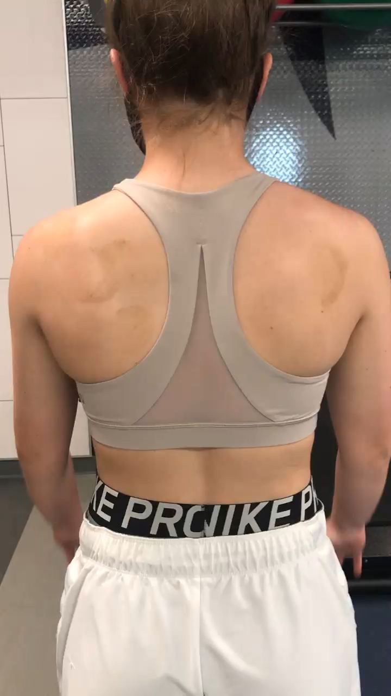

Slide 4
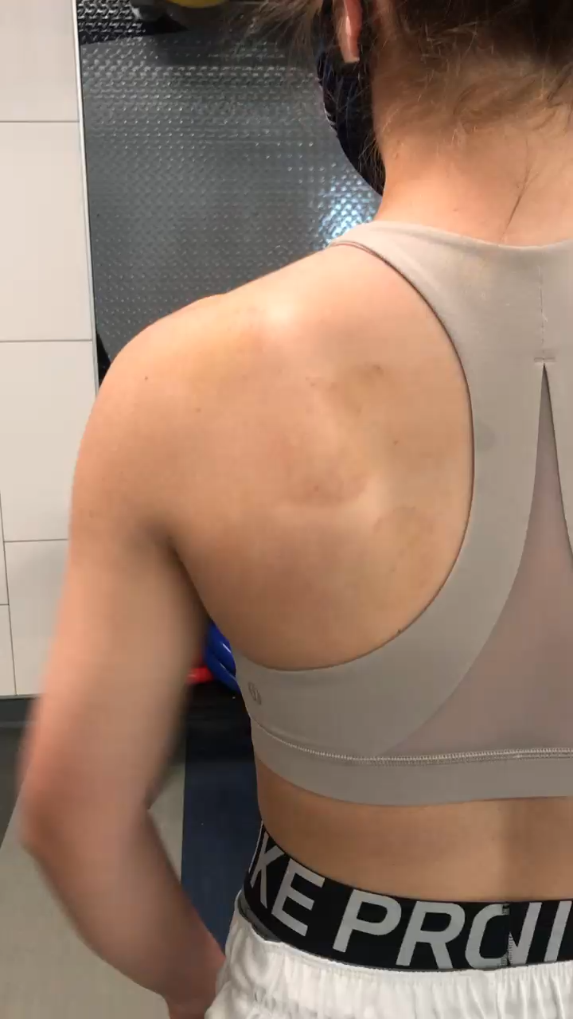

Slide 5
Opinions?

