Slide 1
History
25 y/o M RHD with chronic history of R shoulder pain
Pain progressed last 1.5 year with no linked events
PCP prescribed gabapentin and hydroxyzine → no improvement
Orthopedist diagnosed him with glenoid dysplasia and labral abnormality, suggested TSA
PSH/PMH: none
Social history: smoking 1 pack/day for 10 years, drinks 12 pack/week, works in construction but stopped a month before the clinic visit

Slide 2
Exam
Reports pain throughout shoulder region, worse with any motion
No numbness or paresthesia down his hand
Pain 3-9 out of 10, (+) night pain
SSV 12%
Pain with any shoulder motion, (+) apprehension, (+) posterior loading, (+) labral injury, (+) impingement, (+) biceps, (+) Speed’s, (+) O’Brien’s
FF 140 vs 150, Abd 130 vs 150, ER 50 vs 70, IR Add L2 vs T5
X-ray: R glenoid dysplasia on both AP and axillary views, likely associated with glenoid retroversion
MRI arthrogram: superior labrum tear, profound posterior glenoid dysplasia with 40 deg retroversion

Slide 3
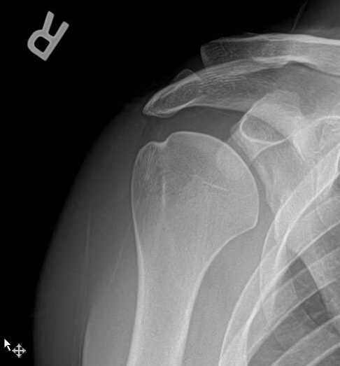
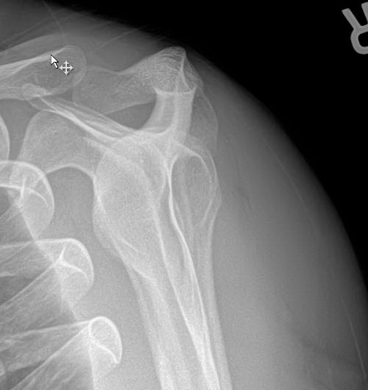

Slide 4
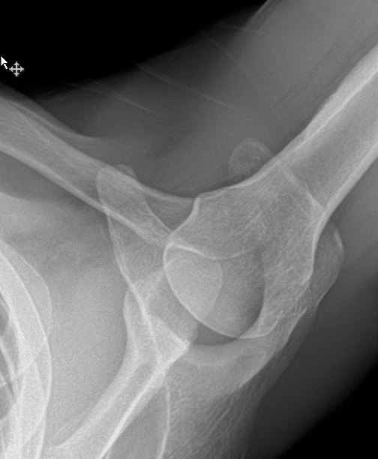
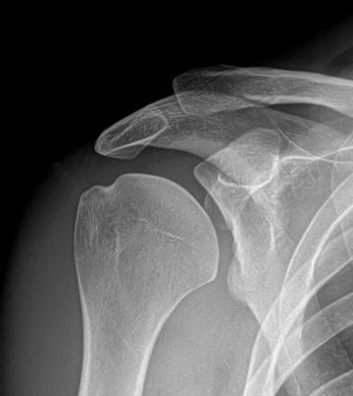

Slide 5
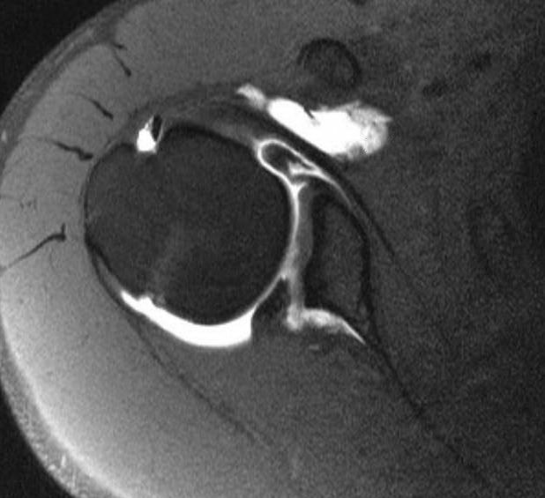
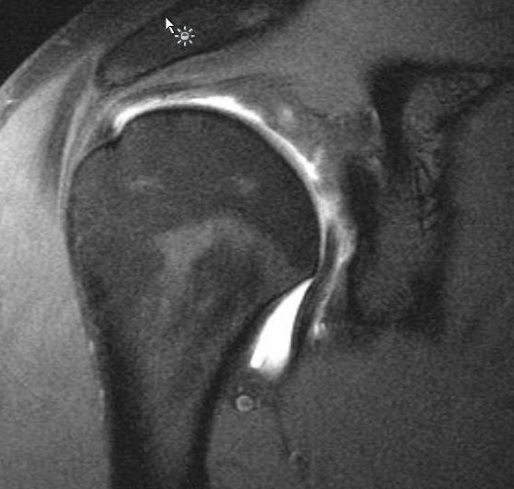
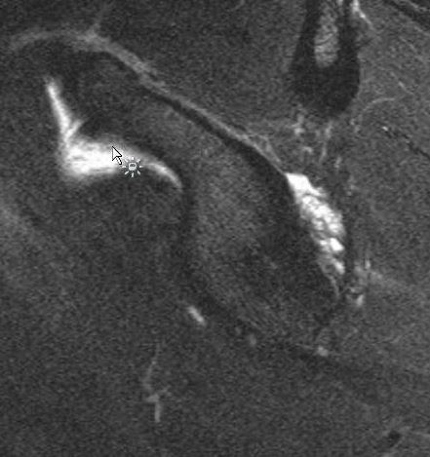

Slide 6
Assessment/Plan
1. Dysplastic glenoid with labrum tear
2. Biceps tendonitis
Plan????
Depbridement?
Biceps tenodesis?
Labrum repair?
Other?

