Slide 1
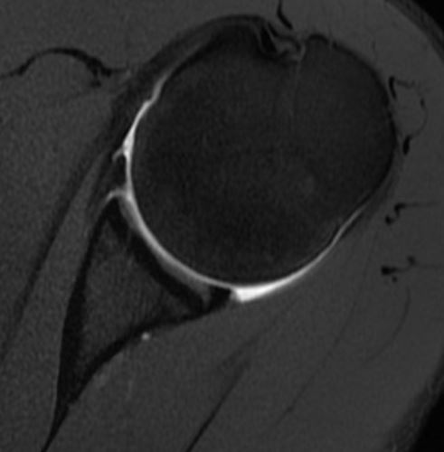
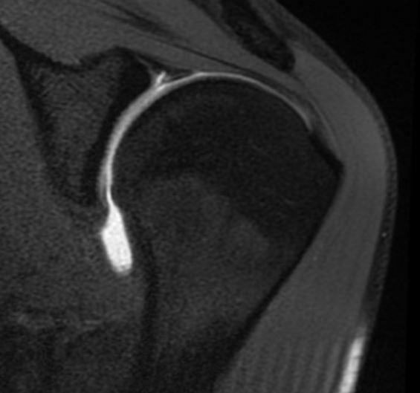
21 yo Division I Collegiate Basketball player with H/O Traumatic anterior dislocation x2
Arthroscopic Bankart repair
SLAP Repair also?

Slide 2
Biomechanical Rationale
(See enclosed articles)
SLAP repair reduces strain in the IGHL with the arm in the cocking position (Rodosky et al, AJSM 1994)
SLAP lesion increases anterior translation in cadaver shoulders (Pagnani, JBJS 1995)

