Slide 1
Case Presentation
Codman Shoulder Society
Notes:
3120077

Slide 2
History
CC Right Shoulder Pain
HPI:
66F RHD underwent a Right Reverse Shoulder Arthroplasty by Dr. Warner in 10/2017. At her last follow-up in 2019, she had minimal pain with occasional aching but excellent range of motion. At that time, XR’s demonstrated lateral bony resorption of the humerus adjacent to the stem, but with the distal 2-3 cm of the stem still covered with bony incorporation. Because of her excellent range of motion and nominal symptoms, we recommended observation.
She decided to pursue a second opinion, who ordered a CT and stated that the humeral stem is loose. They ruled out infection with an aspiration/labs and ultimately recommended a revision reverse arthroplasty.
Today, she returns for our opinion a year later. Her subjective shoulder value is 70%, which is better than in 2019 (60%). She has had intermittent episodes where she has swelling over her arm with some black and blue appearance. She does have occasional catching in her shoulder. Overall, her pain is 0.
PMHx: Back Pain, Depression, OA
PSHx: R Shoulder
Allergies: NKDA
Social: No tobacco use. Drinks alcohol socially.
Occupation: Retired
Social Support and Living: Lives with husband

Slide 3
PE
Height: 5’4"
Weight: 155lbs
Right Shoulder
Well healed incision
No swelling or erythema
No tenderness over the acromion
AROM:
Forward Flexion: L 150 vs. R 170
External Rotation: L 45 vs. R 70
Internal Rotation: L T3 vs. R T3
Can easily put her hand on top and the back of her head with marked external rotation.
Strength: 5/5 for all rotator cuff muscles and deltoid.
Sensation intact throughout

Slide 5
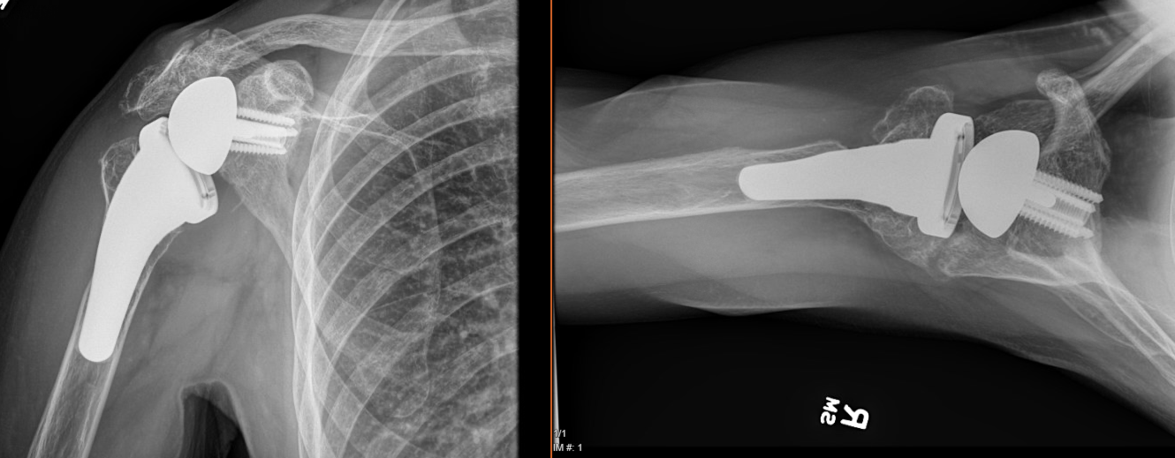
Current XR – Right Shoulder
Resorption of the lateral portion of the humerus adjacent to the humeral stem, but with the distal 2-3 cm of the stem still covered with what appeared to be bony incorporation of the distal stem.

Slide 6
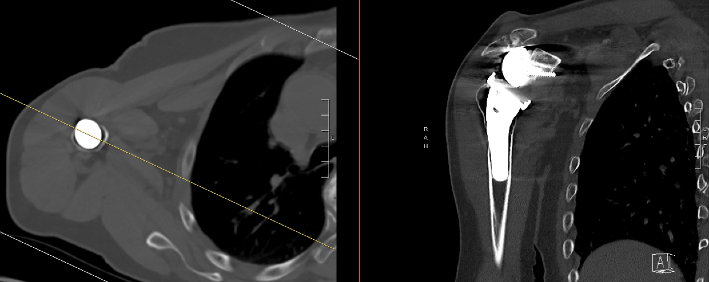
Current CT

Slide 7
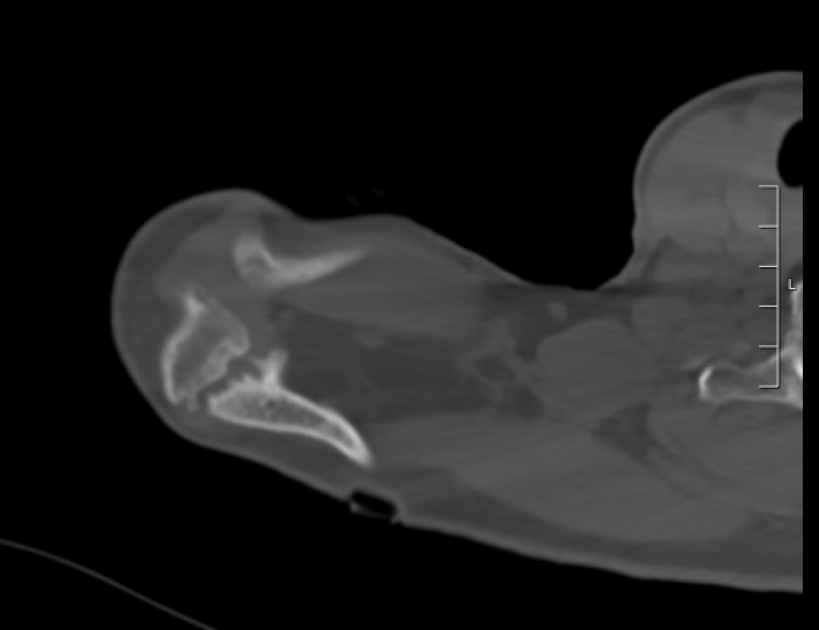
Current CT
Acromion stress fracture which is asymptomatic

Slide 8
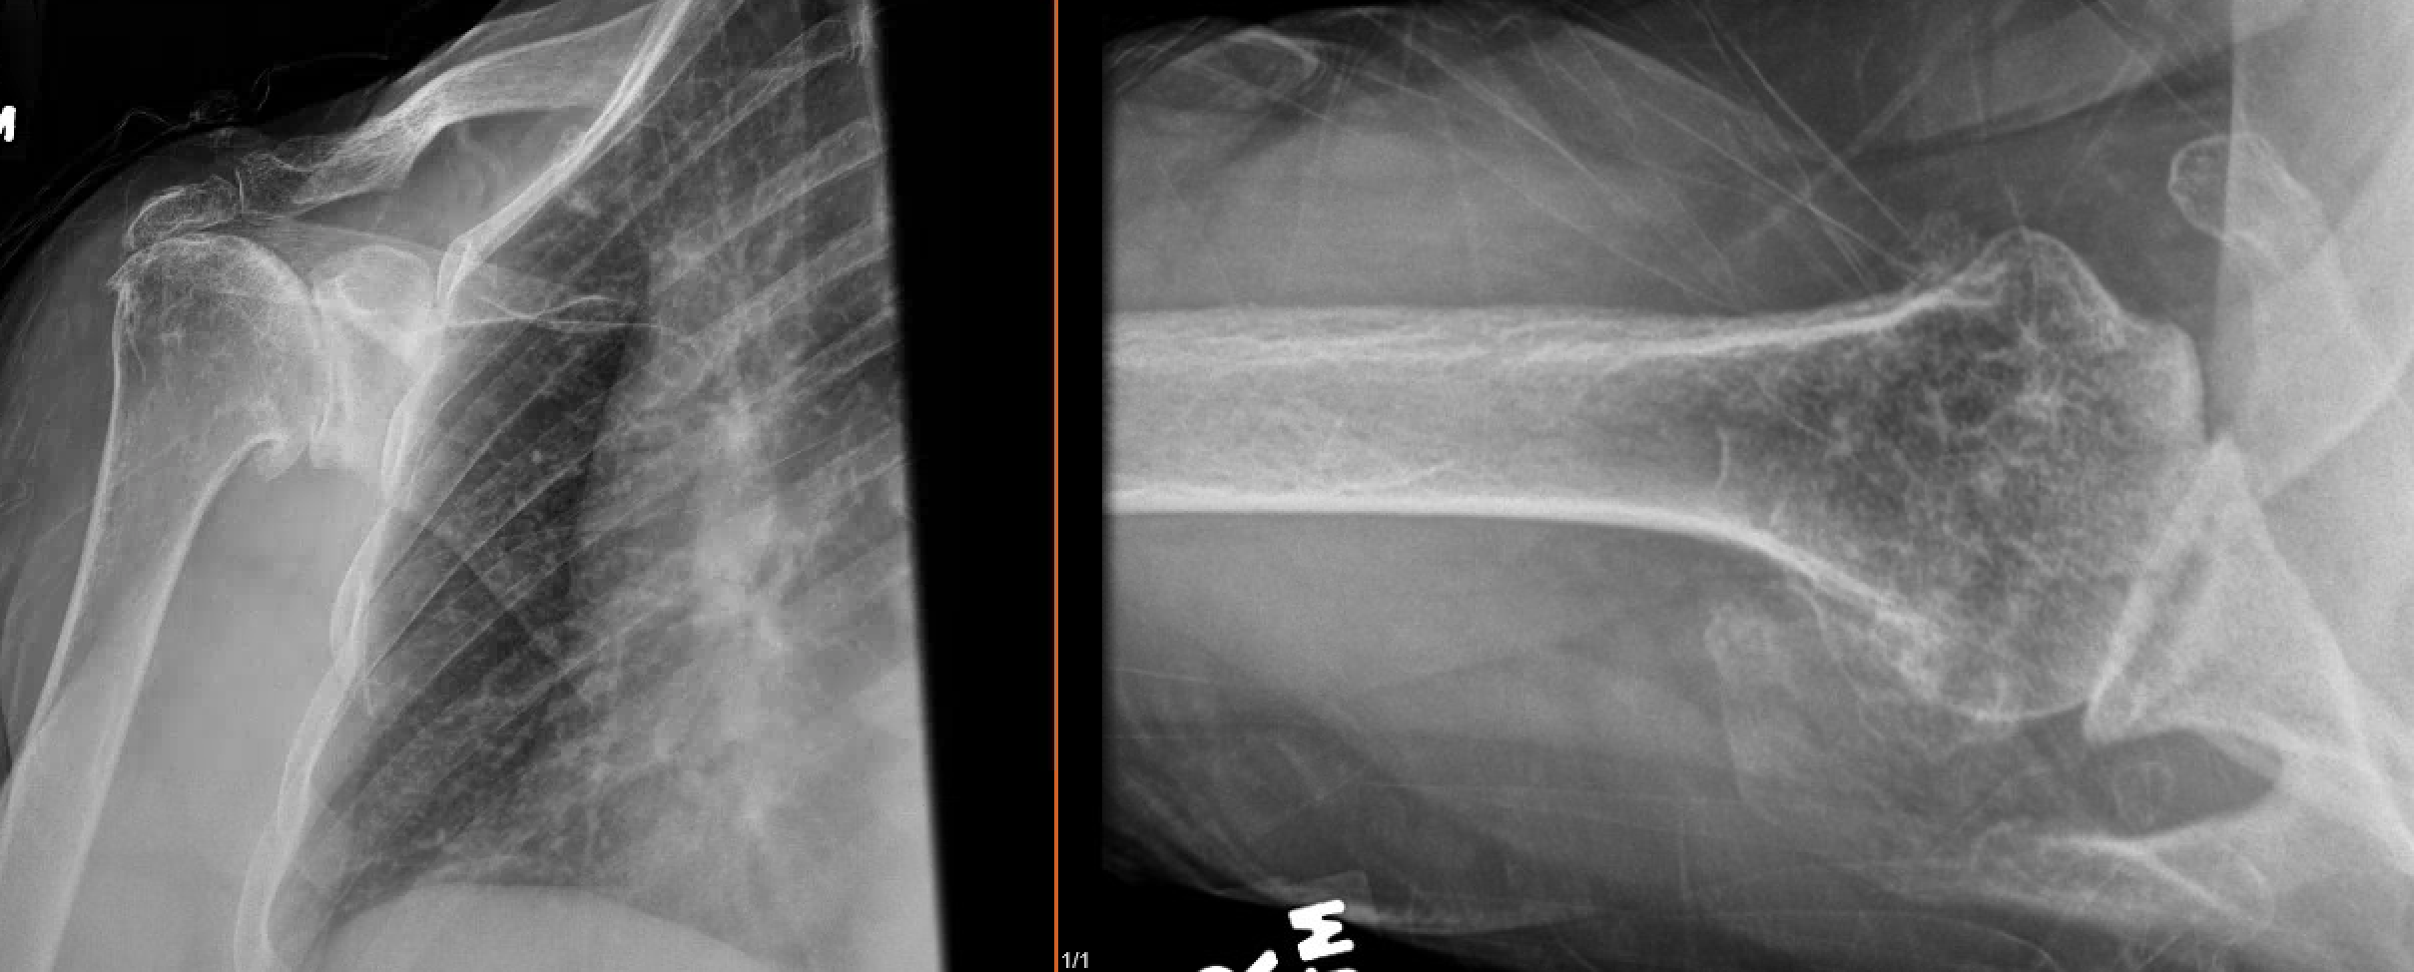
Pre-operative XR for Reference

Slide 9
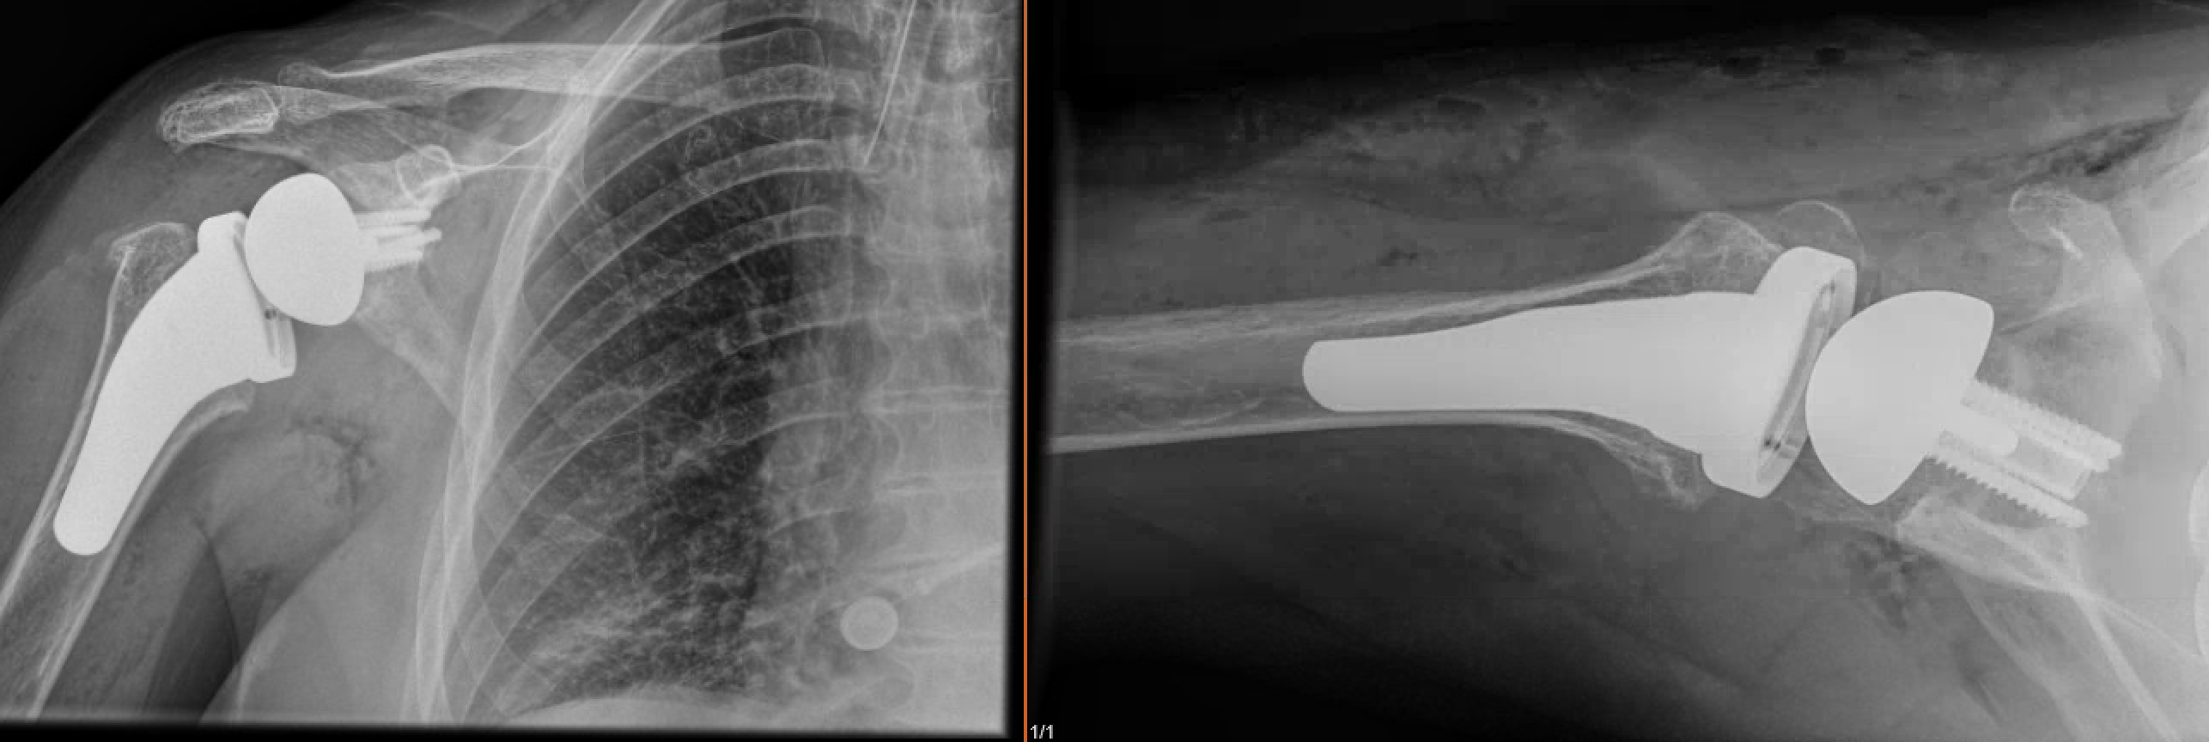
Initial Post-operative XR for Reference

Slide 10
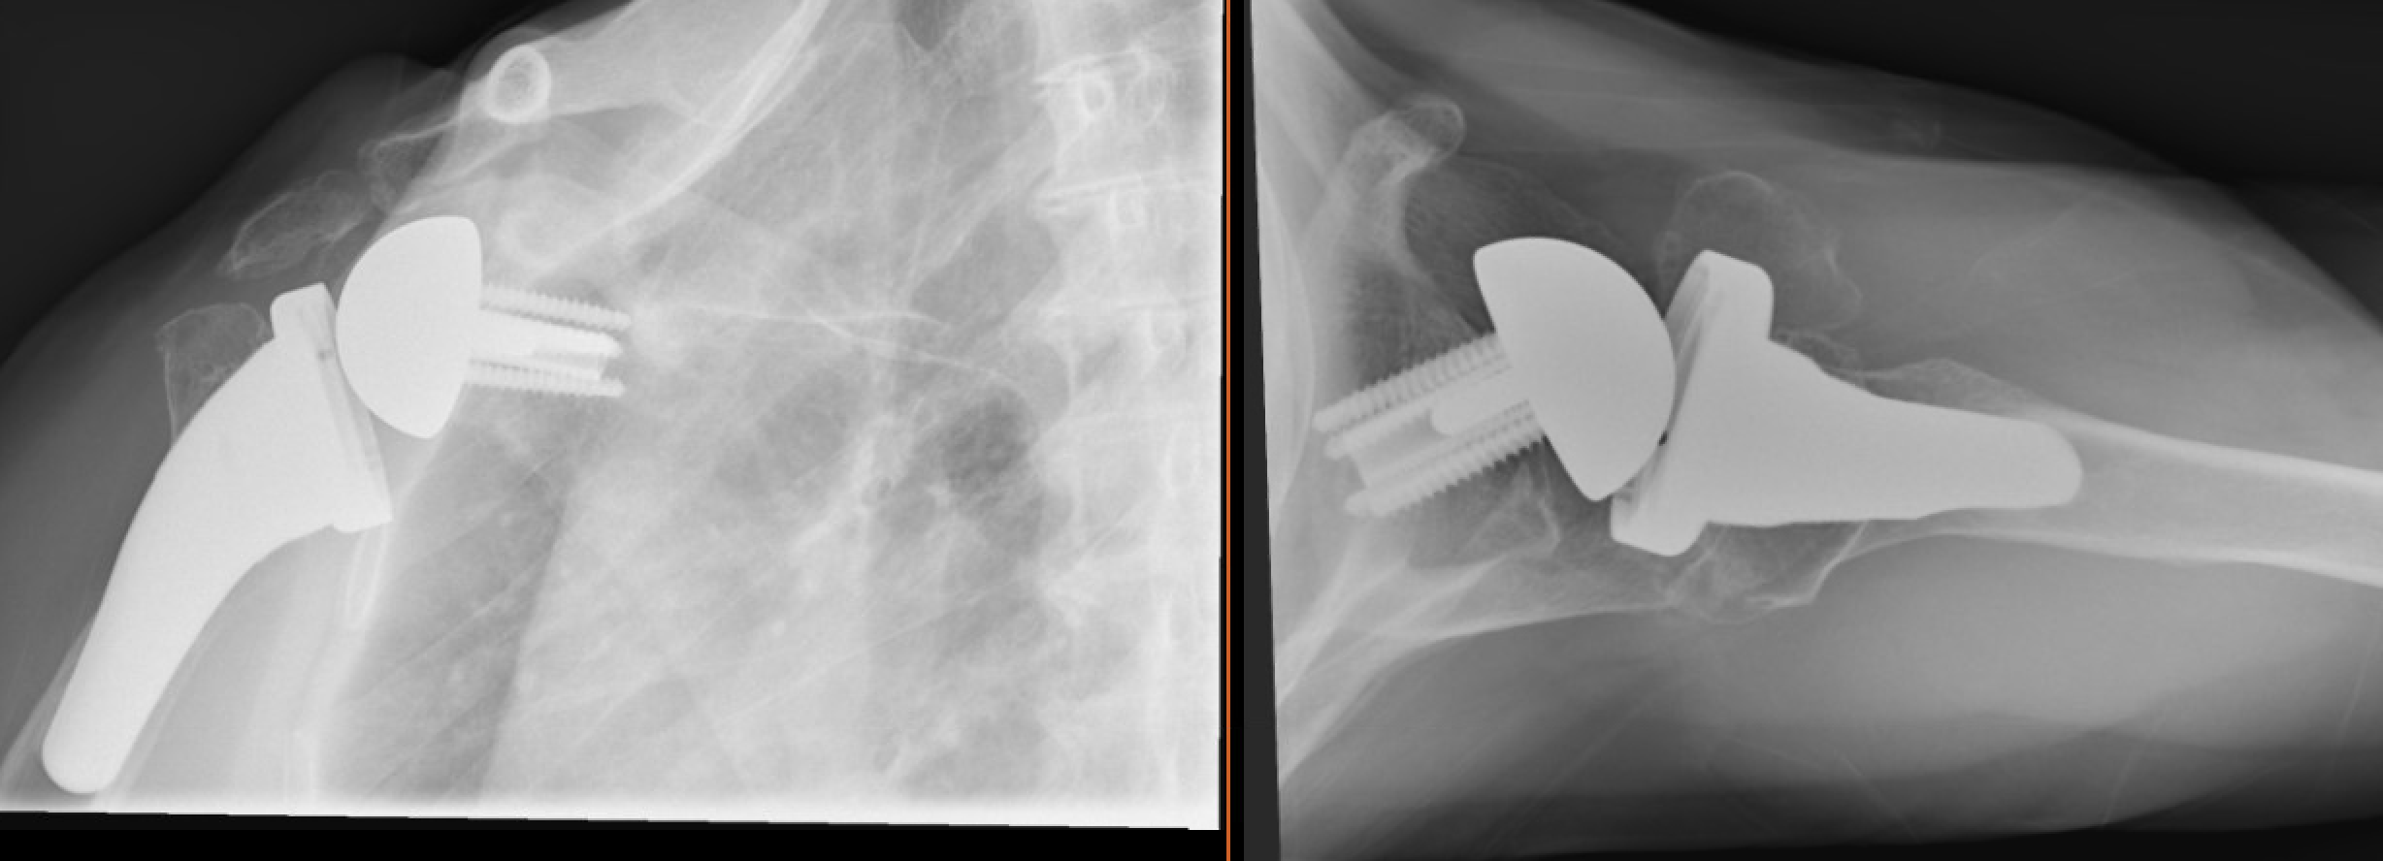
XR in 2019 for Reference

Slide 11
Case Summary
Summary
44F with a RSA with concerning radiographic findings
Excellent motion and no pain
Concerns
Humeral Implant Bony Resorption versus Loosening
Polyethylene Wear
Plan
Bone Scan
Thoughts?

